Slide 1
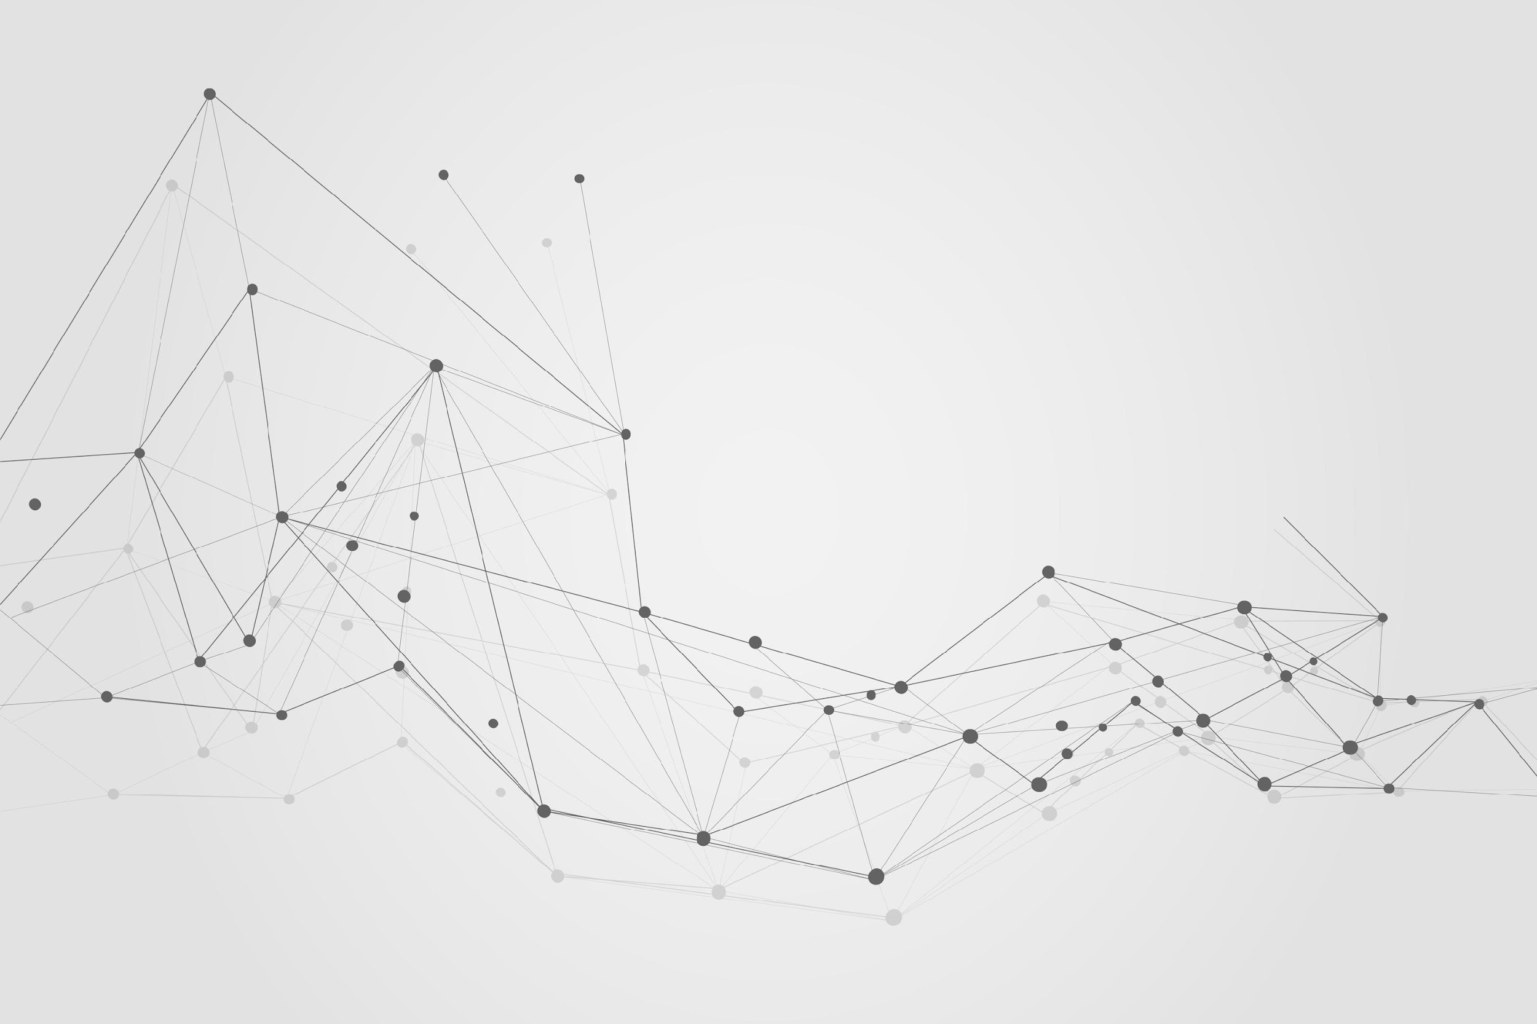

BRIGHTSPARK
THE CHATBOT
TEAM-1

Slide 2


Our Team
Gokul Siva Kumar
(Speech Feature, LangSmith)
Bharath
(Vertex AI, Agent, Chat Memory)
Zhongkai Lin
(Streamlit, BigQuery)
Goutham
(Prompt Engineering, Pinecone)
Karthik
(Data Preparation)
“ Perfect Example for Team Work ”

Slide 3
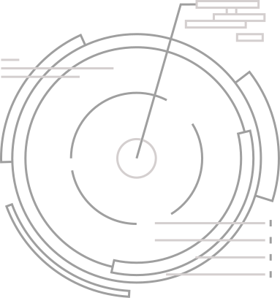

Project Purpose
Develop an advanced chatbot application integrating Retrieval Augmented Generation (RAG) and LangChain Agent within a Streamlit interface. The goal is to offer users a highly interactive and personalized conversational experience. Leveraging techniques like information retrieval from vector embeddings and memory-based contextual understanding, the chatbot aims to deliver accurate, contextually relevant responses to user queries, enhancing overall user experience and utility.

Slide 4





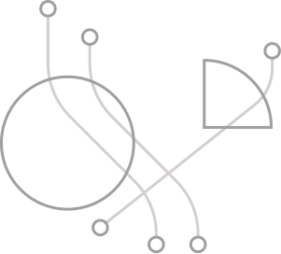


Tech Stack
Streamlit
Langchain
BigQuery
Python
Vertex AI
Pinecone
MySQL

Slide 5
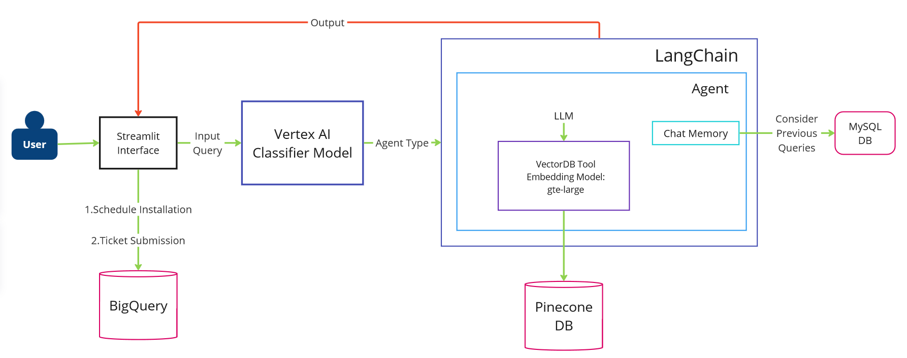
Architecture Of Chatbot

Slide 6


Standard Functional
Streamlit Project Setup:
Create a Streamlit project structure.
Set up the necessary dependencies and configurations.
LangChain Integration:
Import LangChain into the Streamlit project.
Configure LangChain to work within the Streamlit environment.
Vector Database Integration:
Obtain a vector database. Load documents into the database.
Split the documents into appropriate sections.
Generate vector embeddings using an embedding model.
Store the embeddings in the vector database.

Slide 7
Tool Creation for RAG:
Develop a tool within LangChain to access the vector database for Retrieval Augmented Generation (RAG).
Provide the system prompt to the tool to refine its behavior and enhance relevance in responses.
Define tool descriptions to instruct the agent on when to utilize the tool for optimal performance.
LangChain Agent Development:
Create a LangChain agent.
Equip the agent with the previously developed tool for accessing the vector database.
Provide system prompt to the agent to give it a persona and influence its behavior.
Conversation Buffer Memory:
Implement a conversation buffer memory within the agent to retain context from prior conversations within the current session.

Slide 8


Slide 9
Non - Functionalities
Version Control:
Utilize version control systems (e.g., Git) for managing the project codebase.
Agile Development:
Follow an Agile methodology, particularly the Scrum process, for project development.
Scope Of Future:
Integrate emotion recognition capabilities to detect the user's emotional state during conversations. The chatbot can then adapt its tone and responses accordingly, providing empathetic and personalized interactions.
GitHub Link ⬅

Slide 10

Challenges We Faced:
Data gathering
This involves incorporating functionality that allows users to speak to the chatbot instead of typing their messages. Speech to text (STT) conversion is the process of transcribing spoken language into written text, which can then be processed by the chatbot.
Prompting for agents involves determining when human intervention is necessary during a conversation and seamlessly transferring control to a human agent when appropriate.

Slide 11
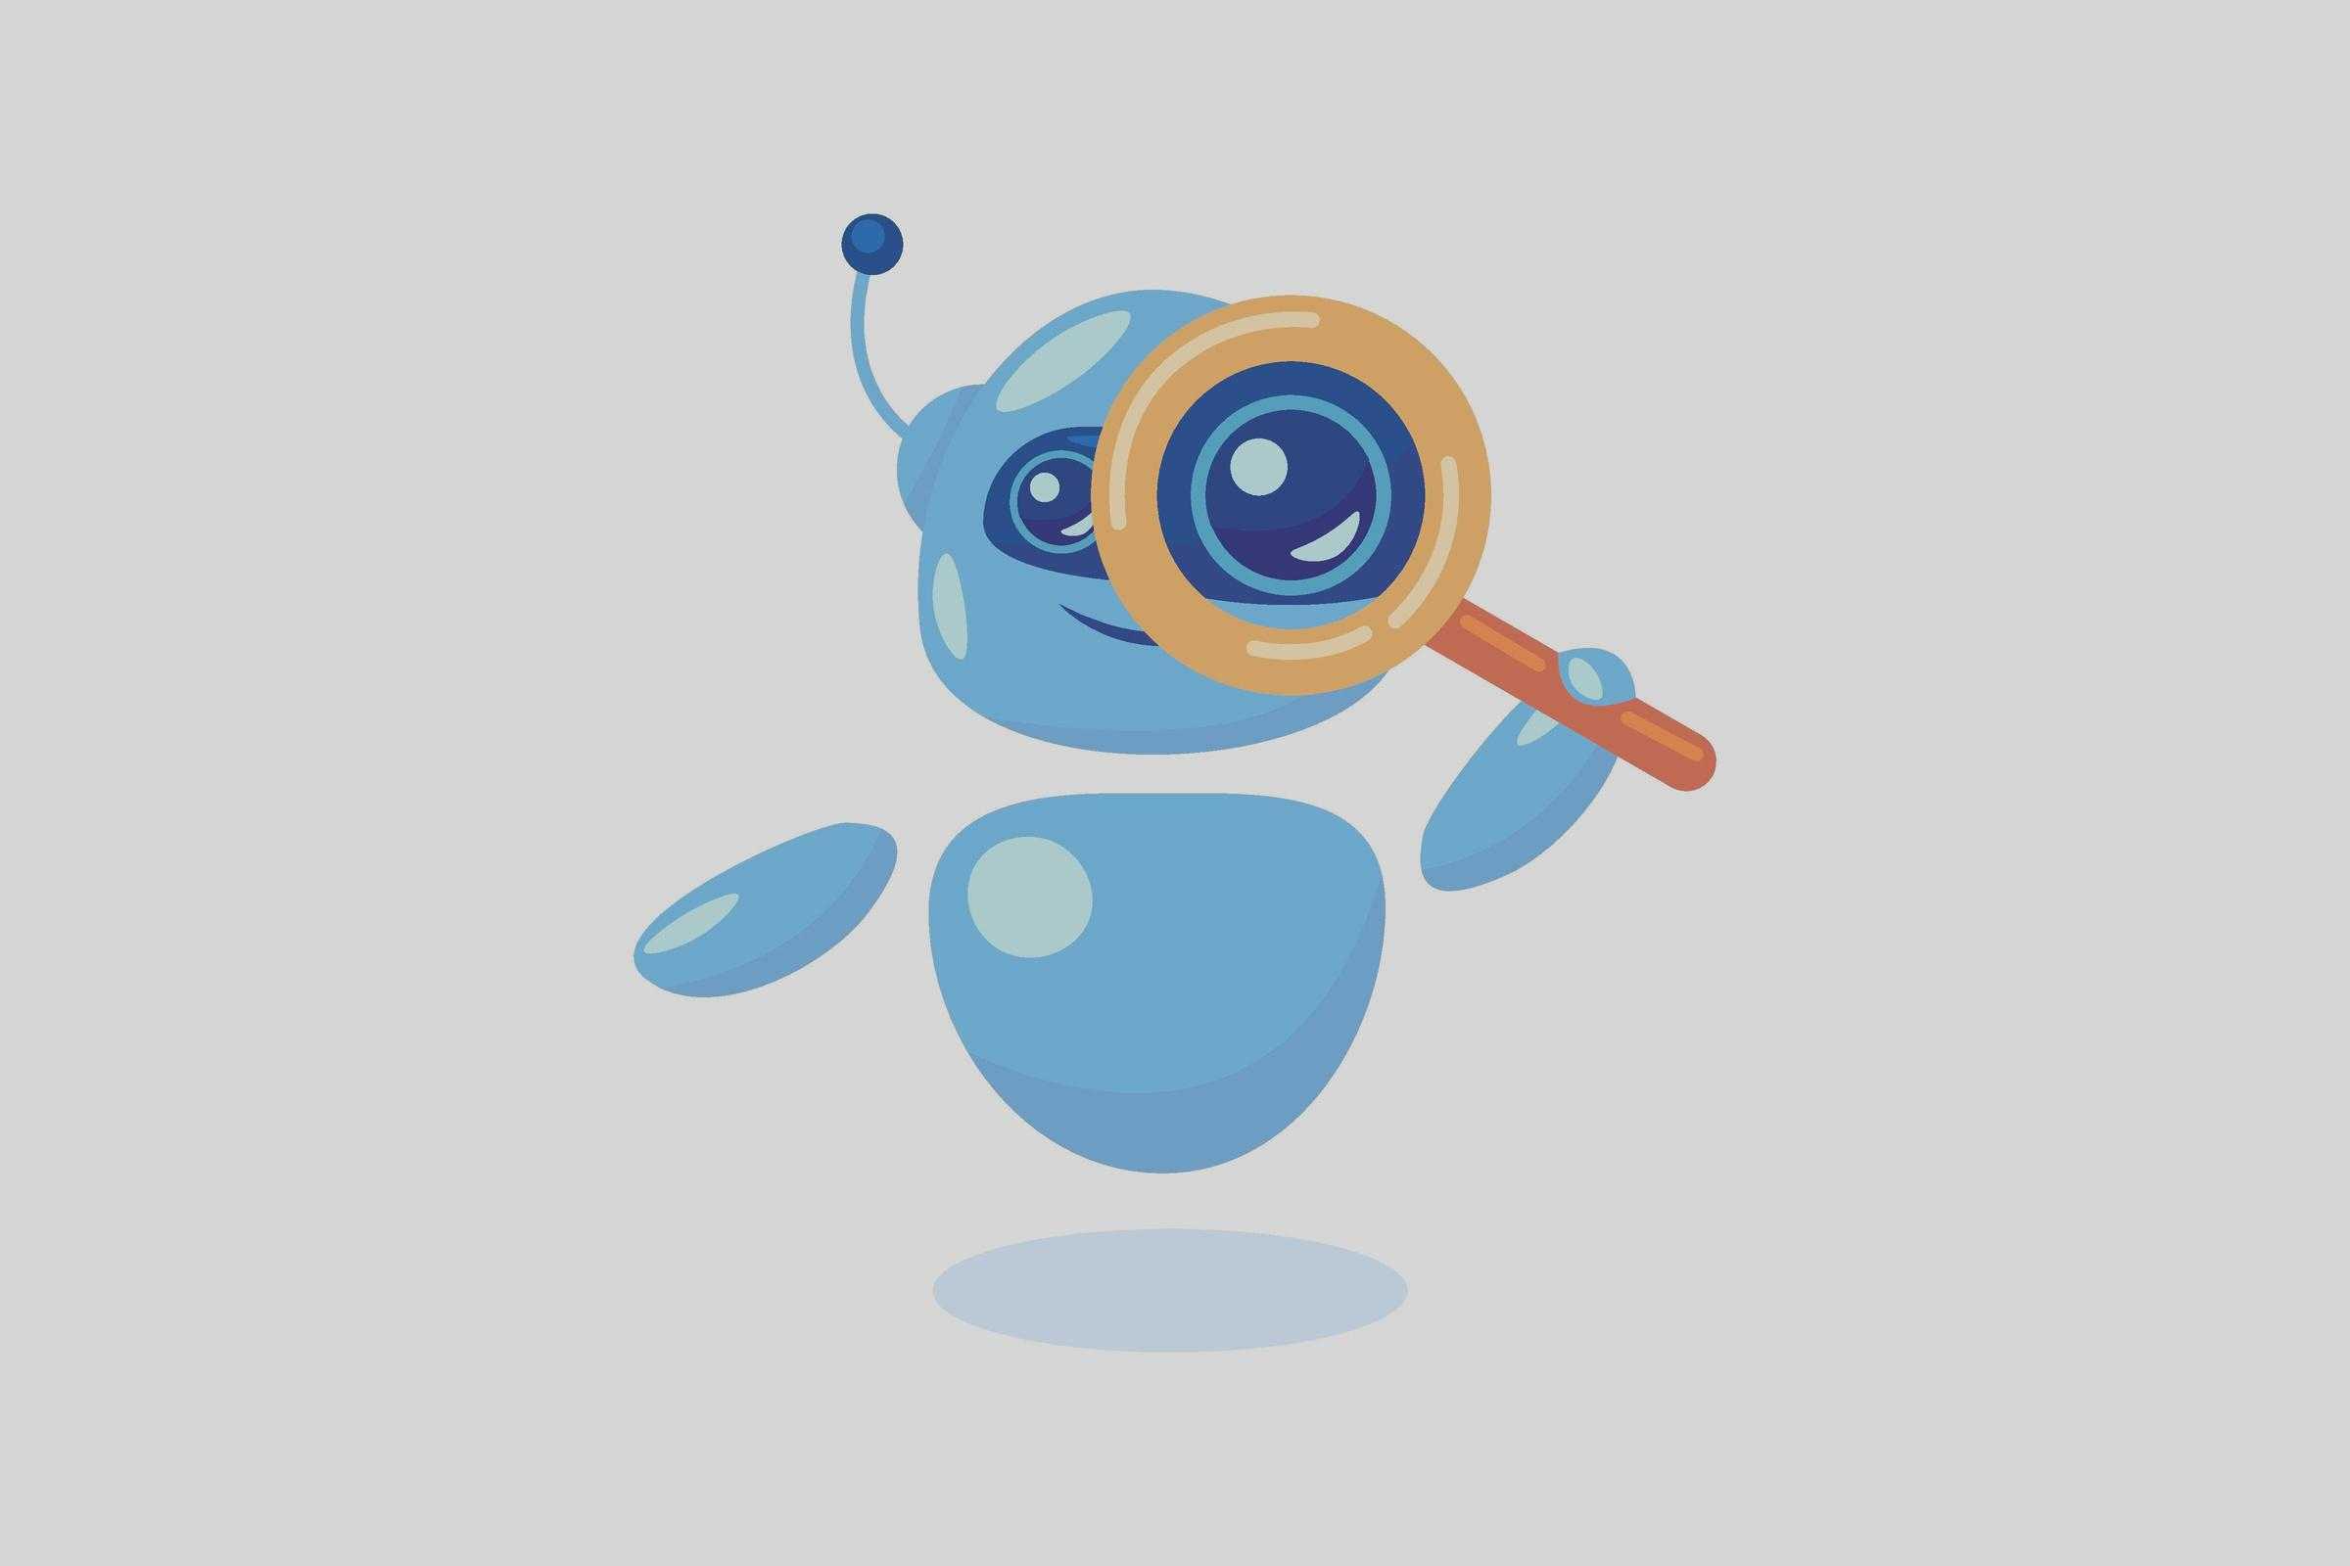
ANY QUESTIONS?

Slide 12
THANK YOU

