Slide 1

EMULATING FIREBASE

Slide 2
PLANNED IMPLEMENTATION
Appropriate Dataset is collected and Pre-processing is implemented.
The Dataset is loaded into MongoDB using Python with PyMongo Library.
The proper indexes are set to the MongoDB according to the requests.
A server is created using Flask with appropriate endpoints and restful libraries that are connected with MongoDB.
As soon as we enter the command the results are fetched by the restful flask server by calling MongoDB and the results can be seen on the terminal.

Slide 3
DATASET
The dataset used for my project is “New York City Airbnb Open Data” which contains Airbnb listings and metrics in NYC for 2019.
The dataset link : https://www.kaggle.com/datasets/dgomonov/new-york-city-airbnb-open-data
This dataset includes information about listings, such as the name, host, location, room type, price, minimum nights, number of reviews, last review date, reviews per month, calculated host listings count, and availability.

Slide 4
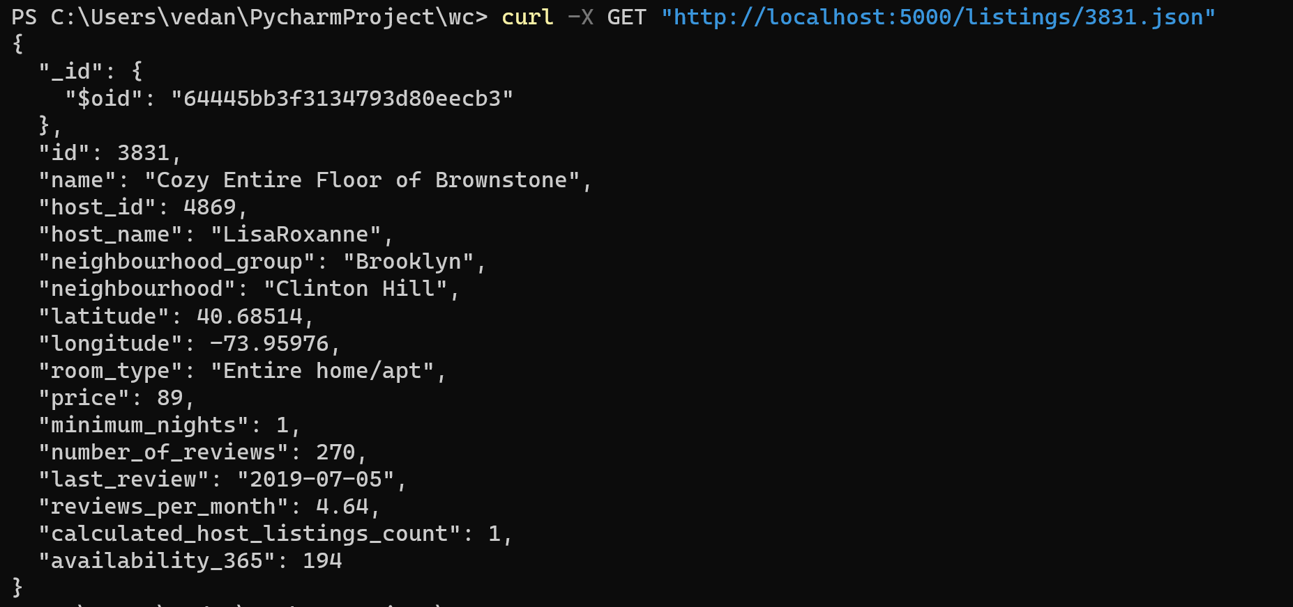
GET command implementation

Slide 5
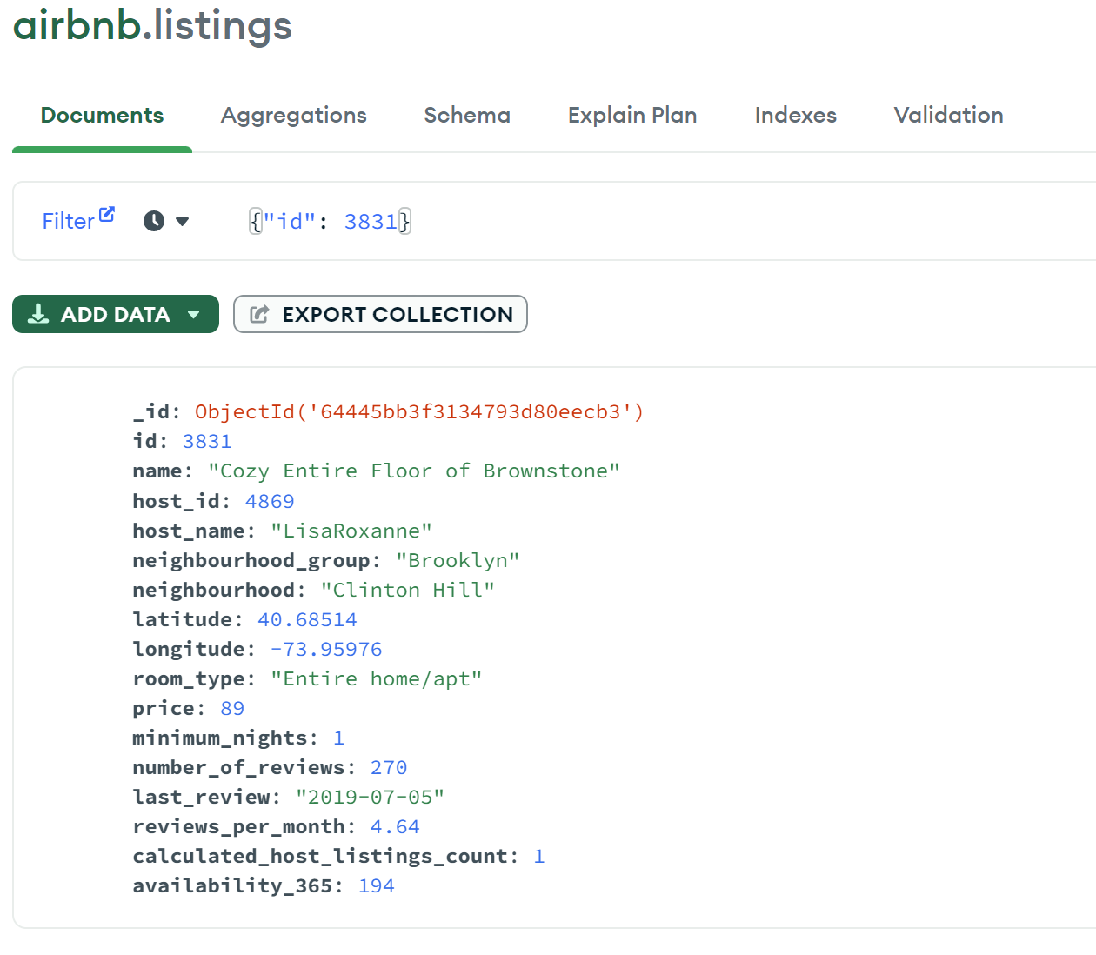
GET command implementation

Slide 6
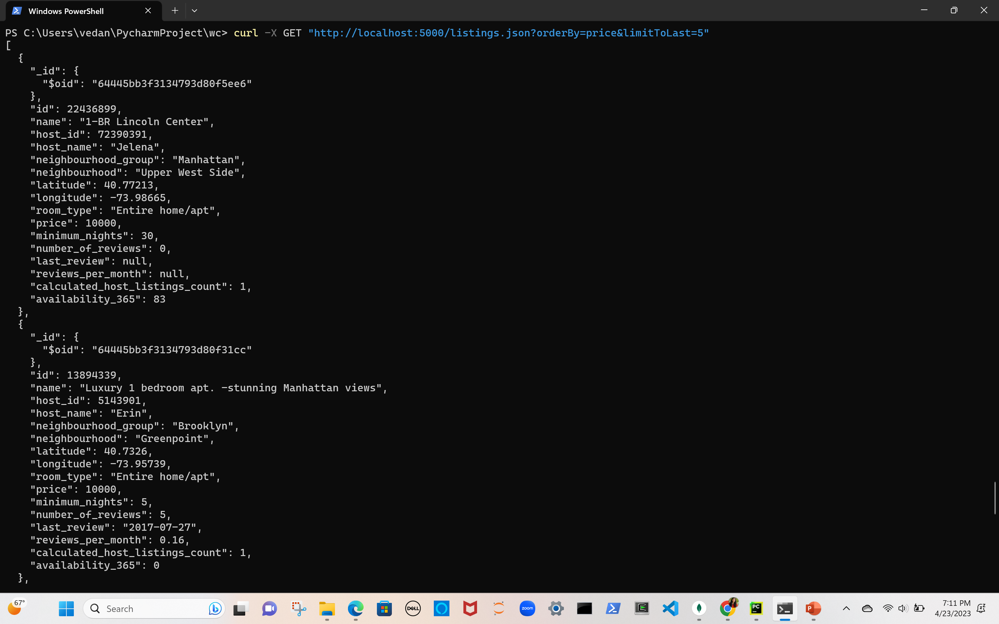
GET command implementation with filtering options

Slide 7
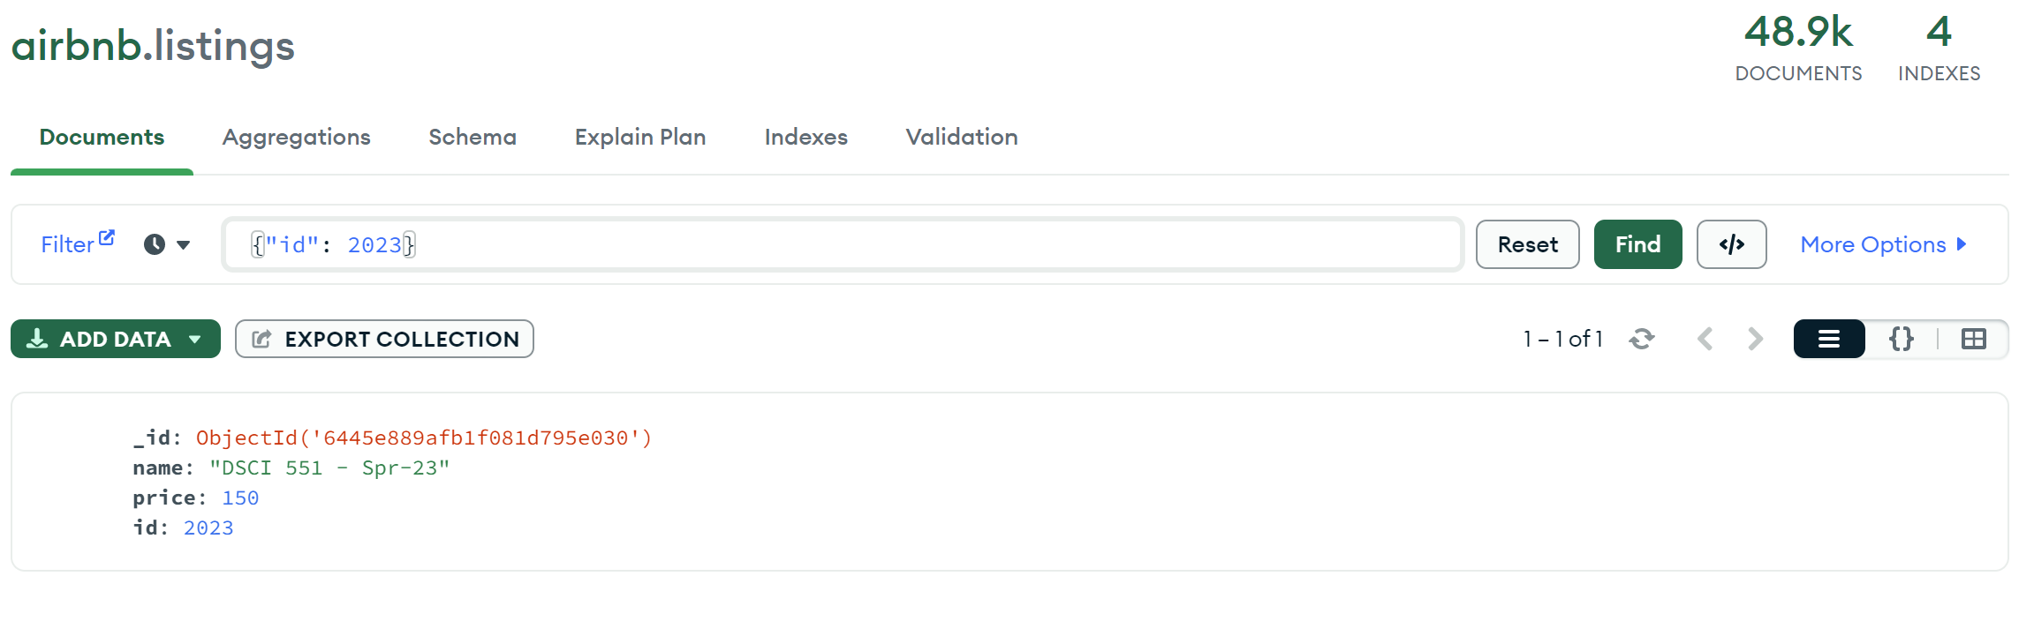
PUT command implementation

Slide 8
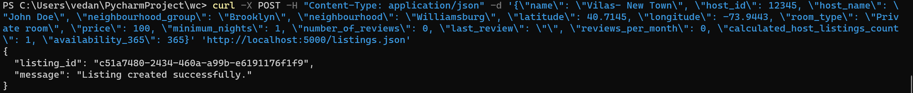
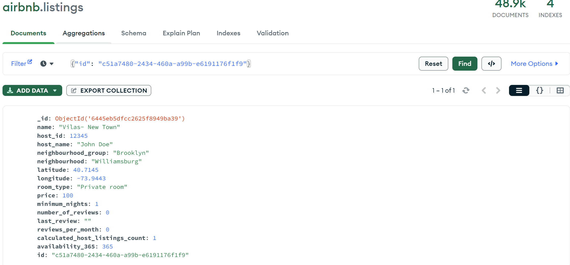
POST command implementation

Slide 9
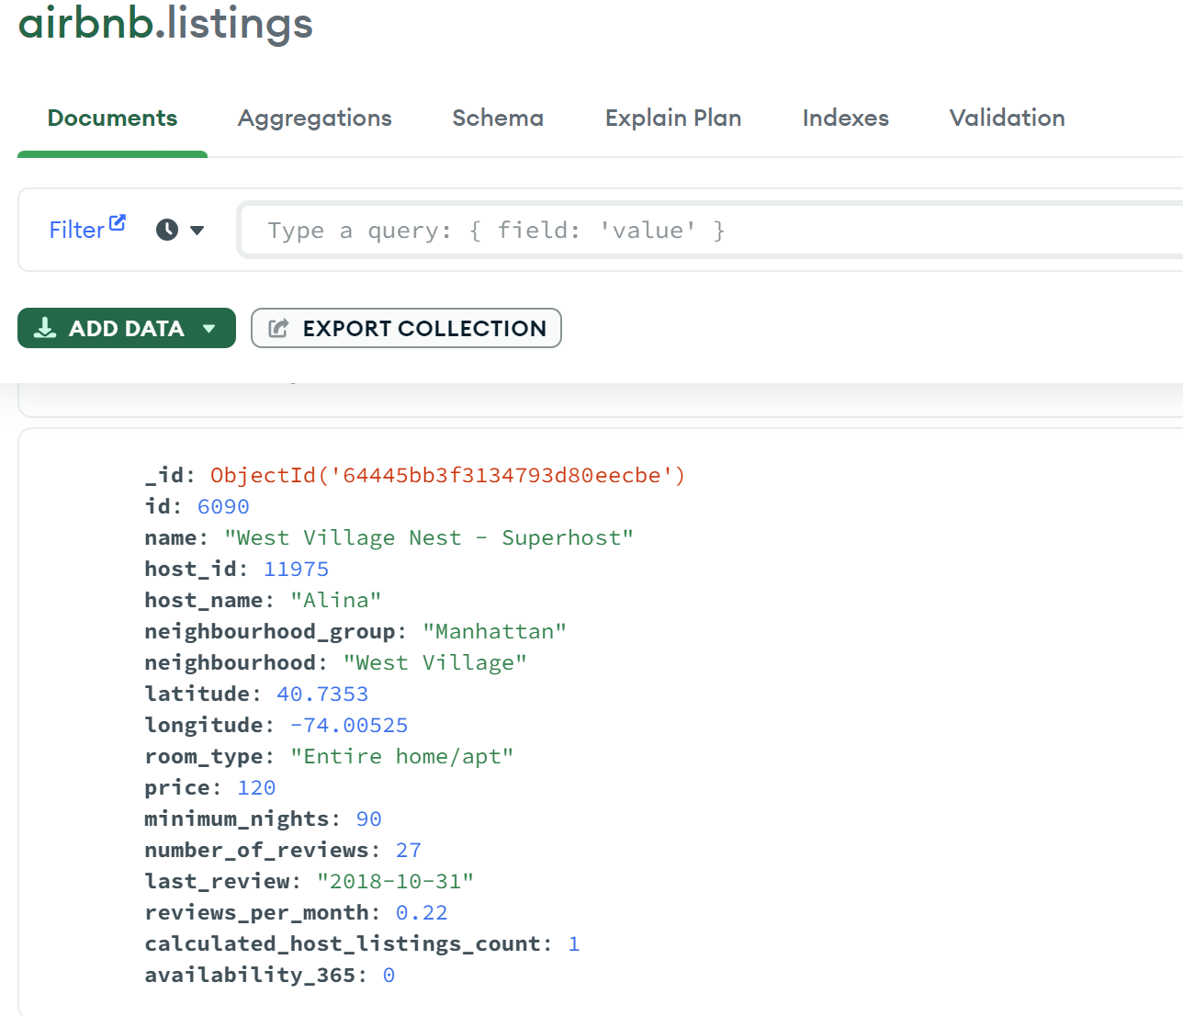
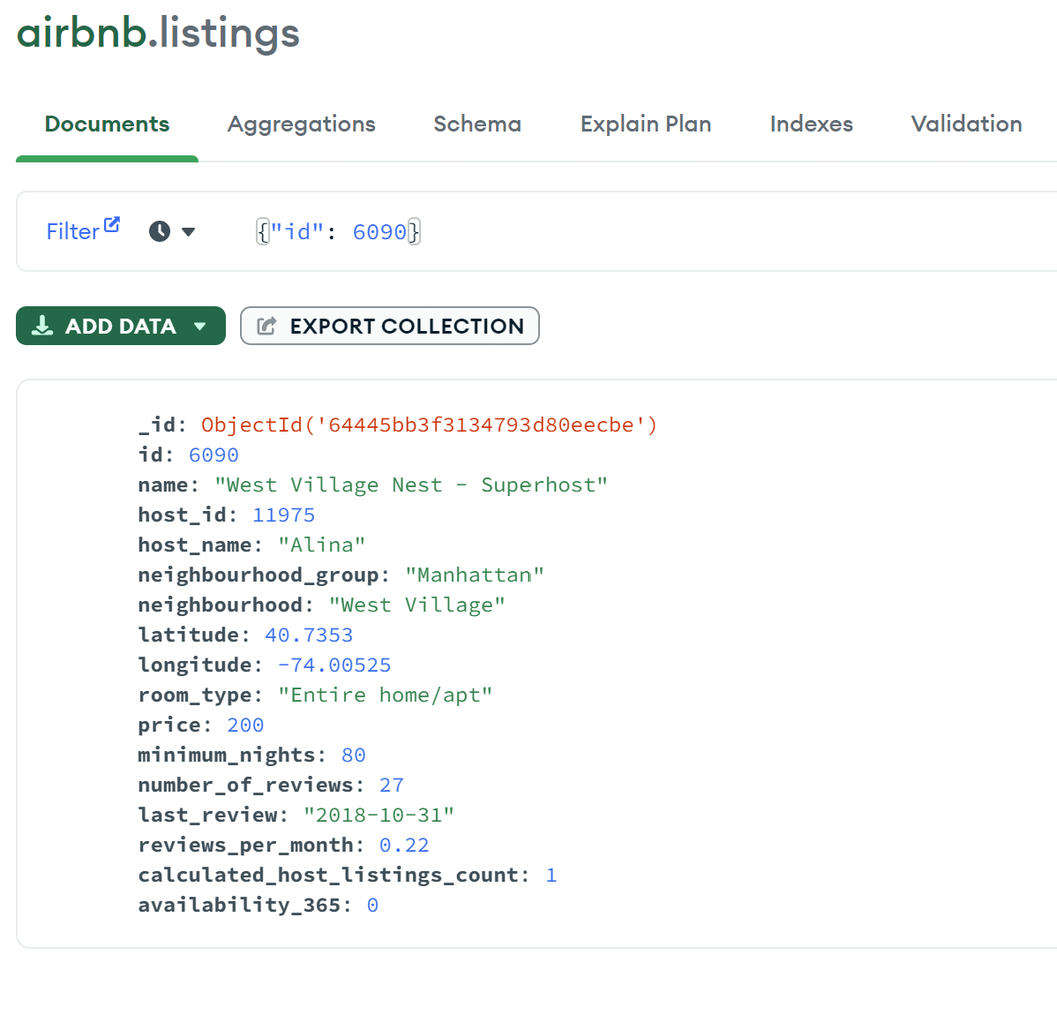
PATCH command implementation
Before Updating After Updating

Slide 10
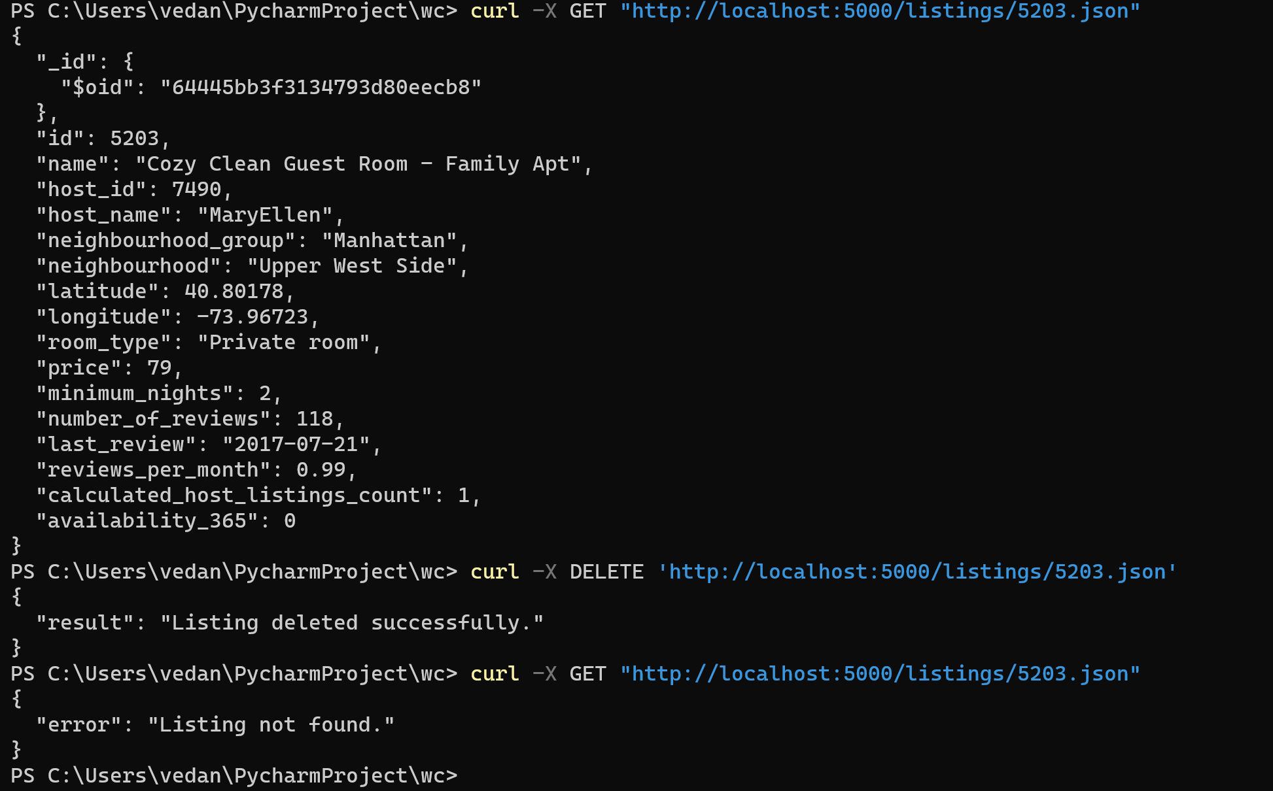
DELETE command implementation

Slide 11
THANK YOU
Vedanvita Gudavalli
(1741003325)

