Slide 1
Yield Curves & Mean Reversion

Slide 2
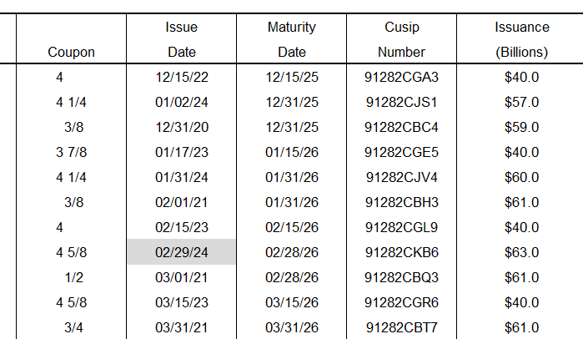
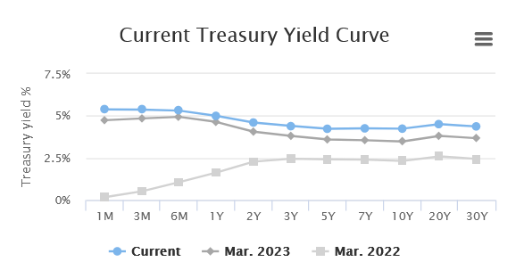
Definitions
Bond - debt security where creditor pays back principle and interest
Yield - annual rate of return of a bond
All the “2 year” Treasury Bonds
Visualizing Bond Relationships

Slide 3
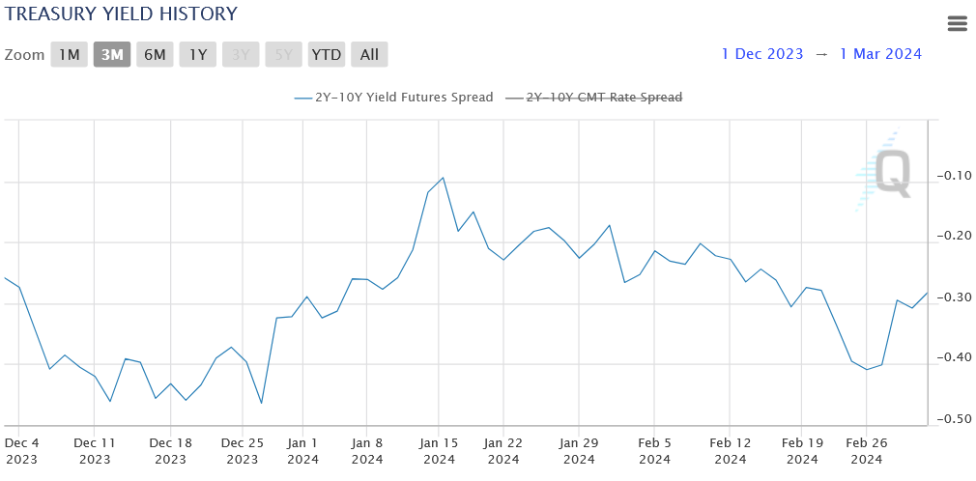
Curve Trading - buying and selling two securities of different maturities betting on the shape of the yield curve
Mean Reversion of Treasury Spreads

Slide 4
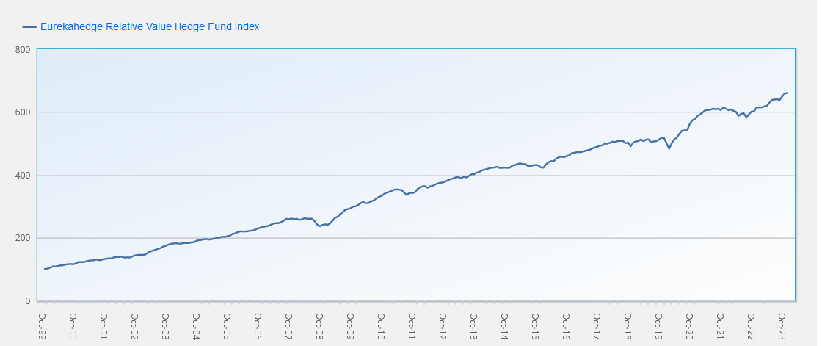
8.15% Market Neutral Annual Return
Index of FI RV Hedge Fund Returns

Slide 5




Data collection and sources
For preliminary data, the Bloomberg terminal was used
Low download limits restricted use of the API and so we are forced to turn away from using Bloomberg as a reliable source for data
World government bonds provides extensive data on yield curves in various countries
A python-based web scraping program is used to harvest data
More detailed information about specific bonds issued can be found on Börse Frankfurt
This includes coupon rate, ISIN, maturity dates, and payouts
Using ISINs, TradingView can be used to find daily price data
This can be collected by using the TradingView API accessed via a Python library

Slide 6
Data collection challenges and mitigations
Compile required data and download at the start of month
Avoid downloading unnecessary data
Extremely strict monthly API limits per Bloomberg terminal
Test strategy on limited data set
Mark out specific bond maturities which need to be accessed on Bloomberg start-of-month
Lack of public information about short-term (<10 year) bond pricing
Code outlier removal into strategy implementations
Access data using web-scraping algorithm which inspects source code
Data is hard to access and sometimes contains outliers

Slide 7
Identify mean reversion trends across various maturities in developing countries, focusing on the yield curve (e.g. Brazil)
Utilise bond price data to assess whether mean reversion trends extend to bond prices and pinpoint maturities showing robust mean reversion tendencies
Apply the Ornstein-Uhlenbeck (OU) process to determine position/trading weights for maturities exhibiting strong mean reversion trends, setting a threshold for delta deviation to trigger pairs trades
Backtest these parameters using the historical bond price data set
Research Process

Slide 8
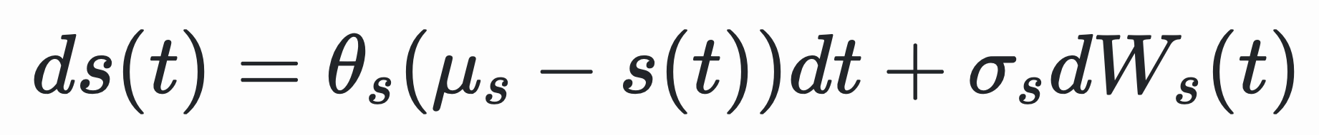
A stationary Gauss–Markov process: mean-reverting and autocorrelated of order 1
The long term mean level 𝜇: all future trajectories will evolve around a mean level in the long run
The speed of reversion 𝜃: the velocity at which yields will regroup around the mean
The instantaneous volatility 𝜎: measures the instantaneous amplitude of randomness (the pre-factor of Brownian motion)
The Vasicek model for evolution of interest rates
The Ornstein-Uhlenbeck Process

Slide 9
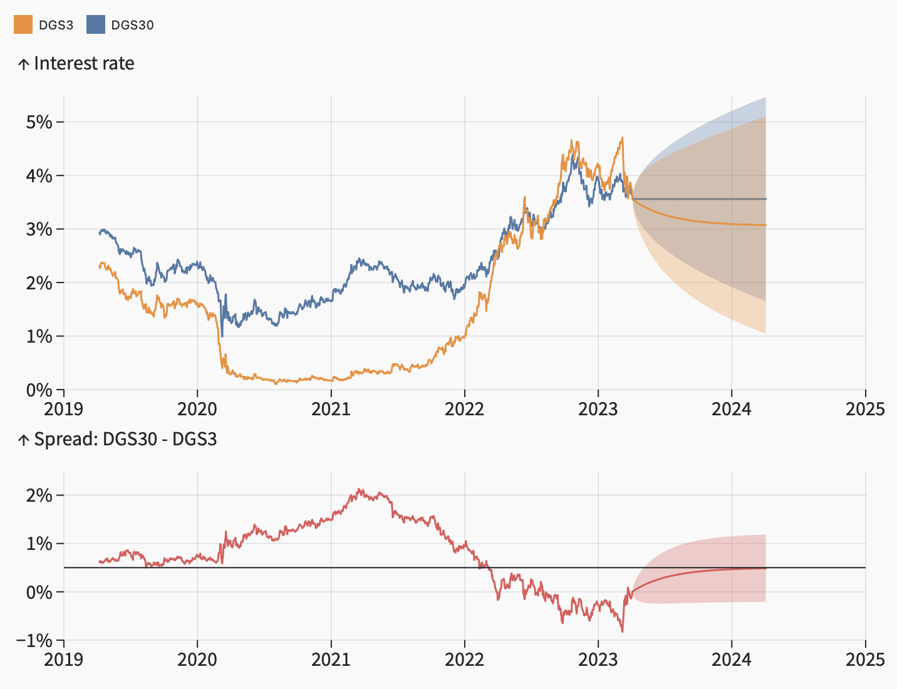
Model the spread between bonds of different maturities as an OU process
Estimate OU parameters based on historical data
Results in a model of the long bond yields and a model of the short bond yields
OU Modelling

Slide 10
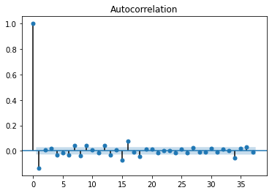
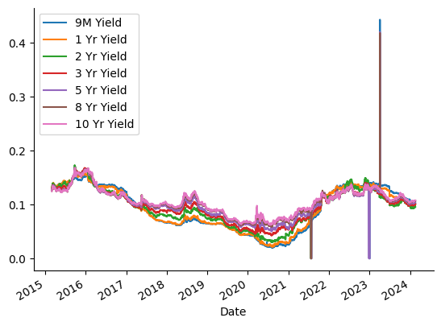
For every pair of bonds of different maturities under consideration, apply a linear lag model of order p
Augmented Dickey-Fuller (ADF) Test: test for the presence of a unit root in an autoregressive time series sample
If a price series possesses mean reversion, then the next price level will be proportional to the current price level
Hurst Exponent: quantifies degree of mean reversion to select best pair
Pairs Identification

Slide 11
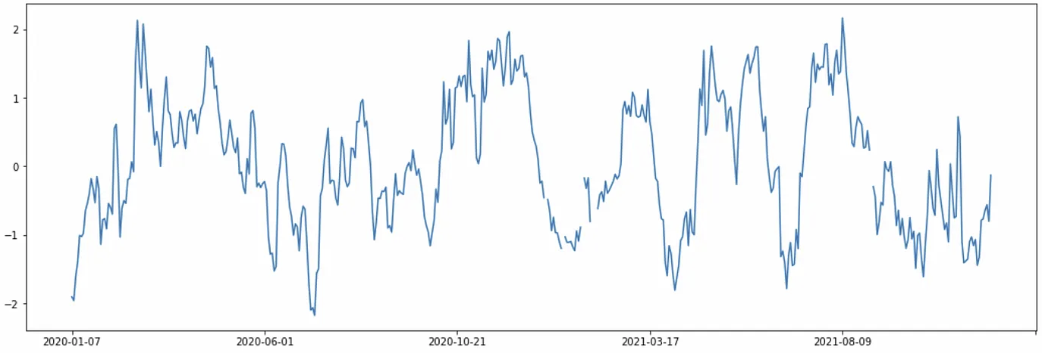
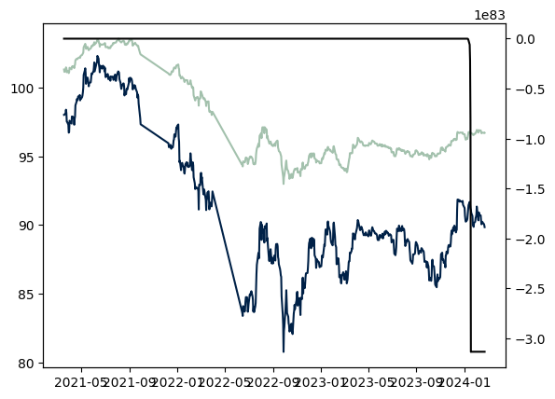
Trigger trade/position change based on calculated z-scores
Multiply position by weights of position, i.e. optimal parameters of OU process
Optimal parameters, i.e. ratio of capital in one bond to the other, found by maximising log-likelihood
Account for transaction costs
Promising sharpe ratio and maximum drawdown
Pairs Trading

Slide 12
Leung, T. S. T., & Li, X. (2015). Optimal mean reversion trading: Mathematical analysis and practical applications (Vol. 1). World Scientific.
Rampertshammer, S. (2007). An Ornstein-Uhlenbeck framework for pairs trading. Preprint.
Holý, V., & Tomanová, P. (2022). Estimation of Ornstein-Uhlenbeck process using ultra-high-frequency data with application to intraday pairs trading strategy. arXiv preprint arXiv:1811.09312.
Letchford (2023), "Mean reversion in government bonds", OS Quant. Available at https://osquant.com/papers/mean-reversion-in-government-bonds/
Citations

