Slide 1
FRAUDWATCH AFRICA
UNSUPERVISED MOBILE MONEY TRANSACTION FRAUD DETECTION
ANOMALOUS
NON ANOMALOUS
AUTHORS: DA-2 PROJECT TEAM
FESTUS IYAMU
MELISSA MATINDI
OLAYEMI OLOYEDE

Slide 2
PROBLEM STATEMENT
The availability and rise of mobile money platforms and services has significantly improved financial inclusion in Africa. However, it has also gained the attraction fo fraudsters, who exploit factors such as anonymity of transaction and weak security measures. And as a result, incidents of identity theft, SIM swaps and unauthorized transactions, have also been on the rise

Slide 3
OBJECTIVES
Gather and explore historical online money transactions to understand key patterns
Clean, preprocess data and check for interactions that can be indicative of fraud
Implement a model using suitable anomaly detection algorithm, evaluate and optimize the model
Deploy model for integration into existing services and for real-time monitoring of transactions

Slide 4
DATA OVERVIEW
Dataset used was simulated due to inavailability of data. It consists of 10,000 transactions that spans across different user details and behaviours such as Transaction ID, User ID, Transaction Type, Amount, Location, Network Provider, Device Type, User Type, Time of the Day, Foreign Transaction flags, SIM swap flags, Multiple accounts flags and datetime.

Slide 5
METHODOLOGY
DATA
PREPROCESSING
Data was collected, cleaned and explored using several visualisation techniques
Data cleaning and column management., feature engineering, scaling and dimensionality reduction
DEPLOYMENT
MODELING AND EVALUATION
Model Pipeline was deployed into an integrable API, which was then connected to a dashboard for real-time predictions
Isolation Forest Algorithm was used to detect anomalies and evaluated using anomaly score.
Tools & Libraries Used: Python, Google Colab, Jupyter, Pandas, Scikit-learn, Streamlit, FASTAPI, Uvicorn
Custom Transformers: FeatureInteractions, DropColumns

Slide 6
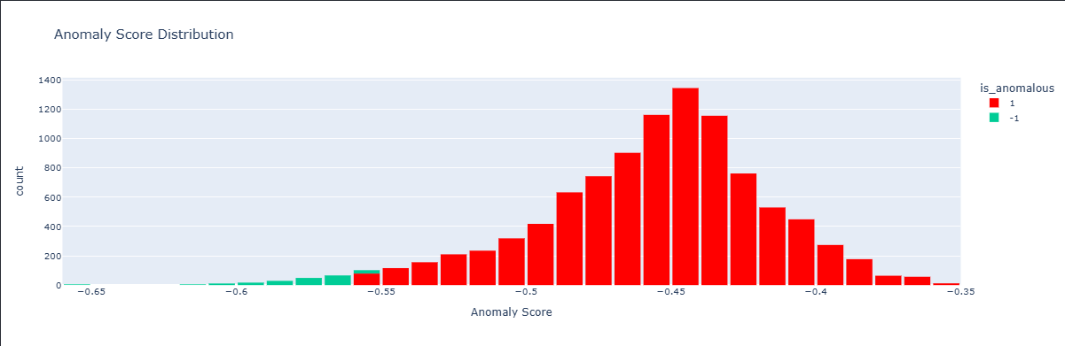
MODEL DEVELOPMENT
Some columns were weighted to give them more importance.
Feature Interactions were explored and new columns that were indicative of fraud were created.
Robust scaler was used due to the outliers present in amount and One Hot Encoder was used for the categorical variables
Isolation Forest Algorithm was trained to detect possible anomalies
One of the parameters, contamination rate was set to 0.02, to constrict the model’s oversensitivity.
Model was evaluated using the anomaly score and was able to pick extreme amounts.

Slide 7
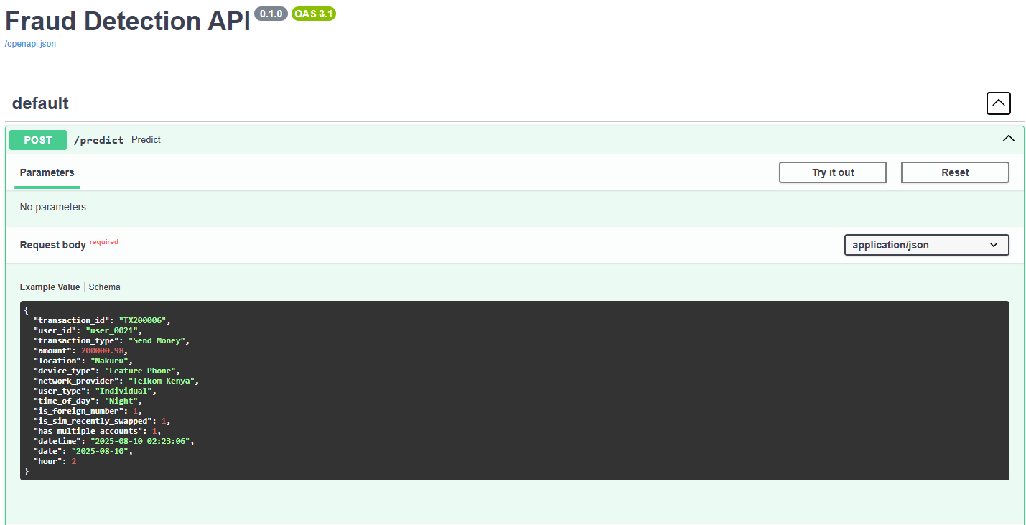
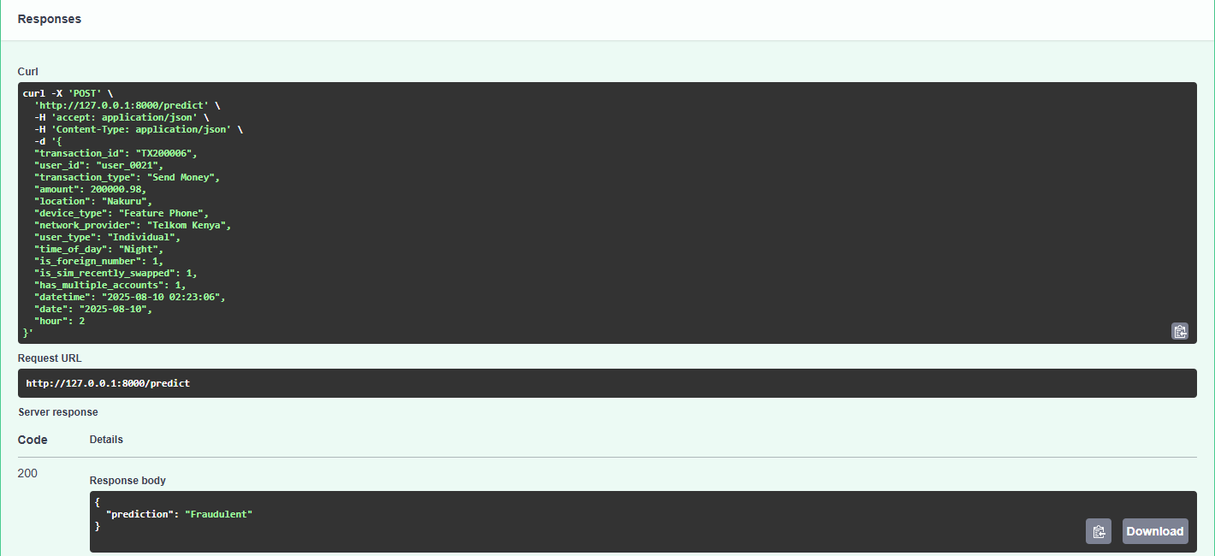
DEPLOYMENT (FASTAPI)
The Model was wrapped in an API for real-time anomaly detection. It works by accepting data, and returns anomaly status based on model prediction. This can be connected with external systems and applications.

Slide 8
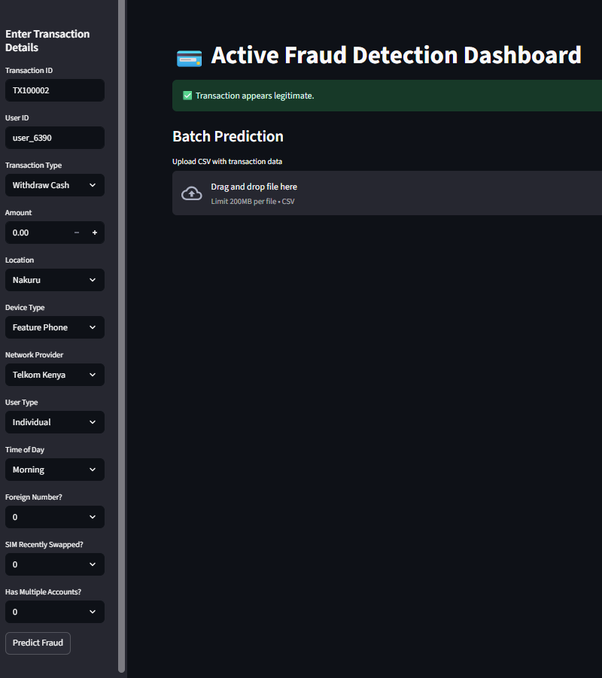
DEPLOYMENT (DASHBOARD)
To enable an ease of use by users, an interactive dashboard was built using streamlit. It allows for input of transaction data, sends the transaction data to the FastAPI endpoint, and then displays the prediction.

Slide 9
CHALLENGES
Precision was reduced due to the usage of Standard scaler, which was sensitive to outlier.
This was solved by changing the scaler to Robust scaler
Data Imbalances, such as <5% Foreign Numbers
Weighting was applied to improve model balance
Uniform Distributions and Irregular plots
Log scales and interaction analyses were used to uncover patterns

Slide 10
CONCLUSIONS
a
b
c
Collected and preprocessed transactional data, ensuring quality and consistency for accurate anomaly detection
Successfully developed an ML model that can identify suspicious or unusual transactions.
Integrated the model into a FastAPI service and connected it to a Streamlit dashboard for an easy and a user-friendly interaction

Slide 11
THANK you!
Does anyone have any questions?

