Slide 1

PAVEL_7
Hackathon 2026
"Pay As You Use"
OPEN PAYMENTS

Slide 2

Meet the team
PavelPayments
Vhutali Tsanwani
Erico Mutonkole
Lisakhanya Tshokolo
Amanda Msutu
Noxolo Ngubo
Thabiso Moropane
Thembalethu Sambo

Slide 3
Problem statement
Problem: Traditional subscription models charge fixed fees regardless of actual usage.
Why tackle this problem: PavelPayments aims to reduce subscription waste, create financial inclusion, promote transparent billing, and increased accessibility.

Slide 4
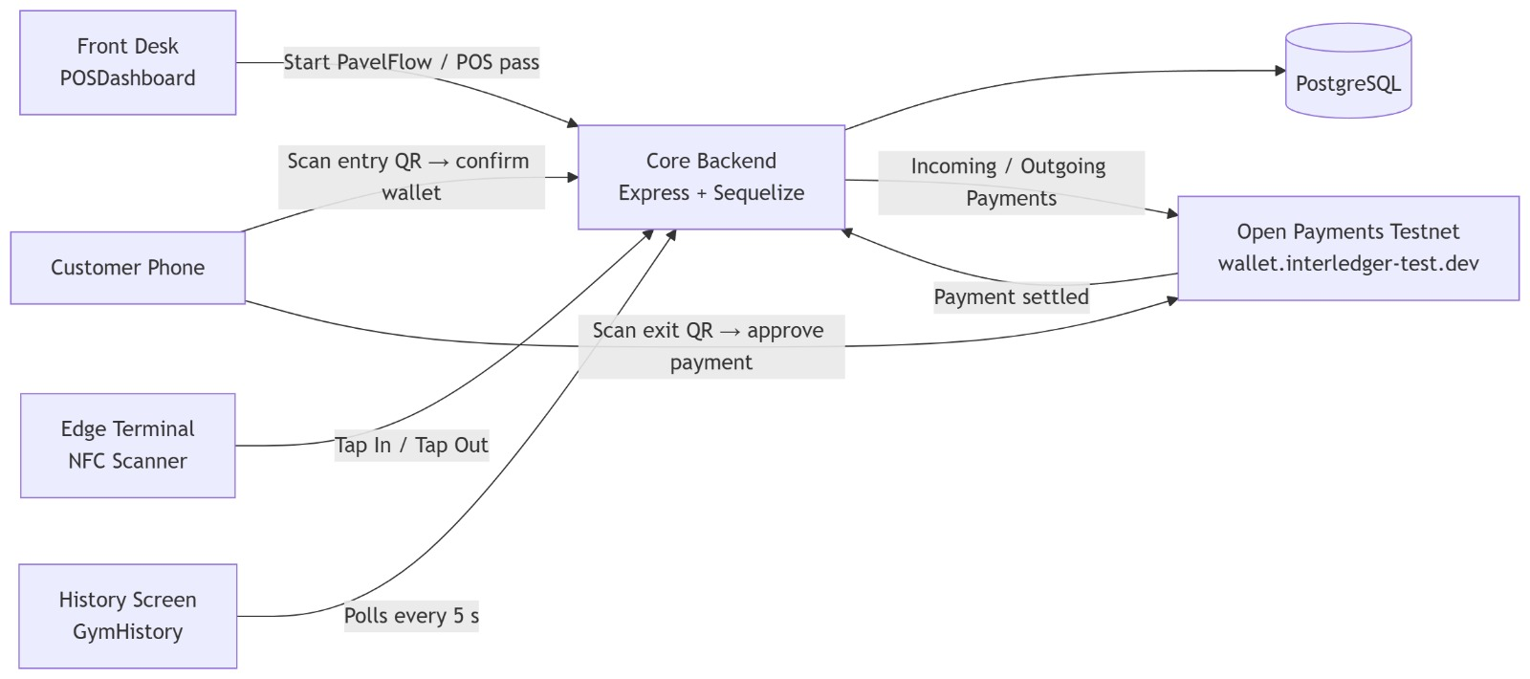
GYM Solution

Slide 5
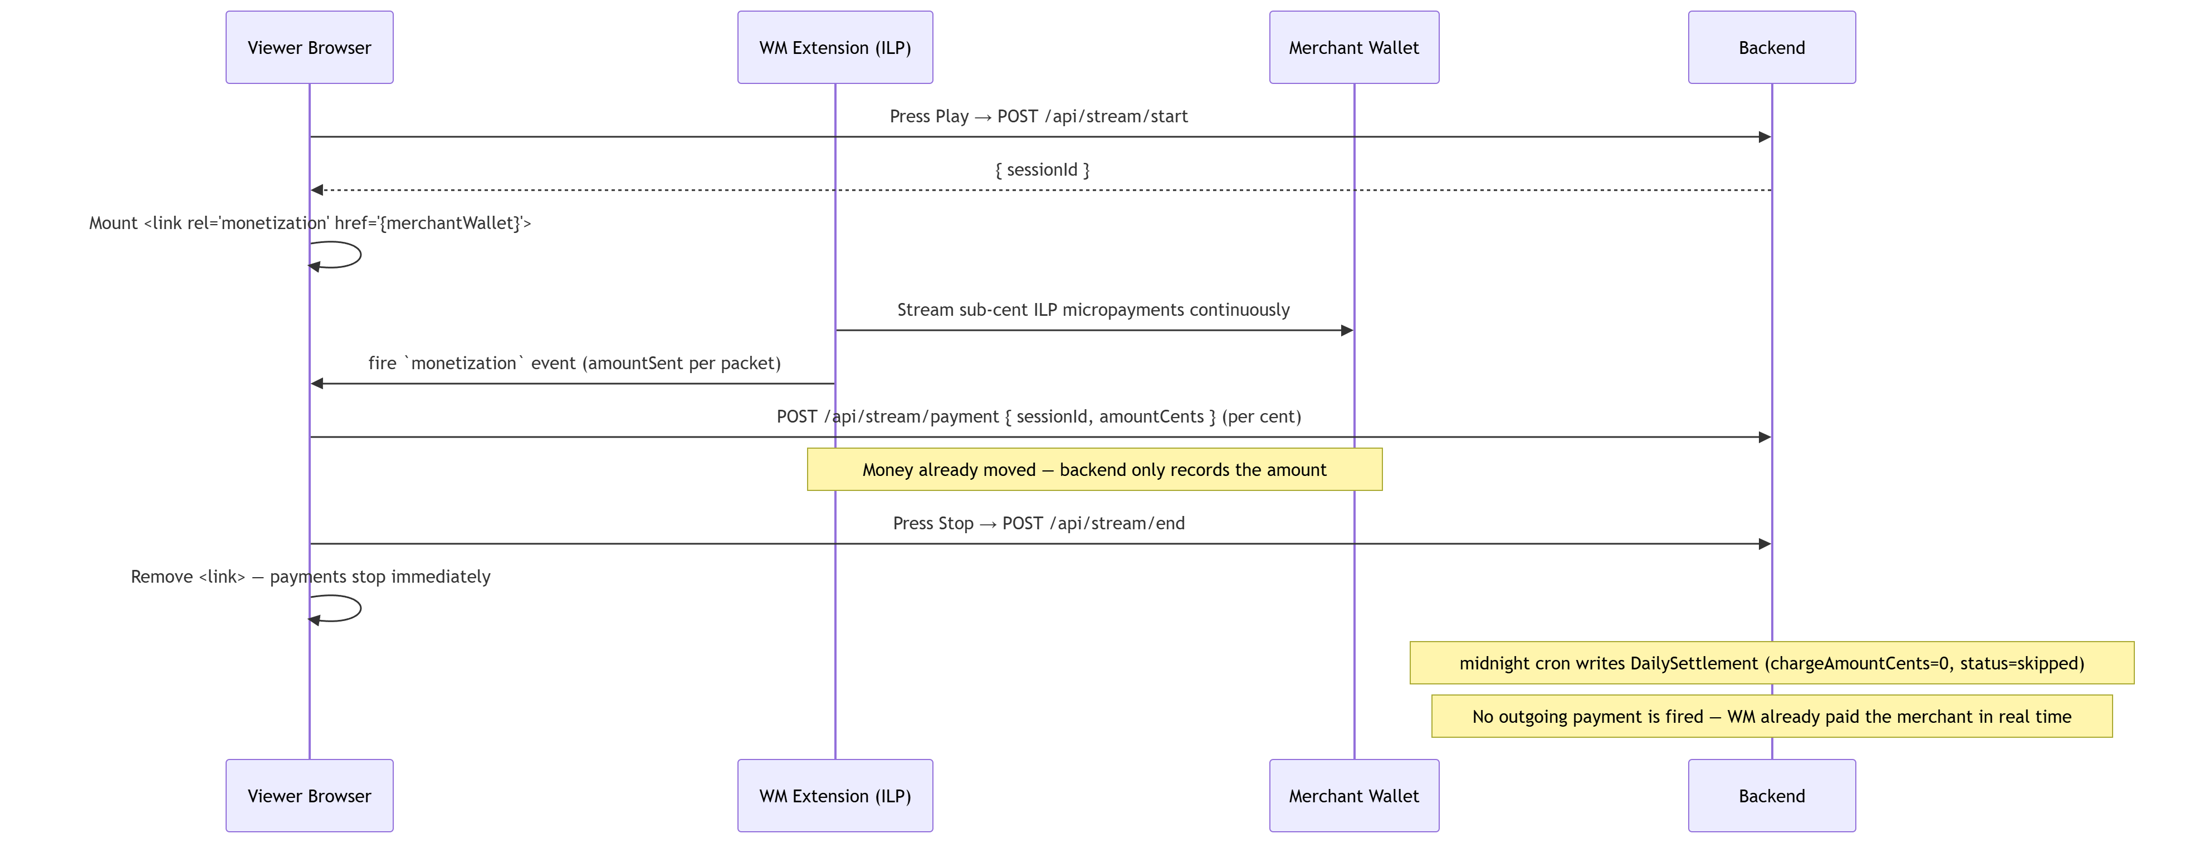
Streaming Solution

Slide 6
Technology Stack
Frontend: React.js
Backend: Node.js + TypeScript
Payments: Interledger Open Payments & GNAP
Database: PostgreSQL
Cache: Redis

Slide 7
What Makes Us Different?
Usage-based billing powered by open payments
Real-time payment settlement
Supports multiple billing models
QR-code physical access control
Fair and transparent payment structure
Designed for financial inclusion

Slide 8
Demo

Slide 9
Conclusion
PavelPayments transforms subscriptions into fair, flexible, and inclusive payment experiences.

Slide 10
Thank you.

