Slide 1
PROJECT SHOWCASE & PROTOTYPE DEMONSTRATION
CachyMusic
A Focused, Distraction-Free Audio Player Prototype
Tactile Vinyl Turntable • Peer-to-Peer Music Sharing • Audiophile DSP
Notes:
Presenter Notes:
• Welcome everyone. Today I'm excited to showcase CachyMusic, a web audio player prototype designed to restore tactile joy, simplicity, and user ownership to personal music listening.
• We will explore what problems this prototype solves, walk through clean visual screenshots of the application, and view its built-in personalization themes.

Slide 2
01 / PROTOTYPE VISION
Why CachyMusic?
1. What This Prototype Solves
Mainstream streaming apps have become noisy storefronts filled with algorithmic suggestions, social feeds, and ads. This prototype brings the focus strictly back to your own audio files with an uncluttered, fast interface.
2. Decentralized Peer-to-Peer File Sharing
Commercial streaming services lock users into subscription models that constantly track listening habits, gatekeep independent artists, and delete albums without notice. CachyMusic integrates a decentralized peer-to-peer file sharing client (Nicotine+ / Soulseek network), allowing music enthusiasts to discover, exchange, and download rare recordings and community audio directly between peers—giving you true offline ownership of your music library.
Notes:
Presenter Notes:
• Point 1: Mainstream streaming apps have morphed into noisy storefronts loaded with algorithmic feeds, podcasts, and intrusive ads. CachyMusic restores a clean, laser-focused player dedicated entirely to your audio files.
• Point 2: We incorporate direct peer-to-peer file sharing via the Soulseek network. Rather than relying on cloud corporations that can remove songs at any moment, users connect peer-to-peer to discover and download independent music directly.

Slide 3
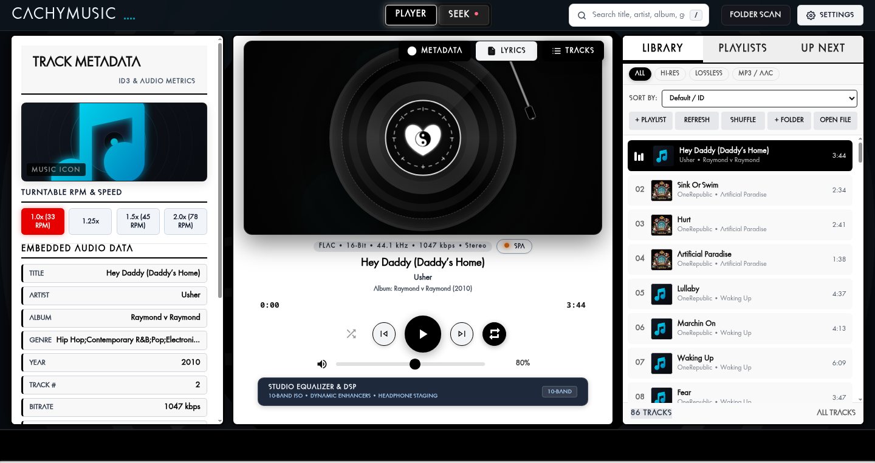
Notes:
Presenter Notes:
• Showcase: The interactive player deck with animated tonearm, vinyl record, and real-time audio visualizer.

Slide 4

Notes:
Presenter Notes:
• Showcase: Instant standalone playback for external audio files without modifying or polluting the main library.

Slide 5

Notes:
Presenter Notes:
• Showcase: The integrated Seek workspace connecting to decentralized peer networks for direct file exchange.

Slide 6
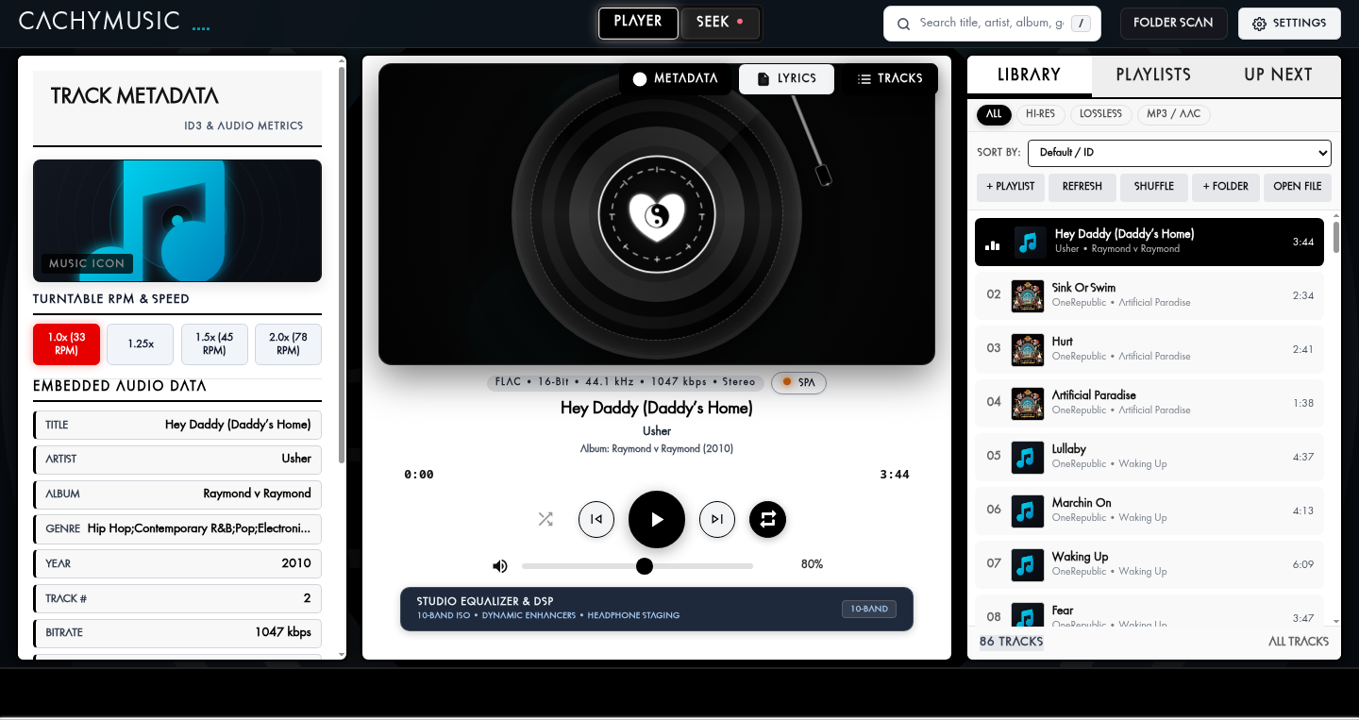
Notes:
Presenter Notes:
• Showcase: Audiophile 10-band equalizer, headphone crossfeed, and subsonic rumble filter.

Slide 7
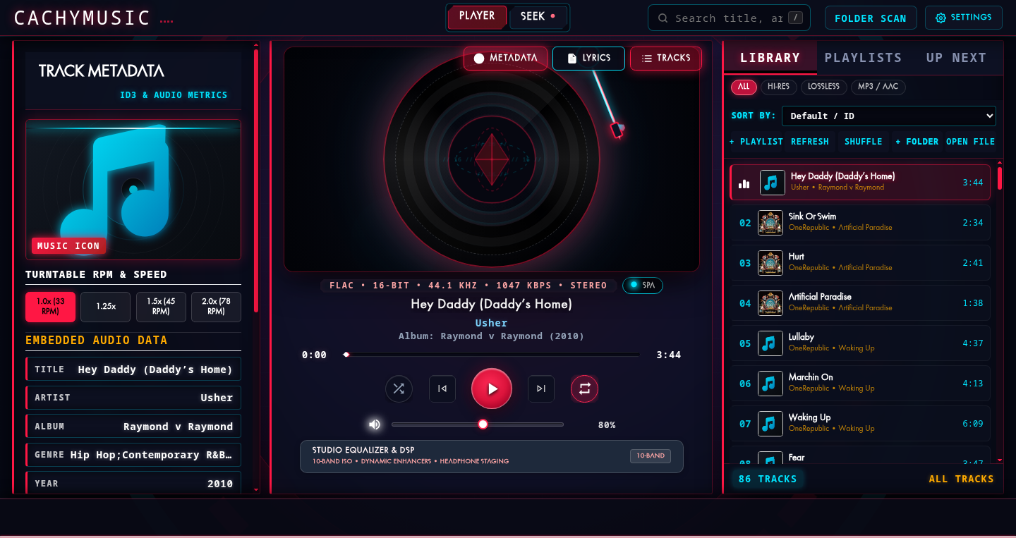
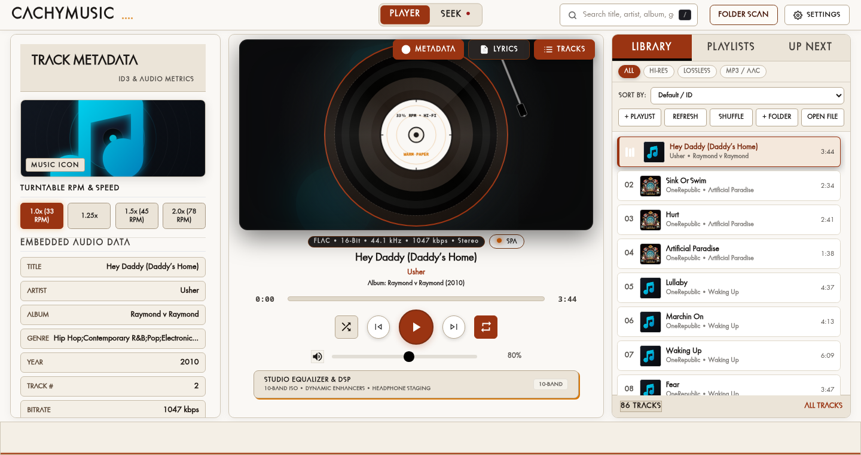
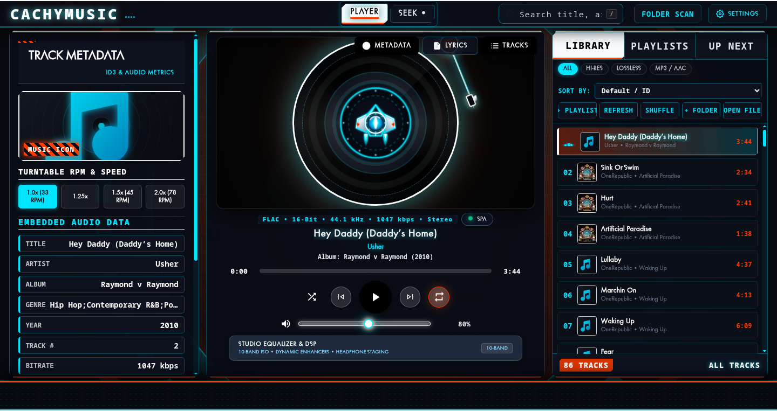
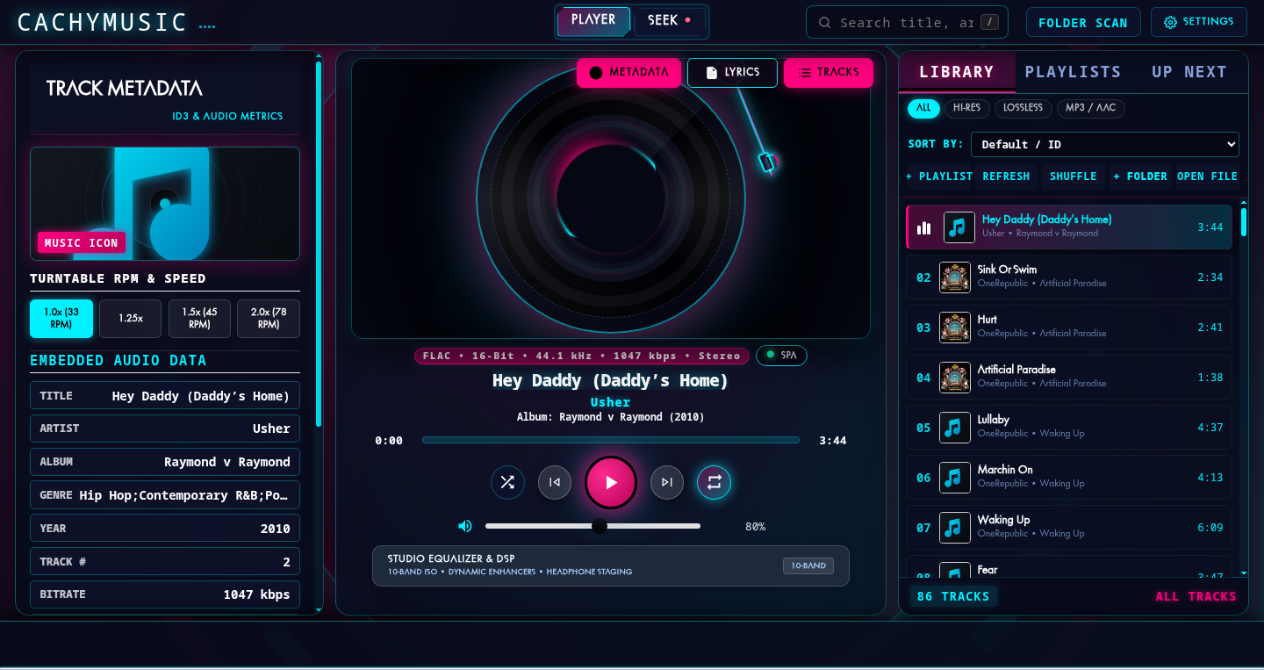
VISUAL PERSONALIZATION
Diverse Aesthetic Themes for Every Mood
The Atlas (Retro Sci-Fi)
Minimalist Warm (Paper & Amber)
Sentinel (Neon Cyan Cyberpunk)
Solar Eclipse (High-Contrast Gold)
Notes:
Presenter Notes:
• Themes Showcase: CachyMusic offers multiple tailored visual themes ranging from high-contrast brutalist and paper warm to atmospheric sci-fi and cyberpunk aesthetics.
• Each theme dynamically transforms the entire interface, turntable platter, and center visualizer.
• Thank you! That concludes the presentation walkthrough.

