Slide 1
SECURE DATA HIDING IN IMAGES USING STEGANOGRPAHY
CAPSTONE PROJECT
Presented By:
Vishali R
Sathyabama Institute Of Science And Technology, Chennai
BE CSE with Cyber Security

Slide 2
OUTLINE
Problem Statement
Technology used
Wow factor
End users
Result
Conclusion
Git-hub Link
Future scope

Slide 3
Problem Statement
The problem being addressed is the need for secure communication in a world where privacy and security are critical.
This project aims to implement a basic steganography algorithm, where a secret message can be hidden within an image, making it undetectable by others.
This method is especially useful for secure communication, where messages need to be sent without being intercepted.

Slide 4
Technology used
Python: The programming language used for implementing the project.
OpenCV (cv2 library) : Used for image manipulation and reading.
File Handling & Security : Basic encryption logic for password protection
Platform: Windows 11

Slide 5
Wow factors
Image-based Security: The concept of hiding data in plain sight within images makes this project quite interesting from a privacy standpoint.
User-Friendly: The use of simple input prompts allows users to interact with the application easily, even without technical knowledge.
Combining Steganography and Encryption: Combining these two concepts makes the project both innovative and secure for practical use.

Slide 6
End users
Individuals: Anyone who needs to send sensitive information securely via images, e.g., journalists, activists, or personal communication.
Organizations: Entities that require encrypted and hidden communication channels for sensitive data transmission.
Developers/Researchers: People interested in exploring basic concepts of encryption and steganography for educational purposes.

Slide 7
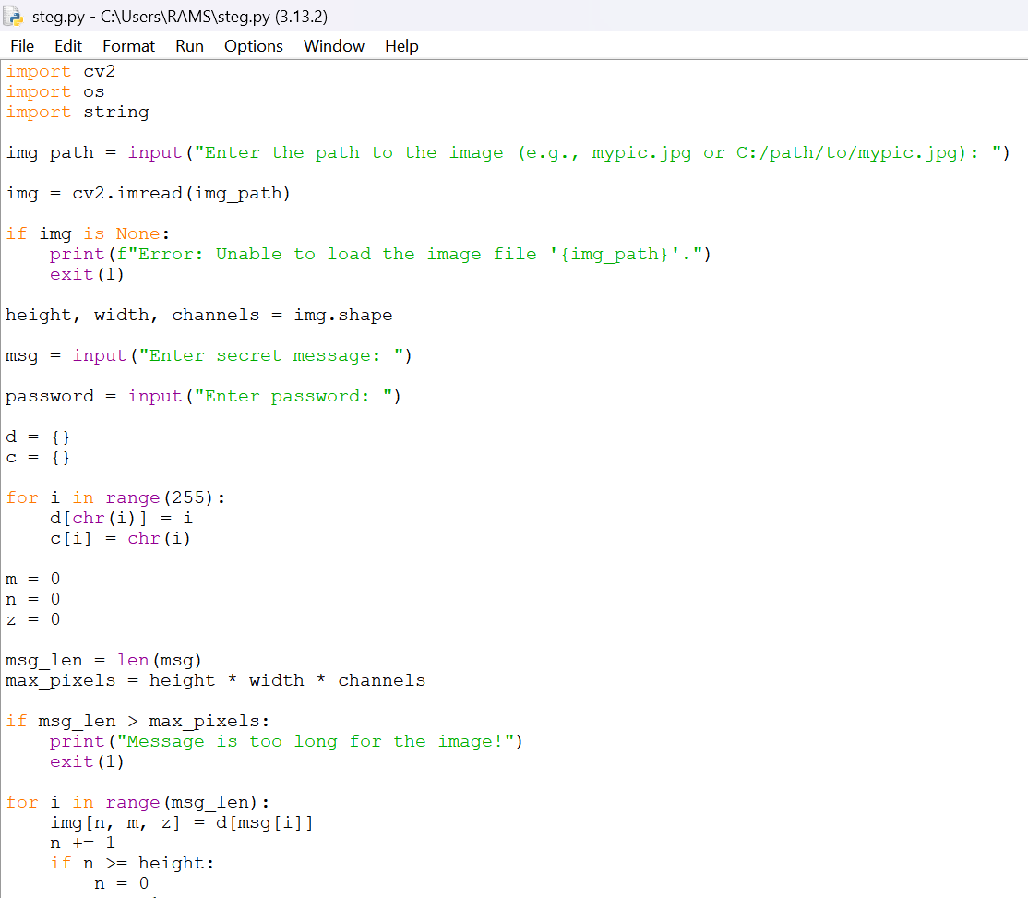
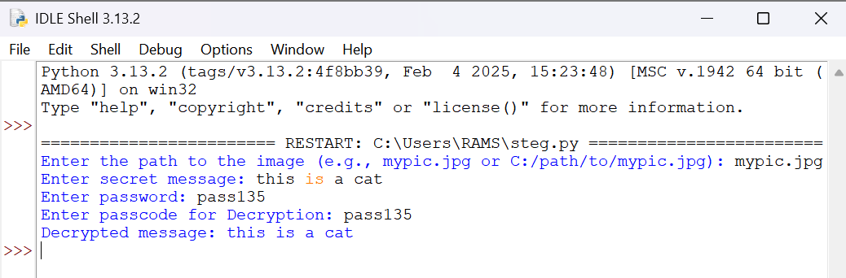

Results
Code : Output :
Encrypted picture :

Slide 8
Conclusion
The project highlights how image manipulation can be used as a means of secure communication through the process of steganography. It is an important concept in cybersecurity and privacy protection. The method implemented here is straightforward but can be extended to more complex encryption techniques for better security.

Slide 9
GitHub Link
https://github.com/Vi137/steg.git
https://github.com/Vi137/steg/blob/fc0f96f0d1ec8a8d70fc823145f8bdc79b1f051f/README.md

Slide 10
Future scope
Improved Security: Implement stronger encryption algorithms like AES or RSA for better message security and add multi-layer encryption alongside steganography to improve security.
Support for Multiple Image Formats: Expand the project to support various image formats like PNG, BMP, etc.
Integration with Modern Cryptography: Use public key cryptography for password-protected decryption.
Mobile Application: Create a mobile version of the app that allows easy integration with phones, where users can share encrypted images.

Slide 11
THANK YOU

