Slide 1



Customer Churn Prediction: Energy Provider Case Study
Vigèr Durand Azimedem Tsafack
Advior:
Anagnostopoulos Aristidis
External Advior:
Ianni Andrea

Slide 2

Bill Gates
“Your most unhappy customers are your greatest source of learning.”

Slide 3
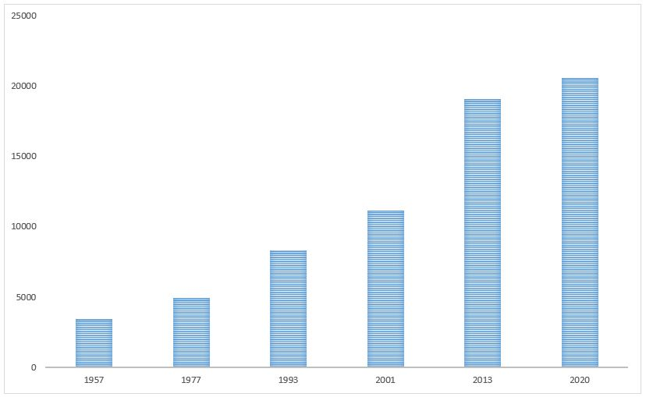

Energy Providers in Italy from 1957 to 2020
Regulatory Authority for Energy, Networks and the Environment.
Favors the development of a competitive energy market.
The number of energy providers in italy increases almost exponentially through the years.
Source:
https://www.arera.it/ModuliDinamiciPortale/reportistica/compilaRicerca

Slide 4
Probems
Prediction
Satisfaction
How to know in advance if a client is about to churn ?
What action to take to increase customer satisfaction ?
Retention
Lost of money
What to do to reverse the churn process ?
Retain clients and prevent the lost of money.

Slide 5

Solution
Usage of Data Science techniques to build models able to predict if a client is about to churn.

Slide 6







The Process
1
3
5
Data Collection: From company’s areas to Data Lake
Results: Gathering all the results
Data
Preprocessing: Format the data for modeling
2
4
6
Feature Creation: Aggregate collected data and create features
Modeling: Building predictive models
Analysis: Selecting
the best model

Slide 7

01
Data Collection
From company’s areas to Data Lake

Slide 8





Data Collection
AREAS
Sources
Billing
Pricing
ETL
Billing
Pricing
CRM
Marketing
CRM
Marketing
Multiple ETL processes created to pull relevant data from different company's areas and load it into a claudera cluster (Data Lake)

Slide 9
02
Feature Creation
Aggregate collected data and create features

Slide 10
Feature Creation
Initial dates t0’s were chosen being the first day of the month (15 dates, from 01 January 2019 up to 01 March 2020);
At each date t0, a picture of the data was taken by computing some customer related metrics that were thought to be related to the churn phenomenon (Number of inbound calls during the last month, If the client payed late in the last month, etc.) 767 features were generated;
Billing
Pricing
Feature creation
CRM
Marketing
Dataset
767 features

Slide 11
Feature Creation - clustering
766 features
766 features
MICRO
SMALL-MEDIUM
Target
Target
1
1
0
.
.
.
0
1
1
1
0
.
.
.
0
1
20 223 914 observations
5 264 625 observations
As required by the company, the data set has been divided in two distinct groups based on their sizes.
The target variable is a Boolean indicating weather or not the corresponding client churned two months after t0.

Slide 12
03
Data Preprocessing
Format the data for modeling

Slide 13
Data Preprocessing
1
Missing data
Imputation by neutral value, by new value
2
Categorical features
One-hot, Boolean, Ordinal, Embeddings
3
Imbalanced data
Undersampling, Oversampling
4
Feature selection
Unique, Missing proportion, Importance, Correlation, RFE
5
Train-Test split
80% vs 20%

Slide 14


Data Preprocessing – Missing Data
111 features with missing values.
Missing data caused by software (ETL) bugs. Imputed by a neutral value.
e.g. For the feature “nation of birth”, missing values were imputed by “other”.
Missing data when feature were not applicable. Imputed by a new value.
e.g. For the feature “number of days since last inbound contact”, missing values were imputed by “-1”.

Slide 15
Data Preprocessing – Categorical features
Boolean encoding
Ordinal encoding
3 features with boolean properties
9 features with a possibility to naturally order their different values
03
04
One-hot encoding
Embeddings
12 features with small amount of distinct values
02
15 features. This method was borrowed from NLP.
Categorical features encoding
01

Slide 16
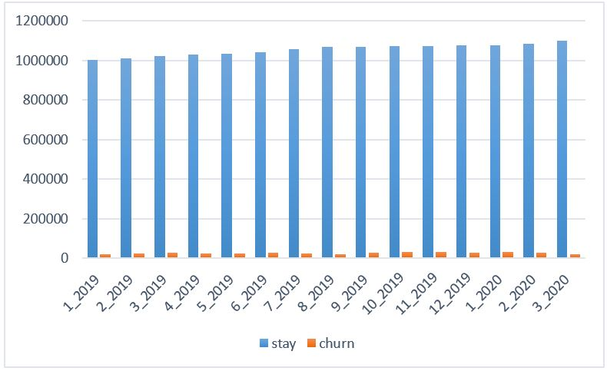
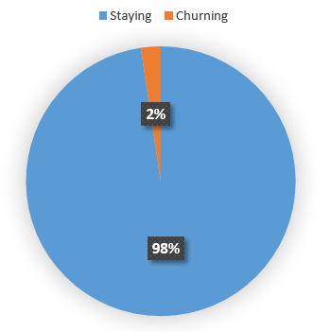
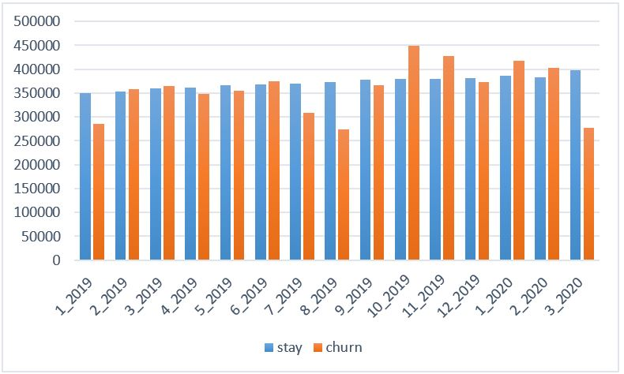
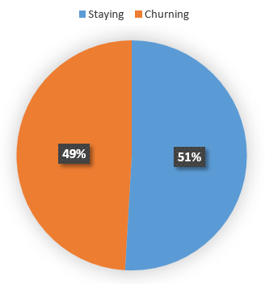
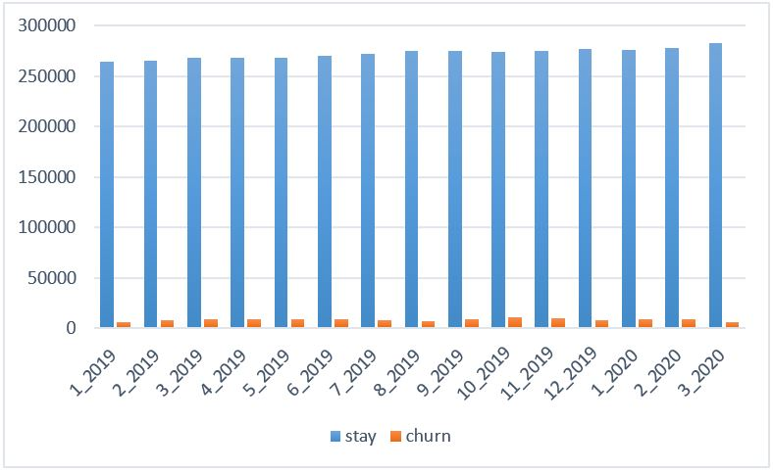
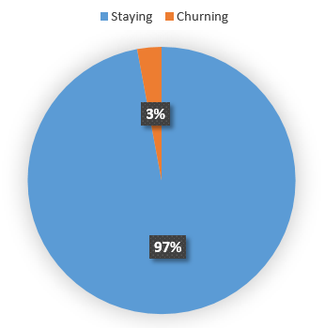
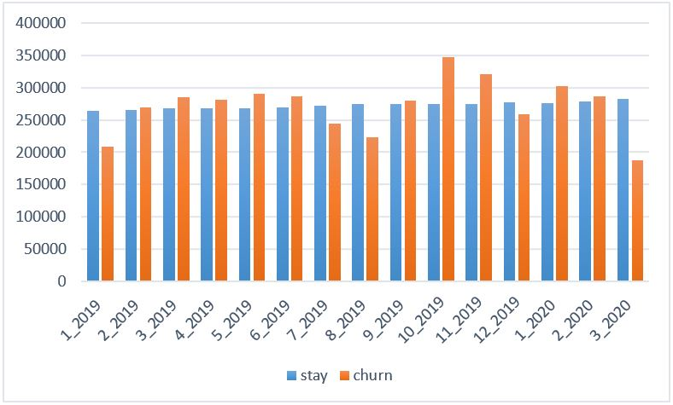
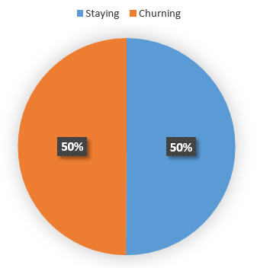
Data Preprocessing – Imbalanced data
Micro
Small-
Medium
Undersampling (stay) + Oversampling (churn)

Slide 17
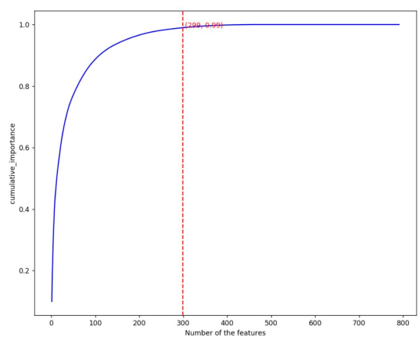
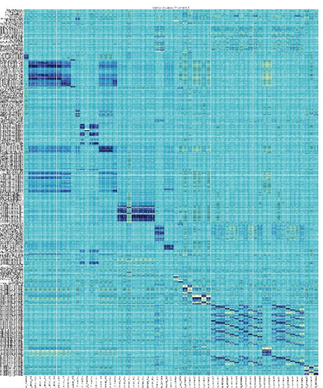



Data Preprocessing – Feature selection
Importance selector
Features removed based on cumulative feature importance of GBT model. (491 micro; 459 small-medium)
Missing selector
Features having a missing percentage higher 60% have been removed. (14 micro; 12 small-medium)
Correlation selector
Highly correlated features (Pearson > 0.9) identified and removed. (63 micro; 81 small-medium)
Unique selector
RFE
Columns having only one unique value have been removed. (65 micro; 68 small-medium)
Fits a model and removes the weakest feature (or features) until the specified number of features is reached. (49 micro; 55 small-medium)

Slide 18
04
Modeling
Building predictive models

Slide 19
Modeling
Random forest classifier
Logistic regression
XGBoost
Decision tree classifier
Gradient-boosted tree classifier

Slide 20
05
Results
Gathering all the results

Slide 21
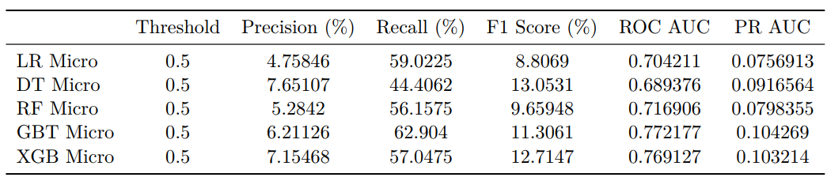
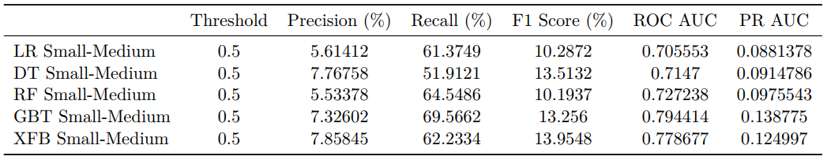
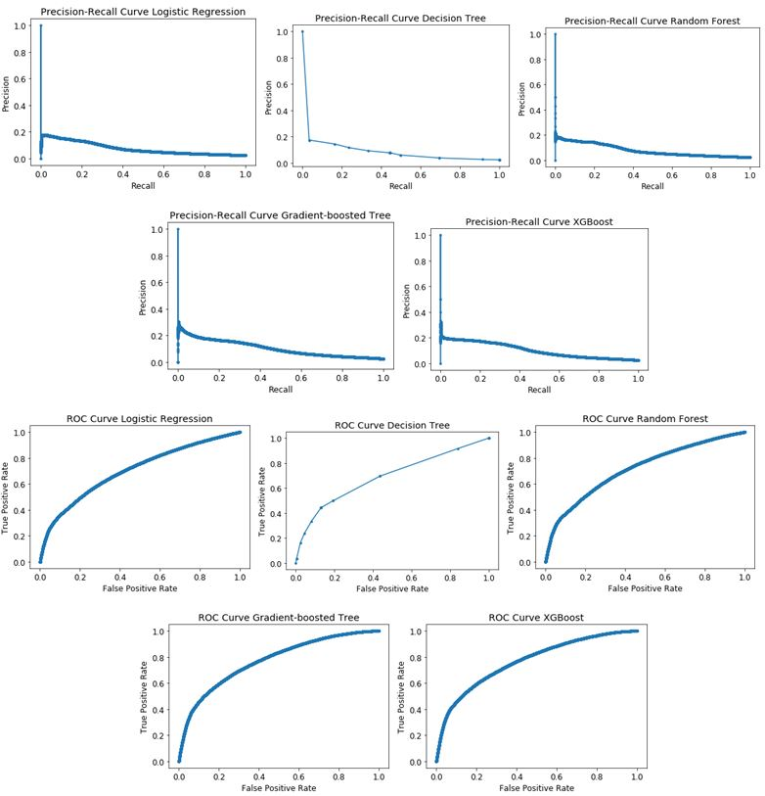
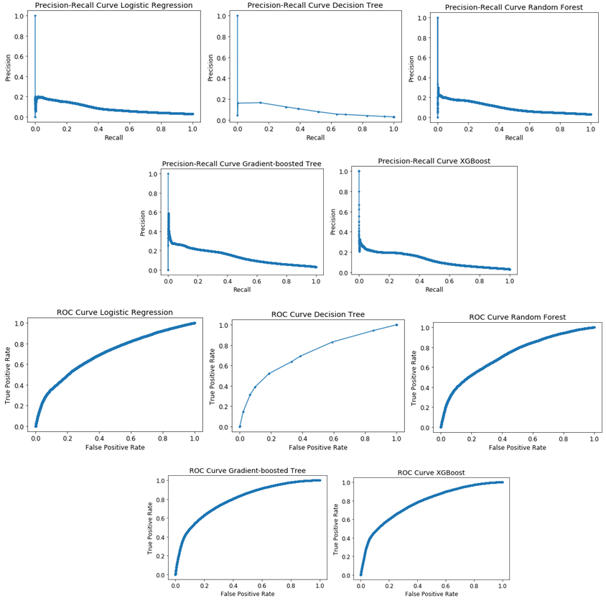
Results
Micro
Small-Medium

Slide 22
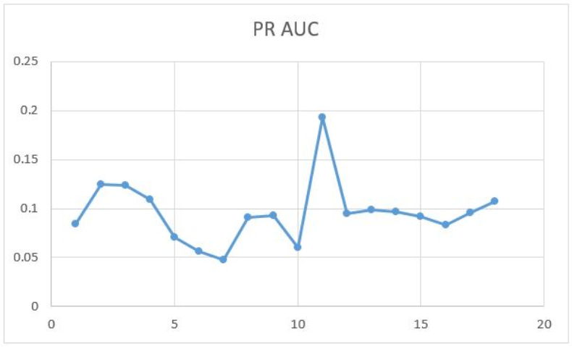
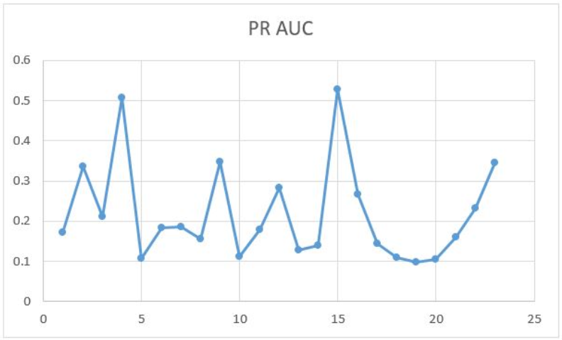
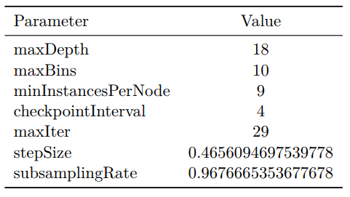
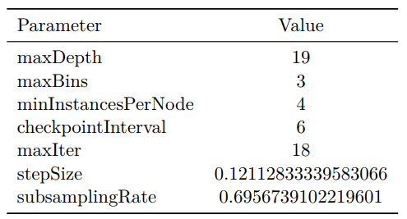
Results – Random search (GBT)
Micro
Small-Medium

Slide 23
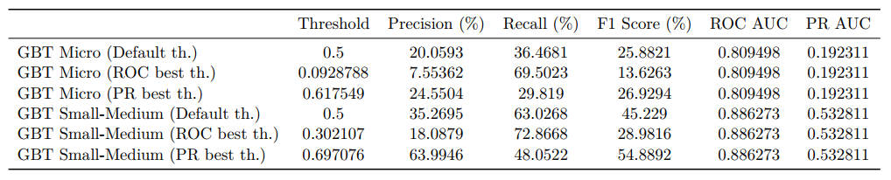
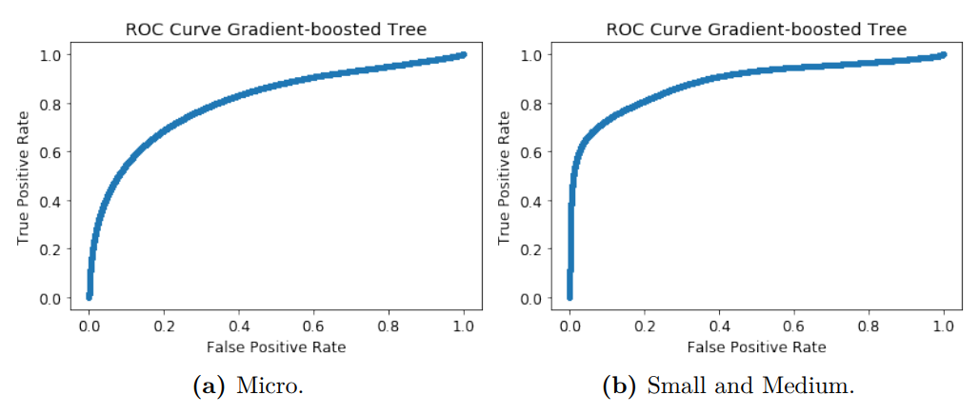
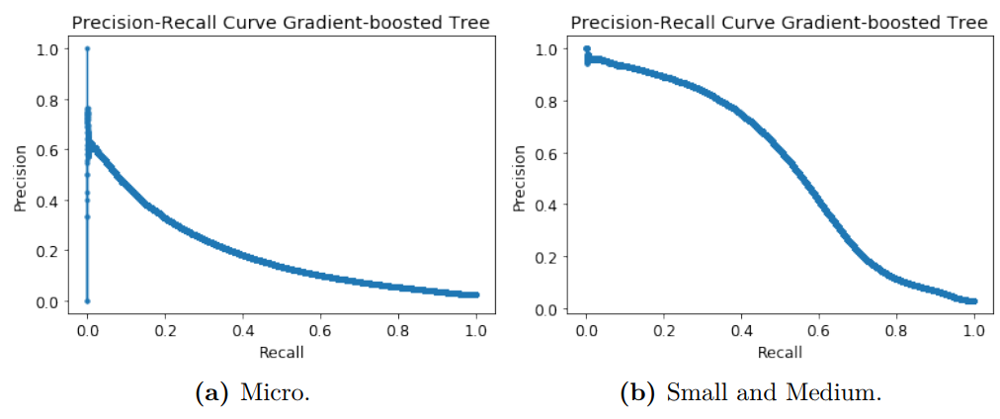
Results – Final results with optimal threshold

Slide 24

Conclusion
This study showed that machine learning is a good tool for predicting customer churn in energy industry
To further improve the results that we achieved, research can be performed in the area of NLP to analyze clients emotions that can be closely related to the churn phenomenon
Furthermore to better identify the right action to be taken in order to retain a client, the reason why the client is churning could be very helpful. Analyzing those reasons could be an excellent subject for a future research.

Slide 25

Thanks!
Do you have any questions?
vigerdurand@yahoo.fr

Slide 26
06
Analysis – Chuner profile
Further analysis on the churning profile

Slide 27











Micro
Small
Medium
Market: LIBERO
Service type: RISTORAZIONE
Consumption: 4<=kW<12
Seniority: < 36 mesi (0-12, 12-24, 24 - 36)
Market: LIBERO
Service type: RISTORAZIONE, Riparazione manutenzione machine, Sport intrattenimento e divertimento, Stampa e riproduzione supporti digitali, Commercio all’ingrosso e al dettaglio e riparazione di auto, alter attività di servizi per la persona
Consumption: 12<=kW<25
Seniority: < 36 mesi (0-12, 12-24, 24 - 36)
Risky region: Veneto, Emilia Romagna, Liguria, Piemonte
Risky province: Torino, Venezia, Caserta, Latina, Forli’ Cesena, Asti, La Spezia, Pordenone, Ferrara, Prato
Risky geographical areas: Nord Est e Nord Ovest
Risky region: Veneto, Emilia Romagna, Liguria, Piemonte, Toscana
Risky province: Torino, Bari, Venezia, Verona, Campobasso
Risky geographical areas: Nord Est
GIUSTAXTE IMPRESA
ENERGIA FLESSIBILE
GIUSTAXTE GAS IMPRESA
GIUSTAXTE BIORARIA IMPRESA
SOLUZIONE ENERGIA STAGIONE
GIUSTAXTE IMPRESA
SEMPRE CON TE IMPRESA
GIUSTAXTE GAS IMPRESA
GIUSTAXTE BIORARIA IMPRESA
Acquisition channel: Agenzia, AGCOR
Reason for activation: Switch Attivo
Acquisition channel : Agenzia, AGCOR
Reason for activation : Switch Attivo

