Slide 1
Lab: FCDS
Ruochun Tzeng

Slide 2
Environment
OpenMP fork-join framework
Techniques
  3-SAT
    Data parallelism on
      testing all possible combinations
  Bucketsort
    Data parallelism on
      putting string to buckets
      sorting buckets
    Fine-grained lock
  Unbounded knapsack Problem
    Fine-grained lock

Slide 3
3-SAT
Sequential version
  Calculate all possible combination
Concurrent version
  Parallel the sequential program
Expected speedup
  At most linear speedup

Slide 4
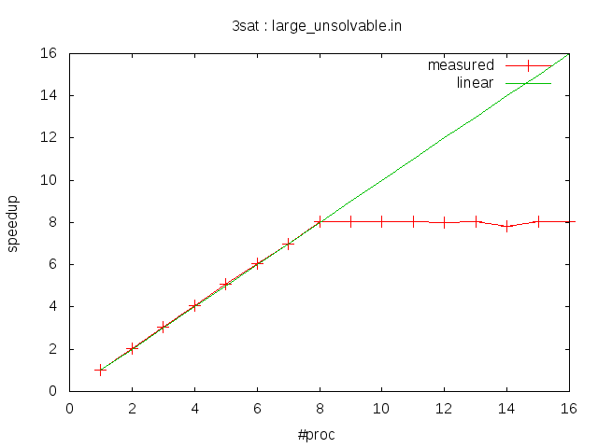

Slide 5
Bucketsort (1/2)
Sequential version
  Put strings to bucket
  Sort each bucket
Concurrent version
  Each thread has its own 94 buckets
    put strings to its local buckets
    sort buckets, less items to sort
  Merge to 94 global buckets
    Problem: concatenation on same bucket
    Approach: each thread start from different buckets
Expected linear-speedup

Slide 6
Bucketsort (2/2)
Superlinear-speedup
Measured
  Heavy I/O task
  Runtime environment changed!
    Cache hit rate increases
    Average page fault on each processor is reduced
#proc input size = 20000*94 50000*94
  2x 4x 10x
  … … ...
  16x 91x 307x
Against Amdahl's Law?

Slide 7
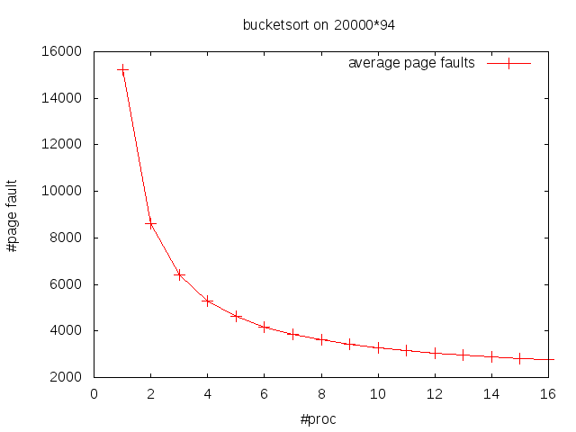
Average page fault decreases..

Slide 8
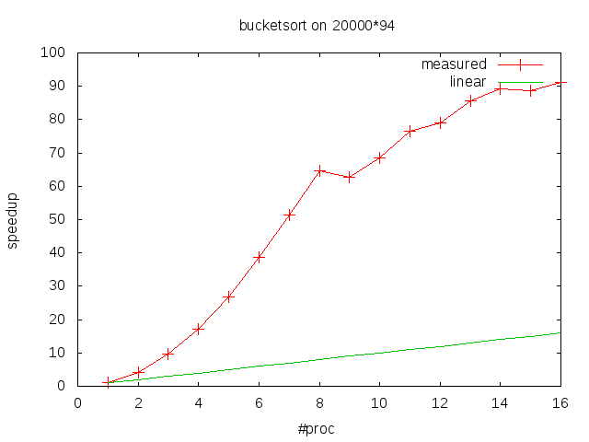
Superlinear-speedup

Slide 9
Knapsack Problem (1/3)
Goal
Dynamic programming
  Identify subproblem
  Find the largest value with capacity M
dp[x]: largest value using x capacity
    now at x capacity
    All case of item i
    wasn't taken
largest value using x capacity
=> dp[x]
    was taken
largest value using (x-weight[i]) capacity + value[i]
=> dp[x-weight[i]] + value[i]

Slide 10
Knapsack Problem (2/3)
      Find a nice order to fill-out dp table
  for(int i=0;i<n;i++)
    for(int j=weight[i];j<=M;j++)
      dp[j] = max(dp[j], dp[j-weight[i]+value[i])
Question
  How could I parallelize it?
What's the necessary condition for dp[x] to be correct?
  dp[x] = max(dp[x], dp[x-weight[i]]+value[i])
  => as long as
  dp[x-weight[i]] is updated with item i

Slide 11
Knapsack Problem (3/3)
What if dp[x-weight[i]] is updated by other item j?
  This would only lead us even quicker to the final answer
Parallel between items, sequential on each item
Fine-grained lock to update dp[x]
dp 1 2 3 4 … x-weight[i] … x ...
updated by item i
updated by item j
Eventually, each dp element must be update by all items
Expected speedup – at most to linear-speedup

Slide 12
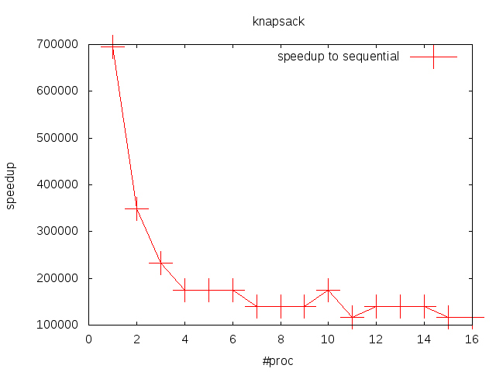
large.in is too small to see
the scalability points

Slide 13
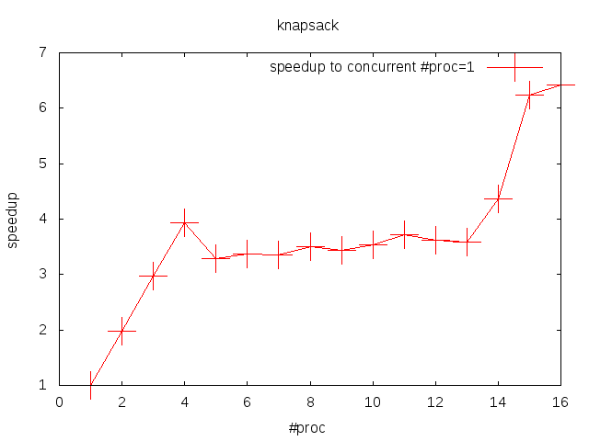
N=1024, M=10**6
Linear-speedup

