Slide 1
Lab: FCDS
Ruochun Tzeng

Slide 2
Environment & Techniques
OpenMP fork-join framework
Techniques used in each tasks
  3-SAT
    Wait-free parallelization
  Bucketsort
    Wait-free sort
    Fine-grained lock
  Knapsack Problem
    Fine-grained lock

Slide 3
3-SAT
Sequential version
  Calculate all possible combination on #literals
Concurrent version
  Parallel the calculation on all combinations
Expected speedup
  Unsolvable inputs: to #proc
  Solvable inputs: at most to #proc
Measured speedup
  At most 8 on unsolvable inputs,
  on 32-core server, comparing to sequential version

Slide 4
Bucketsort (1/2)
Sequential version
  Put strings to bucket
  Sort each bucket
Concurrent version
  Each thread has its own 94 buckets
    put strings to its local buckets
    sort buckets, less items to sort
  Merge thread-local buckets to 94 global buckets
    Problem: concatenation on same bucket
    Approach: each thread start from different buckets
S = #string, P=#proc
  → O(S)
  → O(94*(2-1/S))
  → O(S/P)
  → O(94*(2-P/S))
  → O(S/P)

Slide 5
Bucketsort (2/2)
Expected speedup
  #proc
Measured speedup
  2x #proc get 10x speedup
  when input size = 50000*94
Against Amdahl's Law?
  Heavy I/O task
  Runtime environment changed!
    Cache hit rate increases
    Average page fault on each proc is reduced
Superlinear speedup

Slide 6
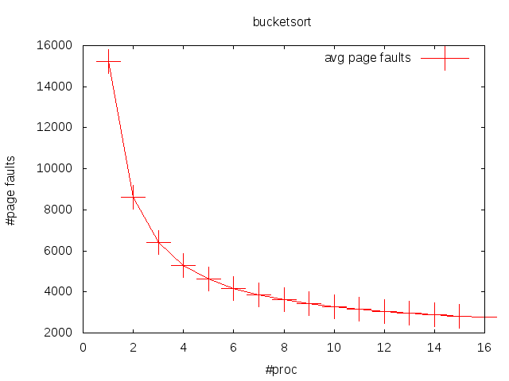
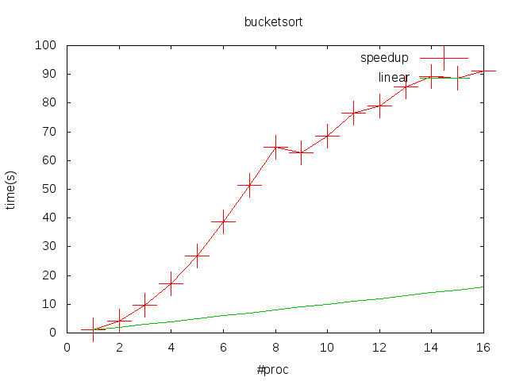
Bucketsort

Slide 7
Knapsack Problem (1/2)
Goal
  the largest value I could have with capacity M
Dynamic programming
  dp[x]: largest value I could have using capacity x
Identify subproblem, for each item i
  dp[x] = max(dp[x], dp[x-weight[i]]+value[i])
Find a nice order to fill out the table
  for(int i=0;i<n;i++)
    for(int j=weight[i];j<=M;j++)
      dp[j] = max(dp[j], dp[j-weight[i]]+value[i])
Question
  How could I parallelize it?

Slide 8
Knapsack Problem (2/2)
What's the necessary condition for dp[x] to be correct?
  dp[x] = max(dp[x], dp[x-weight[i]]+value[i])
  as long as dp[x-weight[i]] is correct
  i.e. dp[x-weight[i]] is updated with item i
What if dp[x-weight[i]] is updated by other item j?
  This would only lead us even quicker to the final answer
Parallel between items, sequential on each item
Fine-grained lock to update dp[x]

Slide 9
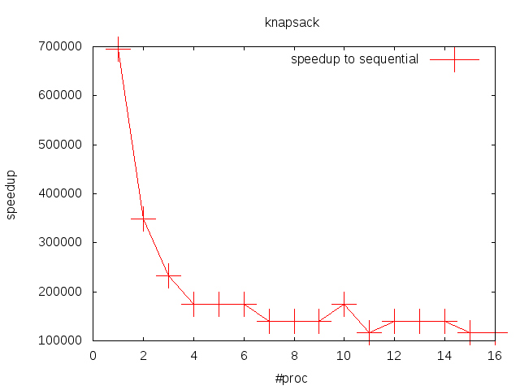
Knapsack Problem
large.in

Slide 10
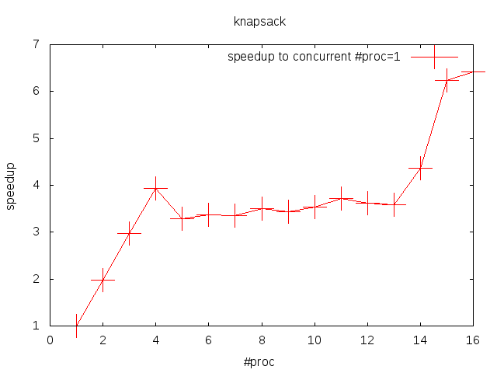
Knapsack Problem
N=1024, M=10**6

