Slide 1
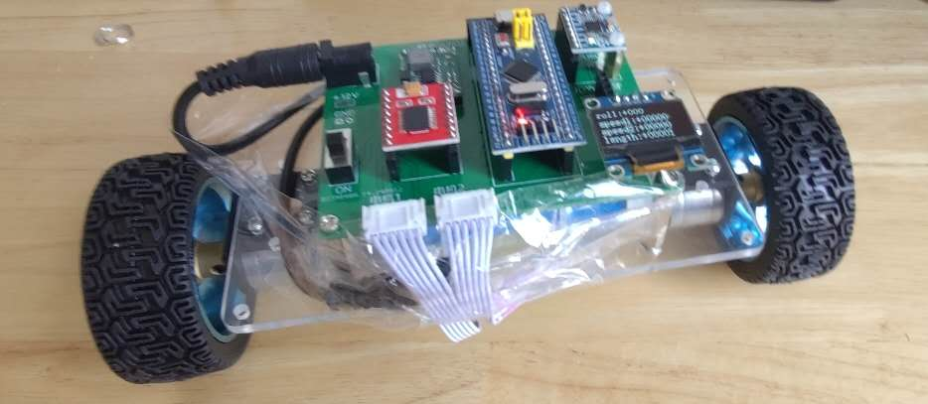
two-wheeled self-balancing ultrasonic obstacle-avoidance transport vehicle based on an Arduino microcontroller
Zihan Gao
I did before: Based on stm32, with no bluetooth wireless control and unbalanced, didn’t finish

Slide 2
Porblem&Aim
Problem:
A four-wheeled transport vehicle has a large size and requires a wide space for turning, making it unsuitable for uneven terrain.
In contrast, a two-wheeled transport vehicle is compact and highly maneuverable, capable of rotating in place and adapting to irregular ground surfaces.
Aim:
To place a cup of water on the vehicle and ensure that it can move flexibly without spilling the water, thereby demonstrating system stability.

Slide 3
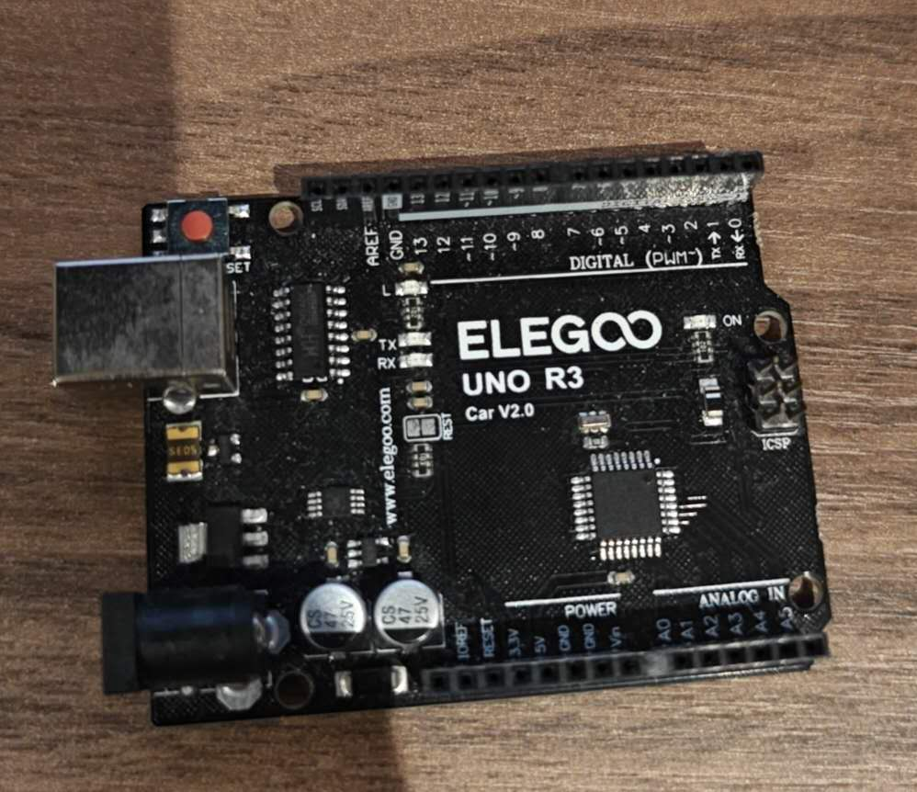
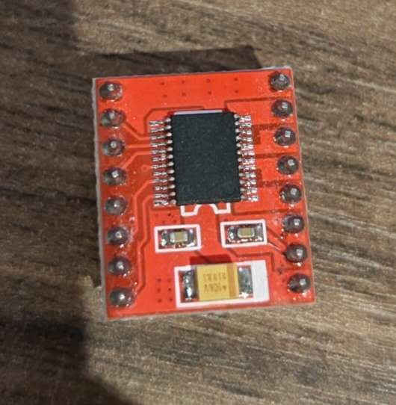
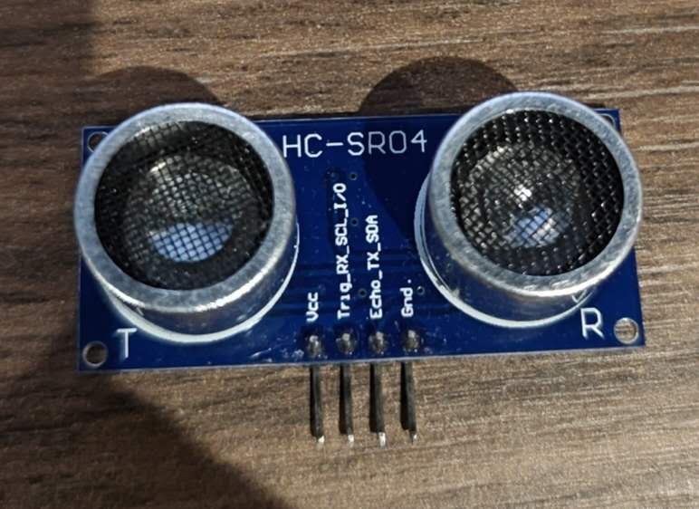
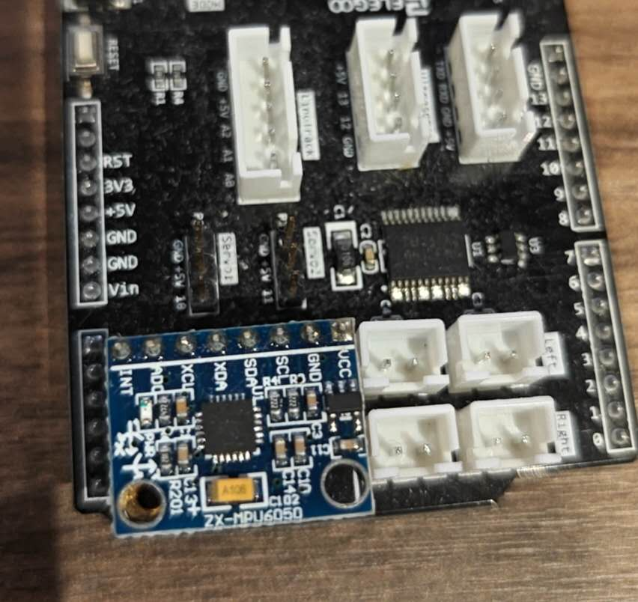
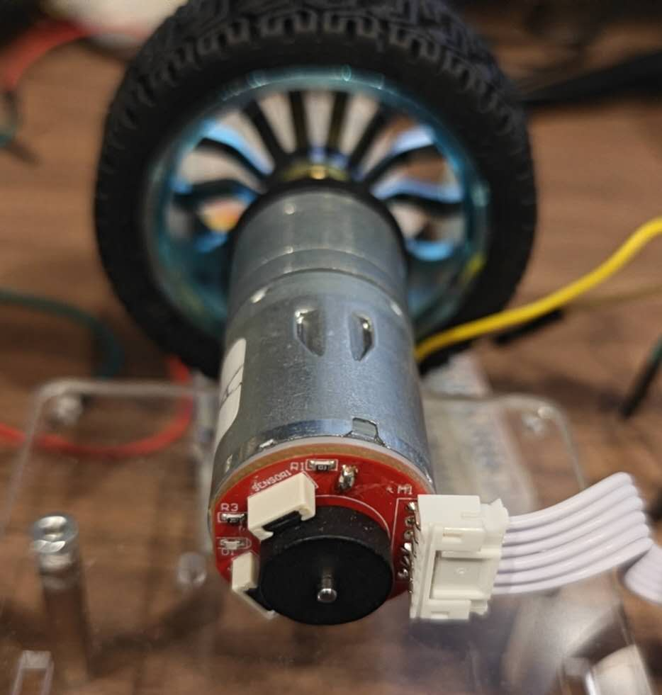
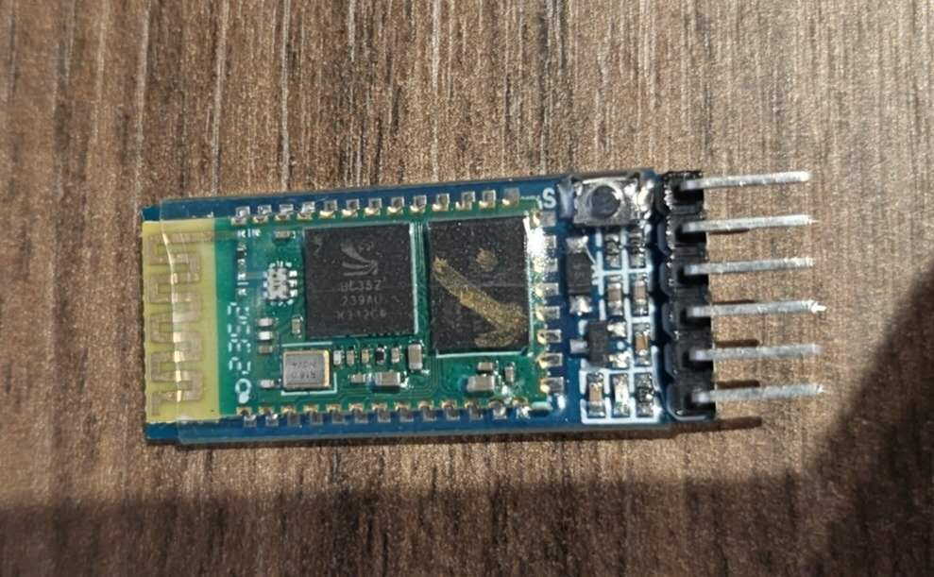
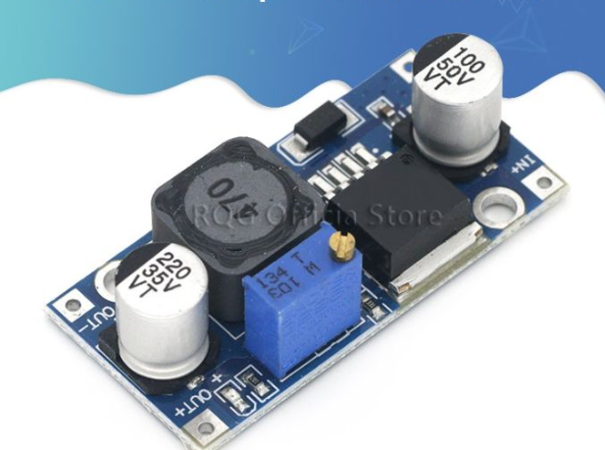
Hardware
Arduino UNO
TB6612 Motor Drive
HC-SRO4 ultrasonic
MPU6050 imu
HC-05 bluetooth
JGA25-370 Encoder Motor
LM2596S voltage decrease

Slide 4
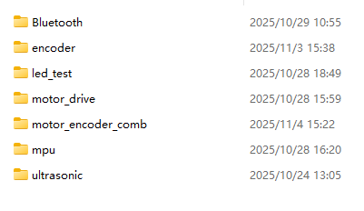
Coding
Plan:
Sensing Layer:
IMU for pitch angle estimation;
Ultrasonic sensor for obstacle detection.
Control Layer:
Arduino UNO
PID control algorithm
obstacle-avoidance logic
Execution Layer:
motor driver for differential wheel control
wireless controller for user interaction
So far:
Next step:
PID control algorism
Rotation algorism
obstacle avoidance
and keep adusting values...

Slide 5
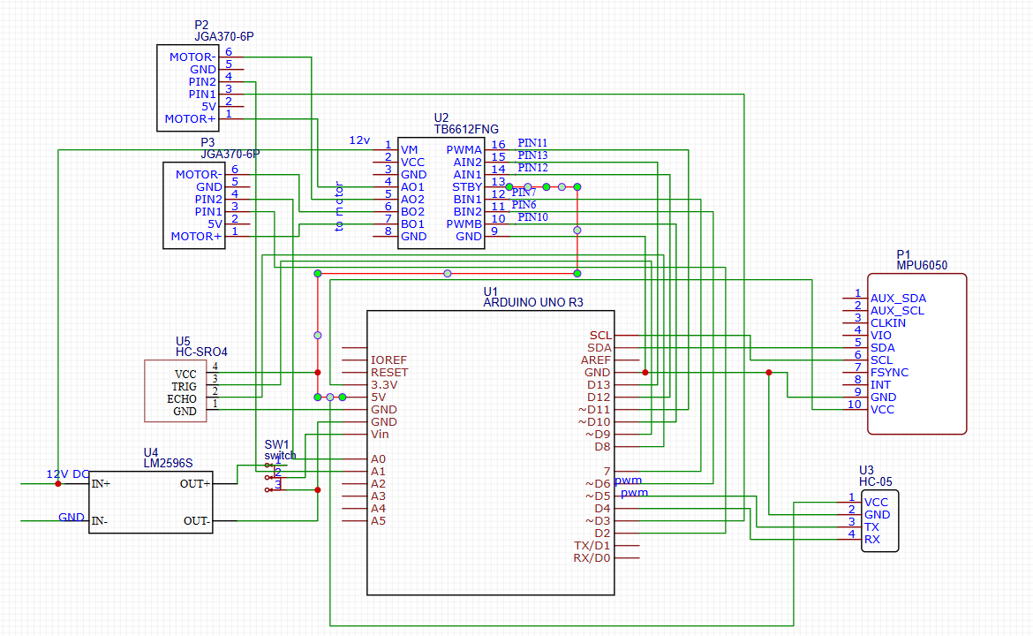
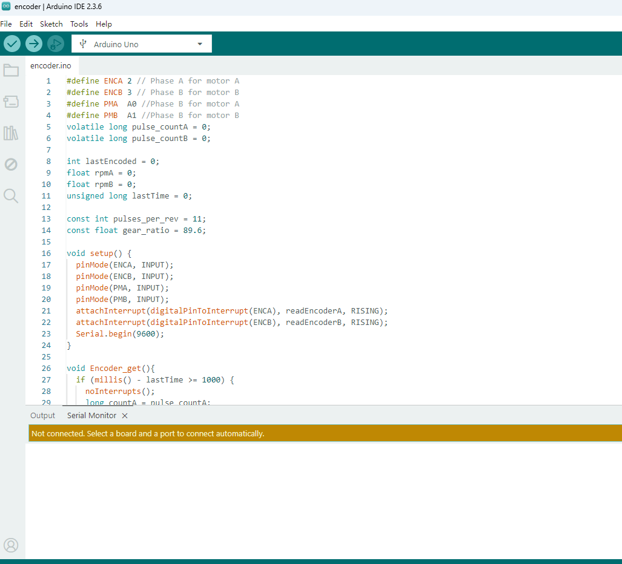
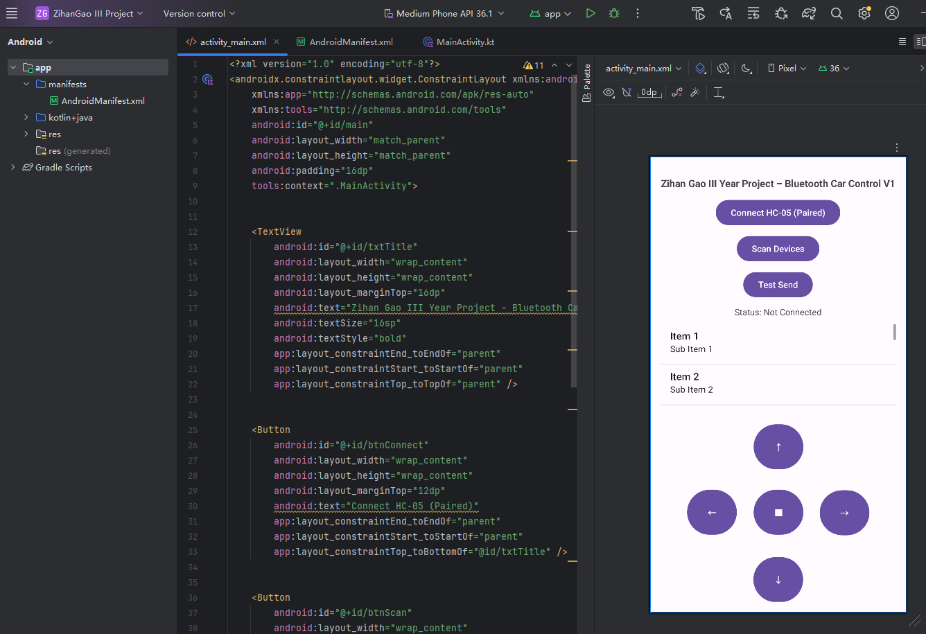
Software require
Arduino IDE
  Android Studio
PCB software
CAD software if needed

Slide 6
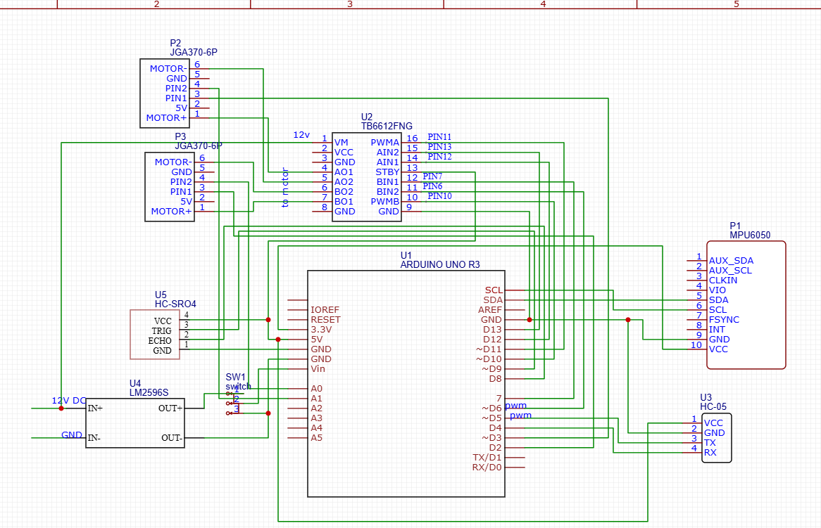
schematic

Slide 7
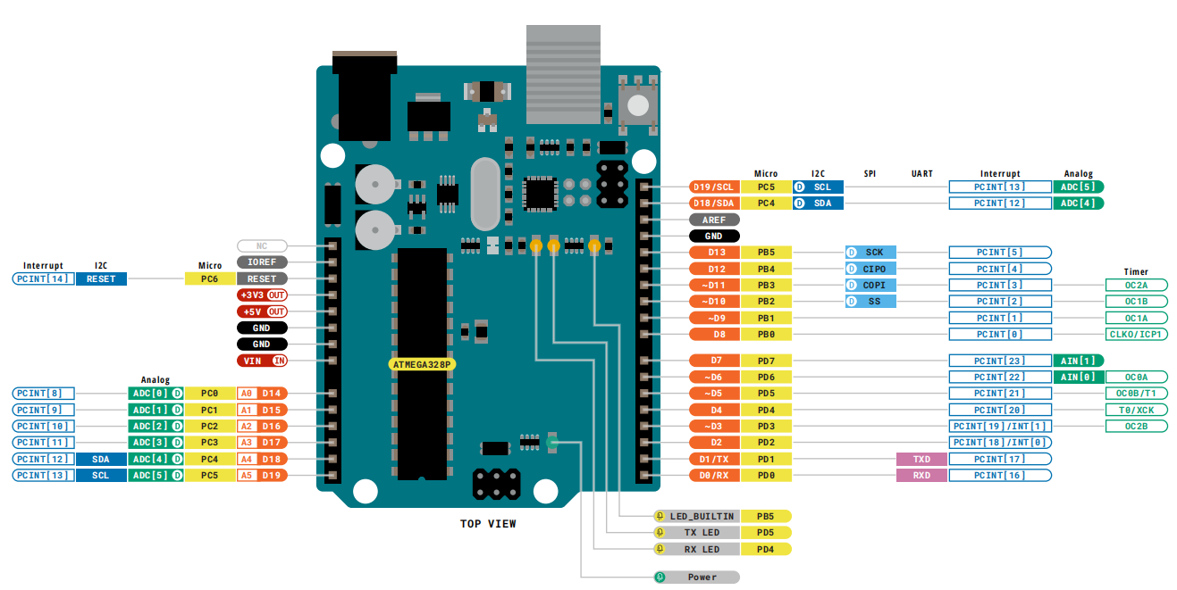
Pin arrangement
Digital PIN | Connection | Function
0 | NO Connection | TX/serial communication/upload
1 | NO Connection | RX/serial communication/upload
2 | Motor A PIN1 | INT[1], encoder interrupt trigger pin
3 | Motor B PIN1 | INT[0], encoder interrupt trigger pin
4 | HC-05 RX | Blue tooth RX pin
5 | HC-05TX | Blue tooth TX pin
6 | TB6612 BIN2 | Motor B direction control
7 | TB6612 BIN1 | Motor B direction control
8 | HC-SRO4 ECHO | ultrasonic echo
9 | HC-SRO4 TRIG | ultrasonic trigger
10 | TB6612 PWMB | PWM output, Motor B speed control
11 | TB6612 PWMA | PWM output, Motor A speed control
12 | TB6612 AIN1 | Motor A direction control
13 | TB6612 AIN2 | Motor A direction control
Analogue PIN
0 | Motor A PIN2 | Use as a digital pin, working with Digital PIN 2
1 | Motor B PIN2 | Use as a digital pin, working with Digital PIN 3
2 | NO Connection
3 | NO Connection
4 | NO Connection
5 | NO Connection
Other Pin
SCL | MPU6050 SCL
SDA | MPU6050 SDA
AREF | NO Connection
IOREF | NO Connection
RESET | NO Connection
3.3V | NO Connection
5V | VCC/TB6612 STBY
Vin | LM2596S OUT+
GND | GND

Slide 8
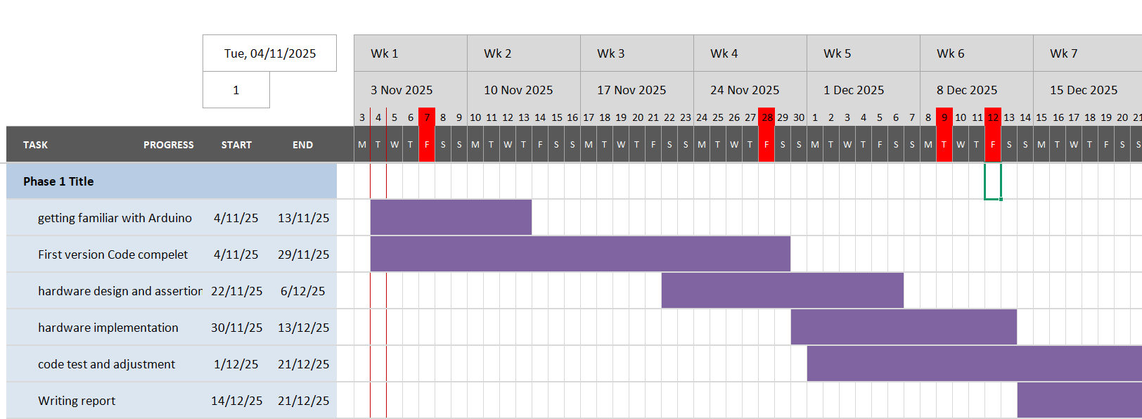
Gantt Chart

Slide 9
Future works
1. PID Control Optimization and Adaptive Tuning
2. Obstacle Avoidance& path planning(if have time)
3. Data Visualization(if have time)
4.Hardware Upgrade(Arduino uno may not enough)
5. Engineering and Application Expansion: The platform can be extended into a small-scale delivery or transport robot

