Slide 1

Rouyn-Noranda Welcomes You
Group2 -Information Architecture
Spring 2022
By: Vi-Anh Nguyen, Vi-Linh Nguyen

Slide 2

Table of Content
Project Overview 3
Objectives 4
Major Content Items 5
User Scenarios 6
Personas 7
Testing Process 9
Content Inventory 10
Card Sorts 11
Tree Testing 17
Wireframe 19
First Click Test 20
Site Map 22
Comparing Navigation 24
Retrospective 26
Contributions 27
Appendix 28

Slide 3

Project Overview
Rouyn-Noranda is a small town in Northern Quebec in the Abitibi-Témiscamingue region, with a population of over 42 000 people.
It's also where our uncle lives!
This project will look at the way information is organized for non-locals, who know less about the town, vs locals, who tend to know more. The audience the website targets is made unclear.

Slide 4
Objectives
Examine and Analyze current information architecture of site
Provide changes to convey meaning better to nonlocals for more efficient navigation
Validate changes

Slide 5
Major Content Items
Community Life & Leisure | What is it like to live in this town as a student? What about a full-time worker with a family? There are also several events held in town at various points of the year to get more involved.
Services for Citizens | Here are programs citizens can have access to in case of emergencies or some municipal work is needed.
Business & Economy | Mining and metallurgy are the driving economic industries of the area, but many smaller businesses can thrive too. Here are the resources and information needed for such ventures. There are resources for contractors who want to work with local businesses too.
Environment | This category contains programs and services related to the environment of the town, from how it deals with natural resources to how to incorporate more eco-friendly ways people can circulate across Rouyn-Noranda.
Transportation | Different methods of getting to the area via provincial highways, local highways or the Rouyn airport. The Rouyn airport is also useful for commercial travel. Information on public transport is also listed.
Local Government | This category contains more administrative services and programs citizens can engage or work with from city news to city hall matters.
Notes:
Major content is result of content inventory and testing

Slide 6
Scenarios
What would a nonlocal do on the site?
Why would nonlocal visit the site?
You found a town to have a new start in, not a huge metropolis, but not a tiny village with no economic prospects.
You are visiting rural Canada for the first time as a tourist.
You are looking for work in Rouyn-Noranda, a promising small town.

Slide 7

Persona 1
Ron just graduated from university but is having trouble finding work with the constant competition in bigger cities.
He loves the outdoors and goes hiking any time he could get back in college. Now that he's done with school, he wants to move to a smaller town to get away from the overwhelming chaos of metropolitan life.
A town life Rouyn-Noranda provides all those needs while still having a good enough economic growth to ensure financial stability for Ron.

Slide 8

Persona 2
Janine wants an affordable vacation that will provide her with opportunities for outdoor activity and have enough historical background to satisfy some museum-going needs.
She's never visited rural Canada before (only the bigger cities) and Rouyn-Noranda's local events seemed like a fun way to get to know a quaint town full of history without breaking the bank too much.

Slide 9
Testing Process
Defined Scope
Defined Personas
Content Inventory
Card Sorts
Site Map Draft
Tree Test
Final SIte Map
round 1
Round 2
Wireframe Draft
Final Wireframe
First Click Testing

Slide 10
Content Inventory
Process
Our group proceeded to lay out the website's information architecture into a content inventory, using each component of the main navigation, there was a total of 113 content items.
Purpose
The inventory would help the group understand the main components of the website and evaluate a more efficient organizational scheme for the user.
What We learned
There were too many links in the website's main navigation.
Certain pages contained links that lead to other parts of the navigation.
The existing category names were unclear at what information they presented based on the user scenario possibilities.
The existing organization, made finding certain topics like "tourism" difficult.

Slide 11
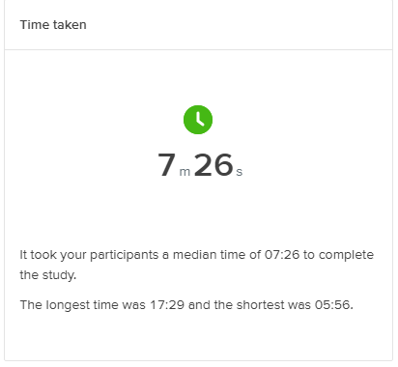
Card Sort 1
Open Sort
Number of Participants: 2, with 3 iterations
Number of Cards: 43
Number of Categories: 39
Where were there the most agreements?
Environment, Transporation, Community Life and Leisure
Where were there the lowest agreements?
These cards: Subsidy for Reusable Products, Property assessment, and Heritage
Government and municipal related cards had similar categories with different names.

Slide 12
What we learned
Naming conventions of some of the cards were vague, some did not convey the purpose enough.
Overlapping categories made classifying cards difficult in some cases. Some cards overlapped in topics. To some users, based on the post study question, they found that some cards could apply to multiple categories.
Some cards talked about topics that were a bit too specifically local, so it made the meaning more confusing to nonlocals. This went against the primary objective of the project

Slide 13
Changes Made
Some categories were combined like business related ones and economy related ones because the topics overlapped anyway.
Other cards were changed to something more general to make the items' levels more consistent. Some cards were combined or axed due to being too niche to nonlocals or inconsistent in levels.
Categories had to be renamed due to vague word choice like "culture" and "resources". This would ensure an easier time for user categorization.

Slide 14
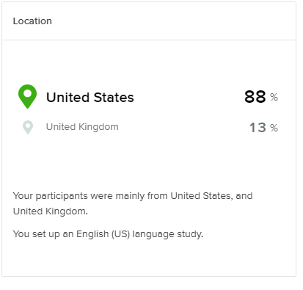
Card Sort 2
Number of Participants: 8 participants completed, 8 abandoned
Number of Cards: 42 cards
Number of Categories: 7 categories
Where were there the most agreements?
Community Life & Leisure
Local Government
Transportation
Where were there the lowest agreements?
These cards: Lodging, mining innovation zone, heritage
This category: Resources for Citizens

Slide 15
What We learned
Some cards still overlapped in which topic they related to most. We did not narrow down the cards enough from the first round of card sorts.
Cards using action words showed an inconsistent organizational scheme, so users seemed to have trouble in categorizing those. Some examples include "Settling in Rouyn-Noranda", and "Invest in Rouyn-Noranda".
Renaming Community Life & Culture to Community Life & Leisure seemed to have make categorization easier for users.
Card name changes from round 1 were still too familiar to locals (especially the cards placed in the "I don't know" category) like "Mining Innovation Zone".
Combining Business and Economy made this category with the biggest frequency in cards being put here.
Resources in a category name is too unclear, especially in the main navigation, so this category will need to be renamed while still conveying what the content is about.

Slide 16
Changes Made
We needed to narrow down some cards more because some still existed at different levels. Some standardization into more subcategories would help in drafting the tree testing so the amount of content would not overwhelm the user.
Here there was still an issue of vague wording in card names like "Cultural Programming" or "Land development" or "waste management". Users seemed to have trouble with these kinds of cards about specific town programs.
"Resources for Citizens" does not convey meaning enough to users, because some cards placed here were placed in "I don't know" by several other users.

Slide 17
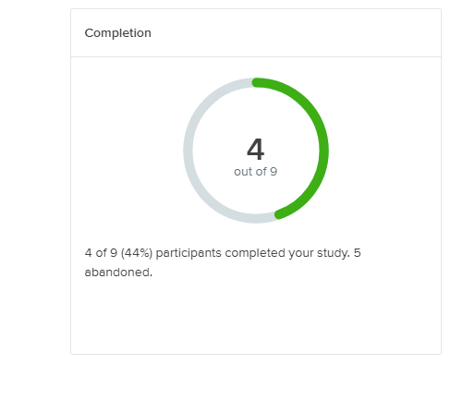
Tree testing
Tasks tested
You are visiting rural Canada for the first time. You're looking for something to do. Where would you look for that information?
You want to move to a small town, but it's a big step. How do you find ways to help the process?
You settled into Rouyn-Noranda, but you need to find work to pay the bills. Where would you find that information?

Slide 18
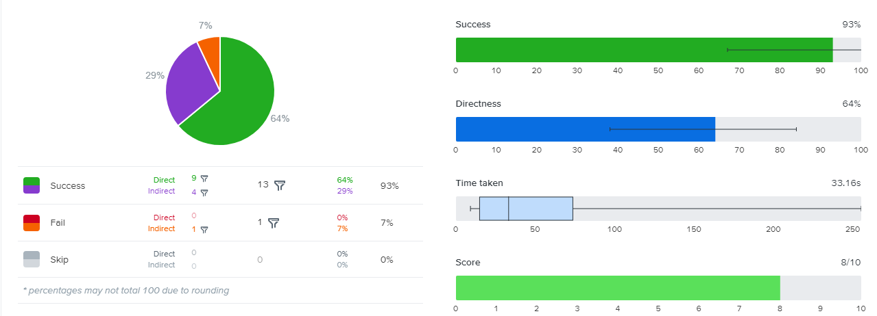
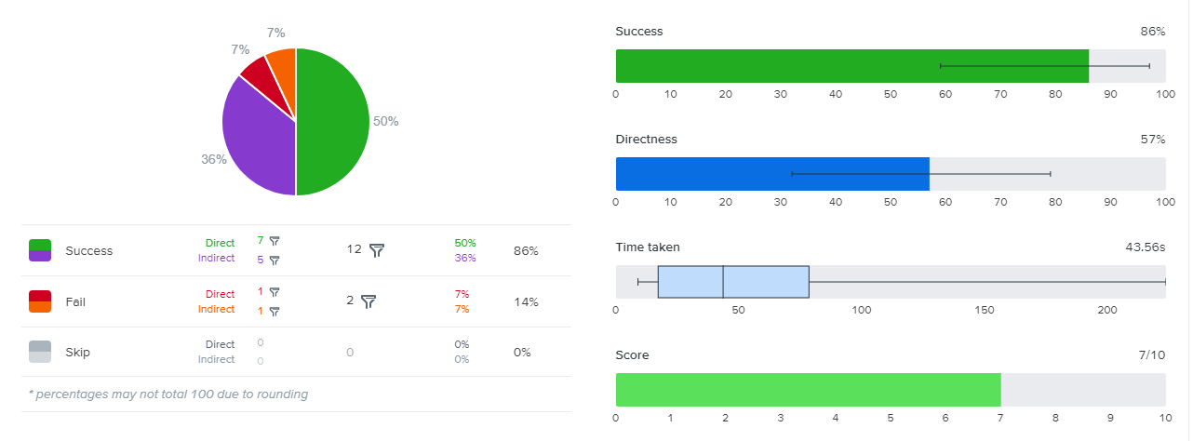
What we learned from tree testing
There was a higher percentage of users who had not heard of the town of Rouyn-Noranda.
What did people find easier?
The first task: Looking for something to do as a visitor
The task had several correct answers because of the broadness of their topics so users seemed to navigate through the tests easily.
Several pages could theoretically help answer one task after all.
What did people find challenging?
The second task: Looking for new residents' resources
Vague task
Several potential correct answers, but some more correct than others.

Slide 19
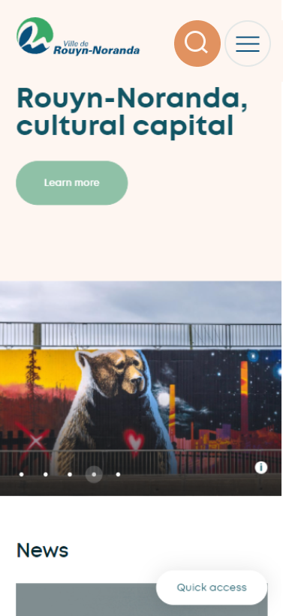
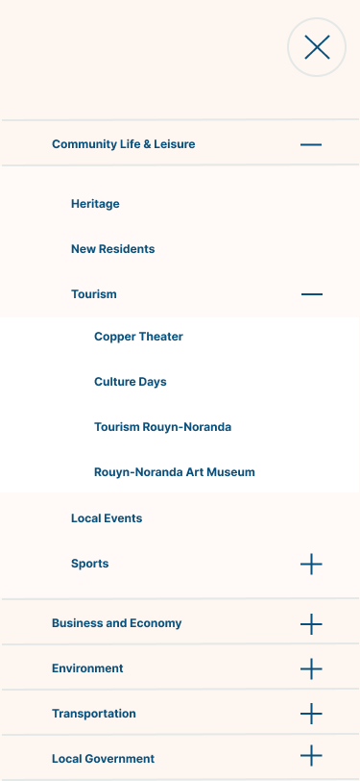
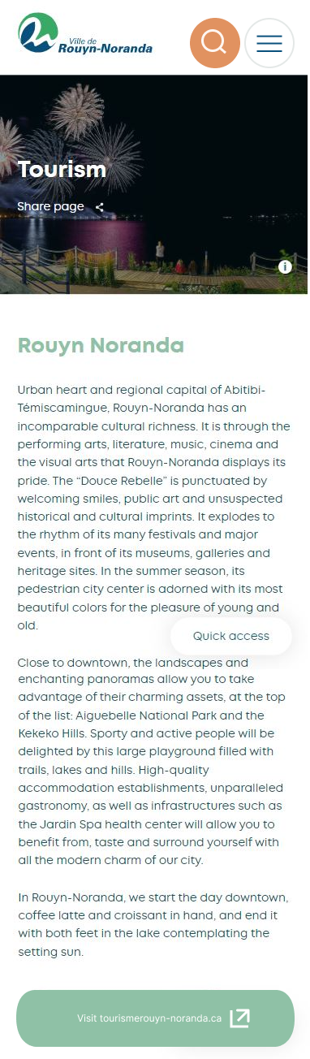
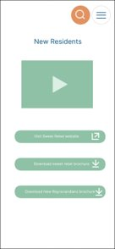
Wireframe
Task 1 : Looking for something to do in town
Task 2 : Looking for resources to help moving into town
Nonlocal users were tested during task -based test

Slide 20
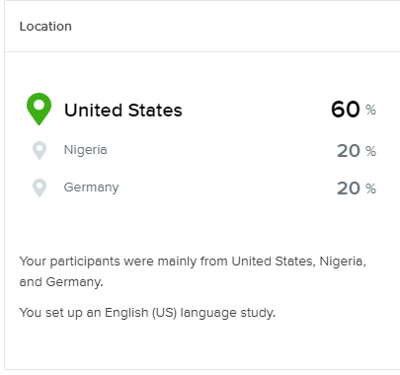
First click test
Number of Participants: 5, all completed the study
Questionnaire results: All participants who answered yes to having heard of Rouyn-Noranda have said they’ve visited the town.

Slide 21
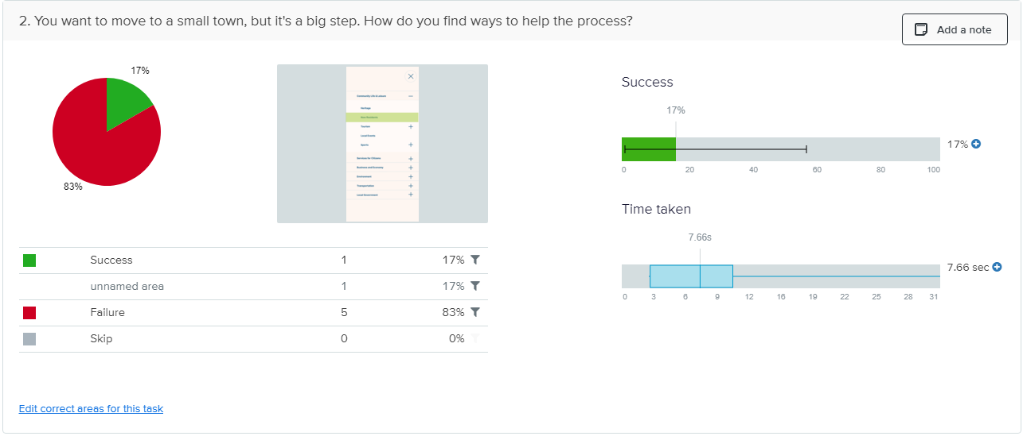
What we learned from First-Click Testing
In general, participants clicked where we expected, but mainly with the tasks that offer multiple options.
Task: Looking for something to do
Task: Finding a job in town
Task with large failure rate: Finding info to help for new residents or to move to town
Smaller correct area
Only one possible "correct" option
Vague task to user

Slide 22
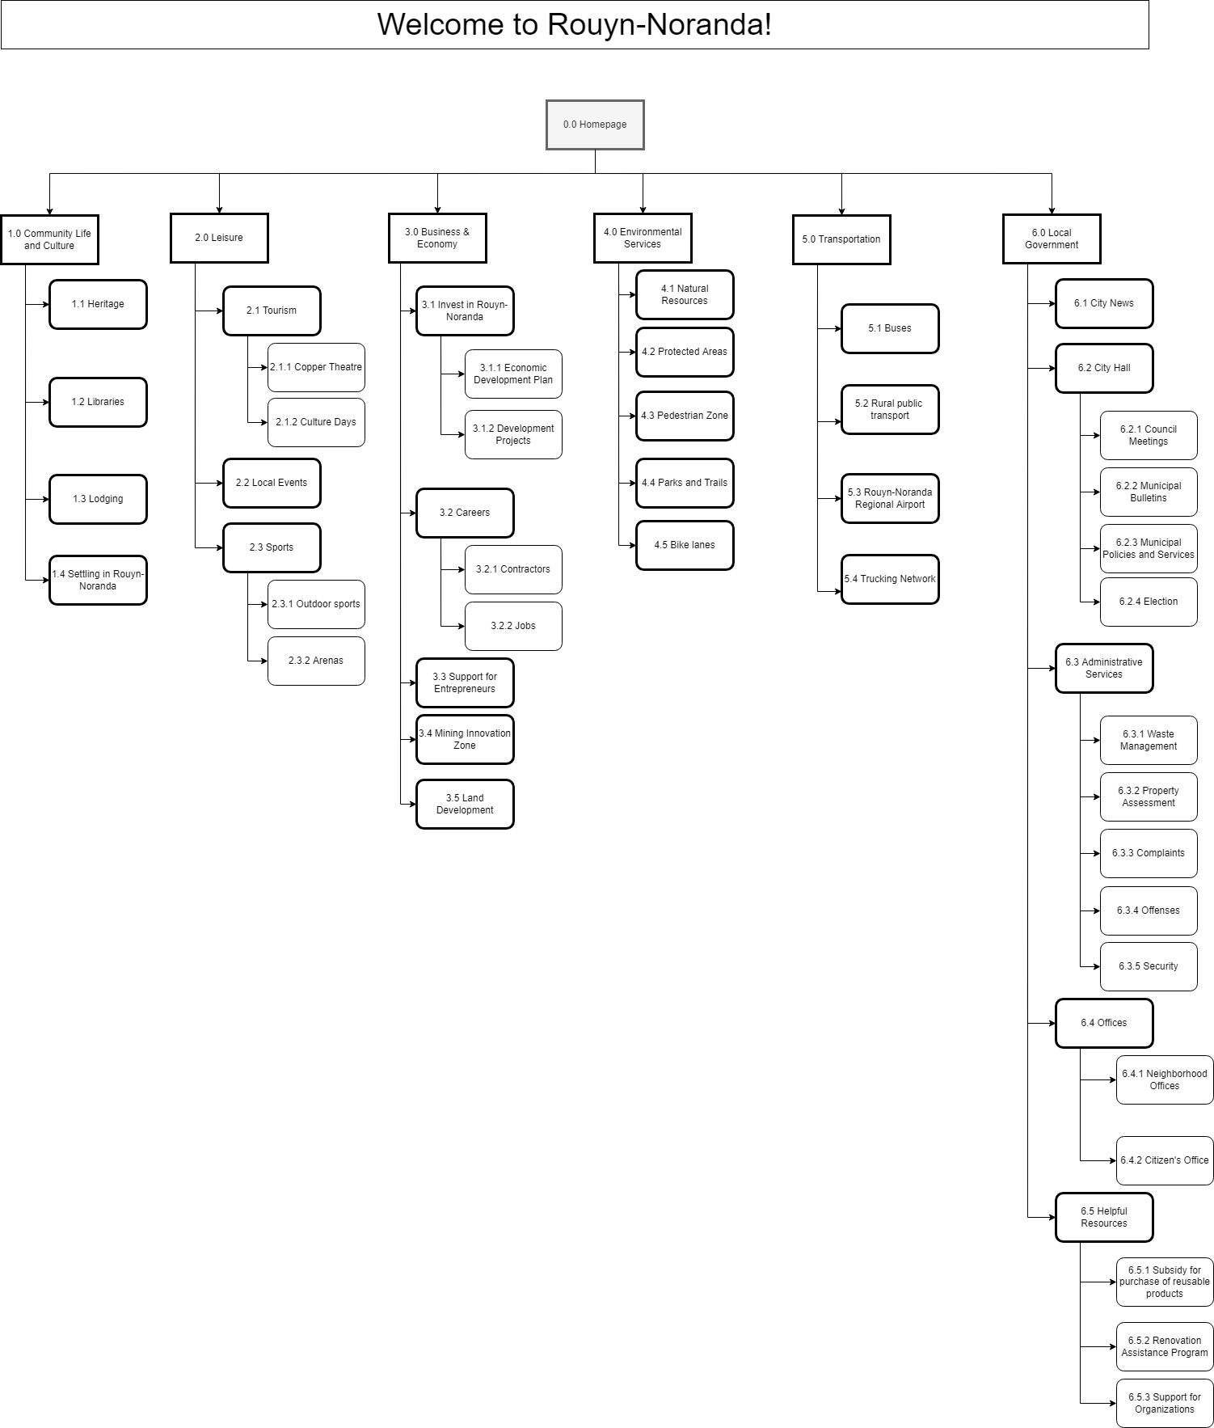
Site Map v1
Draft Version
The naming of the cards from the second card sort came over to this version of the site map.
This proposed site map helps funnel content into different levels of subcategories to narrow down certain topics.

Slide 23
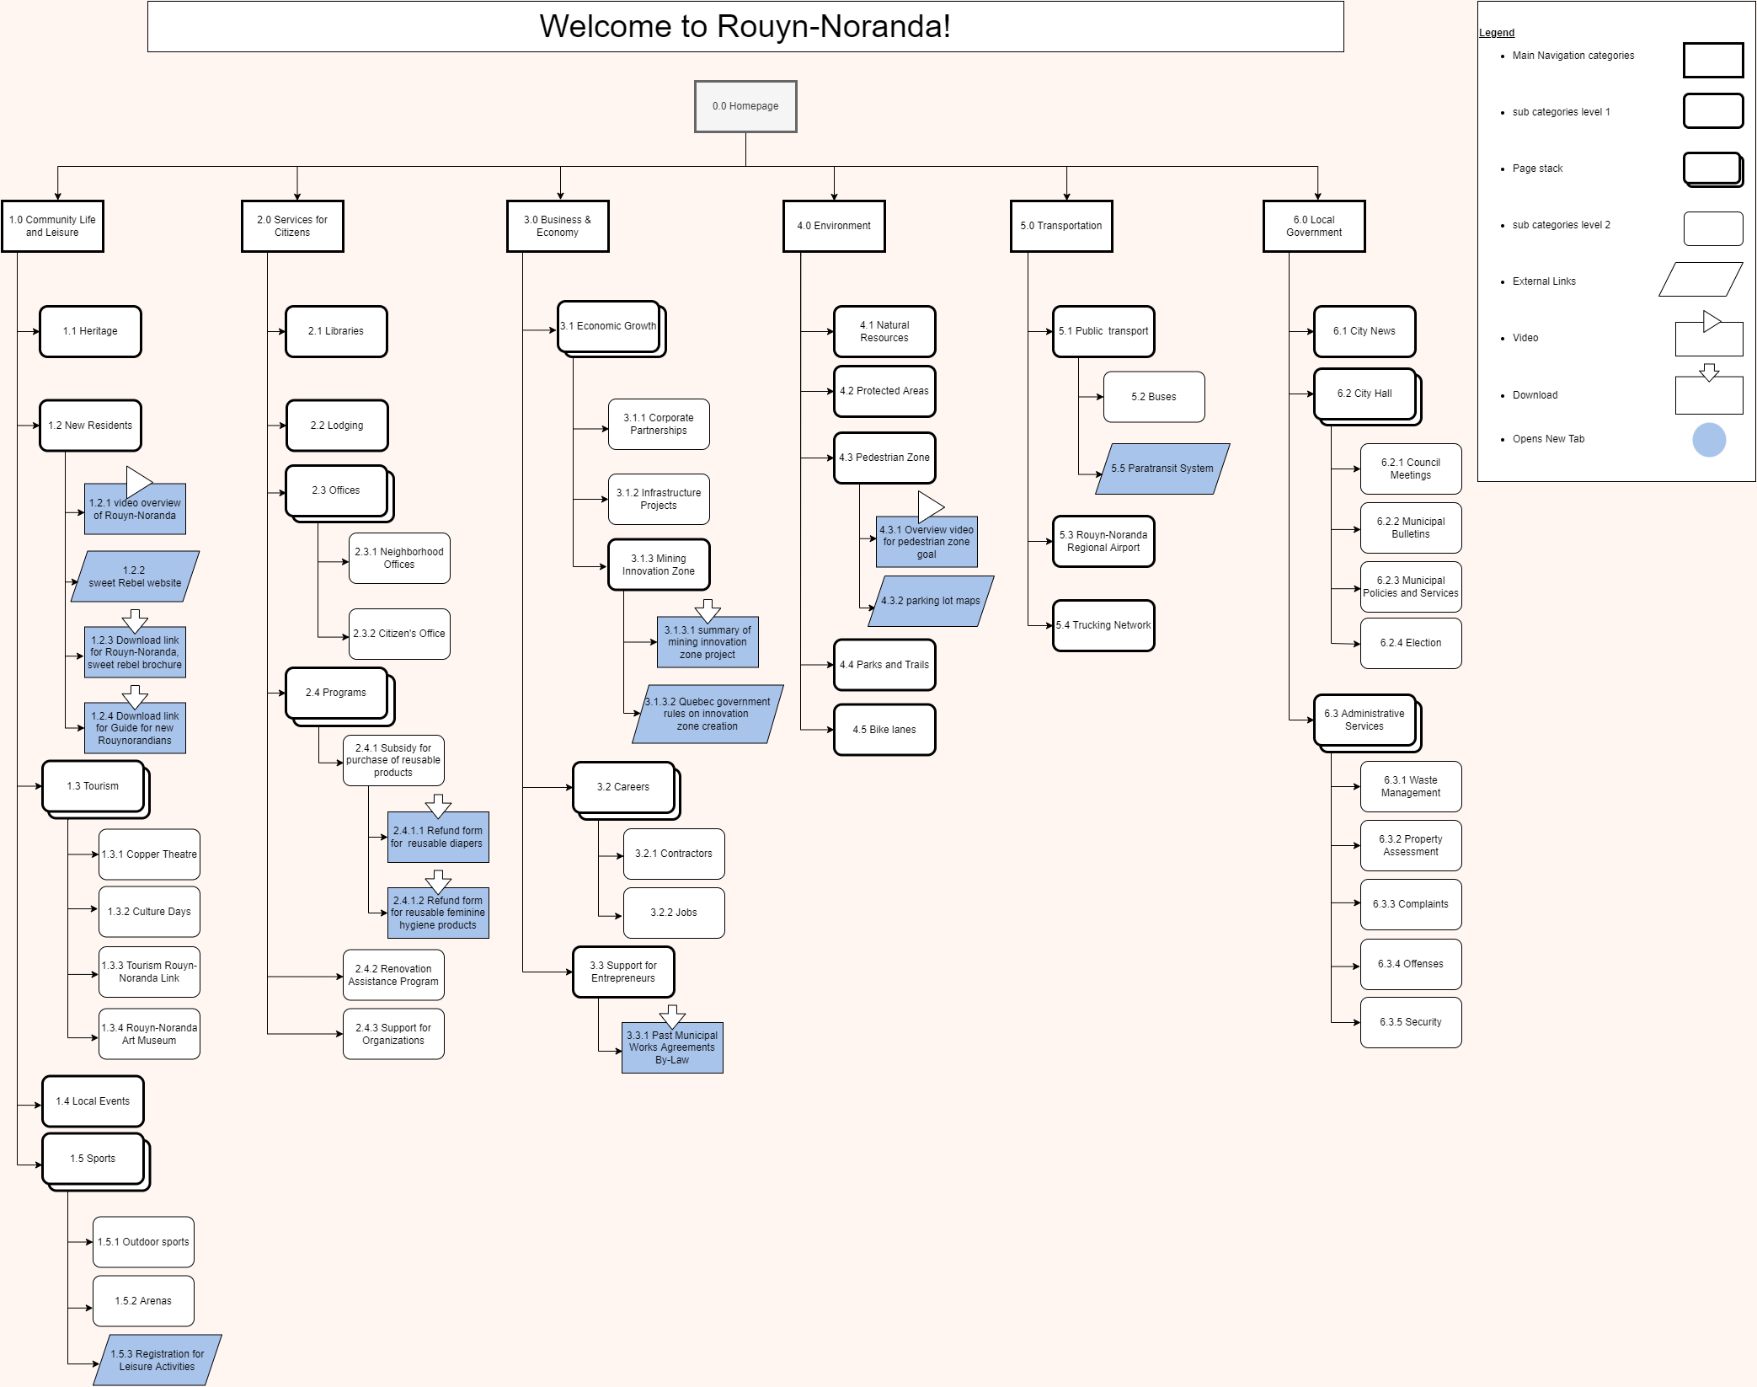
Site Map v2
Final version
Several categories had to be renamed. A big one was "Helpful Resources" had to be renamed to "Programs".
More content like brochures and external links were added to show the full extent of what exists on the website.

Slide 24
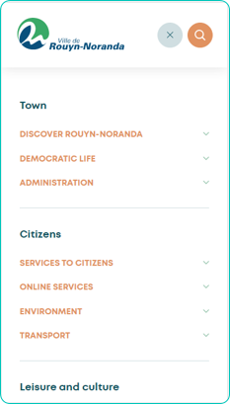
Comparing Navigations: Old
Existing
Too much information crammed into one screen when the user clicks on category in the main navigation's desktop format. In mobile, the information is funneled through several layers of drop-down menus.
Some specific pages don't appear to fit under their existing category from a user perspective.
A card next to the navigational categories isn't obvious as to what its purpose there is supposed to be (in the desktop version). It does not exist in mobile format

Slide 25
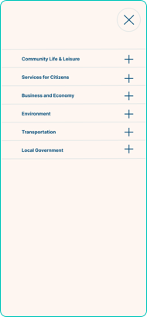
Comparing Navigations: New
New
The information is organized onto different levels to funnel through topics more efficiently.
The pages have been reorganized into topics that will logically fit better and convey more clearly to users. This will make finding more specific topics an easier experience for users.

Slide 26

Retrospective
What we did and learned
A good naming convention matters, which made designating card content meticulous and difficult. This proves difficult when the group members charged with this project speak more than one language.
Our group members both had trouble with wording when it came to designing tasks, so the margin of error in the first click test (for example) may have been vague in one task.
With nearly 11 weeks for the project, it was hard to see if the data we were getting was enough.
What we would have changed
Spend more time naming the cards from the beginning would have prevented some disagreements during the user testing ( and save us work).
Have another group member proofread more to make sure meaning is as clear as possible, due to some potential language troubles on our part.
Plan out timeframe for testing more effectively, to make sure the user testing has a fair sample size while getting data that helps solve the objective problem.

Slide 27


Contributions
Vi-Linh Nguyen
Drafted Project Proposal
Drafted/Edited Sitemap
Drafted wireframe screens
Participated in content inventory
Collaborated and edited key task flows
Annotated final wireframes
Drafted Presentation content
Vi-Anh Nguyen
Drafted Project Proposal
Drafted/Edited Sitemap
Drafted wireframe connections
Designed final wireframes
Participated in Content Inventory
Collaborated and edited key task flows
Edited Presentation content

Slide 28

Appendix
Content Inventory 29
Card Sort 1 data 32
Card Sort 2 data 34
Full Site map 52
Full wireframe 53
Tree testing data 42
Wireframe Screens & annotations 55
First Click Testing Data 45

Slide 29
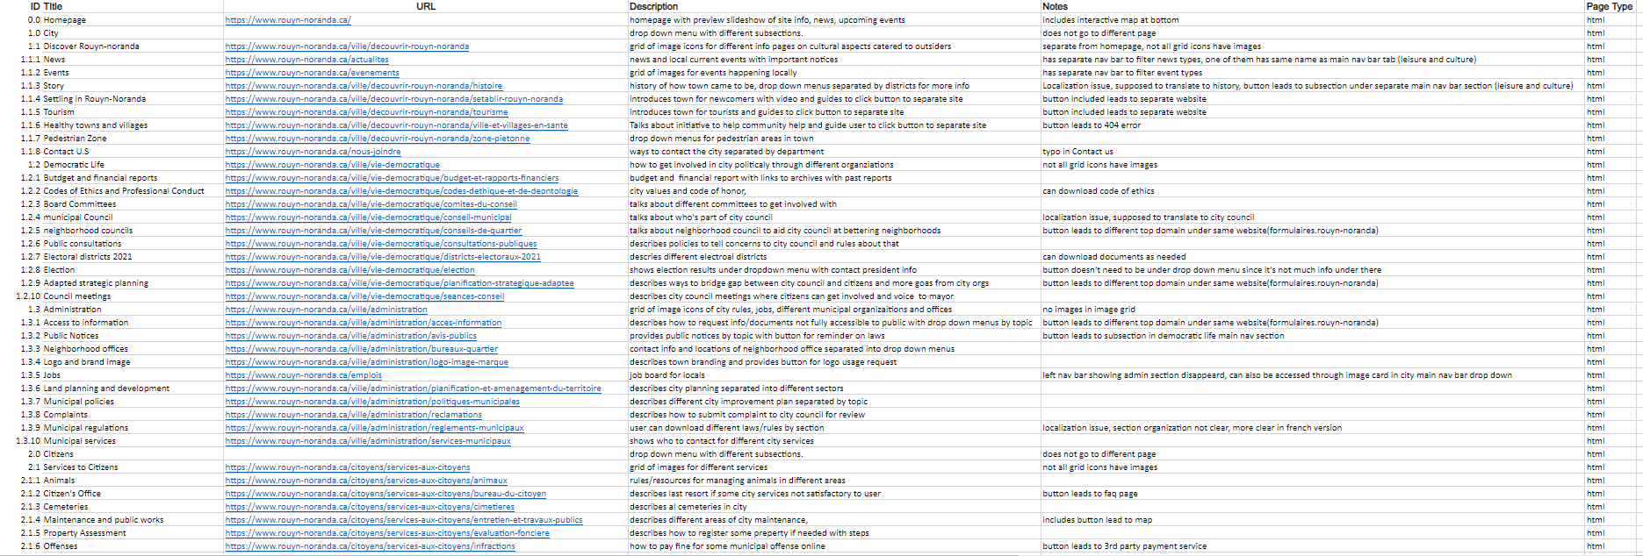
Full Content Inventory

Slide 30
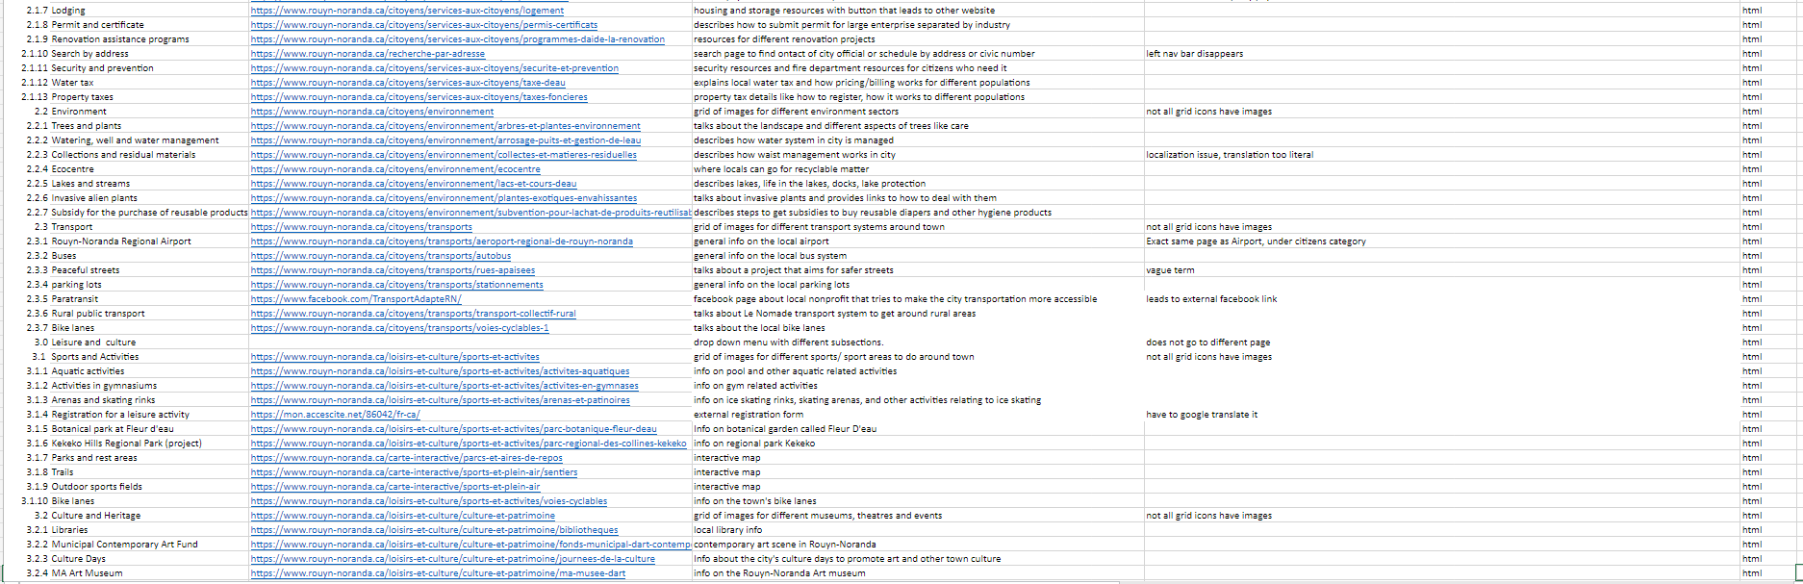
Full Content Inventory Cont.

Slide 31
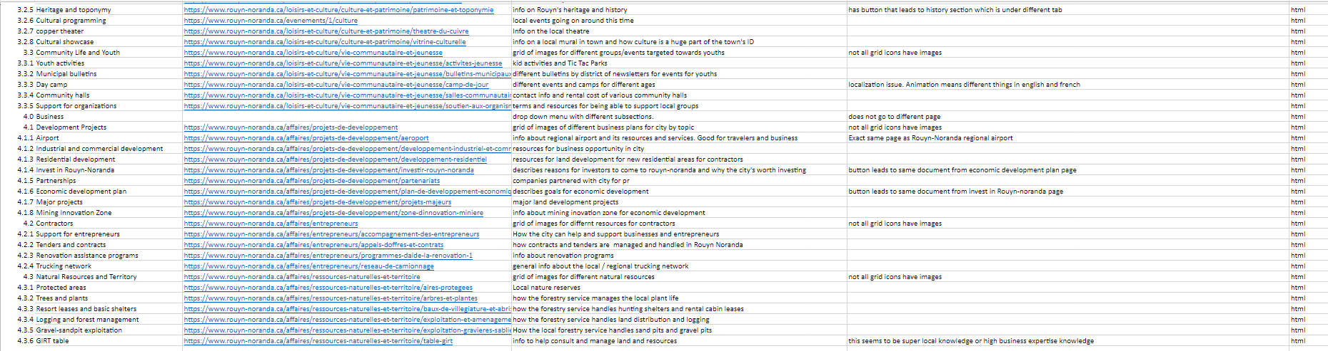
Full Content Inventory Cont.

Slide 32
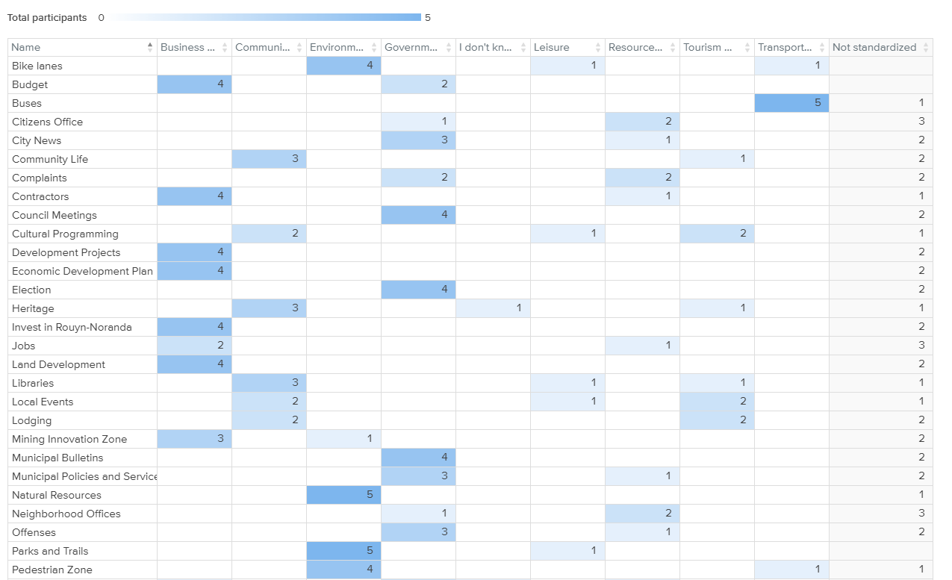
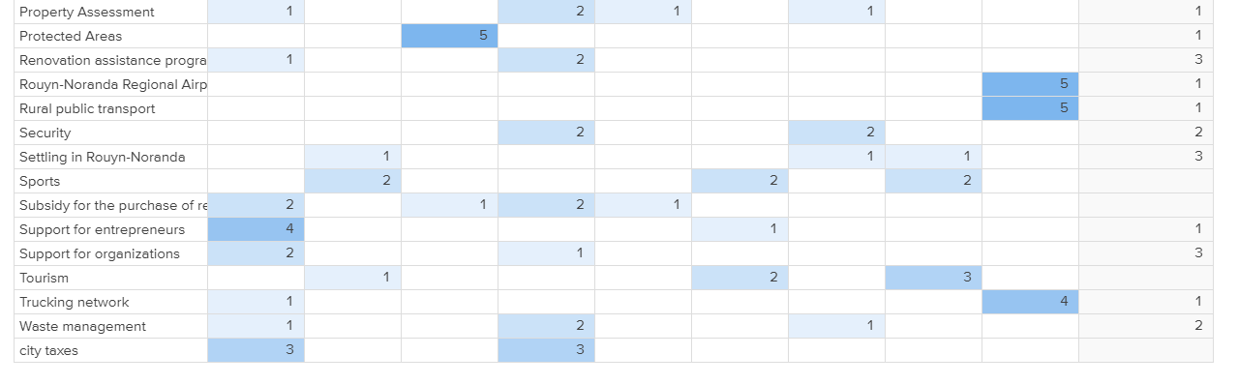
Card sort 1
Standardization grid(right)
Open Card
Link to results

Slide 33
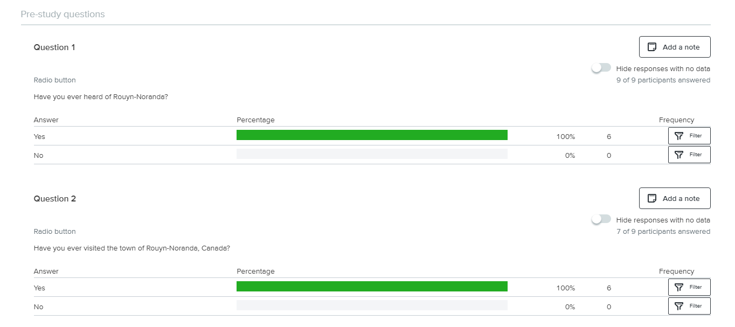
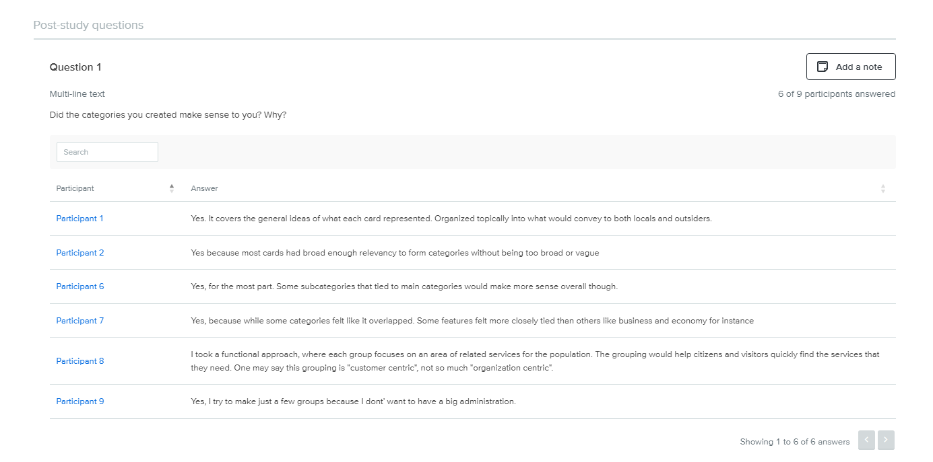
Card Sort 1 cont.

Slide 34
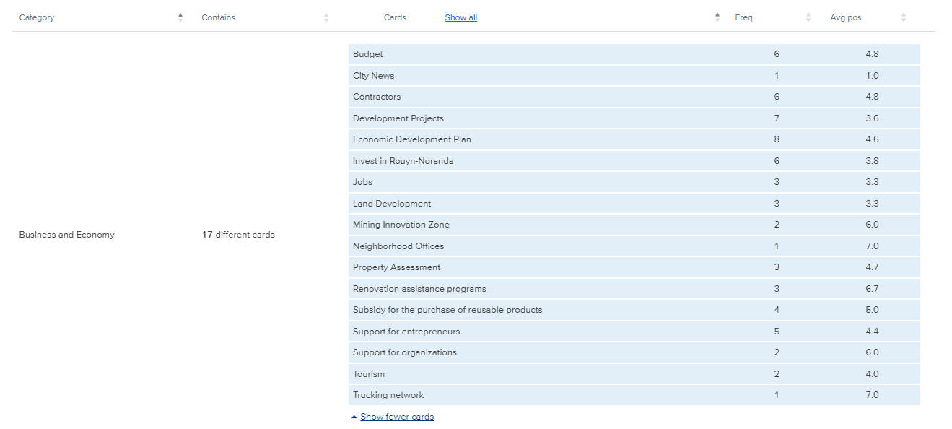
Card Sort 2
Categories and their frequencies:

Slide 35
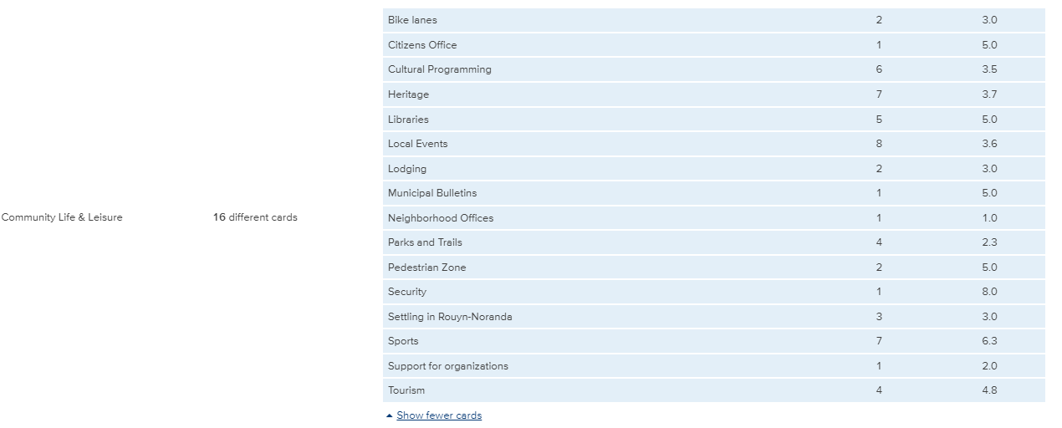
Card Sort 2 Cont.

Slide 36
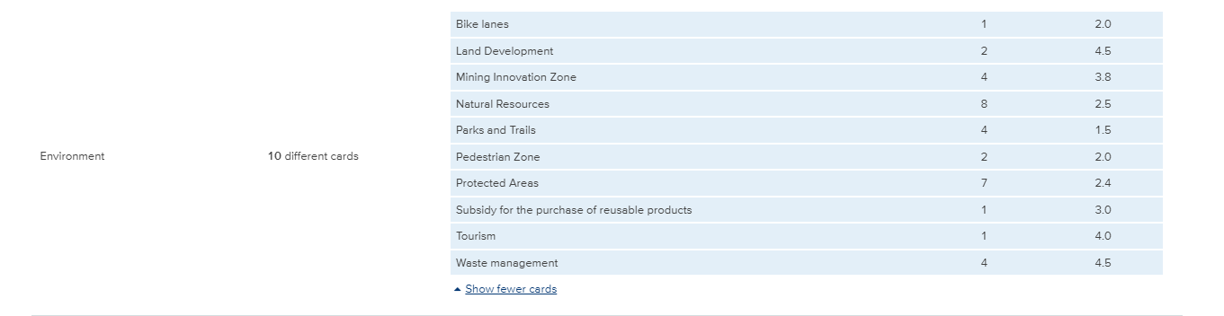
Card Sort 2 Cont.

Slide 37
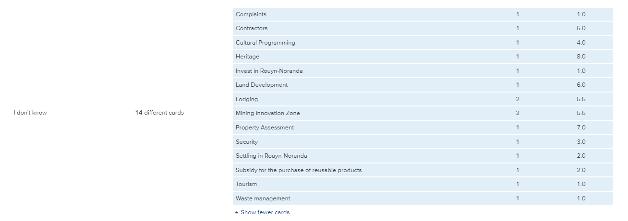
Card Sort 2 Cont.

Slide 38
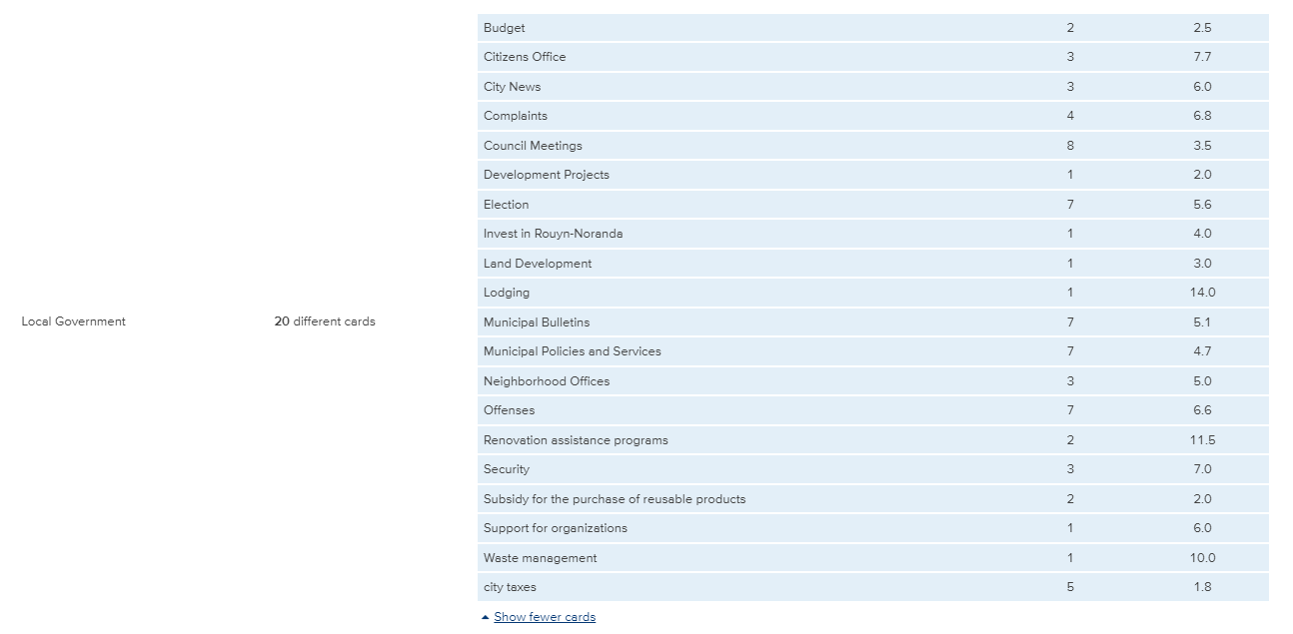
Card Sort 2 Cont.

Slide 39
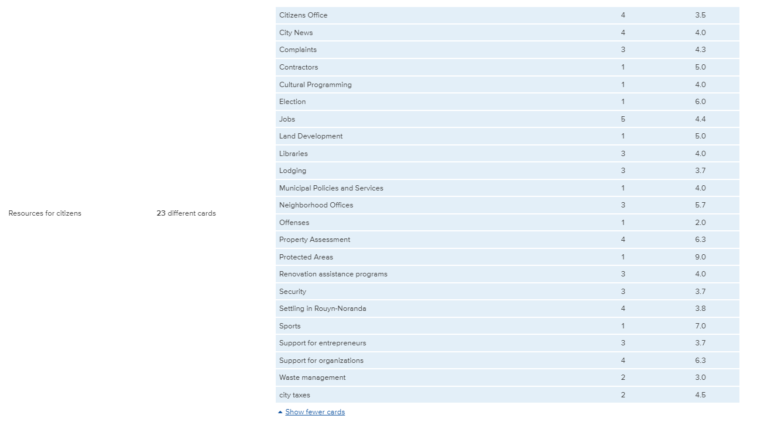
Card Sort 2 Cont.

Slide 40
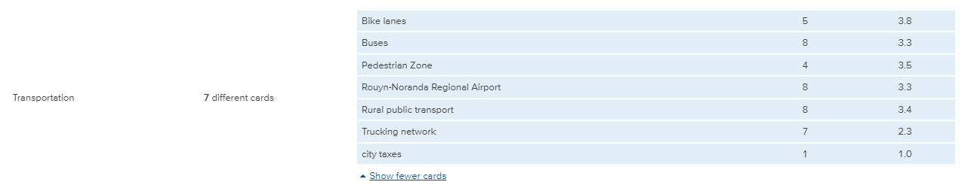
Card Sort 2 Cont.

Slide 41
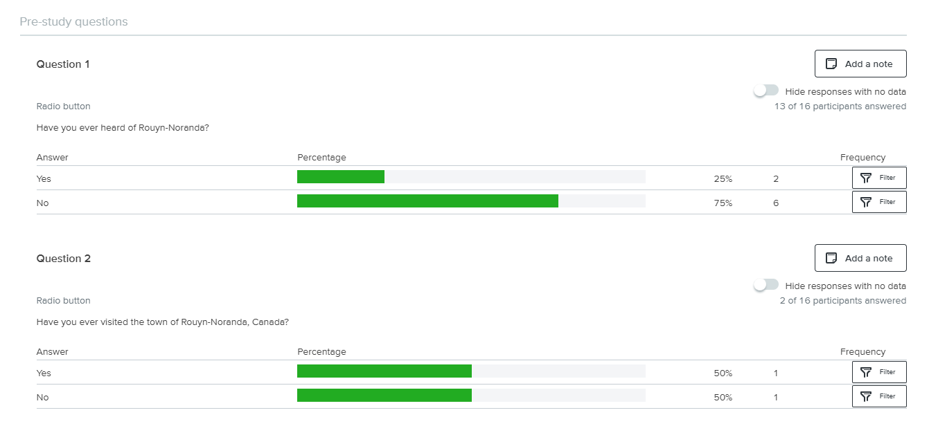

Slide 42
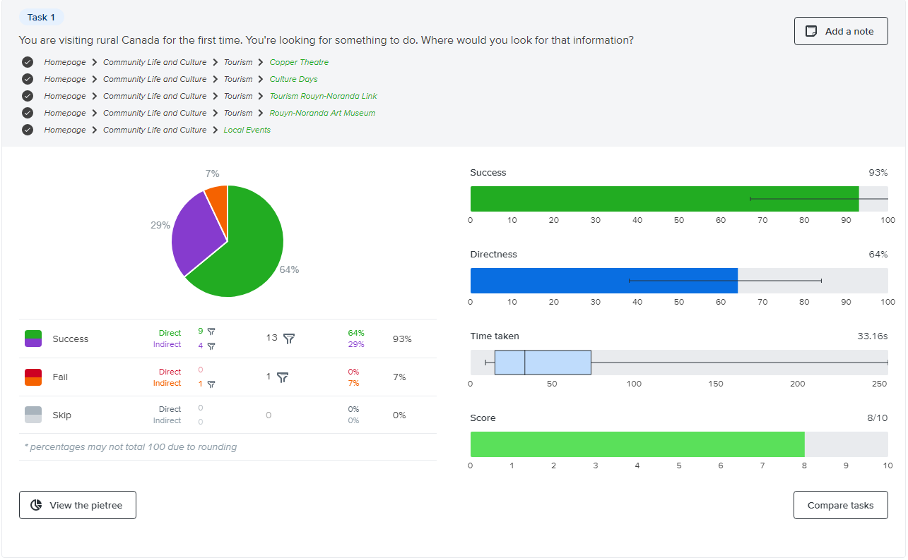
Tree testing

Slide 43
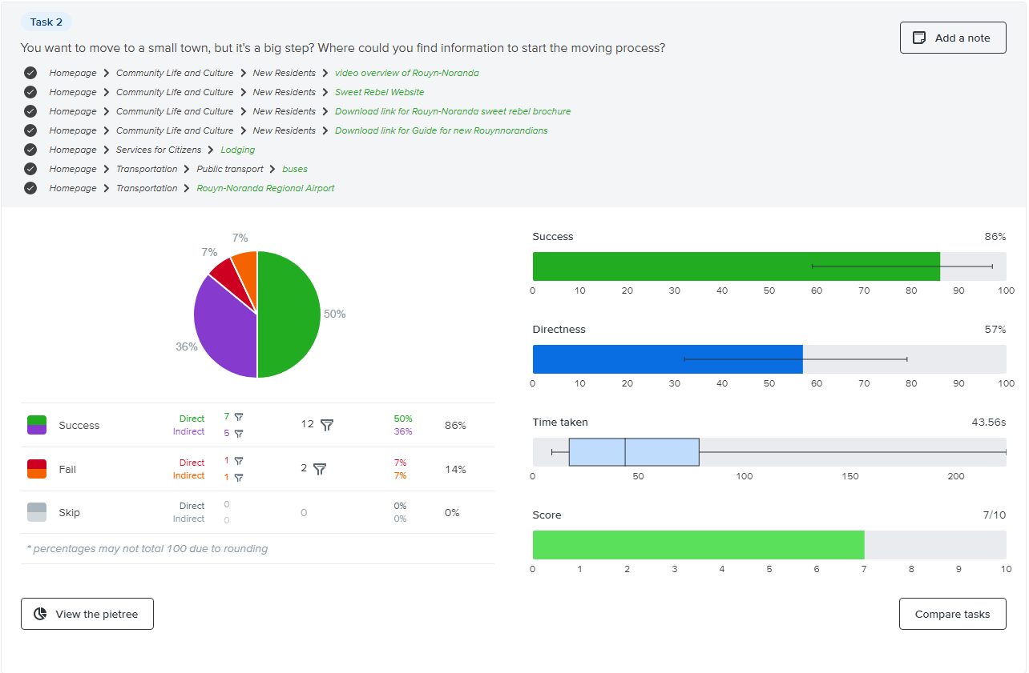
Tree testing cont.

Slide 44
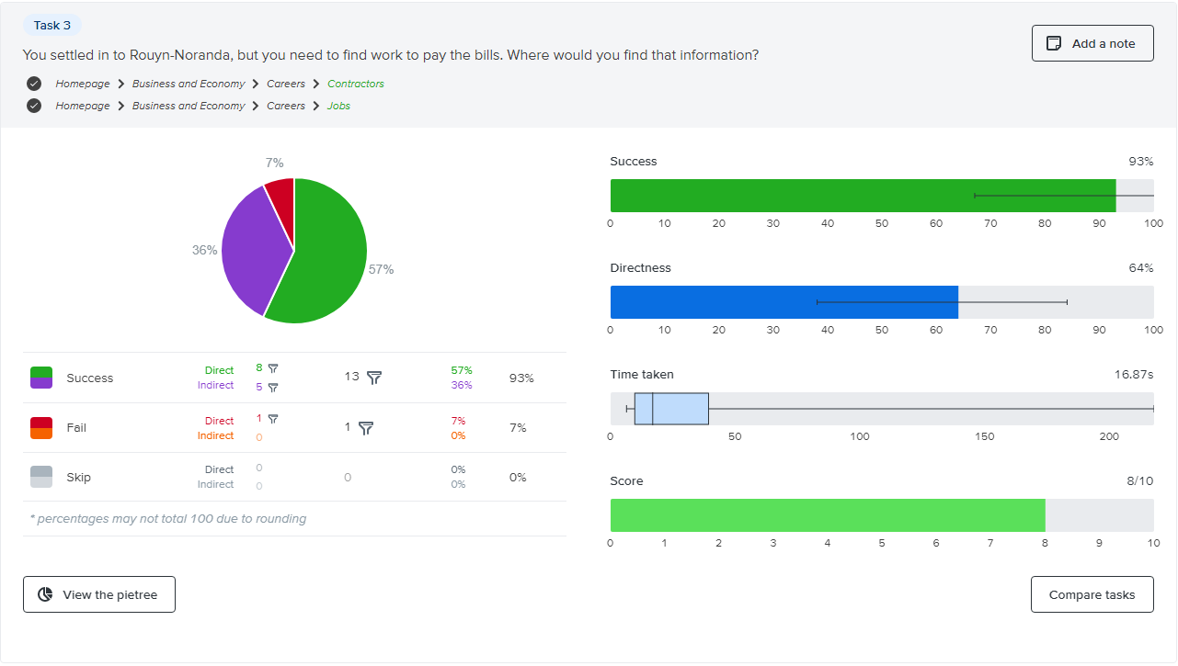
Tree testing cont.

Slide 45
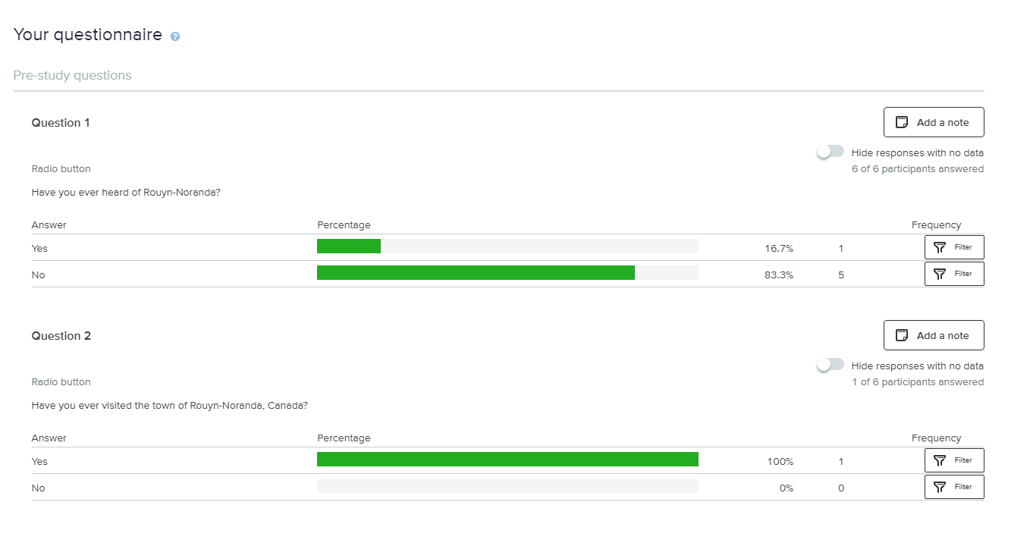
First Click Testing

Slide 46
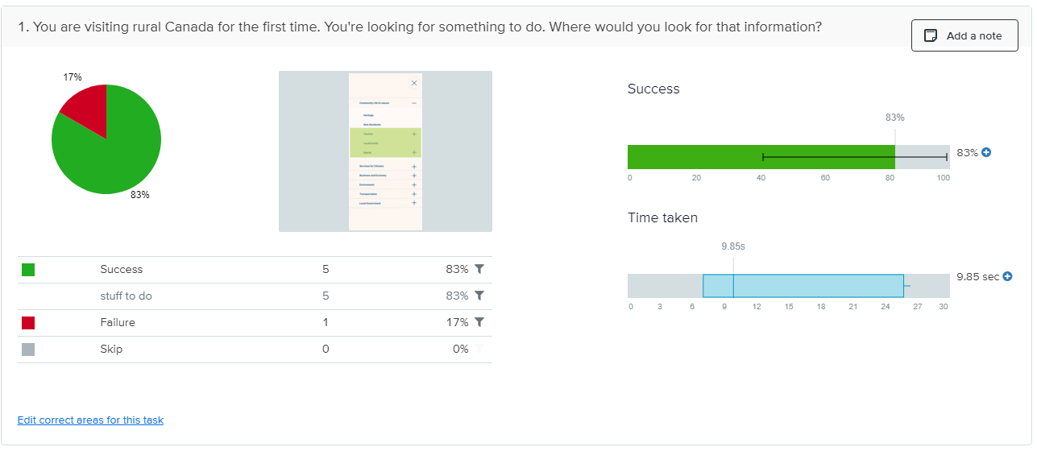
First Click Testing Cont. : Task Results

Slide 47
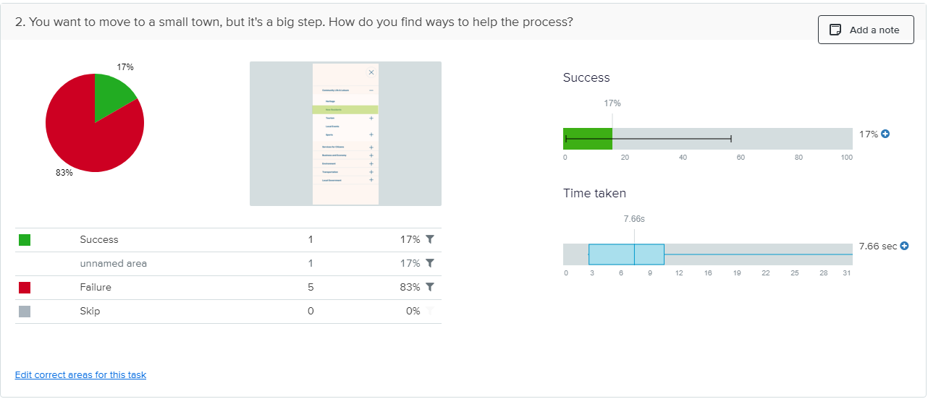
First Click Testing Cont. : Task Results

Slide 48
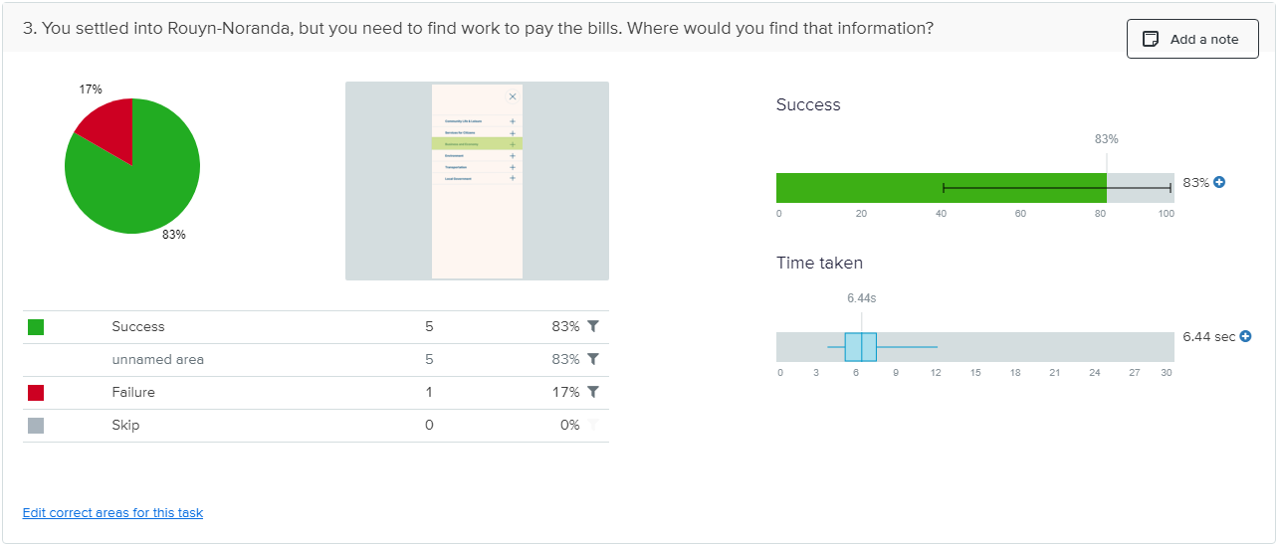
First Click Testing Cont. : Task Results

Slide 49
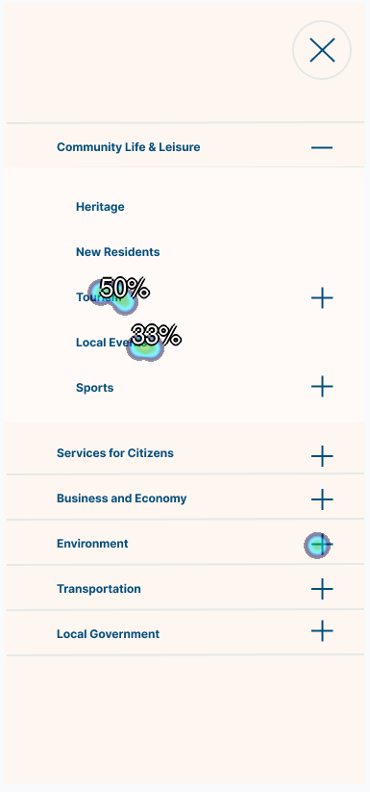
First Click Testing cont. : Clickmaps
Task 1: You are visiting rural Canada for the first time. You're looking for something to do. Where would you look for that information?
6 clicks
5 successful
0 skips
14.3 avg (secs)

Slide 50
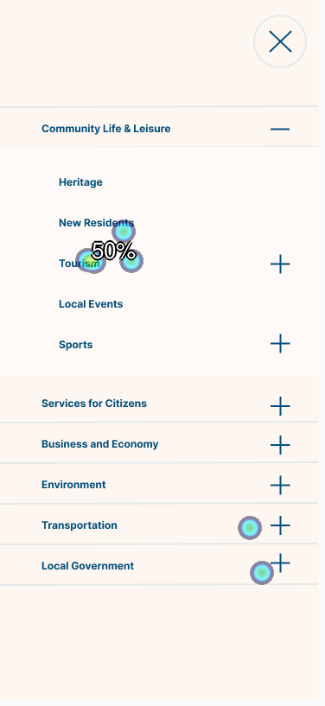
First Click Testing cont. : Clickmaps
Task 2: You want to move to a small town, but it's a big step. How do you find ways to help the process?
6clicks
1 successful
0 skips
10.5 avg (secs)

Slide 51
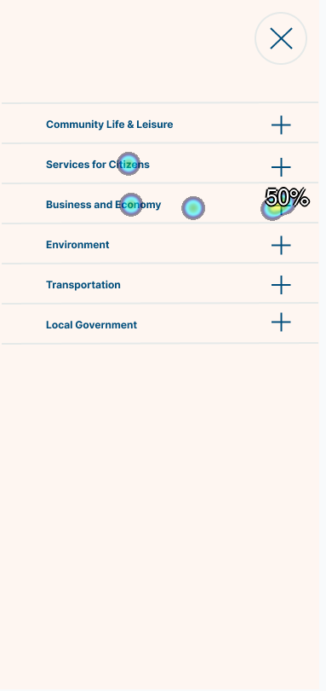
First Click Testing cont. : Clickmaps
Task 3 : You settled into Rouyn-Noranda, but you need to find work to pay the bills. Where would you find that information?
6 clicks
5 successful
0 skips
6.9 avg ( secs)

Slide 52
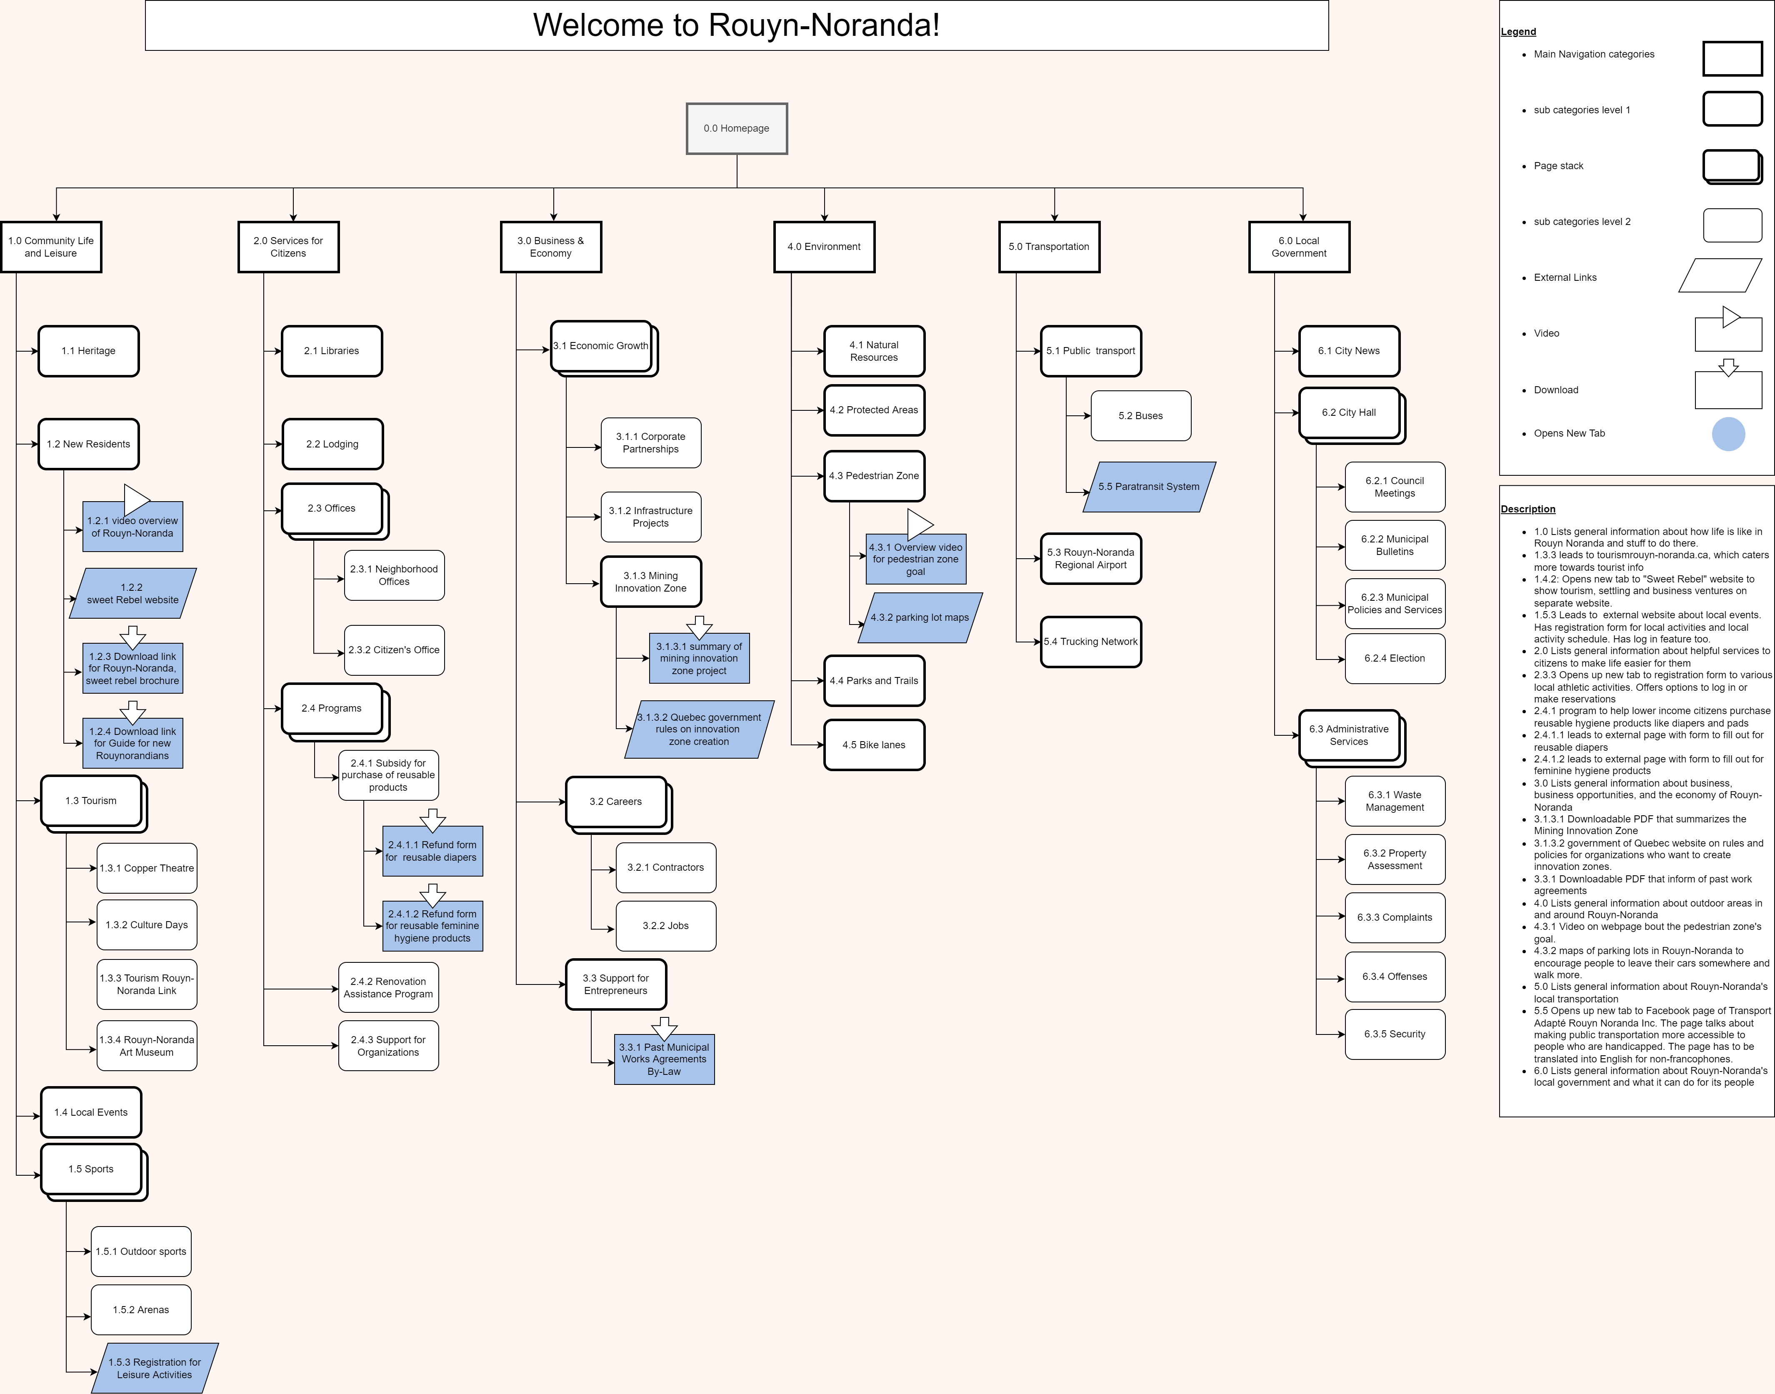
Site Map
Full sitemap

Slide 53
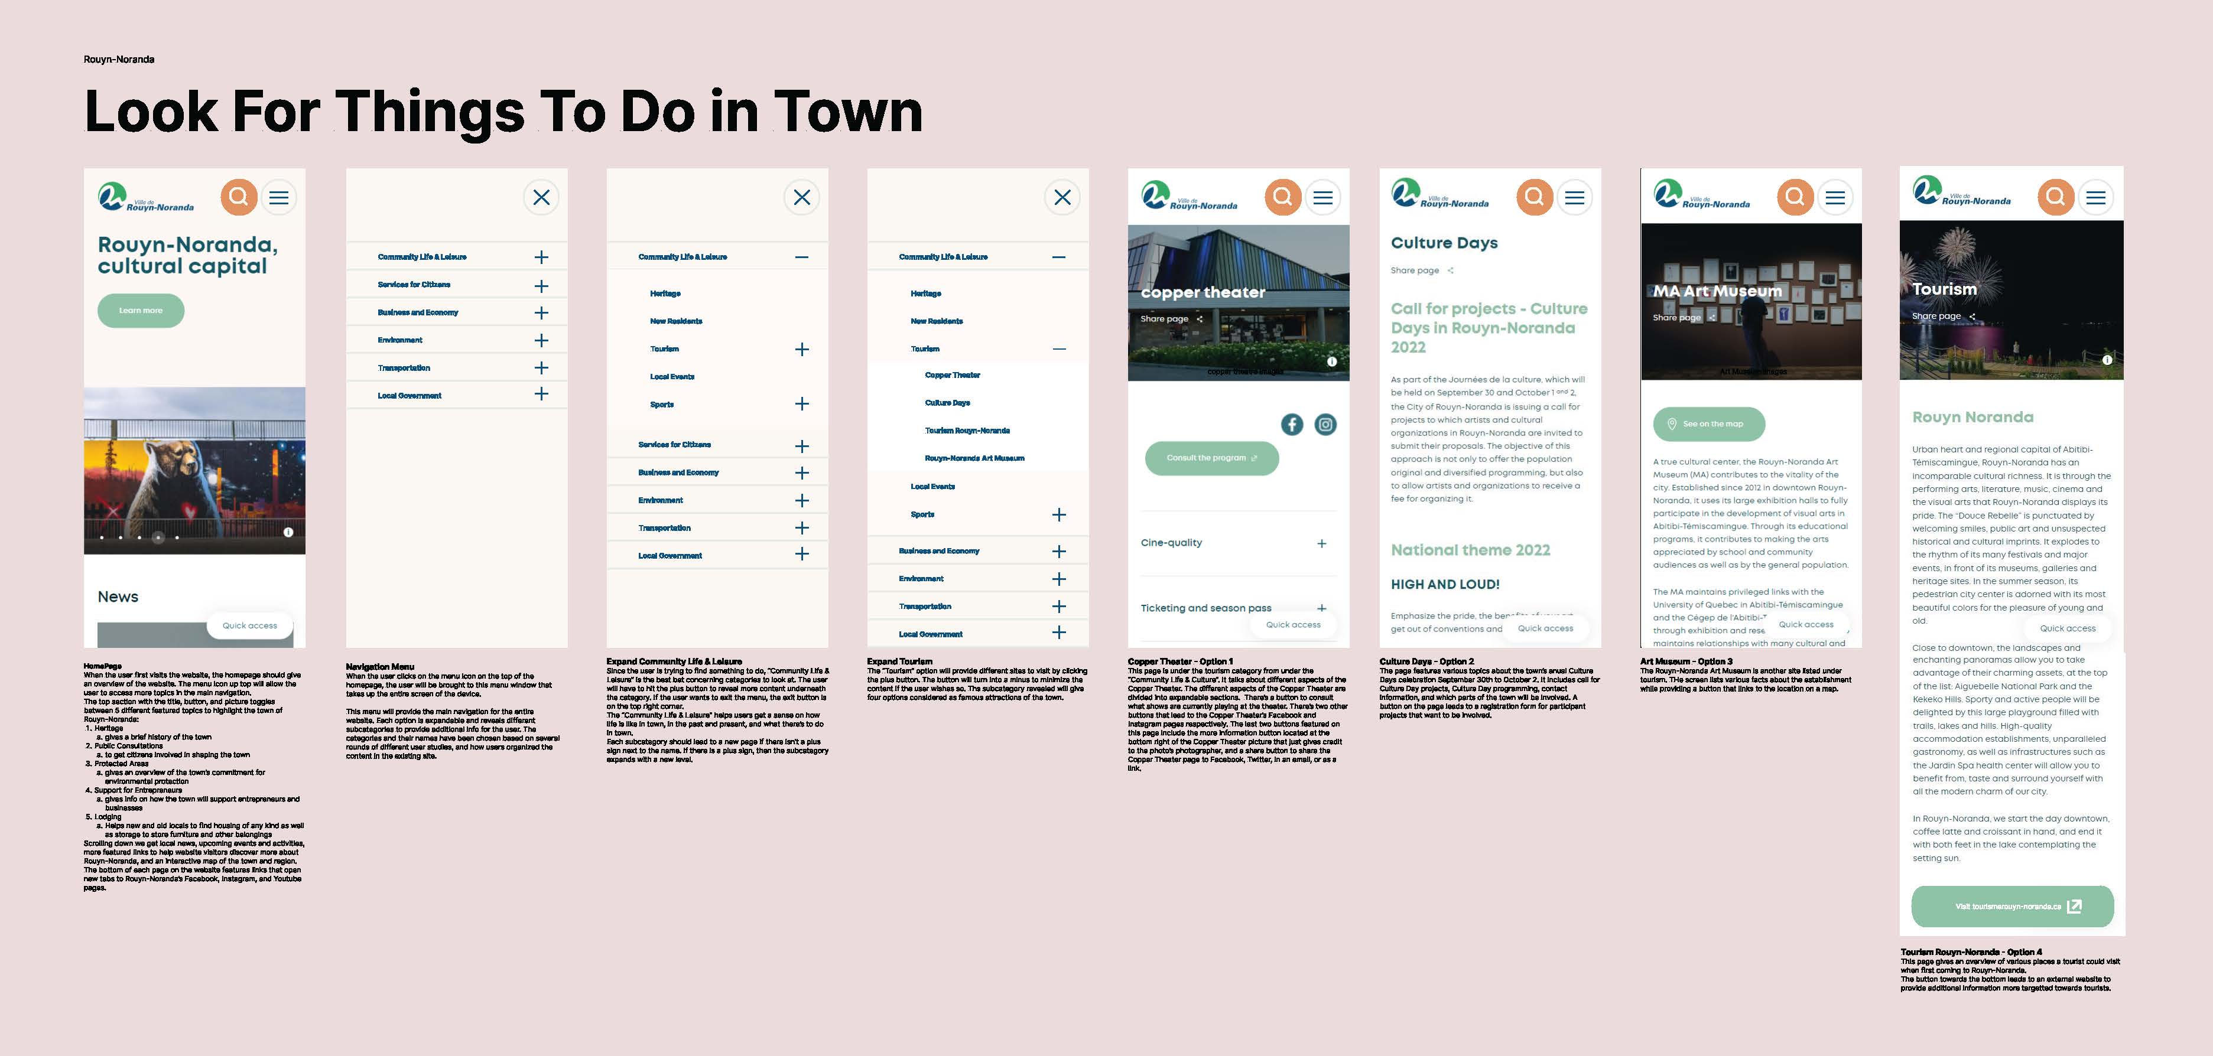
Full Wireframe 1

Slide 54
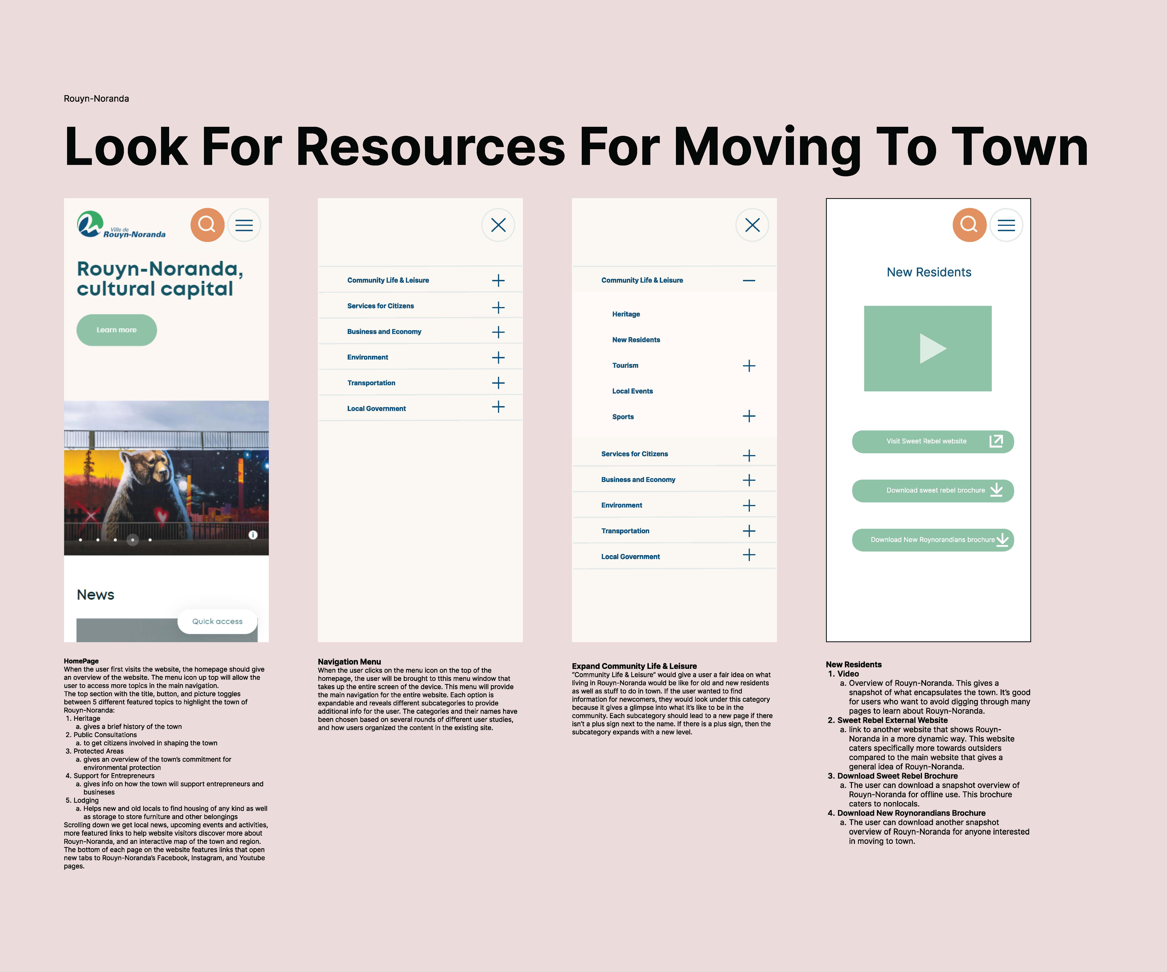
Full Wireframe 2

Slide 55
Wireframe Screen 1: homepage
When the user first visits the website, the homepage should give an overview of the website. The menu icon up top will allow the user to access more topics in the main navigation. The top section with the title, button, and picture toggles between 5 different featured topics to highlight the town of Rouyn-Noranda:
Heritage: gives a brief history of the town
Public Consultations : to get citizens involved in shaping the town
Protected Areas: gives an overview of the town’s commitment for environmental protection
Support for Entrepreneurs: gives info on how the town will support entrepreneurs and businesses
Lodging: Helps new and old locals to find housing of any kind as well as storage to store furniture and other belongings
Scrolling down we get local news, upcoming events and activities, more featured links to help website visitors discover more about Rouyn-Noranda, and an interactive map of the town and region. The bottom of each page on the website features links that open new tabs to Rouyn-Noranda’s Facebook, Instagram, and Youtube pages.

Slide 56
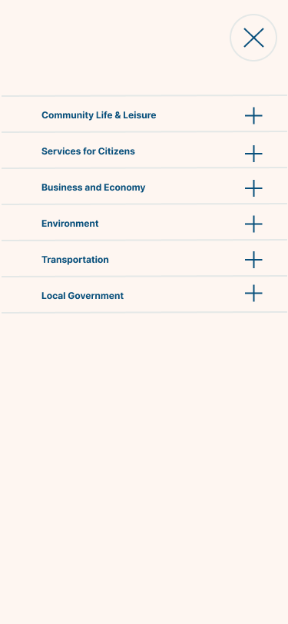
Wireframe Screen 2: Main Navigation
When the user clicks on the menu icon on the top of the homepage, the user will be brought to this menu window that takes up the entire screen of the device.
This menu will provide the main navigation for the entire website. Each option is expandable and reveals different subcategories to provide additional info for the user. The categories and their names have been chosen based on several rounds of different user studies, and how users organized the content in the existing site.

Slide 57
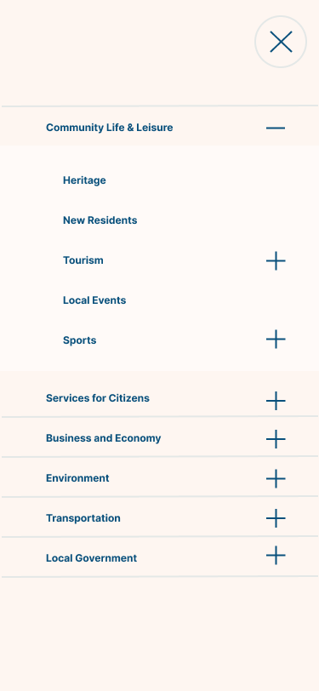
Wireframe Screen 3: Community Life & Leisure Expanded
The “Community Life & Leisure” category helps users get a sense on how life is like in town, in the past and present, and what there’s to do in town.
If the user wanted to find information for newcomers, they would look under this category because it gives a glimpse into what it’s like to be in the community. Each subcategory should lead to a new page if there isn’t a plus sign next to the name. If there is a plus sign, then the subcategory expands with a new level.
If the user is trying to find something to do, “Community Life & Leisure” is the best bet concerning categories to look at.
If the user wants to exit the menu, the exit button is on the top right corner. Each subcategory should lead to a new page if there isn’t a plus sign next to the name. If there is a plus sign, then the subcategory expands with a new level.

Slide 58
Wireframe Screen 4: Tourism expanded
The “Tourism” option will provide different sites to visit by clicking the plus button. The button will turn into a minus to minimize the content if the user wishes so. This subcategory revealed will give four options considered as famous attractions of the town.

Slide 59

Wireframe Screen 5: New Residents
Video: Overview of Rouyn-Noranda. This gives a snapshot of what encapsulates the town. It’s good for users who want to avoid digging through many pages to learn about Rouyn-Noranda.
Sweet Rebel External Website: link to another website that shows Rouyn-Noranda in a more dynamic way. This website caters specifically more towards outsiders compared to the main website that gives a general idea of Rouyn-Noranda.
Download Sweet Rebel Brochure The user can download a snapshot overview of Rouyn-Noranda for offline use. This brochure caters to nonlocals.
Download New Roynorandians Brochure The user can download another snapshot overview of Rouyn-Noranda for anyone interested in moving to town.

Slide 60
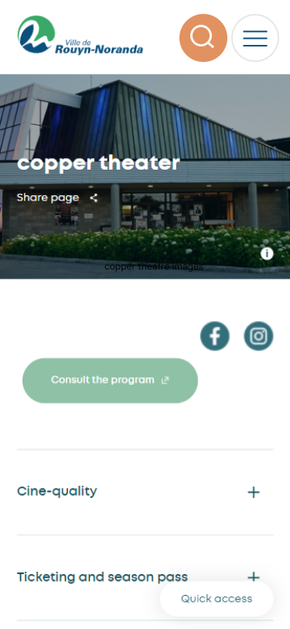
Wireframe Screen 6 option 1: Copper Theatre
This page is under the tourism category from under the “Community Life & Culture”. It talks about different aspects of the Copper Theater. The different aspects of the Copper Theater are divided into expandable sections. There’s a button to consult what shows are currently playing at the theater. There’s two other buttons that lead to the Copper Theater’s Facebook and Instagram pages respectively. The last two buttons featured on this page include the more information button located at the bottom right of the Copper Theater picture that just gives credit to the photo’s photographer, and a share button to share the Copper Theater page to Facebook, Twitter, in an email, or as a link.

Slide 61
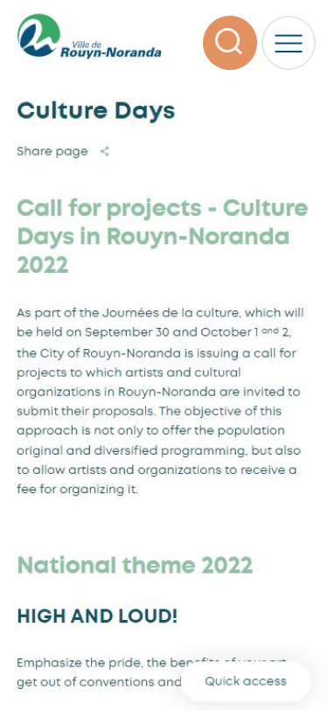
Wireframe Screen 6 Option 2: Culture Days
The page features various topics about the town’s anual Culture Days celebration September 30th to October 2. It includes call for Culture Day projects, Culture Day programming, contact information, and which parts of the town will be involved. A button on the page leads to a registration form for participant projects that want to be involved.

Slide 62
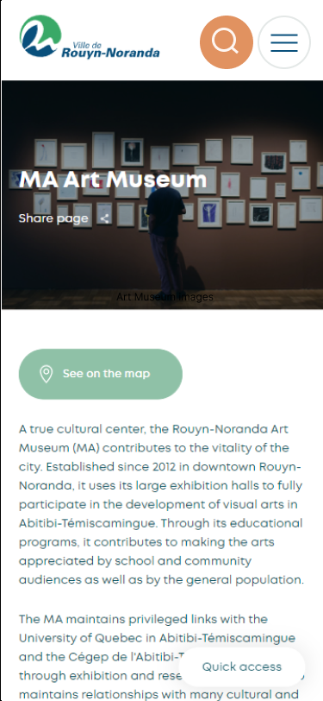
Wireframe Screen 6 Option 3: Art Museum
The Rouyn-Noranda Art Museum is another site listed under tourism. The screen lists various facts about the establishment while providing a button that links to the location on a map.

Slide 63
Wireframe Screen 6 Option 4: Tourism Overview
This page gives an overview of various places a tourist could visit when first coming to Rouyn-Noranda. The button towards the bottom leads to an external website to provide additional information more targeted towards tourists.

