Slide 1

PwnSch00l
https://sigint.mx/pwn/

Slide 2
Binary Hacking 0x02
Reversing Managed Languages – Workshop 1
“Dissecting Android Applications”
01.28.2019, Victor

Slide 3
DISCLAIMER
All of the material in this school can be used for good (testing, research, educating), but also for bad
We use our skills and knowledge responsibly and ethically
We recommend you do the same
We are not responsible for anything you do as a result of these lessons

Slide 4
LET’S GET STARTED!

Slide 5
Everything can be found on GitHub: https://github.com/ViRb3/sigint-workshop-1

Slide 6
CONTENT [1/2] – THEORY
Dalvik
Dalvik VM
Dalvik bytecode
Dalvik VM vs. Android Runtime (ART)
JIT (Just In Time) vs. AOT (Ahead Of Time)

Slide 7
CONTENT [2/2] – PRACTICE
Challenge 1
Basic decompilation and recompilation
Challenge 2
Anti-tamper check, bypass with optimization patch
Challenge 3
Google CTF 2018 – Shall we play a game?

Slide 8
THEORY

Slide 9
Dalvik
Open-source software, originally written by Dan Bornstein
Named after the fishing village of Dalvík in Eyjafjörður, Iceland
Dalvik Virtual Machine
Dalvik bytecode
A managed solution (as opposed to native/unmanaged)

Slide 10
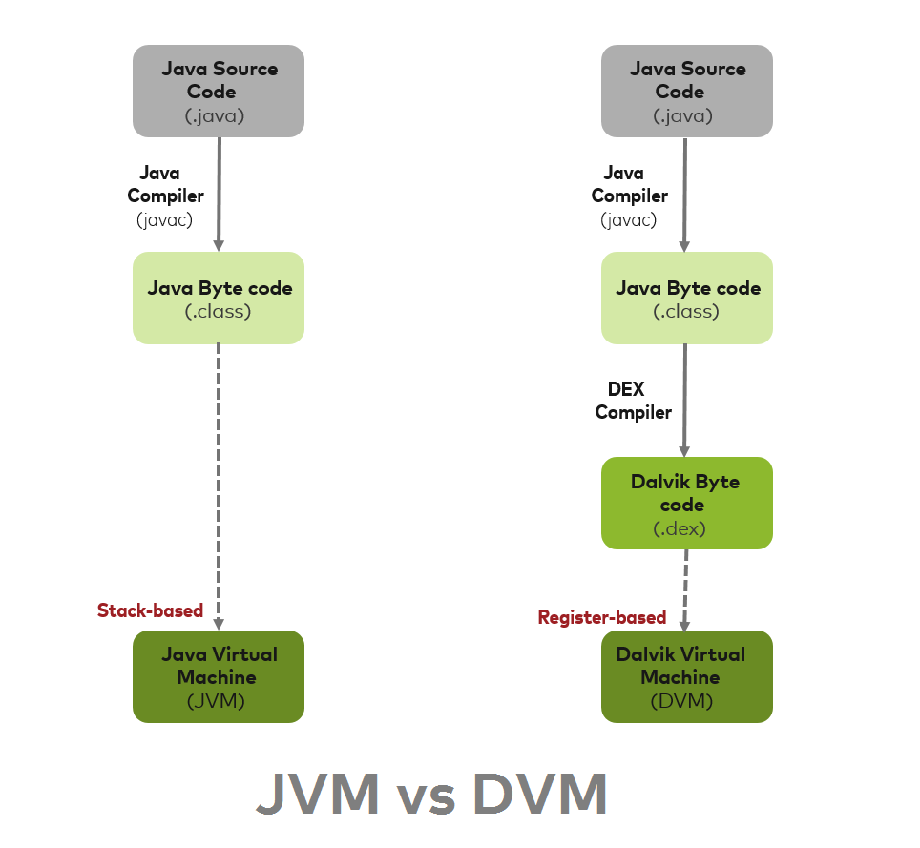

Slide 11
Dalvik VM vs. Android Runtime (ART)
ART replaces Dalvik VM since Android 5.0
Reads and processes good-old .DEX files
Dalvik uses JIT
ART uses hybrid JIT+AOT (eventually everything is AOT’d)

Slide 12
JIT (Just In Time) vs. AOT (Ahead Of Time)
JIT compiles just in time when the method is executed
Restart the program, do all again
Slow initial loading time for all methods
AOT precompiles methods ahead of their time of execution
Restart the program, will always use that precompiled code
Fast, equivalent to native code loading times

Slide 13
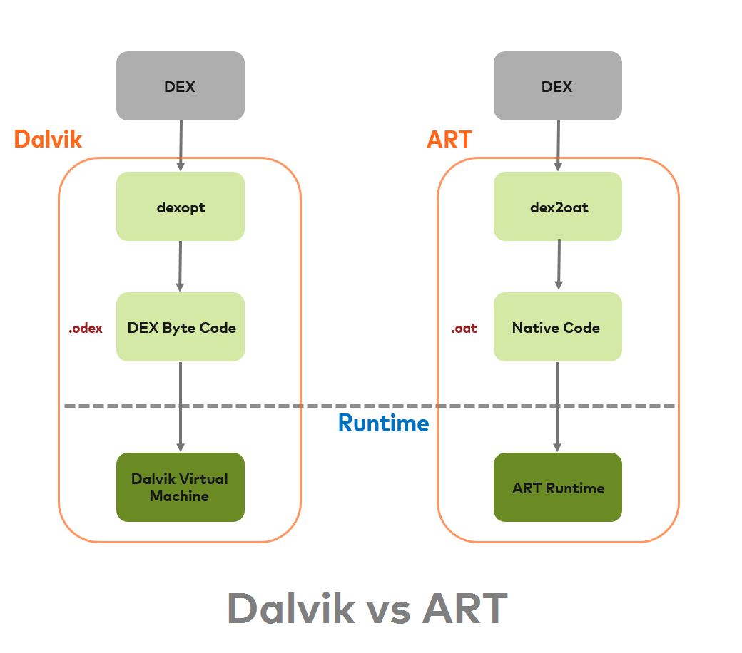

Slide 14
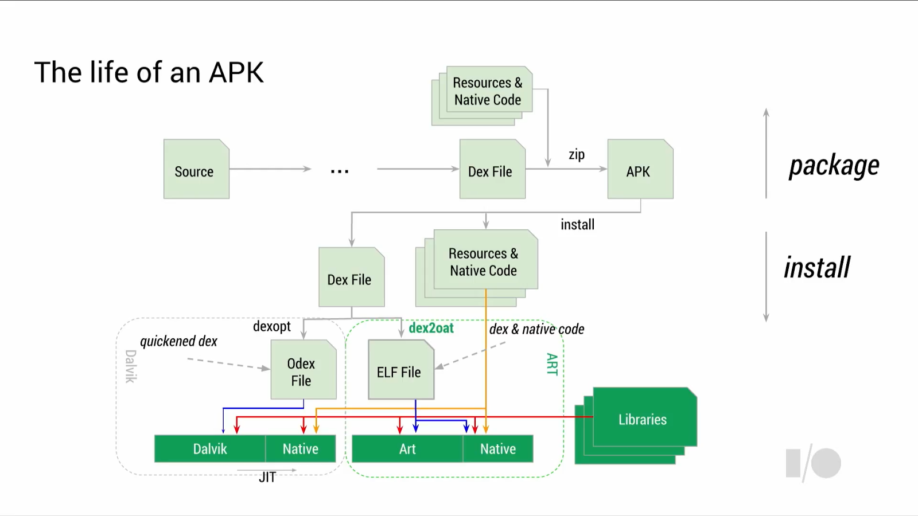

Slide 15
PRACTICE

Slide 16
SETUP
Android SDK
https://developer.android.com/studio/#downloads
(Windows) Add to PATH:
android-sdk/platform-tools/
android-sdk/build-tools/xx.x.x/

Slide 17
TOOLS
APK Utilities
https://github.com/ViRb3/apk-utilities
(Windows) Smali Helper
https://github.com/ViRb3/SmaliHelper
Bytecode Viewer
https://github.com/Konloch/bytecode-viewer
Brain.exe
No download at this time ☹

Slide 18
RESOURCES
Dalvik opcode reference
http://pallergabor.uw.hu/androidblog/dalvik_opcodes.html

Slide 19
CHALLENGE 1

Slide 20
CHALLENGE 2

Slide 21
CHALLENGE 3

Slide 22

Android isn’t secure?

Slide 23
WHAT’S NEXT?
Dealing with native code (libraries)
Dealing with obfuscation
Debugging
Frida

Slide 24
CONNECT WITH US
Official Slack workspace
https://siginthqv2.slack.com
Or if you prefer Discord, make sure to spam the heck out of the admins to make the switch
Website
https://school.sigint.mx
Social media
https://www.facebook.com/SigintEdinburgh https://twitter.com/siginthq?lang=en

