Slide 1
Employee Salary Prediction using Gradient Boosting Classifier
CAPSTONE PROJECT
Presented By:
Student Name: VISHWANTH R
College Name: R.M.D ENGINEERING COLLEGE
Department: Electronics and Communication Engineering
AICTE ID: STU68387fd71764a1748533207

Slide 2
OUTLINE :
Problem Statement (Should not include solution)
System Development Approach (Technology Used)
Algorithm & Deployment (Step by Step Procedure)
Result
Conclusion
Future Scope(Optional)
References

Slide 3
PROBLEM STATEMENT : Organizations often face challenges in identifying which employees are likely to earn higher salaries based on various personal and professional attributes. Accurately predicting whether an employee earns above or below a certain salary threshold can help in decision-making related to hiring, promotions, and workforce planning. Manual evaluation is time-consuming and prone to bias, hence there is a need for a data-driven approach.
Mention what your project is all about min 5 line:
This project aims to build a machine learning model that predicts whether an employee earns ≥ $50K or < $50K annually. It uses historical data with features like education, experience, job role, and Location. The model helps companies make data-driven hiring and salary Decisions. Students will learn data cleaning, preprocessing, feature engineering, and regression Modeling. They'll use Python tools like Jupyter, Matplotlib for data analysis and visualization.

Slide 4
SYSTEM APPROACH :
Minimum System Requirements :
Hardware:
Processor: Dual-core CPU (Intel i3/Ryzen 3 or better)
RAM: 4 GB (8 GB recommended)
Storage: At least 1 GB of free disk space
Internet: Required for downloading packages and datasets (optional if pre-installed)
Software:
Operating System : Windows, macOS, or Linux
Python Environment : Python version: 3.7 to 3.10
Required Python Libraries : numpy, pandas, scikit-learn, matplotlib, jupyter

Slide 5
ALGORITHM & DEPLOYMENT :
Loaded dataset using pandas and explored initial structure.
Handled missing values and encoded categorical columns.
Performed EDA using seaborn, matplotlib.
Scaled features and split data into training/testing sets.
Trained models: Logistic Regression, Random Forest, KNN, SVM, Gradient Boosting.
Evaluated models using accuracy, precision, recall, F1-score.
Selected the best-performing model and saved using joblib.
Loaded saved model and predicted salay class (>50k/<=50k).
Displayed results and messages dynamically in the UI.
Deploy the app using platforms like Github pages.

Slide 6
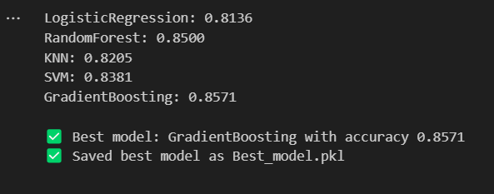
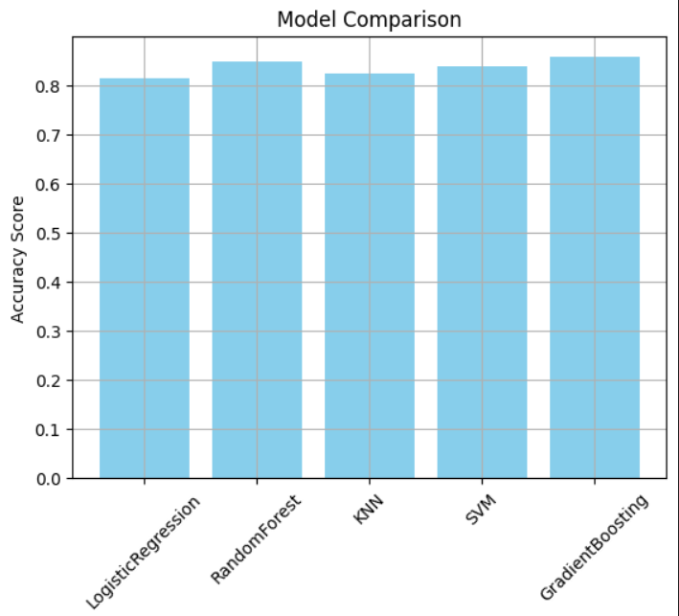
RESULT :

Slide 7
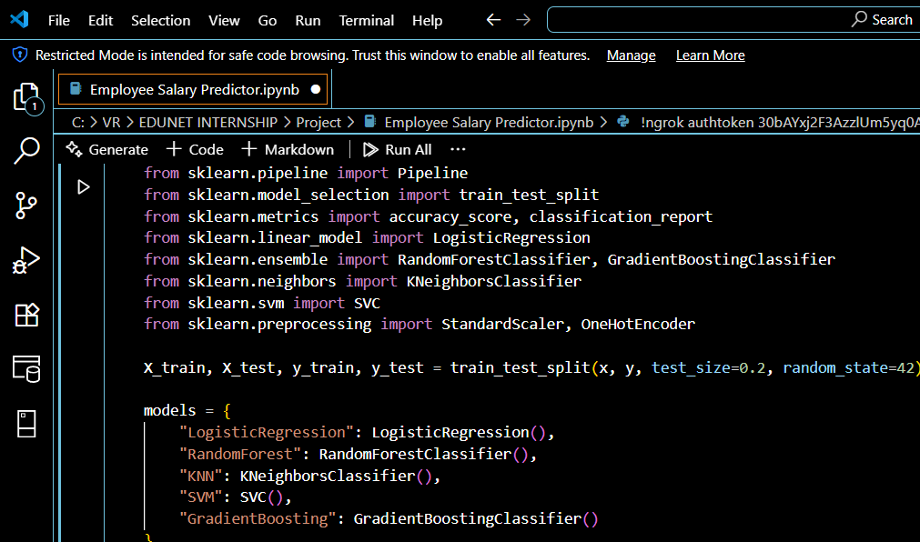
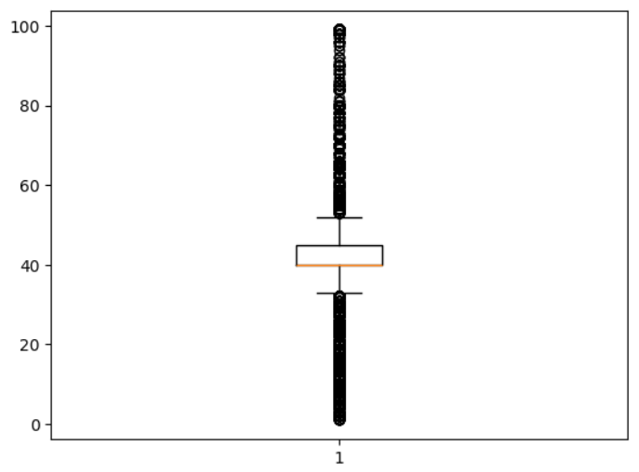
RESULT :
Git-Hub Link :
https://github.com/ViShWa-GiT85/Employee-Salary-Predictor

Slide 8
CONCLUSION :
Multiple machine learning algorithms were tested: Logistic Regression, Random Forest, KNN, SVM, and Gradient Boosting.
The models were evaluated using accuracy and classification metrics (precision, recall, F1-score, Support).
The best-performing model was automatically selected based on highest accuracy and saved using joblib.
The selected model was successfully deployed.

Slide 9
FUTURE SCOPE :
Model Improvement Use advanced algorithms like XGBoost or deep learning models to increase prediction accuracy.
More Features Include additional features such as industry trends, company size, and economic factors to enhance predictions.
Real-Time Integration Integrate the model with HR systems or job portals for real-time salary prediction and decision-making.
Deployment Develop a user-friendly web or mobile application using frameworks like Flask.
Cross-Country Support Extend the model to support salary prediction across different countries, currencies, and tax systems.

Slide 10
REFERENCES :
UCI Machine Learning Repository – Adult Income Dataset Source dataset used to train and test the salary classification model. https://archive.ics.uci.edu/ml/datasets/adult
Scikit-learn: Machine Learning in Python For model implementation, preprocessing, and evaluation metrics. https://scikit-learn.org/stable/
Pandas: Python Data Analysis Library For data reading, manipulation, and cleaning. https://pandas.pydata.org/
NumPy: Numerical Python Used for efficient numerical computations. https://numpy.org/
Matplotlib & Seaborn for Data Visualization Used for plotting boxplots, histograms, and other visualizations in EDA.
https://matplotlib.org/
https://seaborn.pydata.org/
Joblib: Efficient Serialization for Python Used to save and load the trained machine learning model. https://joblib.readthedocs.io/

Slide 11
THANK YOU

