Slide 1

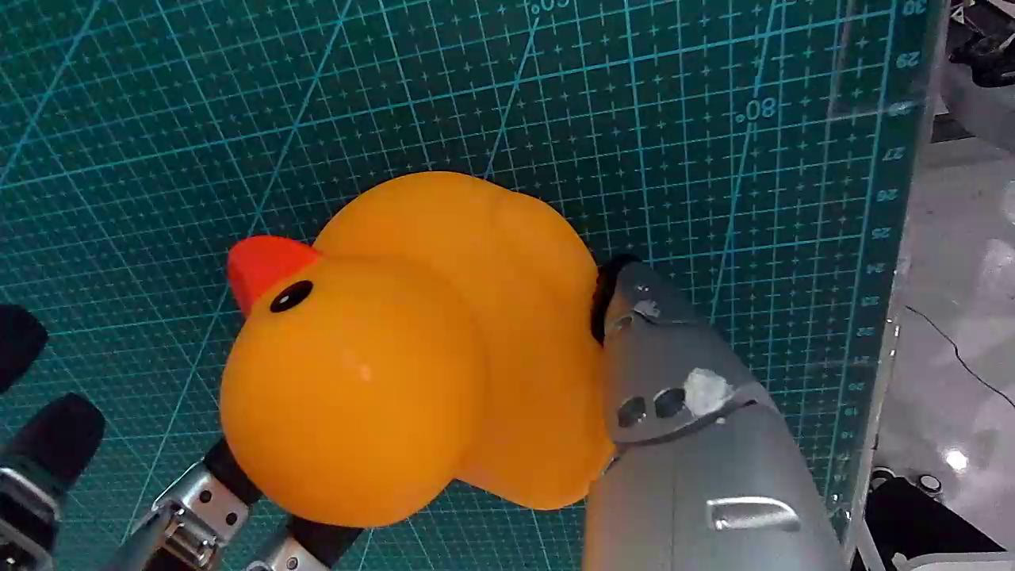
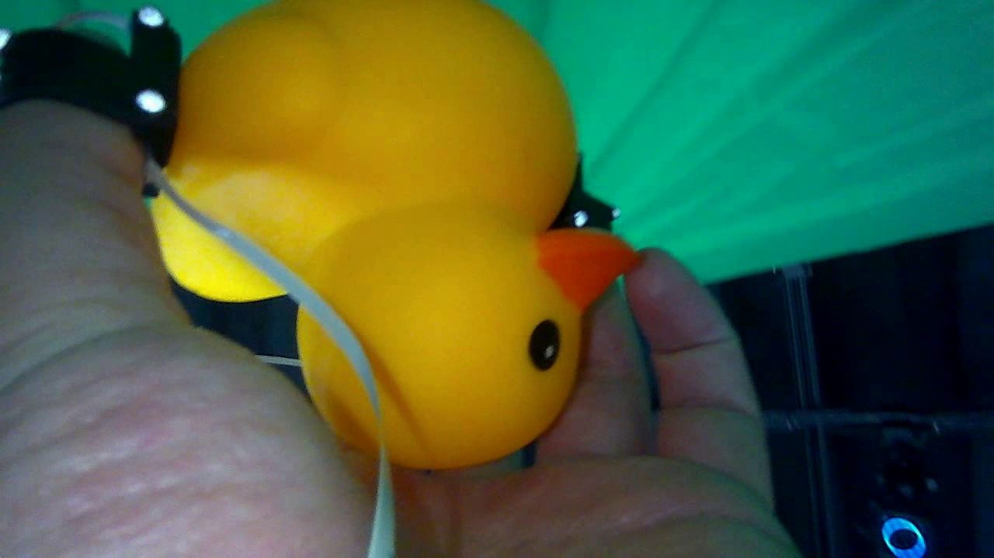
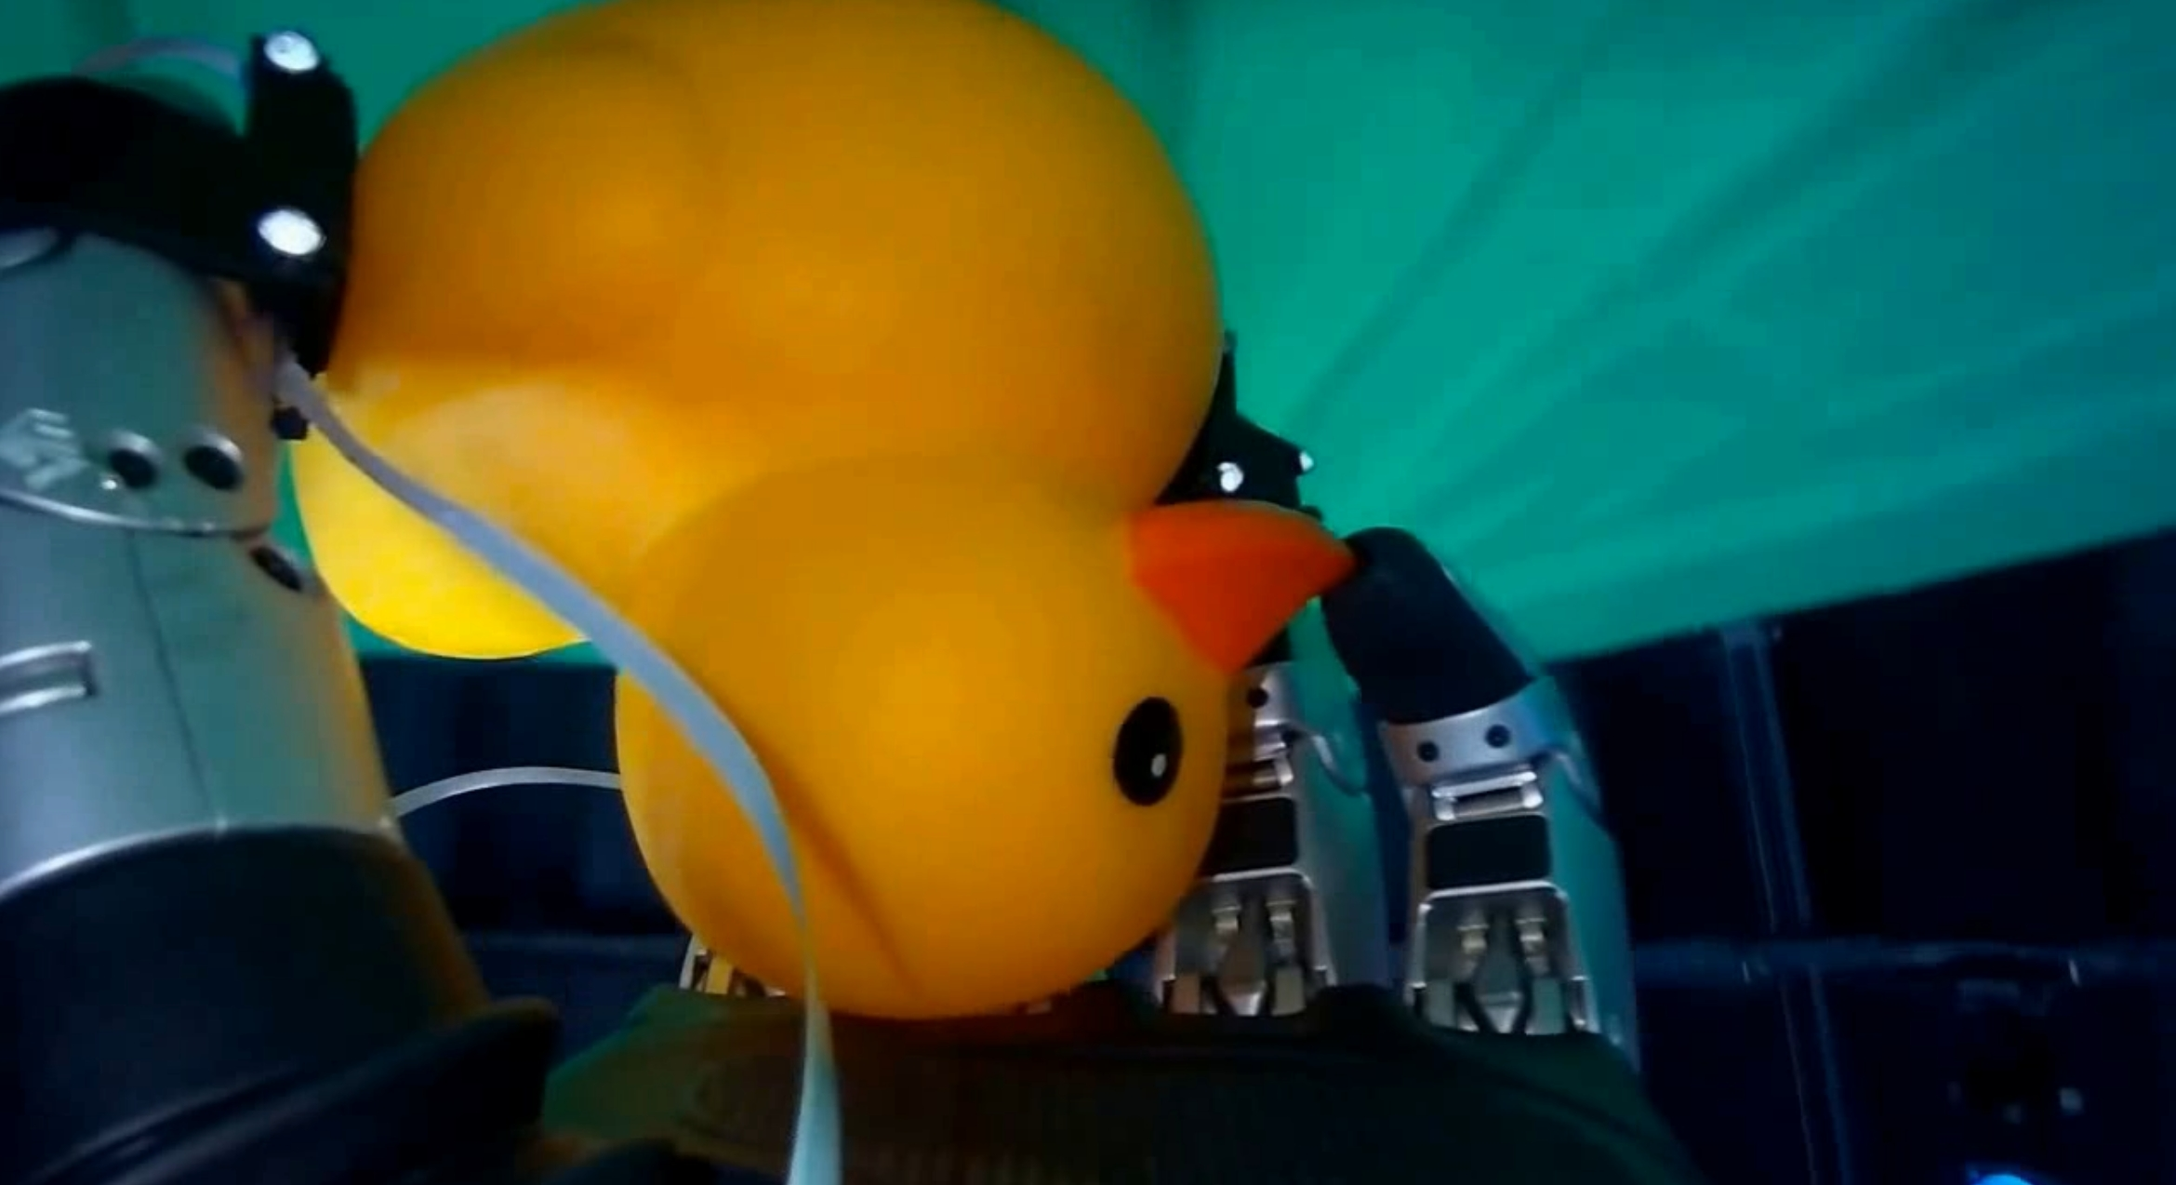

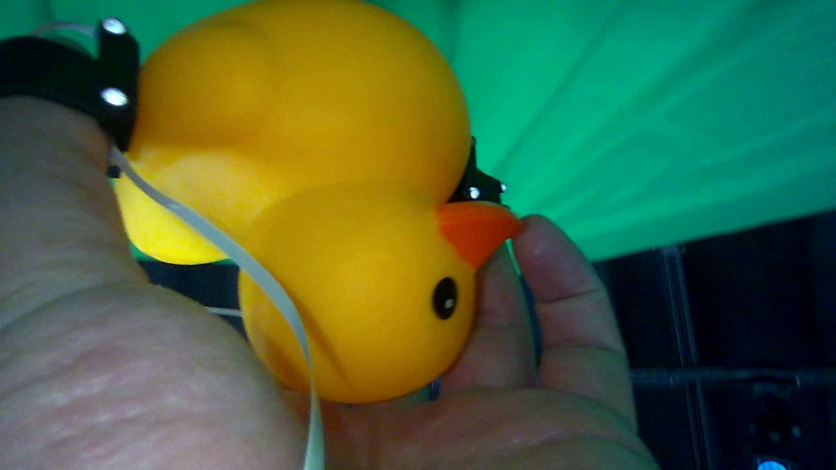

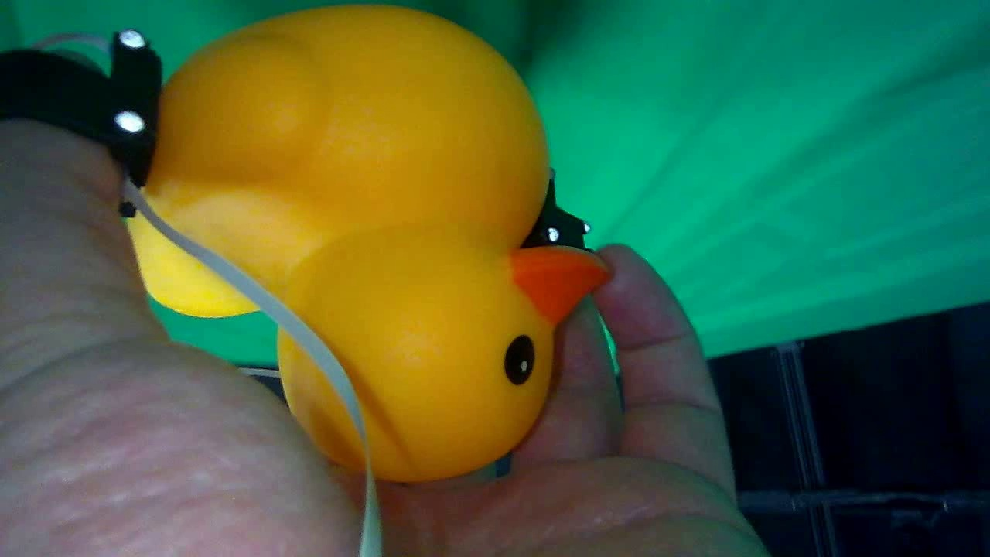










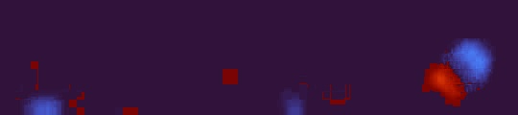
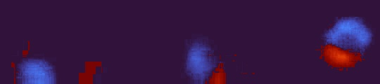














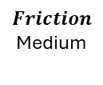






The image shows a object will be grasped…
Important observation rule:
Focus ONLY on the object being held by the gripper or hand. Ignore the robot hand, gripper, sensors, cameras… Reasoning rules: ... Output structure: ...Example output: ...
Understanding: The object appears to be a yellow rubber duck toy ...
Object type: rubber duck squeeze toy.
Mass hypotheses: low : confidence 0.85 ; evidence small toy …
medium : confidence 0.15 ; evidence be thicker rubber body than typical
Material hypotheses: ...
B.
Language Encoder
$$Offline$$
Before contact, using a frame and describe
$$F_{text}$$
a) Teleoperated grasp
b) Human hand grasp
c) Augmented grasp
C.
action seq.
Feature
0
…
GRU Cell
Cross- Attention // Pooling
Q
K
V
Head Layer
Content Stream $E^{c}$
$$Mass$$
Medium
Transformer Encoder
Transformer Decoder
Visual Window $∈ R^{15X160X90X3}$
Scaled Dot
Product Attention
Sequence visual feature
$Z_{v}$
Cross- Attention
GRU Cell
$$F_{v}$$
$$Gated$$
Contact
Property token
Wrist image
Joints
position embeddings
$$Stiffness$$
1.96 N/mm
0/1
Voting and Discretization
Visual Flow ${Flow}_{v }∈ R^{14X160X90X2}$
Motion Stream $E^{m}$
$$Skipped Connection$$
ViTacPhys
style variable: z
$$F_{fused}$$
Transformer Encoder
GRU Cell
Understanding: The object appears to be a yellow rubber duck…
Object type: rubber toy.
Mass hypotheses: …
Tactile Window $I_{t}∈ R^{15X180X40}$
$$Friction$$
Medium
…
[CLS]
joints
action seq.
Sequence tactile feature
$Z_{t}$
h
$$F_{t}$$
Fusion Module
VLM call
A.
Tactile Flow ${Flow}_{t}$ $∈ R^{14X180X40X2}$
Tactile Window $I_{t}$
Visual Window $I_{v}$

