Slide 1
PUMPING LEMMA FOR REGULAR SETS

Slide 2
Pumping Lemma provides a method to prove that certain languages are not regular. The Pumping Lemma states that for any regular language, there exists a length such that any string longer than this length can be divided into three parts, and by repeating or removing the middle part, the resulting string will also be in the language.

Slide 3
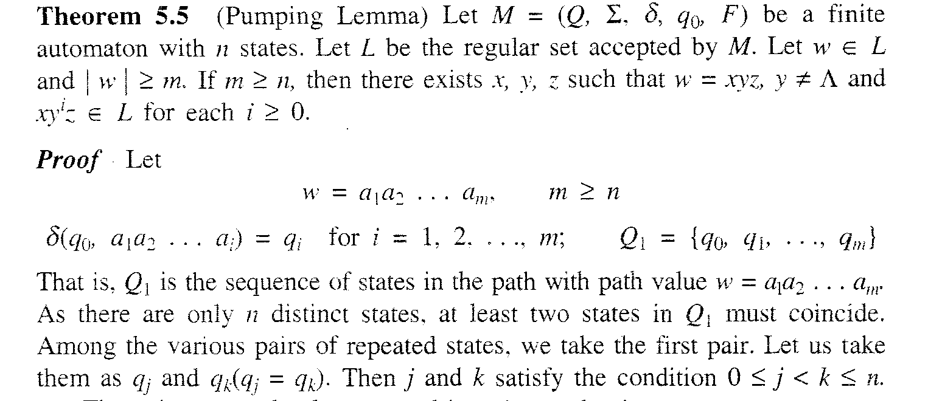

Slide 4
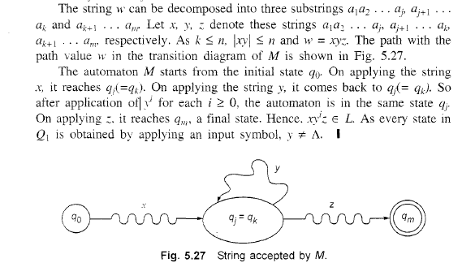

Slide 5
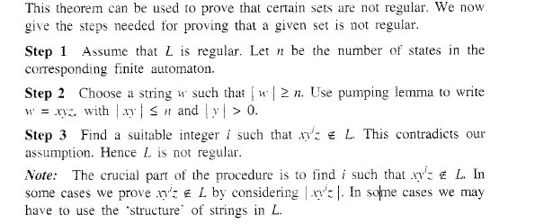
APPLICATION OF PUMPING LEMMA

Slide 6
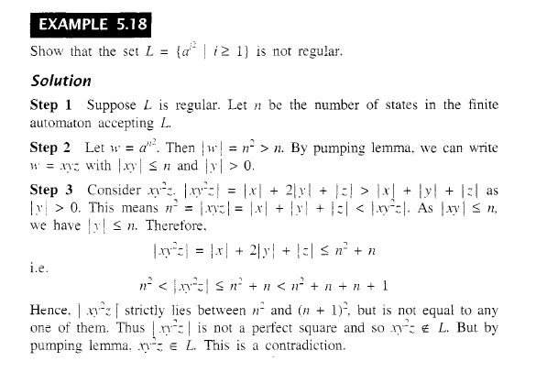

Slide 7
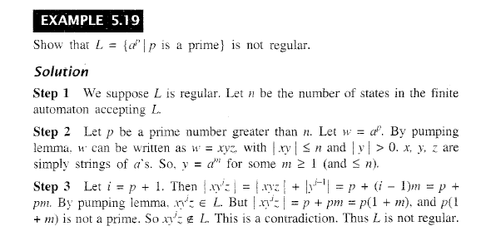

Slide 8
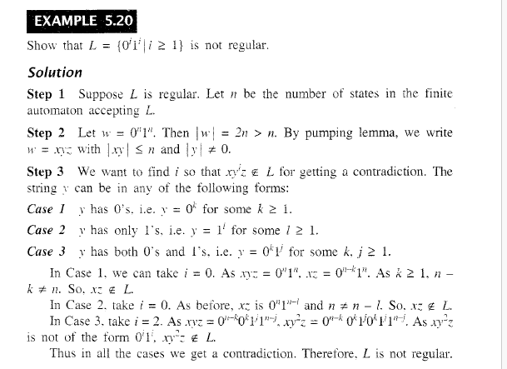

Slide 9
Generating regular expression from Finite Automata

