Slide 2
What is software-defined networking (SDN)?
SDN is an architecture designed to make a network more flexible and easier to manage. SDN centralizes management by abstracting the control plane from the data forwarding function in the discrete networking devices.

Slide 3
SDN elements
An SDN architecture delivers a centralized, programmable network and consists of the following: A controller, the core element of an SDN architecture, that enables centralized management and control, automation, and policy enforcement across physical and virtual network environments Southbound APIs that relay information between the controller and the individual network devices (such as switches, access points, routers, and firewalls) Northbound APIs that relay information between the controller and the applications and policy engines, to which an SDN looks like a single logical network device

Slide 4
SDN adoption
SDN has seen wide adoption across data centers (64%), WANs (58%), and access networks (40%). For more information on SDN trends, see the 2020 Global Networking Trends report.
SDN and IBN SDN serves as a foundational element of a comprehensive intent-based networking (IBN) architecture. SDN has been limited to automated provisioning and configuration. IBN now adds “translation” and “assurance” so you can automate the complete network lifecycle and continuously align the network to business needs. Watch our Beyond SDN webinar recording to explore more ways that intent is changing how we network.

Slide 5
Features and benefits
Simplify operations
Build programmable networks that auto-discover and auto-configure fabrics and switches.
Achieve faster troubleshooting
Improve the health of networks with network analytics, machine learning and predictive insights.
Improve security
Deploy consistent zero-trust access across your network with policy-based segmentation

Slide 6
Traditional Networking
Networking has always been very traditional. We have specific network devices like routers, switches, and firewalls that are used for specific tasks. These network devices are sold by networking vendors like Cisco and often use proprietary hardware. Most of these devices are primarily configured through the CLI, although there are some GUI products like CCP (Cisco Configuration Protocol) for the routers or ASDM for the Cisco ASA firewalls. A network device, for example, a router has different functions that it has to perform. Think for a moment about some of the things that a router has to do in order to forward an IP packet:

Slide 7
It has to check the destination IP address in the routing table in order to figure out where to forward the IP packet to.
Routing protocols like OSPF, EIGRP or BGP are required to learn networks that are installed in the routing table.
It has to use ARP to figure out the destination MAC address of the next hop or destination and change the destination MAC address in the Ethernet frame.
The TTL (Time to Live) in the IP packet has to be decreased by 1 and the IP header checksum has to be recalculated.
The Ethernet frame checksum has to be recalculated.

Slide 8
All these different tasks are separated by different planes. There are three planes: control plane data plane management plane Let’s take a look at the difference between these three planes…

Slide 9
Control Plane
The control plane is responsible for exchanging routing information, building the ARP table, etc. Here are some tasks that are performed by the control plane:
Learning MAC addresses to build a switch MAC address table.
Running STP to create a loop-free topology.
Building ARP tables.
Running routing protocols like OSPF, EIGRP, and BGP and building the routing table.

Slide 10
Data Plane
The data plane is responsible for forwarding traffic. It relies on the information that the control plane supplies. Here are some tasks that the data plane takes care of:
Encapsulate and de-encapsulate packets.
Adding or removing headers like the 802.1Q header.
Matching MAC addresses for forwarding.
Matching IP destinations in the routing table.
Change source and destination addresses when using NAT.
Dropping traffic because of access-lists.
The tasks of the data plane have to be performed as fast as possible which is why the forwarding of traffic is performed by specialized hardware like ASICs and TCAM tables.

Slide 11
Management Plane
The management plane is used for access and management of our network devices. For example, accessing our device through telnet, SSH or the console port.
When discussing SDN, the control and data plane are the most important to keep in mind. Here’s an illustration of the control and data plane to help you visualize the different planes:

Slide 12
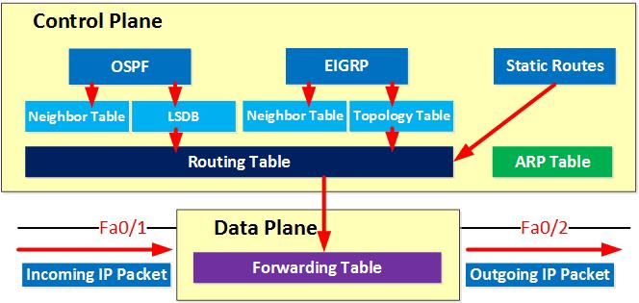
Above you can see the control plane where we use routing protocols like OSPF and EIGRP and some static routing. The best routes are installed in the routing table. Another table that the router has to build is the ARP table.
Information from the routing and ARP table is then used to build the forwarding table. When the router receives an IP packet, it will be able to forward it quickly since the forwarding table has already been built.

Slide 13
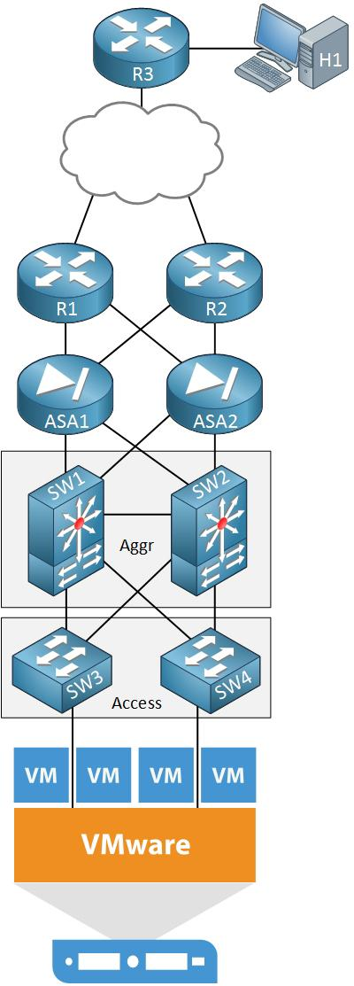
Limitations of traditional networking
Everything I described above is the way we have
done things for the last ~30 years so it’s
not like there is something “wrong” with
traditional networking. However, nowadays
there are some business challenges that
ask for different solutions.

Slide 14
Above we see the network infrastructure of a company’s data center. At the bottom, we find a VMware ESXi server with a number of virtual machines. This server is connected to some switches in the access and aggregation layers. We also see two ASAs that protect our server and two routers for access to the outside world. On top, there is another router with a host device.
Let’s say this company has a business requirement for a new application that requires four new virtual machines to be installed on the VMware server. For security reasons, each virtual machine should be in a different VLAN. A user that is using H1 behind R3 should be able to access the application that runs on these virtual machines.

Slide 15
Let’s consider some of the things we have to configure on our network to make this happen:
The VLANs have to be created on all switches.
We have to configure a root bridge for the new VLANs.
We have to assign four new subnets, one for each VLAN.
We need to create new sub-interfaces with IP addresses on the switches.
We need to configure VRRP or HSRP on the switches for the new VLANs.
We have to configure the firewalls to permit access to the new applications / subnets.
We have to advertise the new subnets in a routing protocol on our switches, routers, and firewalls.

Slide 16
Although there are network automation tools to help us, we often use the CLI to configure all of these devices, one-by-one. It’s a slow, manual process that a human has to do. While it only takes a few minutes to spin up a new virtual machine, it might take a few hours for the network team to prepare the network. Changes like these are also typically done during a maintenance window, not during business hours.
Server virtualization is one of the reasons why businesses are looking for something that speeds up the process described above. Before virtualization, we used to have one physical server with a single operating system. Nowadays we have multiple physical servers with hundreds of virtual machines.

Slide 17
These virtual machines are able to move automatically from one physical server to another. When they cross an L3 boundary, you don’t want to wait for the network team to make the required changes to routing or access-lists. It should be automatic.
The “trend” nowadays is that everything should be virtual. It’s not strange to see that this is also happening to networking. Large companies like Cisco that used to sell only proprietary hardware are now also offering virtual routers, ASAs, wireless LAN controllers, etc. that you can run on VMWare servers.

Slide 18
SDN (Software Defined Networking)
Like the buzzword “cloud” a few years ago, every organization or vendor has a different opinion about what SDN exactly is and different products that they offer.
Traditional networking uses a distributed model for the control plane. Protocols like ARP, STP, OSPF, EIGRP, BGP and other run separately on each network device. These network devices communicate with each other but there is no central device that has an overview or that controls the entire network.
One exception here (for those that are familiar with wireless networking) are the wireless LAN controllers (WLC). When you configure a wireless network, you configure everything on the WLC which controls and configures the access points. We don’t have to configure each access point separately anymore, it’s all done by the WLC.

Slide 19
With SDN, we use a central controller for the control plane. Depending on the vendor’s SDN solution, this could mean that the SDN controller takes over the control plane 100% or that it only has insight in the control plane of all network devices in the network. The SDN controller could be a physical hardware device or a virtual machine.
Here’s an illustration to help you visualize this:

Slide 20
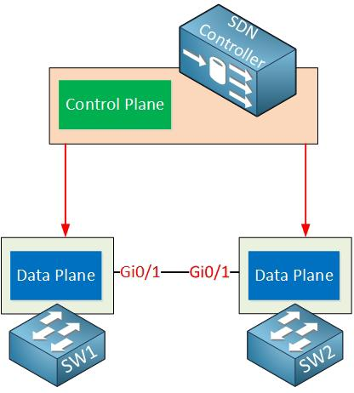
Above you can see the SDN controller which is responsible for the control plane. The switches are now just “dumb” devices that only have a data plane, no control plane. The SDN controller is responsible for feeding the data plane of these switches with information from its control plane.
There are some advantages and disadvantages of having a distributed vs a central control plane. One of the advantages of having a central controller is that we can configure the entire network from a single device. This controller has full access and insight of everything that is happening in our network.

Slide 21
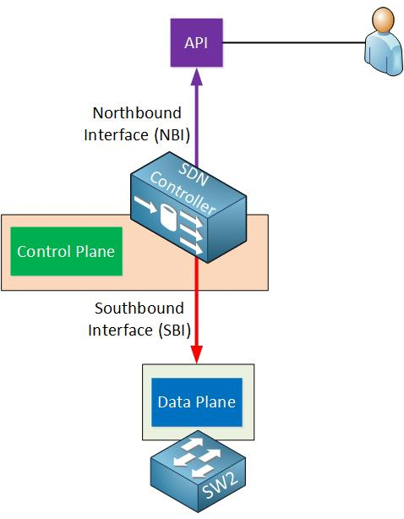
Let’s add some more detail to this story. The SDN controller uses two special interfaces, take a look at the image below:
The interfaces are called the
northbound interface (NBI) and
southbound interface (SBI).
Let me explain both…

Slide 22
Southbound Interface
The SDN controller has to communicate with our network devices in order to program the data plane. This is done through the southbound interface. This is not a physical interface but a software interface, often an API (Application Programming Interface).
An API is a software interface that allows an application to give access to other applications by using pre-defined functions and data structures. I’ll explain more about this in a minute.

Slide 23
Some popular southbound interfaces are:
OpenFlow: this is probably the most popular SBI at the moment, it’s an open source protocol from the Open Networking Foundation. There are quite a few network devices and SDN controllers that support OpenFlow.
Cisco OpFlex: this is Cisco’s answer to OpenFlow. It’s also an open source protocol which has been submitted to the IETF for standardization.
CLI: Cisco offers APIC-EM which is an SDN solution for the current generation of routers and switches. It uses protocols that are available on current generation hardware like telnet, SSH, and SNMP.

Slide 24
Northbound Interface
The northbound interface is used to access the SDN controller itself. This allows a network administrator to access the SDN to configure it or to retrieve information from it. This could be done through a GUI but it also offers an API which allows other applications access to the SDN controller. You can use this to write scripts and automate your network administration. Here are some examples:
List information from all network devices in your network.
Show the status of all physical interfaces in the network.
Add a new VLAN on all your switches.
Show the topology of your entire network.
Automatically configure IP addresses, routing, and access-lists when a new virtual machine is created.

Slide 25
Through the API, multiple applications are able to access the SDN controller:
A user that is using a GUI to retrieve information about the network from the SDN controller. Behind the scenes, the GUI is using the API.
Scripts that are written in Java or Python can use the API to retrieve information from the SDN controller or configure the network.
Other applications are able to access the SDN controller. Perhaps an application that automatically configures the network once a new virtual machine is created on a VMware ESXi server.

Slide 26
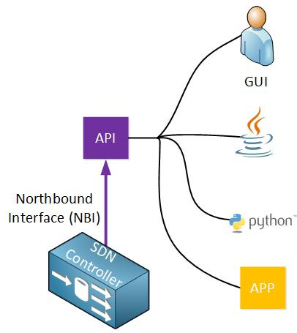

Slide 27
REST API
I have mentioned a few times that the north- and southbound interfaces use APIs. Let’s take a closer look at what an API is. SDN controllers typically use a REST API (Representational State Transfer).
The REST API uses HTTP messages to send and receive information between the SDN controller and another application. It uses the same HTTP messages that you use when you browse a webpage on the Internet or when you enter a contact form online:
HTTP GET: used when we want to retrieve information.
HTTP POST/PUT: used when we want to upload or update information.

Slide 28
It is similar browsing a webpage, only this time, you are not requesting a webpage or picture but a particular object from the SDN controller, for example, a list with all VLANs in the network.
When the SDN controller receives the HTTP GET request, it will reply with an HTTP GET response with the information that was requested. This information is delivered in a common data format. The two most used data formats are:
JSON (JavaScript Object Notation)
XML (eXtensible Markup Language)
Here’s an example to help you visualize this:

Slide 29
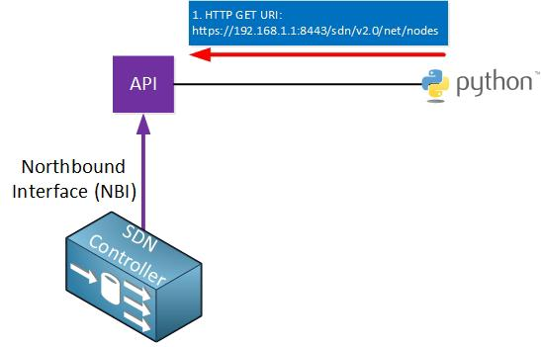
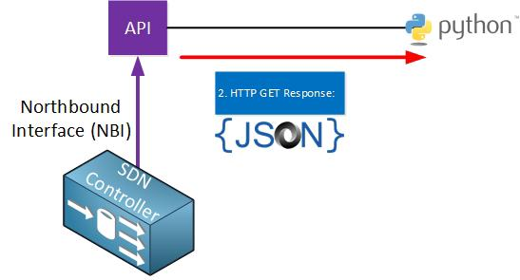
Above we have a python script that is using HTTP GET to fetch the following URL through the API:
https://192.168.1.1:8443/sdn/v2.0/net/nodes
This URL will retrieve some of the variables that are available, for example, information about all nodes (hosts) on the network.
Once the API receives this, it will respond with an HTTP GET response message:

Slide 30
Decoding the implications of software-defined networking in IoT
SDN is an innovative networking technology becoming increasingly important in software defined networking in IoT as it allows devices to communicate more easily and securely
Software-defined networking (SDN) is an innovative networking technology that empowers network administrators to efficiently oversee and govern network traffic through software, thereby eliminating traditional hardware-based monitoring methods. SDN not only facilitates the centralized management and security of networks by taking control over all devices, but it also orchestrates a fundamental architectural shift. This separation of network functions from hardware to software augments configurational and managerial flexibility, ultimately ushering in a new era for network administrators.

Slide 31
SDN separates the control of networking devices from the data processing functionality within the networking devices. This separation allows for more centralized management and flexibility when it comes to adapting the network to changing needs.
Components of SDN
Management plane: This plane is responsible for the overall network management of the SDN environment. It includes the SDN controller, which acts as the central brain of the network and manages the entire system. The management plane handles tasks such as network configuration, monitoring, provisioning and policy enforcement.
Control plane: This plane makes high-level decisions about how a network should operate. Acting as a bridge, it communicates with the management plane and translates the high-level network policies into low-level instructions for the data plane. The control plane uses protocols like OpenFlow to communicate with the data plane and manage network traffic.

Slide 32
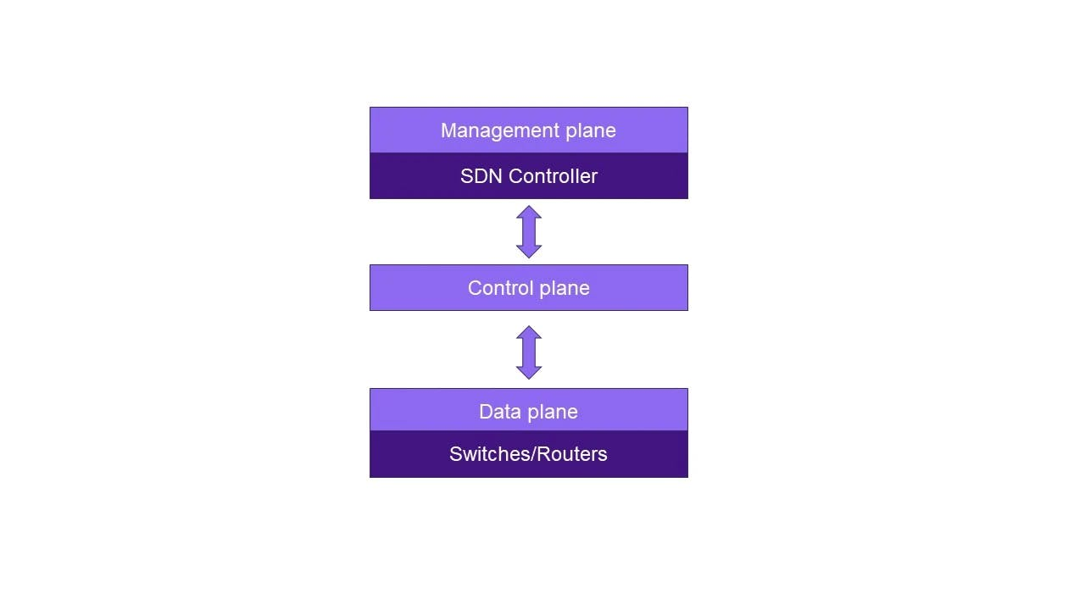
Data plane: The data plane or the forwarding plane is responsible for the actual forwarding of network traffic. It consists of switches or routers that are managed by the control plane. The data plane forwards packets based on the instructions received from the control plane.

Slide 33
By separating the control plane from the data plane and centralizing control through an SDN controller, software-defined networking provides flexibility, agility and programmability to networks. It allows for efficient network management, dynamic and adaptive traffic routing and the ability to implement innovative network services and applications to streamline and simplify the responsibilities of network administrators

Slide 34
Application of SDN in IoT
SDN is becoming increasingly important in IoT because it allows devices to communicate more easily and securely
SDN is becoming increasingly important in IoT because it allows devices to communicate more easily and securely. SDN can also help reduce the cost of deploying and managing IoT networks.
SDN is essential for the development of IoT because it provides the flexibility and centralized management that is necessary for a network of objects that are constantly collecting and sharing data. SDN allows for the adaptation of the network to changing needs which is essential for a network that is constantly growing and evolving. SDN also allows for the centralized management of devices, which is necessary for a network that is spread out over a large area.

Slide 35
Centralized control: SDN enables centralized control and management of the entire IoT network, allowing administrators to efficiently monitor, configure and update network devices from a single point of control. This provides better visibility and control over network management.
Scalability: SDN helps in scaling IoT networks by allowing for the easy addition and removal of devices without complete manual configuration as the number of IoT devices increases.
Enhanced security: Security is a critical concern in IoT networks. SDN allows for centralized security policies, making it easier to implement and enforce security measures across the entire network. It helps in threat detection for IoT devices.
Traffic optimization: SDN helps in efficient traffic routing and load balancing in IoT networks. It ensures that data flows through the most optimal paths. This helps in improving network performance and reducing latency.
Resource optimization: With SDN, administrators can optimize resource allocation in IoT networks. They can allocate bandwidth dynamically, prioritize critical traffic, and optimize network resources based on real-time requirements. This helps in improving overall network efficiency.

Slide 36
Potential drawbacks of using SDN in IoT networks:
Single point of failure: Since SDN relies on a centralized SDN controller, any failure in the controller can have a major impact on the entire network. This single point of failure can potentially disrupt operations until the controller is rectified.
Network dependency: SDN in IoT networks heavily relies on network connectivity and uninterrupted communication with the SDN controller. In case of network outages or connection issues, the network may become inaccessible or experience limited functionality.
Latency: The dependency on a centralized SDN controller can introduce additional latency into the network. All decisions and routing instructions must pass through the controller, which can introduce delays in data transfer to network devices, especially in large-scale IoT deployments.
Complexity: Implementing and managing software defined networking in IoT networks requires expert knowledge and specialization. It can be complex to set up and configure, requiring administrators to have a deep understanding of SDN concepts and protocols.
Cost: Implementing SDN in IoT networks may require additional investments in hardware, software and expertise. The cost of acquiring and maintaining SDN infrastructure, specialized controllers and compatible devices may be higher compared to traditional networking solutions.

Slide 37
Data Handling
Data handling means gathering, organizing, storing, and working with information to find useful insights. Generally, It includes tasks like putting in data, checking it, cleaning it, analyzing, and showing results. However, Good data handling helps make sure information is correct, dependable, and safe, helping people make smart choices in different areas and industries.

Slide 38
Types of Data Handling
Generally, there are two main types of data, and the methods for managing it can be customized based on its nature.
Qualitative Data: Particularly, Qualitative data gives details and descriptions about a topic.
Quantitative Data: Quantitative data provides numbers and has two types.
Discrete Data: Discrete data means it can only be specific whole numbers and not in-between values.
Continuous Data: Continuous data can be any value within a certain range.
In addition, knowing what kind of data you have helps you use the right methods for analyzing and understanding it better.

Slide 39
Data Handling Steps
Handling data involves 8 major steps to ensure that data is collected, processed, analyzed, and utilized effectively. Below are the eight key steps:
Define Objectives: Collect and arrange data to improve understanding and make informed decisions. The goal is to use data effectively for smarter choices.
Data Collection: Gather precise data from diverse sources—databases, surveys, sensors, and APIs. In short, Verify accuracy, ensure completeness, and present a comprehensive overview of the issue/question.
Data Entry: Organize data in a database or spreadsheet, cleaning errors, duplicates, and irrelevant details to ensure accuracy and clarity.
Data Cleaning: Find and deal with information that's not there or doesn't match. This involves adding in missing values, fixing mistakes, and making sure everything follows the same format to keep the data accurate.

Slide 40
Data Transformation: Change the data as needed to analyze it better. However, This might mean making sure everything is on the same scale, turning categories into numbers, or combining data differently.
Data Storage: Pick the right place to store your data, like a relational database, NoSQL database, data warehouse, or cloud storage, depending on how much data you have and what kind of data it is.
Data Retrieval: Create ways to get the data you need quickly. However, This could mean writing SQL queries, using API calls, or other methods, depending on how you stored the data.
Data Exploration and Analysis: Look at the data closely to find interesting information, see patterns, and notice trends. This usually includes using statistics, creating visual representations, and using machine learning methods.

Slide 41
Data handling also contains steps like Data Interpretation, Presentation, Security and Privacy, Documentation, Continuous Monitoring, and Improvement. These steps help organizations handle and use data well, making smart decisions and solving problems based on good information. Data Handling and the Data Science Lifecycle are closely related but serve different purposes in the data workflow.

Slide 42
Data Handling Uses
Businesses use it to make decisions and improve how they work. However, Scientists use it for experiments and understanding things. In healthcare, it helps manage patient records and do medical research.
Schools use it for grading students and managing tasks. It is also important to keep information safe online. It helps in many areas to make good choices and work better.

Slide 43
How to Represent the Data?
In data handling, we use tables to organize information in rows and columns, making structured data easy to understand. Generally, Graphs and charts help us see trends and relationships in the data, making analysis simpler.
Use diagrams, such as flowcharts or mind maps, to show processes or connections in your data. However, Pick the representation method that suits your data and the insights you want to convey, making it easy for others to understand, like:
Bar Graphs
Line Graphs
Pictographs
Histograms
Stem and Leaf Plots
Dot Plots
Frequency Distributions
Cumulative Tables and Graphs

Slide 44
Data Handling Skills
Data handling skills mean being good at collecting and understanding information. Generally, It is important to know how to use tools for processing data, analyzing statistics, and managing databases. Paying close attention to details, thinking critically, and solving problems are crucial for making sure data is accurate. Also, showing data in easy-to-understand visuals is part of these skills. However, These abilities are important in areas like business, research, and technology, where making smart decisions depends on managing and understanding data well.

Slide 45
Example of Data Handling
Imagine a small store tracking its daily sales. They use a table with columns like date, product name, quantity sold, and total revenue to organize sales data. A bar chart helps visualize monthly sales trends, and a flowchart illustrates the sales process, making it easier to manage inventory and serve customers. In addition, These methods organize, analyze, and understand data for better business decisions.

