Slide 1
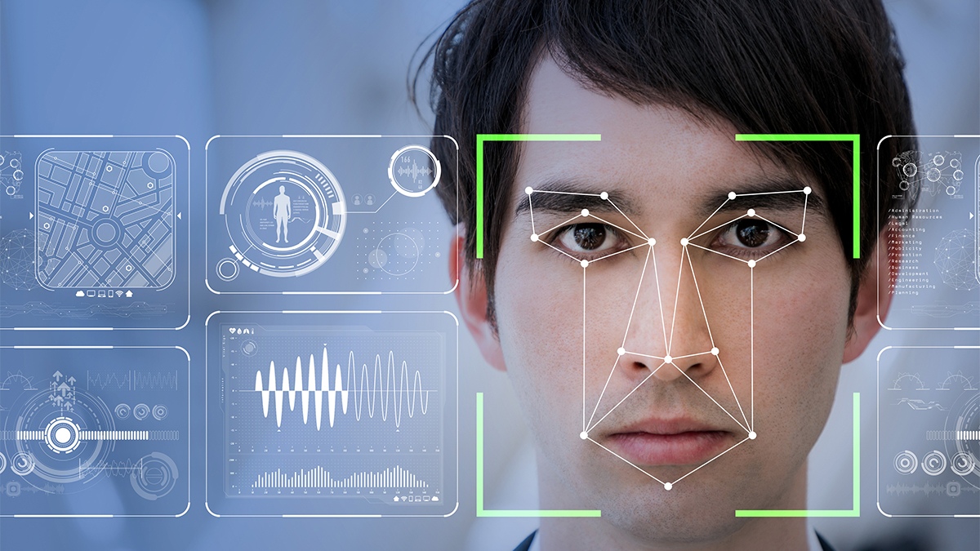
Face Recognition Attendance System
Created By – Via5k
Roll No – XxxXxxX
B.Tech [CSE]

Slide 2
AIM OF THE PROJECT
The main purpose of the this project is to create a face recognition attendance system to enhance the traditional way of recording data. The current traditional way of recording attendance has lot of ambiguity that results in false information, and sometimes recording of someone else’s attendance in someone else’s.
The face is one natural trait that is almost different in every person, we will be using face to recognise who the person is and the other details.
Then, during the scan of face, attendance will be marked for the student, which can be easily retrieved by opening the excel file that has been created.

Slide 3
LIBRARIES USED
OPEN CV
DLIB
OS
DATE TIME
FACE RECOGNITION
WHEEL

Slide 4
OPEN CV
OpenCV is a cross-platform library using which we can develop real-time computer vision applications. It mainly focuses on image processing, video capture and analysis including features like face detection and object detection.

Slide 5
DLIB
Dlib is an open source modern C++ library implementing many machine learning algorithms.
The dlib library provides two functions for face detection. The first one is a HOG + Linear SVM face detector, and the other is a deep learning MMOD CNN face detector

Slide 6
OS
Python OS module allows us to use the operating system dependent functionalities and to interact with the underlying operating system in several different ways. For example, we can work with files, change the environment variables, and we can move files around, etc. This is as same as overriding all the os built-in functionalities in a module and using them in a file I/O and system handling.

Slide 7
DATE TIME
Python module datetime consists of 6 different function from which i am going to use “datetime”.
Datetime is a combination of date, month, year, time in minute, hours, seconds. Which returns date, month and year when called. This is used for attendance marking in the system.

Slide 8
FACE RECOGNITION
Recognize and manipulate faces using python. It is build using dlib’s state of art face recognition built with deep learning.
Face recognition is a method of identifying or verifying the identity of an individual using their face. There are various algorithms that can do face recognition but their accuracy might vary

Slide 9
METHODOLOGY
Installation of libraries that are necessary
Reading the image (source)
Detecting the face location in the image (source)
Encoding the image (source)
For correct detection, using a rectangle box to check if the face has been detected properly (source)
Same set of above instructions are followed for input (input)

Slide 10
METHODOLOGY
Comparing the detected face of image from source image to the input image. If the image matches then we proceed further, otherwise we do not.
If the two faces match, we analyse with the face distance that how much is the face matching for accuracy.
After this, we store the detected face name (which was earlier image name that was given to the program as a source image) and time.
Then we check for if the face is read again for the same day, we do not store the result again, if not then we store the results.

Slide 11
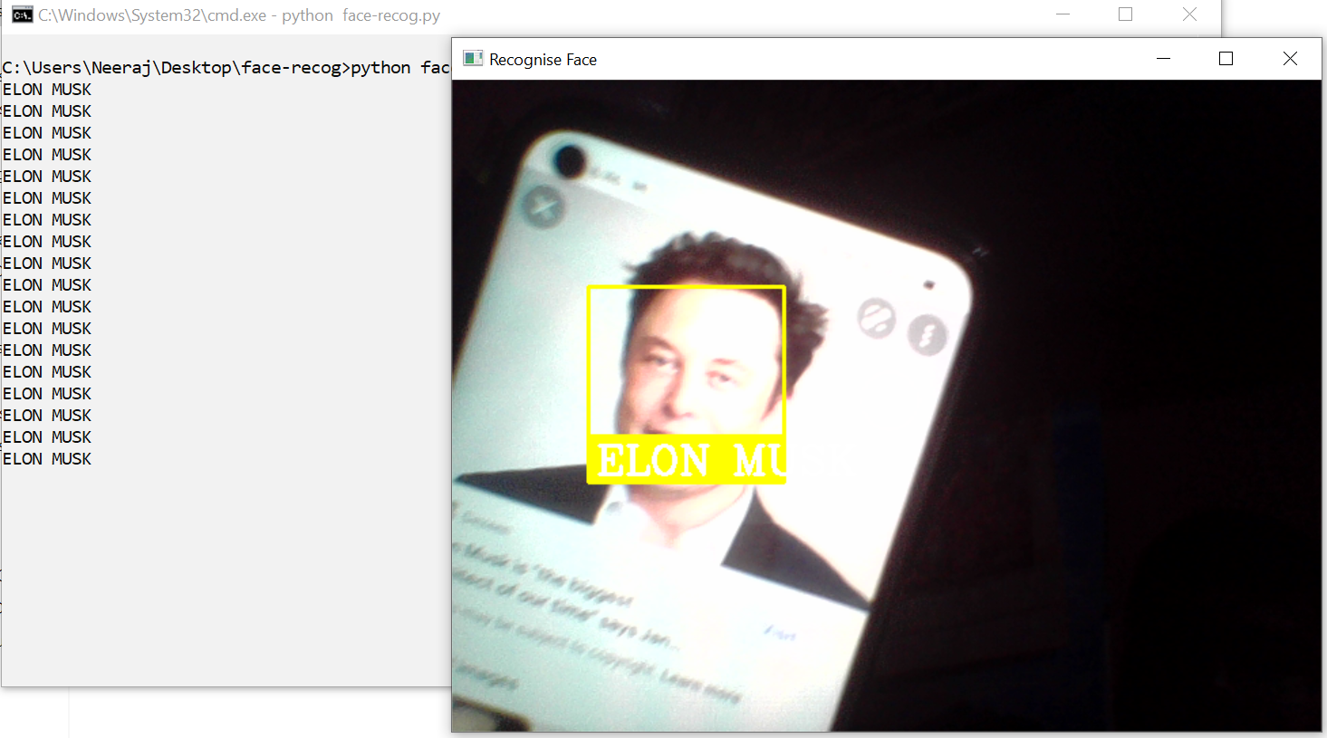
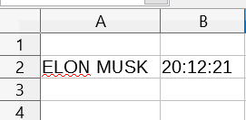
SCREENSHOT
Attendance Table Showing the information of recognized faces.

Slide 12
THANK YOU

