Slide 1

VIACLIN
SUPPLY CHAIN CONSULTANCY
Life Sciences & AI-Integrated Supply Chain Excellence
Notes:
Title slide. Introduce Viaclin as a specialist life sciences supply chain consultancy with embedded AI capability. Audience: COOs and CEOs.

Slide 2



THE CHALLENGE
Fragmented Operations
Reactive Decision Making
Regulatory & Compliance Exposure
Clinical and commercial supply chains managed across siloed teams — no unified ownership, constant handoff gaps, and compounding risk.
Delayed responses to demand signals, regulatory changes, and manufacturing disruptions. Leaders acting on stale data with limited AI support.
Increasingly complex GMP, FDA, EMA, and ICH requirements demand specialist expertise that most internal teams cannot sustain alone.
Notes:
Set the context. Life sciences supply chains are uniquely complex. Highlight the problem Viaclin solves before presenting the solution.

Slide 3
WHO WE ARE
A specialist life sciences supply chain consultancy — with embedded AI capability built in.
3
EU · US · UK
Core Pillars
Remote-first global team
Viaclin was built to solve the problems that generalist consultancies cannot. We operate at the intersection of deep supply chain expertise and practical AI integration — providing both hands-on execution and strategic oversight across the full life sciences supply chain.
Our consultants are senior practitioners with direct experience in pharmaceutical, biotech, and MedTech supply operations — not analysts learning on your time.
GxP
AI
Fully compliant operations
Purpose-built agent capability
Notes:
Brief company overview. Emphasise the specialist positioning — not a generalist firm — and the AI-native differentiation.

Slide 4


THE NAVIGATOR IDENTITY
Three Pillars of Viaclin Excellence
01
02
03
PREDICTIVE
PLANNING
COMPLETE
OVERSIGHT
AI
INTEGRATION
Proactive Management
End-to-End Execution
Guided Decision Making
Full enterprise S&OP ownership — deploying SAP and Anaplan to align clinical demand, commercial rollout, and manufacturing capacity. Optimised buffer stock, eliminated overproduction, capital where it belongs.
Total ownership from high-tech packaging and cross-border logistics to CDMO tech transfers and global site readiness. No siloed teams. No gaps between functions.
Purpose-built AI agents that act as navigators for supply professionals and leaders — bridging manual activity and full autonomy, providing insights that de-risk your supply chain.
Notes:
Core value proposition slide. Three pillars = Predictive Planning (SAP/Anaplan), Complete Oversight (end-to-end), AI Integration (proprietary agents). Stress the 'navigator' concept.

Slide 5

PILLAR 1 — PREDICTIVE PLANNING
Proactive Management
S&OP PLANNING CYCLE
We take full enterprise ownership of S&OP — deploying advanced forecasting via SAP and Anaplan to align clinical demand, commercial rollout, and manufacturing capacity.
1
Demand Review
Clinical forecasting & commercial planning
2
Supply Review
Enterprise S&OP ownership across clinical and commercial
CMO/CDMO capacity & inventory alignment
SAP & Anaplan advanced forecasting deployment
3
Pre-S&OP
Clinical demand & manufacturing capacity alignment
Gap analysis & scenario modelling
Optimised buffer stock — eliminate overproduction
Executive S&OP
4
Capital allocation optimisation
Leadership decisions & financial alignment
Notes:
Pillar 1 deep dive. Stress the SAP/Anaplan capability. S&OP cycle shows structured governance.

Slide 6




PILLAR 2 — COMPLETE OVERSIGHT
End-to-End Execution Across Every Critical Function
CDMO / CMO
Management
Clinical Supply
Operations
Packaging &
Labelling
Global Logistics
& Cold Chain
Regulatory &
Compliance
Tech Transfer
& Scale-Up
No handoffs between siloed teams. No gaps between functions. One integrated operational stack.
Notes:
Pillar 2 deep dive. The key message is unified ownership — not fragmented sub-contractors. Reference CDMO transfers and cold chain as differentiators.

Slide 7


PILLAR 3 — AI INTEGRATION
THE NAVIGATOR SPECTRUM
MANUAL
VIACLIN GUIDED AI
FULL AUTONOMY
Supply Navigator
Decision Advisor
Workflow Accelerator
Monitors inventory positions, demand signals, and supply exceptions — surfacing prioritised actions for supply planners in real time.
Provides scenario modelling and risk analysis for COOs and supply leaders, reducing time-to-decision and improving confidence.
Automates repetitive supply chain tasks: RFQs, contract summaries, label generation, and compliance documentation drafts.
Notes:
AI Integration slide. Key message: our agents are NOT full autonomy tools — they are navigators. That positioning de-risks AI adoption for cautious pharma leaders.

Slide 8

WHAT WE CAN HELP WITH
SCM SUPPORT ACTIVITY
BESPOKE SERVICES
Greenfield buildout & end-to-end project management
CMO / CDMO management
AI Agent Implementation
SOP creation and implementation
Packaging & labelling — serialisation
Clinical supply operations — IRT, pharmacy manuals
Global logistics management
AI Training & Upskilling
CRO performance ownership
Predictive planning & S&OP
Supply Transformation
Tech transfer, scale-up & PPQ
Full commercial supply support
Interim Senior Support
Notes:
Full service menu. Left side = core retainer-style consulting. Right = premium bespoke engagements including AI. Emphasise breadth without losing specialist identity.

Slide 9
CLINICAL SUPPLY EXPERTISE
From IND to commercial launch — we own the full clinical supply lifecycle.
IRT / IXRS Management
Label & Packaging Operations
End-to-end IRT oversight — setup, site management, audit trails, and controlled decommissioning.
Label generation, translation management, global reconciliation, and controlled destruction protocols.
Cold Chain & GDP Logistics
Inventory Reconciliation
Temperature-controlled shipping, excursion management, Envirotainer/LN2 logistics across borders.
Full global reconciliation — DS, DP, reference standards, raw materials — with final disposition strategy.
CMO / CDMO Close-Out
Regulatory Compliance
Campaign close-out, MBR archiving, cancellation negotiations, and material liability settlement.
21 CFR Part 11, Annex 11, import/export licence management, and cross-border IMP returns.
Notes:
Clinical supply specialist credentials. Key proof points: IRT, cold chain, CDMO close-out, global compliance. Show depth, not just breadth.

Slide 10
SUPPLY CHAIN WIND-DOWN & CLOSE-OUT
A critical, often under-resourced phase. Viaclin provides structured, risk-based close-out programme management.
01
Inventory Reconciliation
02
IRT / IXRS Shutdown
03
CMO / CDMO Close-Out
DS/DP, reference standards, raw materials — global scope with final disposition.
Patient supply continuity, system decommission, full audit trail archival.
Slot cancellations, MBR archiving, IP security, financial settlement.
04
Label & Packaging Ops
05
Cold Chain Decommission
06
Customs & Trade Close
Global reconciliation and controlled destruction of unused clinical labels.
Temp data archival, datalogger close-out, container and depot wind-down.
Import/export licence closure, bond settlement, cross-border IMP returns.
Notes:
Specialist wind-down service. Many pharma companies approach this reactively. Position Viaclin as the structured programme lead for trial close-out.

Slide 11
OUR GLOBAL TEAM
Diverse, senior consultants distributed across Europe, the US, and the UK. Fully remote and integrated.
EUROPE
UNITED STATES
UNITED KINGDOM
Regulatory expertise across EMA, HPRA, and MHRA markets. Clinical supply hubs in Ireland, UK, Germany, and Netherlands.
FDA regulatory fluency. Commercial supply and strategic sourcing coverage across major US pharma clusters.
Post-Brexit import/export specialisms. MHRA-experienced quality and supply chain consultants.
Senior Practitioners
GxP Fluent
AI-Native
Remote-Ready
Not analysts — experienced operators
FDA, EMA, MHRA, ICH compliant
Practical, not theoretical AI use
Fully integrated across time zones
Notes:
Team slide. Emphasise seniority and real-world operational experience — not juniors managed from afar. Remote model is a feature, not a limitation.

Slide 12


WHY VIACLIN
What sets us apart from generalist and specialist alternatives
Specialist, not generalist
Embedded AI capability
Built exclusively for life sciences. No learning curve on regulatory frameworks, GxP requirements, or clinical supply complexity.
AI is not an add-on — it is native to our operating model. We deploy purpose-built agents trained on supply chain operations.
Senior-only delivery
Full operational ownership
Every engagement is led and delivered by senior practitioners. No bait-and-switch from partners to analysts.
We do not advise from the sidelines. Viaclin takes accountability for outcomes — not just recommendations.
Notes:
Competitive differentiation. Key message: we are not a big 4 firm, not a staffing agency, not a tech vendor. We are specialist operators who use AI as a tool.

Slide 13
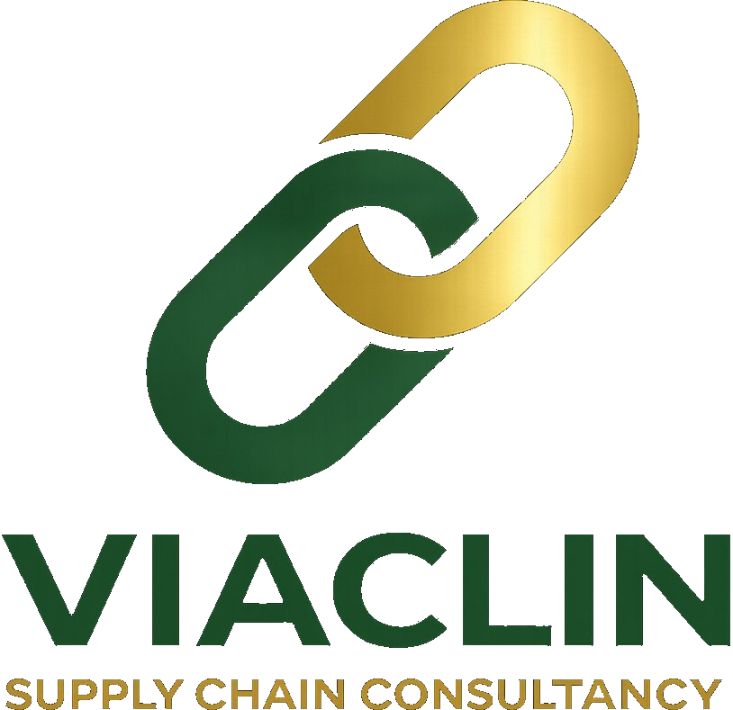
LET'S BUILD YOUR SUPPLY CHAIN
CAPABILITY TOGETHER.
Schedule a discovery conversation
contact@viaclin.com | www.viaclin.com
Notes:
Close with confidence. Ask: 'What is the one supply chain challenge that keeps you up at night?' Position next step as a 30-minute discovery call, no-commitment.

