Slide 1

Clustering of French Cities

Slide 2
Clustering of french cities is valuable for government
Regional deputees cost a lot of money and their number often sparks debates
In 2016, a reform divided by 2 the number of regions in France
Redefining France split and merging regions was not obvious
Was this done effectively ?

Slide 3
Data
Cities (Coordinates, Altitudes, Population, Density, Area) obtained from https://www.data.gouv.fr/
Weather (temperature, humidty, wind intensity and direction) data from Openweather API : https://openweathermap.org/api
Venues (Restaurants, Parks, Train Stations, Airports, Beaches) from Foursquare API : https://developer.foursquare.com/

Slide 4
Clustering
Defined 13 clusters
Randomly initialized the centroids
Used 72 features

Slide 5
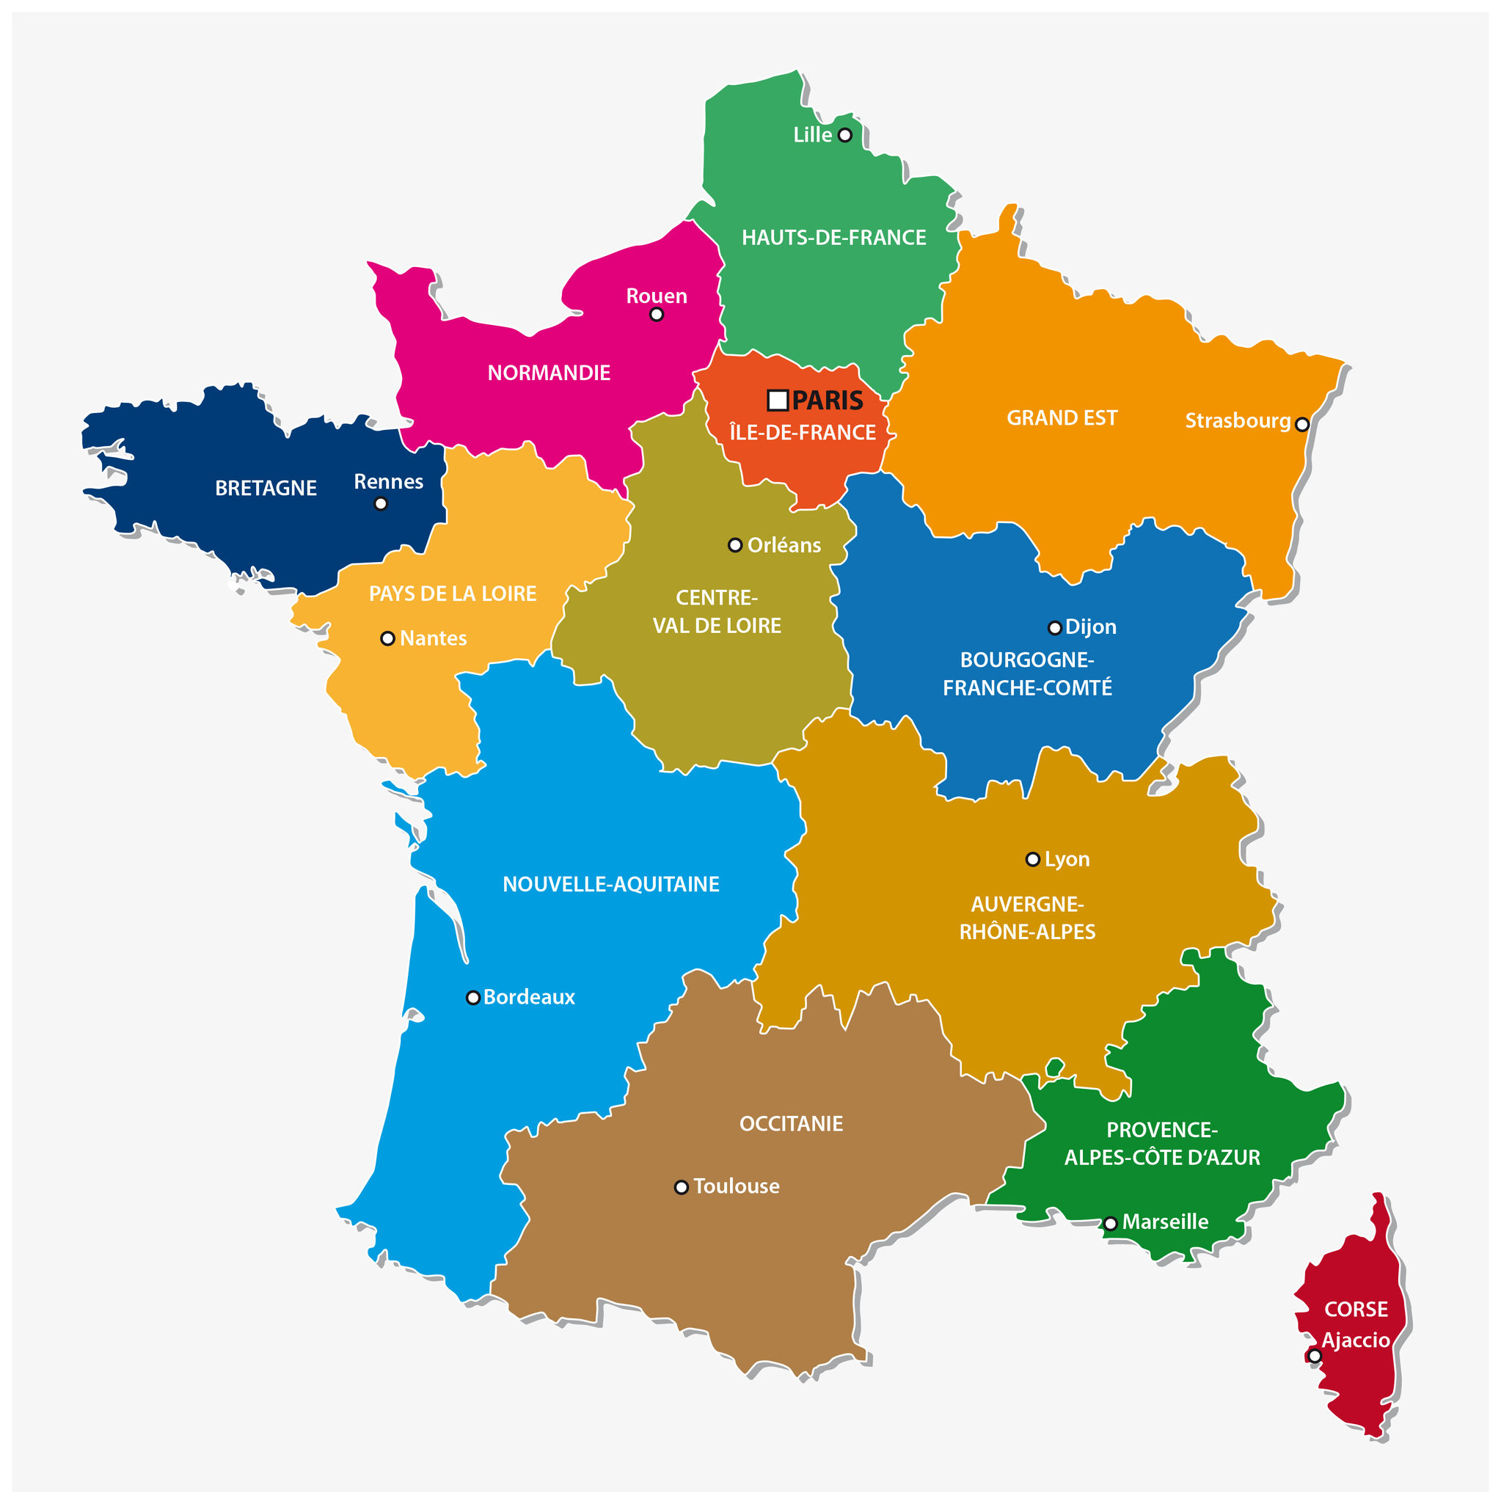
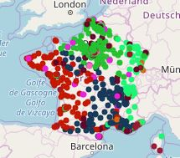
results

Slide 6
discussion and conclusion
Not production level ready for now
Replace (current) weather data by climate data (i.e. historical weather data)
Better filtering of cities required
Fine tune feature selection and feature weighing

