Slide 1



Team Details
  Team name: VibeRick
  Team leader name: Jaeho Shin
  Problem Statement: Media, Content & Digital Experiences — creators reach only the viewers who speak their language. VibeRick Dub turns one video into dubbed tracks in the creator's own voice.

Slide 2
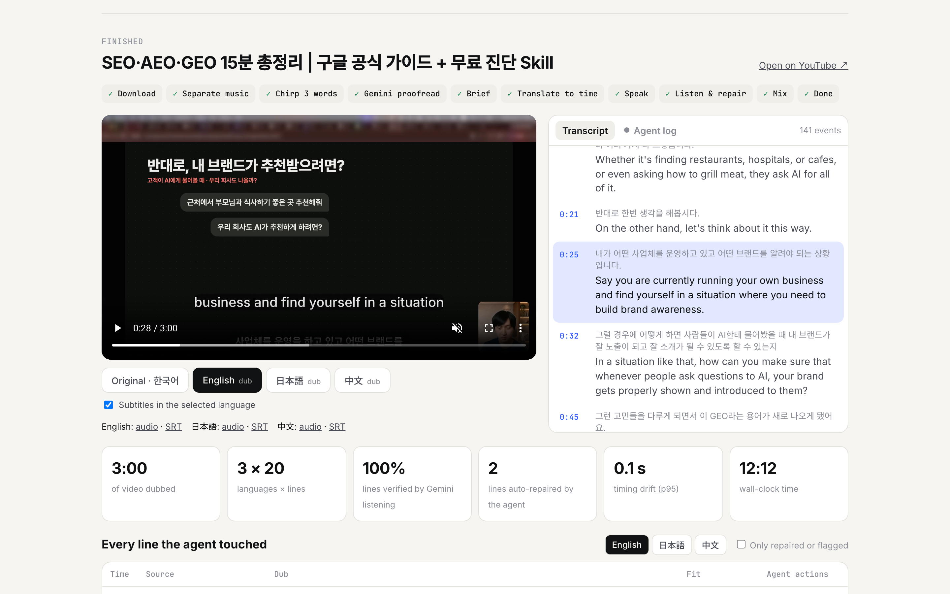
Brief about the idea
One video. Every language. Your own voice.
Paste a YouTube link. An AI agent built on Gemini transcribes it, translates every sentence to fit its timing, speaks it in the creator's own cloned voice, then listens back to every line and repairs what doesn't sound right.
The creator gets dubbed tracks and subtitles ready for YouTube's multi-language audio — in minutes, for cents per minute, with consent built in: the cloned voice is used only for the person who recorded it.
Languages today: Korean · English · Japanese · Chinese (source detected automatically).

Slide 3
Opportunities
How is it different from existing ideas?
• YouTube auto-dubbing: not the creator's voice, cannot be edited, and Korean sources get only English and Indonesian. VibeRick Dub speaks in the creator's own voice, in any of our languages, and shows every line.
• Voice-clone dubbing services (ElevenLabs, Rask, Perso) charge ~$0.33–2.20 per minute and run open-loop. Our agent listens to every dubbed line with Gemini and repairs it, for ~$0.05 per dubbed minute.
How will it solve the problem?
• YouTube: creators who add multi-language audio get over 25% of watch time from other languages. VibeRick Dub makes that track a one-link job instead of a studio booking.
USP
• Own voice + time-fitted translation + a self-verifying agent + consent by design (two locks: channel consent and speaker verification), all on Google Cloud.

Slide 4
List of features offered by the solution
Creator's own voice
Gemini 3.8 Flash TTS voice replication from a 20 s sample + spoken consent
Translation that fits the clock
Each sentence gets a character budget from its time slot and the voice's measured speed
Self-verifying agent
Gemini listens to every dubbed line; too long → shorten, wrong → re-speak → re-translate → flag
Accurate transcript
Chirp 3 timings + Gemini proofreading by listening (7.6% CER, on par with the best tool we tested)
Multi-speaker
Chirp 3 diarization; Gemini casts a fitting preset voice for every other speaker
Consent lock
Clone only for the channel owner whose voice verifies against the consent recording
Live studio
Watch the agent work in real time; switch languages on the video; synced transcript
Ready to upload
Dubbed MP4 + M4A (−14 LUFS, original music kept) + SRT/VTT subtitles

Slide 5
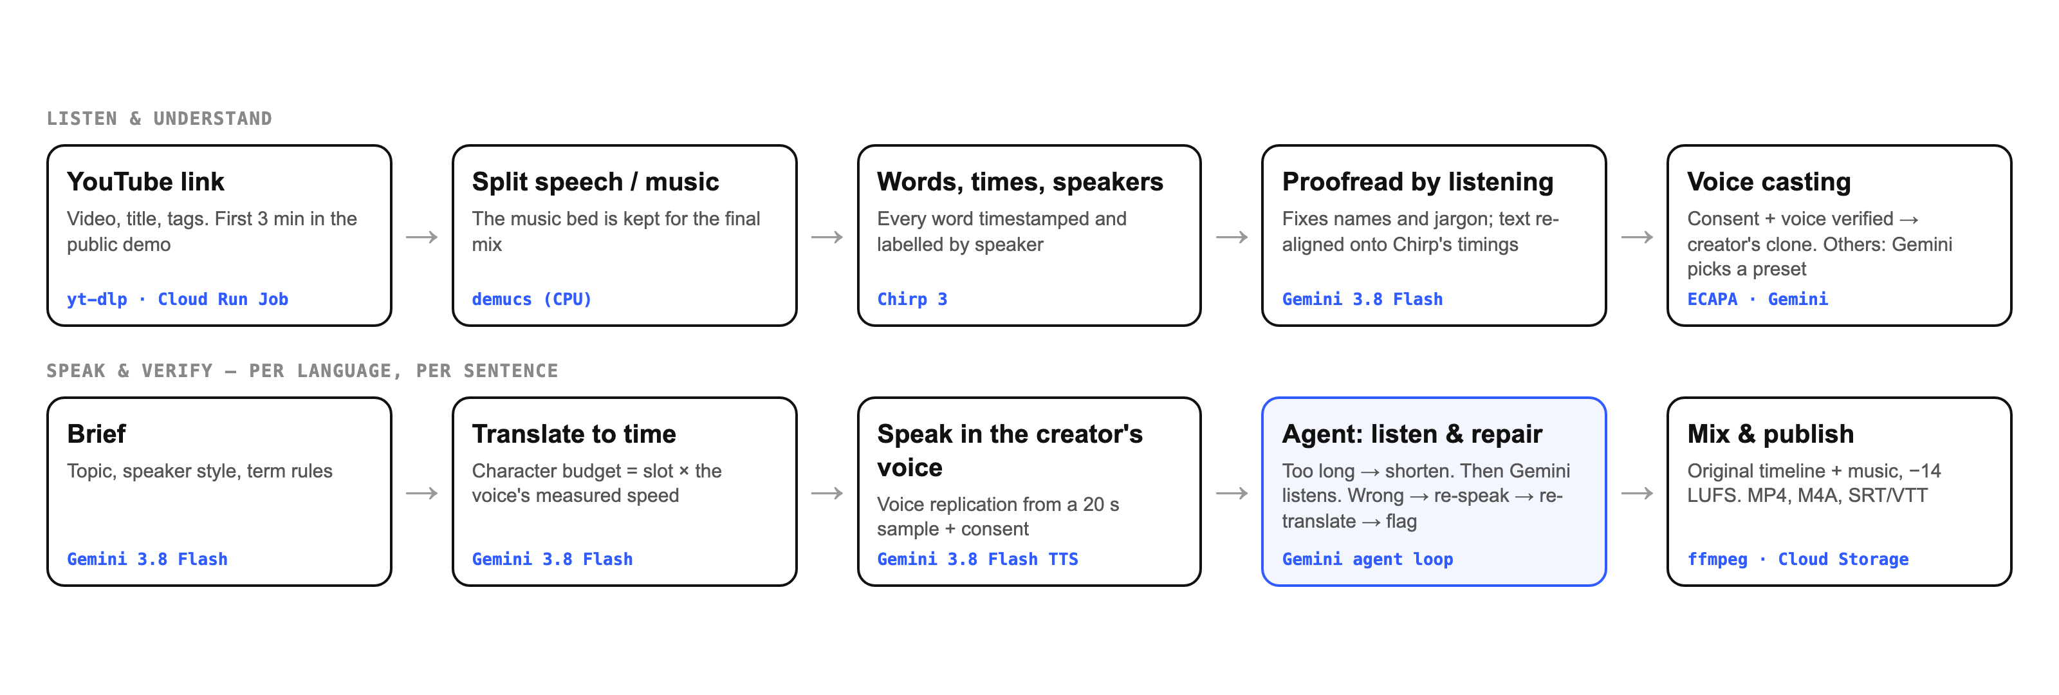
Process flow diagram

Slide 6
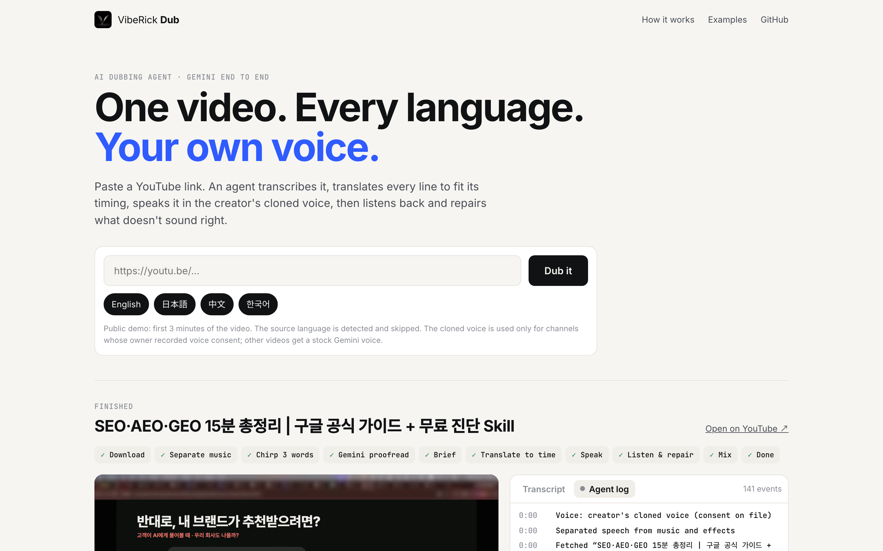
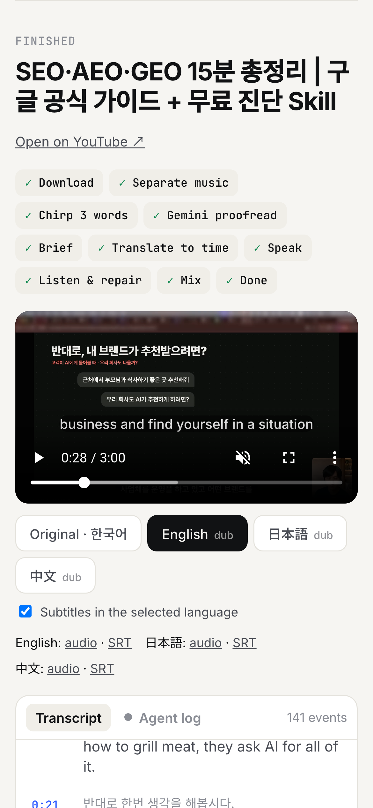
Wireframes / mock: the live product

Slide 7
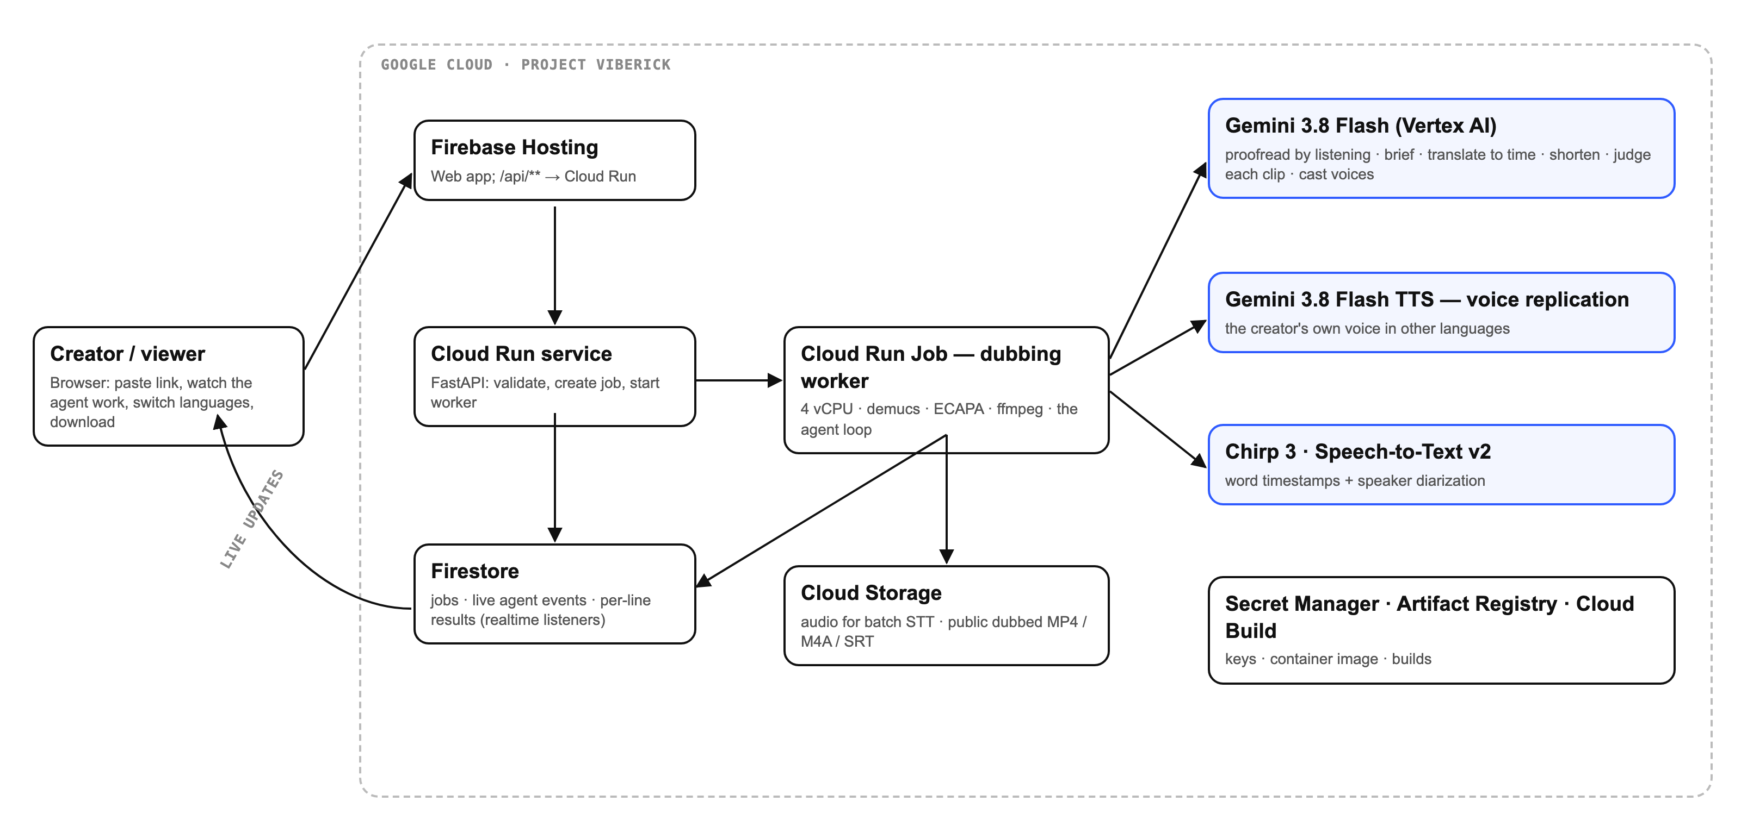
Architecture diagram of the proposed solution

Slide 8
Technologies used in the solution
Technology | Role
Gemini 3.8 Flash (Vertex AI) | Proofread by listening · dubbing brief · translate to time · shorten · judge every clip · cast voices
Gemini 3.8 Flash TTS — voice replication | The creator's own voice in other languages (SynthID watermarked)
Chirp 3 (Speech-to-Text v2) | Word timestamps + speaker diarization — the timing backbone
Cloud Run (service + Job) | FastAPI API · dubbing worker (4 vCPU, demucs, ECAPA, ffmpeg)
Firestore | Jobs, live agent event stream, per-line results (realtime listeners)
Firebase Hosting | Web app; /api/** rewritten to Cloud Run
Cloud Storage | Batch STT input; public dubbed MP4/M4A/SRT/VTT
Secret Manager · Artifact Registry · Cloud Build | Keys · container image · builds
Open source | demucs (music bed), ECAPA-TDNN (speaker verification for the consent lock), yt-dlp, ffmpeg

Slide 9
Estimated implementation cost
Per dubbed minute (measured) | USD
Gemini 3.8 Flash text + listening checks | 0.008
Gemini 3.8 Flash TTS (25 audio tokens/s, $9/1M) | 0.014
Chirp 3 (per source min ÷ 3 languages) | 0.005
Cloud Run Job (4 vCPU) | 0.003
Total | ≈ 0.03
Voice-clone dubbing | USD / min
ElevenLabs | 0.33 – 2.20
Rask AI | ≈ 1.56
Perso AI | ≈ 0.55 – 0.73
VibeRick Dub | ≈ 0.03
Competitor list prices checked 2026-10-10. Fixed cost: Cloud Run scales to zero; Firestore and Hosting stay within the free tier for the demo.

Slide 10
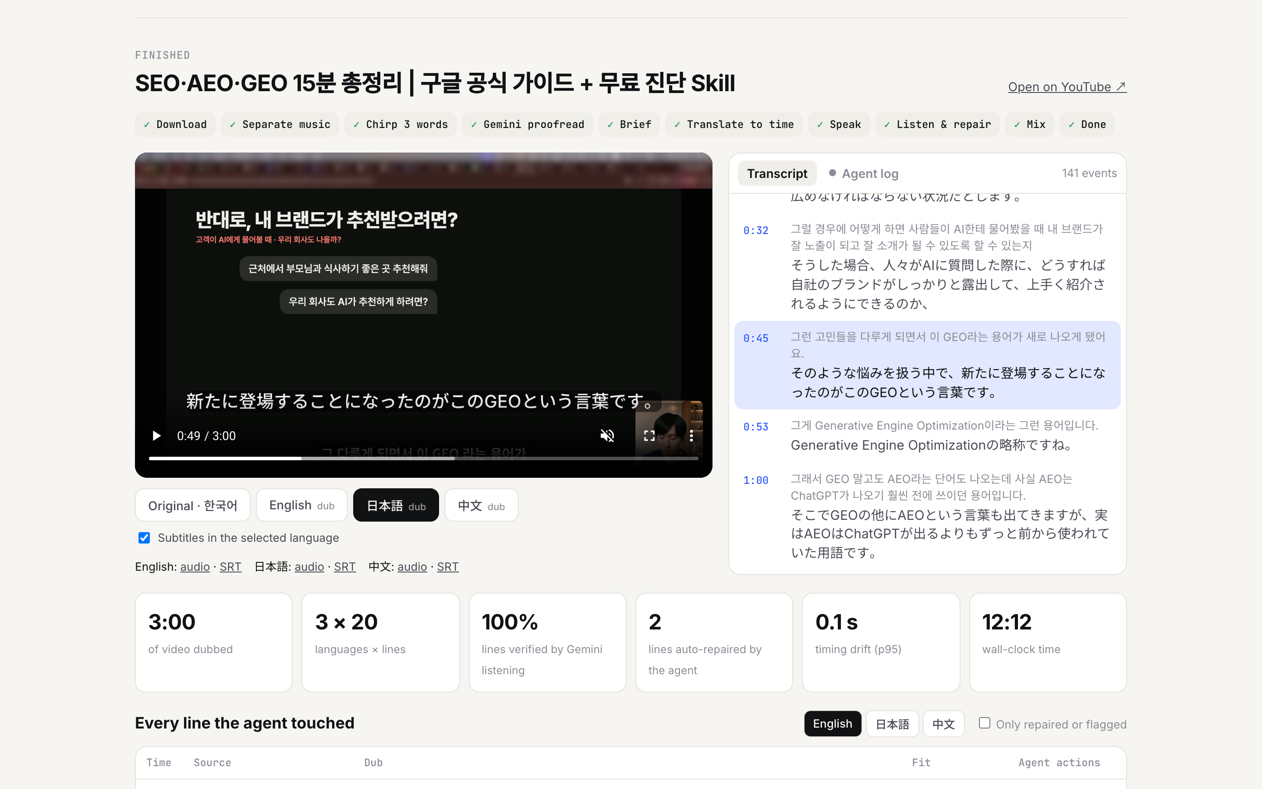
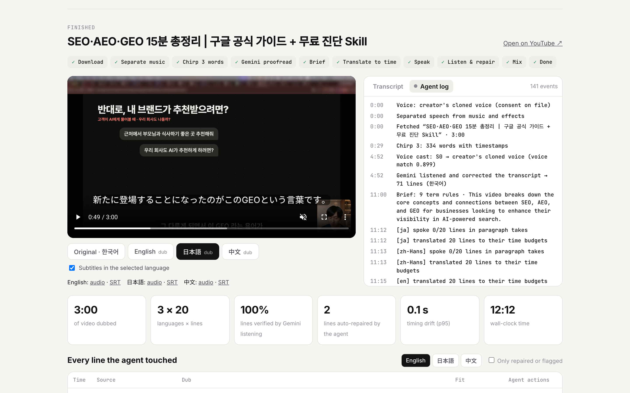
Snapshots of the prototype
Left: Japanese dub with subtitles and the synced transcript. Right: the agent log — every shorten, re-speak, re-translate and Gemini verdict, streamed live from Firestore.

Slide 11
Prototype performance report / benchmarking
Measure | Result
3-min Korean video → en, ja, zh: lines verified by Gemini listening | 69 / 69
Timing drift (p95, worst language) | 0.16 s
Wall-clock, 3 languages | 2:52
Full 15:05 video → 3 languages: verified · wall-clock | 366 / 369 · 10:58
2-speaker English podcast → Korean: lines verified; voices cast | 28 / 28 · male + female presets
Transcript CER vs creator's edited captions (3 runs) | Chirp 3 + Gemini 7.6–7.9% · Chirp 8.6% · Gemini 10.6–11.8%
Gemini-only timestamps drift (why Chirp is the clock) | up to 42 s
Speaker similarity to the creator (ECAPA cosine) | English clone 0.68 · creator 0.90 · others 0.00–0.09

Slide 12
Additional details / future development
• More languages: the same path covers every language Gemini TTS speaks; subtitles for 100+.
• One-click publish to YouTube multi-language audio via the YouTube Data API.
• Guest consent in the browser: guests record the consent line and get their own cloned voice.
• Line editor: fix one line, re-speak only that line; glossary per channel.
• Emotion and emphasis transfer from the original delivery; lip-sync for on-camera close-ups.
• Shorts and podcasts: the same agent for vertical video and audio-only feeds.

Slide 13
Links
GitHub public repository
https://github.com/jays0606/viberick-dub
Demo video (under 3 minutes)
(demo video link — added at submission)
Final product
https://viberick-dub.web.app

Slide 14
Consent and safety by design
Two locks before a voice is cloned
1. Channel lock: the channel owner recorded the consent statement.
2. Speaker lock: the diarized speaker's voice verifies against that recording (ECAPA cosine ≥ 0.45).
Everyone else gets a Gemini preset voice chosen by Gemini after listening to them.
Only a 192-number voice embedding is stored, never the audio. Every clip carries SynthID.
Speaker vs consent recording | Cosine
Creator (own video) | 0.90
Creator's consent take | 0.88
Podcast speaker A | 0.09
Podcast speaker B | 0.00
Threshold | 0.45

Slide 15


