Slide 1

PERSEVEX · ARTIFICIAL INTELLIGENCE INTERNSHIP
BrandPulse AI
Voice of Customer Intelligence
Twitter sentiment analysis — Classical Machine Learning vs Deep Learning, served through a live dashboard.
Aaditiya Anjan · 24BCS13112 · BE-CSE · Semester 5
77.0%
0.723
14,640
3
ACCURACY
MACRO F1
TWEETS
SENTIMENT CLASSES

Slide 2
01 · CONTEXT
Internship Overview
ORGANIZATION
DOMAIN
DURATION
MY ROLE
Persevex
Artificial Intelligence
2 Months
NLP Intern
AI / Data Science partner
Applied NLP & deep learning
End-to-end delivery
Data → Model → Product
WHAT I DELIVERED
A complete, explainable sentiment-analysis system — from raw, messy tweets to two trained model families and a premium live dashboard. The project compares the classical TF-IDF approach against a Bi-LSTM deep model and ships an honest, imbalance-aware evaluation.
BrandPulse AI · Voice of Customer Intelligence · Persevex AI Internship
Aaditiya Anjan 01 / 14

Slide 3
02 · THE PROBLEM
A brand's reputation moves in minutes
63%
The Problem
Thousands of noisy tweets per day — slang, sarcasm, emojis, negation. Keyword counting fails completely.
of tweets are complaints
Why It Matters
People mostly tweet at brands to complain. A single viral post can erase reputation faster than any campaign can rebuild it — and no human team can read the firehose in real time.
Sentiment is the earliest signal of a brand crisis. Measuring it live means responding before damage spreads.
The Objective
Classify every tweet as positive, neutral or negative — and explain why — so teams can act on the Voice of the Customer.
BrandPulse AI · Voice of Customer Intelligence · Persevex AI Internship
Aaditiya Anjan 02 / 14

Slide 4
03 · APPROACH
An end-to-end NLP pipeline
1
2
3
4
5
6
7
Data Collection
Cleaning & Normalise
Negation Fusion
Feature Engineering
Model Building
Evaluation
Dashboard
14.6k tweets
regex + lemmas
not_good token
TF-IDF / tokens
Classical + LSTM
macro-F1, CM
live Streamlit
Principle: one shared cleaning module is used at BOTH train and serve time — so the live app always sees text cleaned exactly like the training data. No train/serve skew.
BrandPulse AI · Voice of Customer Intelligence · Persevex AI Internship
Aaditiya Anjan 03 / 14

Slide 5
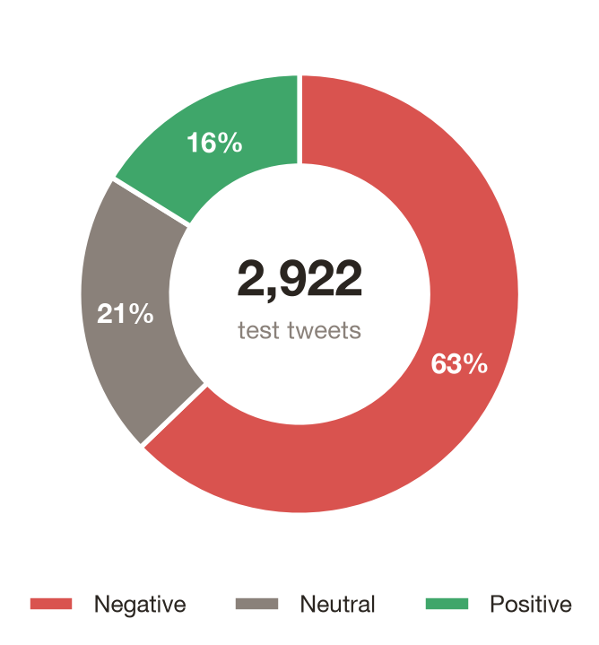
04 · THE DATA
Twitter US Airline Sentiment
14,640
3
LABELLED TWEETS
SENTIMENT CLASSES
63 / 21 / 16
80 / 20
NEG / NEU / POS %
STRATIFIED SPLIT
Chosen over Sentiment140 (binary only) because the brief requires three classes — and its real Feb-2015 timestamps power the dashboard's sentiment-over-time trend.
BrandPulse AI · Voice of Customer Intelligence · Persevex AI Internship
Aaditiya Anjan 04 / 14

Slide 6
05 · PREPROCESSING
Taming the messiest text on the internet
1
Normalise
2
Strip noise
3
Expand contractions
Lowercase, decode HTML entities (&amp; → &).
Regex removes URLs, @mentions, # symbols, numbers, stretched letters.
can't → can not, so negation survives tokenisation.
4
Lemmatise
5
Negation fusion
6
Stopwords
POS-aware WordNet: running → run, better → good.
not good → not_good — one clearly-negative feature.
Remove filler words but KEEP negation words.
BrandPulse AI · Voice of Customer Intelligence · Persevex AI Internship
Aaditiya Anjan 05 / 14

Slide 7
06 · MODELLING
Two philosophies, one fair contest
Approach A — Classical
Approach B — Deep Learning
TF-IDF → Logistic Regression / Naive Bayes
Embedding → Bi-LSTM → Dense (softmax)
• Unigrams + bigrams, 20k features
• Vocabulary 10k, sequences padded to 40
• Class-weighted for 63% imbalance
• Reads word order — 'not happy' ≠ 'happy'
• Trains in seconds on CPU
• EarlyStopping restores best epoch
• Fully interpretable — reads driving words
• Context-aware, less interpretable
BrandPulse AI · Voice of Customer Intelligence · Persevex AI Internship
Aaditiya Anjan 06 / 14

Slide 8
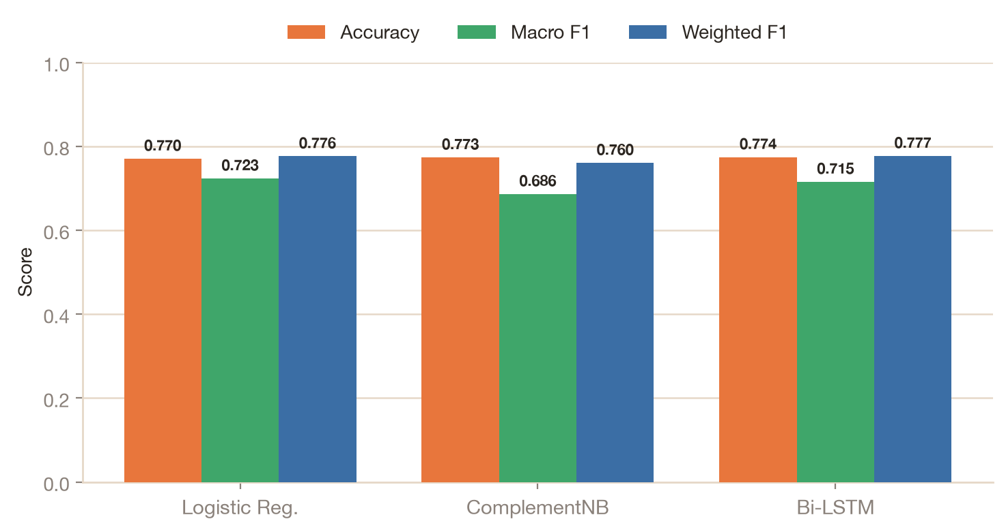
07 · RESULTS
Macro-F1 is the headline metric
On 63%-negative data, accuracy misleads — macro-F1 weights all three classes equally.
Logistic Reg.
77.0%
0.723
0.715
BEST MODEL
ACCURACY
MACRO F1
BI-LSTM MACRO F1
BrandPulse AI · Voice of Customer Intelligence · Persevex AI Internship
Aaditiya Anjan 07 / 14

Slide 9
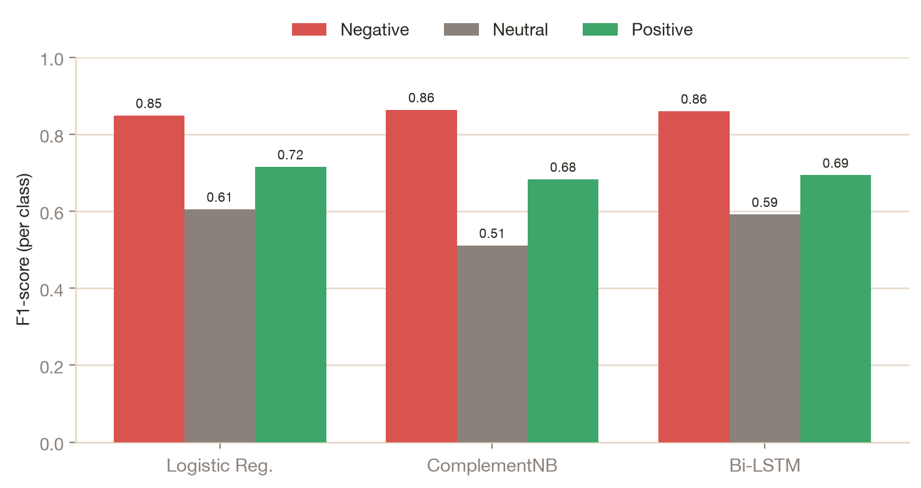
08 · RESULTS
Per-class precision & recall
The real test: does the model handle the rare positive and neutral classes, not just negative?
Logistic Regression — per class
Class
Prec.
Recall
F1
Negative
0.88
0.82
0.85
Neutral
0.55
0.67
0.61
Positive
0.71
0.72
0.72
Strong on negative (F1 0.85); neutral is hardest, as expected.
BrandPulse AI · Voice of Customer Intelligence · Persevex AI Internship
Aaditiya Anjan 08 / 14

Slide 10
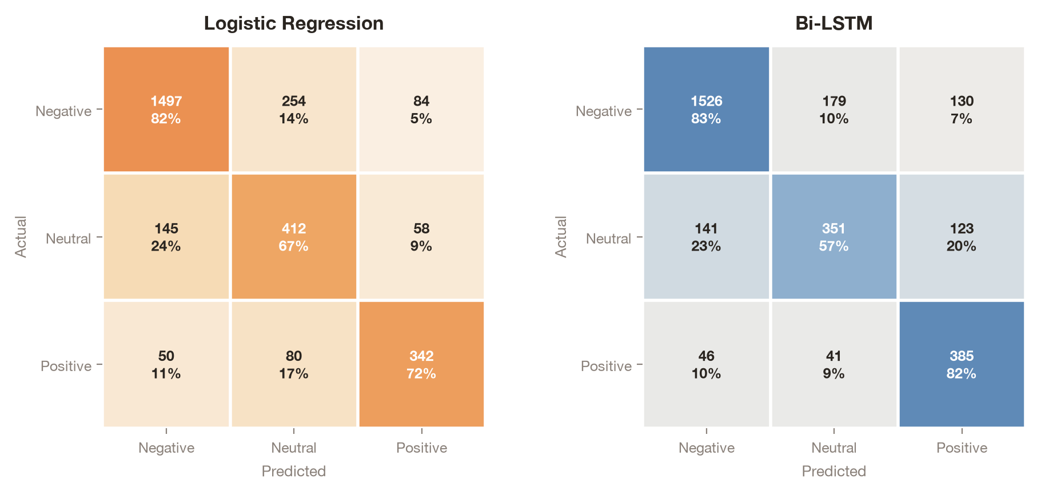
09 · DIAGNOSTICS
Where the models fail
Both confuse neutral ↔ negative most — flat complaints carry no overtly negative words.
BrandPulse AI · Voice of Customer Intelligence · Persevex AI Internship
Aaditiya Anjan 09 / 14

Slide 11
10 · EXPLAINABILITY
Not a black box — we know why
NEGATIVE
not_good · delay · cancel
How it works
Every classical prediction comes with the exact words that drove it, read straight from the Logistic Regression coefficients. The dashboard shows these live, so a user can trust — and challenge — each verdict.
Predictions below 60% confidence are flagged “needs human review” rather than forced into a label — realistic production behaviour.
POSITIVE
thanks · great · amazing
NEUTRAL
flight · gate · time
BrandPulse AI · Voice of Customer Intelligence · Persevex AI Internship
Aaditiya Anjan 10 / 14

Slide 12
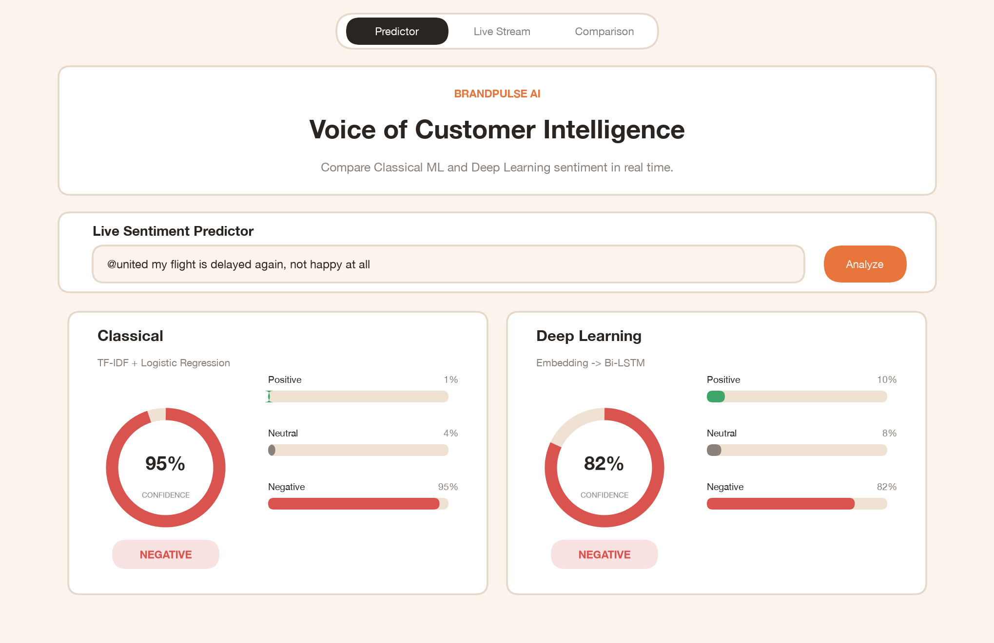
11 · PRODUCT
The live dashboard
An Apple-inspired light interface serving both models side by side — explainable and real-time.
BrandPulse AI · Voice of Customer Intelligence · Persevex AI Internship
Aaditiya Anjan 11 / 14

Slide 13
12 · CONCLUSION
Findings & what's next
The simple model won. Class-weighted Logistic Regression took the best macro-F1 — beating the Bi-LSTM while training in seconds and explaining itself.
FUTURE SCOPE
→ Fine-tune a transformer (DistilBERT)
Honest evaluation. Macro-F1 over accuracy, confidence-based review flags, and one shared cleaning module to prevent train/serve skew.
→ Probability calibration
→ Dedicated sarcasm detection
Production-minded. A premium live dashboard with explainability and real-timestamp trend analysis — viva and recruiter ready.
→ Live X-API streaming + deployment
KEY REFERENCES
[1] Pedregosa et al., scikit-learn, JMLR 2011
[2] Hochreiter & Schmidhuber, LSTM, 1997
[3] Abadi et al., TensorFlow, 2016
BrandPulse AI · Voice of Customer Intelligence · Persevex AI Internship
Aaditiya Anjan 12 / 14

Slide 14
Thank You
BrandPulse AI — from messy tweets to Voice-of-Customer intelligence.
Questions & discussion welcome.
GITHUB & COLAB
PRESENTED BY
See Live_Link.txt in the project folder
Aaditiya Anjan · 24BCS13112 · BE-CSE · Sem 5

