Slide 1
PERSEVEX · ARTIFICIAL INTELLIGENCE INTERNSHIP
Predictive Customer Churn Modelling for a Telecom Provider
Identifying at-risk customers and turning prediction into proactive retention.
Aaditiya Anjan · 24BCS13112 · BE-CSE · Semester 5
0.846
80.5%
$39.8K
7,043
ROC-AUC
CHURN RECALL
NET BENEFIT
CUSTOMERS
Notes:
Good [morning/afternoon]. I'm Aaditiya Anjan. Over my two-month AI internship at Persevex
I built an end-to-end churn-prediction system for a telecom provider. The goal was not just
a model, but a decision tool: who is about to leave, why, and what we should do about it.
Three numbers frame the talk - a 0.846 ROC-AUC champion model, 80% of churners caught, and
a simulated 39.8 thousand dollars of net retention benefit on the test set.

Slide 2
01 · CONTEXT
Internship Overview
ORGANIZATION
DOMAIN
DURATION
MY ROLE
Persevex
Artificial Intelligence
2 Months
ML Intern
AI / Data Science partner
Applied ML & analytics
End-to-end delivery
Data → Model → Strategy
WHAT I DELIVERED
A complete, explainable churn-prediction pipeline — from raw telecom records to a deployed-ready risk model — paired with a financial simulation and a six-point retention playbook the business can act on immediately.
Predictive Customer Churn Modelling · Persevex AI Internship
Aaditiya Anjan 02 / 14
Notes:
This was a full two-month engagement in Persevex's AI domain. I owned the project end to end:
sourcing and cleaning the data, exploratory analysis, feature engineering, modelling, model
explainability, and finally translating it into a financial business case. The emphasis was
on delivering something a business could actually use, not just a notebook of metrics.

Slide 3
02 · THE PROBLEM
Churn is silent, recurring revenue loss
The Problem
26.5%
Telecom operates in a saturated, low-switching-cost market — customers leave quietly and without warning.
of customers churn
Why It Matters
Nearly 1 in 4 customers leaves. Each exit erases predictable monthly recurring revenue — and winning a replacement costs far more than keeping the original.
Retention is cheaper than acquisition. Even a small reduction in churn compounds into significant protected revenue.
The Objective
Predict who will churn before they leave, explain why, and prioritise proactive retention spend.
Predictive Customer Churn Modelling · Persevex AI Internship
Aaditiya Anjan 03 / 14
Notes:
The core business problem: telecom is a saturated market where switching costs are low, so
customers leave quietly. In this dataset 26.5% have already churned. The expensive part is
that acquiring a replacement customer costs several times more than retaining an existing one,
so churn is really a recurring-revenue and margin problem. My objective was threefold - predict
churn before it happens, explain the drivers, and prioritise where retention budget should go.

Slide 4
03 · APPROACH
An end-to-end, eight-stage pipeline
1
2
3
4
5
6
7
8
Data Cleaning
Exploratory Analysis
Hypothesis Testing
Feature Engineering
Encoding & Scaling
Model Building
SHAP Analysis
Business Strategy
Fix types, nulls
Find risk patterns
Validate signals
10 new features
47 model features
4 algorithms
Why it predicts
Retention plan
Principle: every stage feeds a business decision — the pipeline ends in money saved, not just a metric.
Predictive Customer Churn Modelling · Persevex AI Internship
Aaditiya Anjan 04 / 14
Notes:
My methodology followed eight stages. After cleaning the raw data, I ran exploratory analysis
and hypothesis testing to confirm which patterns were statistically real, not noise. I then
engineered ten domain features, encoded and scaled to 47 model columns, trained four algorithms,
explained the winner with SHAP, and finished with a business strategy. The guiding principle was
that every technical step should ladder up to a business decision.

Slide 5
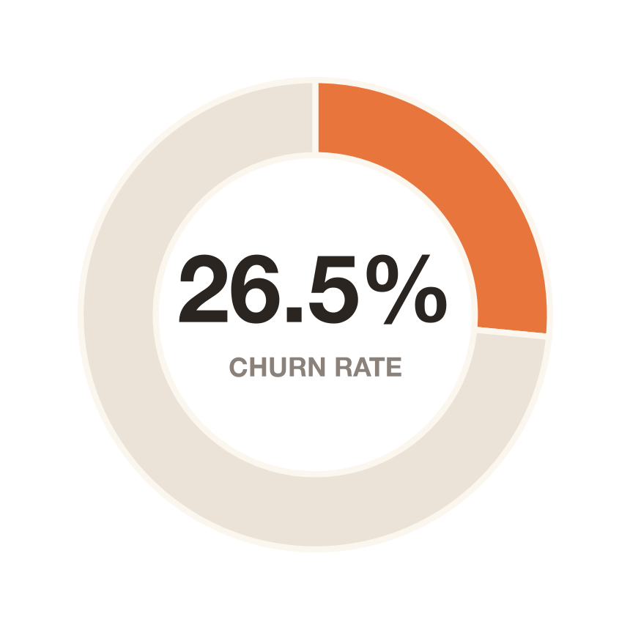
04 · THE DATA
Telco Customer Churn Dataset
7,043
21 → 47
CUSTOMERS
RAW → MODEL FEATURES
Churn
80 / 20
TARGET VARIABLE
STRATIFIED SPLIT
Customer demographics, subscribed services, contract terms and billing history — a 360° view of each account, with churn as the outcome to predict.
Churn 26.5% · Retained 73.5%
Predictive Customer Churn Modelling · Persevex AI Internship
Aaditiya Anjan 05 / 14
Notes:
The dataset is the well-known Telco Customer Churn set - 7,043 customers, each described by
demographics, the services they subscribe to, their contract type, and billing information.
The target is a simple binary: did the customer churn. It's imbalanced at roughly 26.5% churn,
which matters for modelling. I used a stratified 80/20 split so both train and test preserve
that ratio, and after feature engineering and encoding the 21 raw fields became 47 model features.

Slide 6
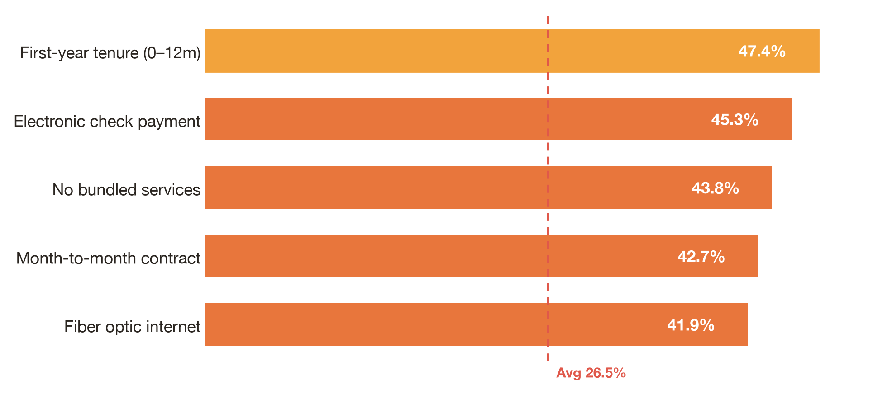
05 · EXPLORATORY ANALYSIS
Churn concentrates in a few high-risk segments
CONTRACT
42.7%
2.8%
Month-to-month
Two-year
TENURE
47.4%
6.6%
First 12 months
60–72 months
BUNDLING
43.8%
5.3%
0 services
8 services
Predictive Customer Churn Modelling · Persevex AI Internship
Aaditiya Anjan 06 / 14
Notes:
Exploratory analysis was the most insight-rich part. Churn is not evenly spread - it concentrates
in identifiable segments. Month-to-month contracts churn at 42.7% versus just 2.8% for two-year
contracts. Customers in their first year churn at 47.4% versus single digits for long-tenured
ones. Fiber-optic, electronic-check payers, and customers with no bundled services all churn far
above the 26.5% baseline. These contrasts directly shaped both my features and my recommendations.

Slide 7
06 · FEATURE ENGINEERING
10 features that encode loyalty & risk
ContractRiskScore
ServiceCount
AverageMonthlySpend
LongTermCustomer
PremiumServiceFlag
BundleScore
TotalChargesPerTenure
PremiumCustomerFlag
AutoPaymentFlag
✦ LoyaltyScore — the standout engineered feature
Combines tenure, spend and contract length into a single loyalty signal — and emerged as one of the model's most important predictors of churn.
Predictive Customer Churn Modelling · Persevex AI Internship
Aaditiya Anjan 07 / 14
Notes:
Raw columns rarely capture behaviour directly, so I engineered ten features that encode loyalty
and risk explicitly. ContractRiskScore turns contract type into a numeric risk level; BundleScore
and ServiceCount capture stickiness; AutoPaymentFlag and the premium flags capture commitment.
The standout was LoyaltyScore, which fuses tenure, spend and contract length into one signal - it
became one of the strongest predictors in every model, validating the feature-engineering effort.

Slide 8
07 · MODELLING
Four algorithms, one fair contest
★ CHAMPION
Logistic Regression
Random Forest
XGBoost
Support Vector Machine
Transparent linear baseline; odds ratios reveal direction of each driver.
Bagged trees capturing non-linear interactions; native feature importance.
Gradient boosting — the champion. Highest ROC-AUC and best churn recall.
Margin-based classifier; strong recall on the minority churn class.
CLASS BALANCING
VALIDATION
TUNING
class_weight / scale_pos_weight for 26.5% imbalance
Stratified 5-fold cross-validation
GridSearch over 144 XGBoost configurations
Predictive Customer Churn Modelling · Persevex AI Internship
Aaditiya Anjan 08 / 14
Notes:
I trained four algorithms on identical splits for a fair contest: Logistic Regression as a
transparent baseline, Random Forest and XGBoost for non-linear power, and an SVM. Because the
data is imbalanced, I used class weighting and scale_pos_weight so the models don't just predict
"stay" for everyone. Everything was validated with stratified five-fold cross-validation, and I
tuned XGBoost across 144 configurations with grid search. XGBoost emerged as the champion.

Slide 9
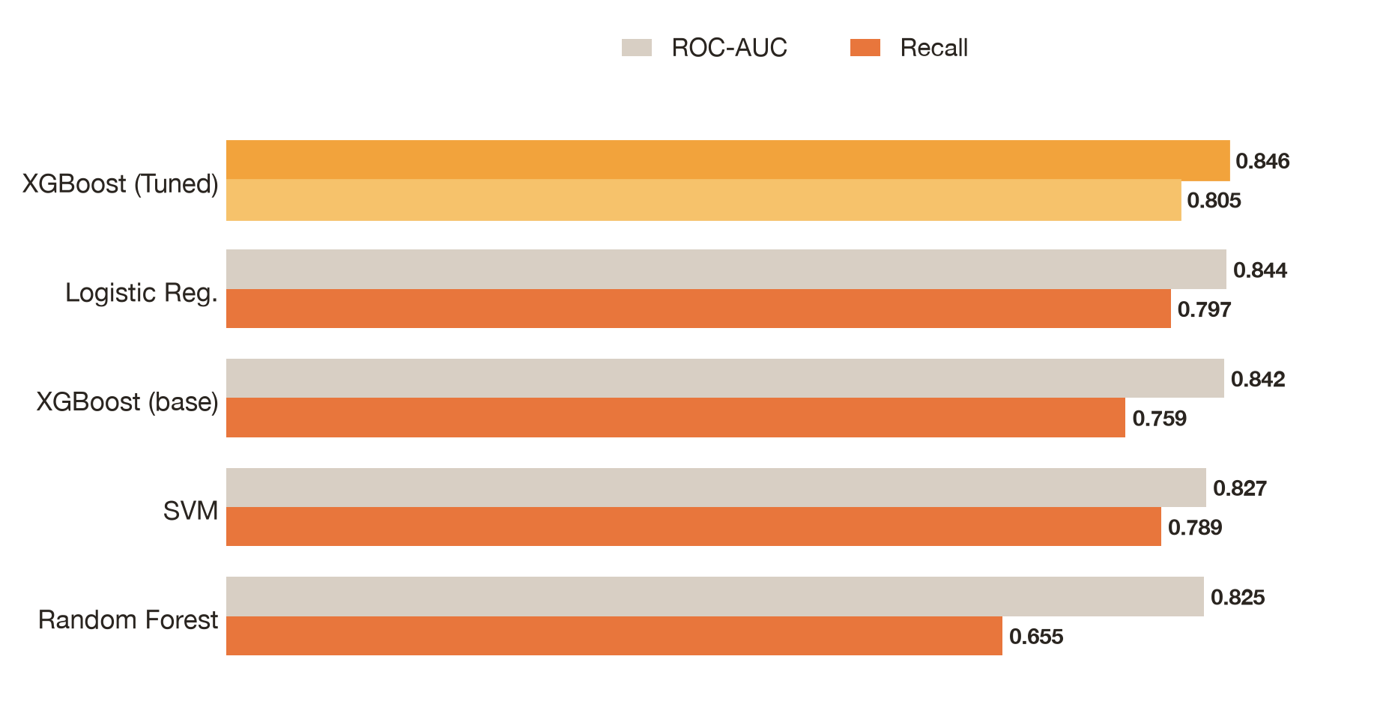
08 · RESULTS
Model comparison — recall is the priority
0.846
CHAMPION ROC-AUC
XGBoost (Tuned)
0.848
CROSS-VAL ROC-AUC
± 0.010 — stable
80.5%
CHURN RECALL
Catches most leavers
Predictive Customer Churn Modelling · Persevex AI Internship
Aaditiya Anjan 09 / 14
Notes:
Here's the head-to-head. On ROC-AUC the models are close - between 0.825 and 0.846 - but ROC-AUC
isn't the whole story. For churn, recall matters most: missing a customer who actually leaves is
far costlier than a false alarm. Tuned XGBoost wins on both fronts, with the top ROC-AUC of 0.846
and the best recall at 80.5%. Its cross-validated ROC-AUC of 0.848 with a tight standard deviation
confirms the result is stable and not an artefact of one lucky split.

Slide 10
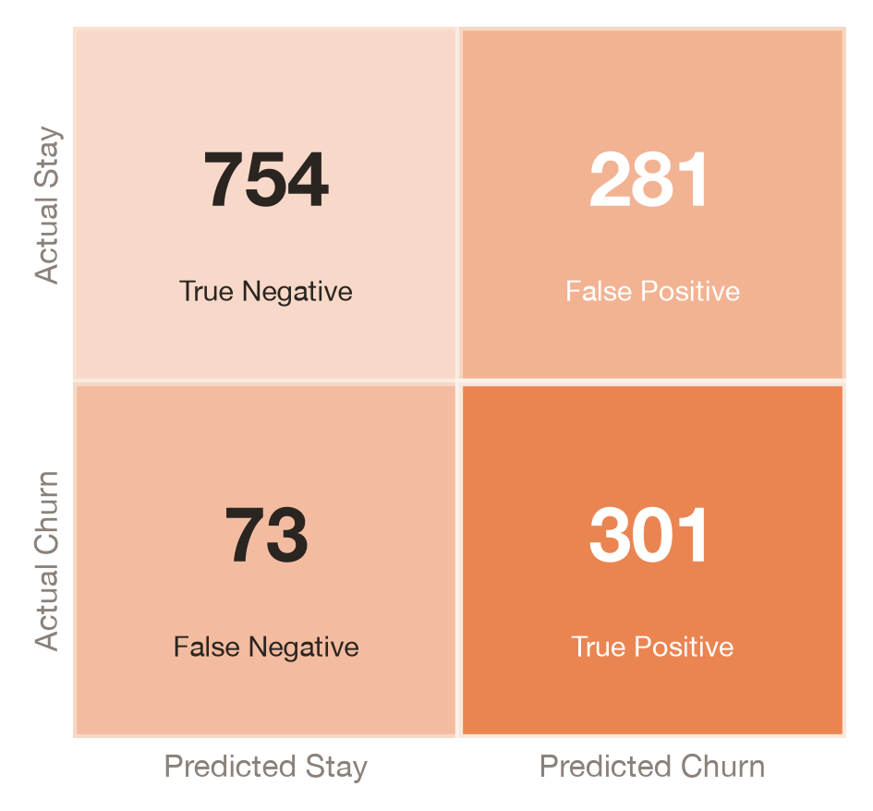
09 · CHAMPION MODEL
XGBoost — catches 4 in 5 churners
0.846
80.5%
ROC-AUC
RECALL
0.630
0.848
F1 SCORE
CV ROC-AUC
301 of 374 real churners correctly flagged — the model prioritises catching leavers over avoiding false alarms.
Predictive Customer Churn Modelling · Persevex AI Internship
Aaditiya Anjan 10 / 14
Notes:
Zooming into the champion. The confusion matrix shows it caught 301 of the 374 actual churners
in the held-out test set - about 80%. There are 281 false positives, customers flagged who would
have stayed, but that trade-off is deliberate and cheap: a retention offer to someone who'd have
stayed costs little, while missing a real churner loses their lifetime value. ROC-AUC is 0.846,
F1 is 0.63, and the cross-validated AUC of 0.848 confirms it generalises.

Slide 11
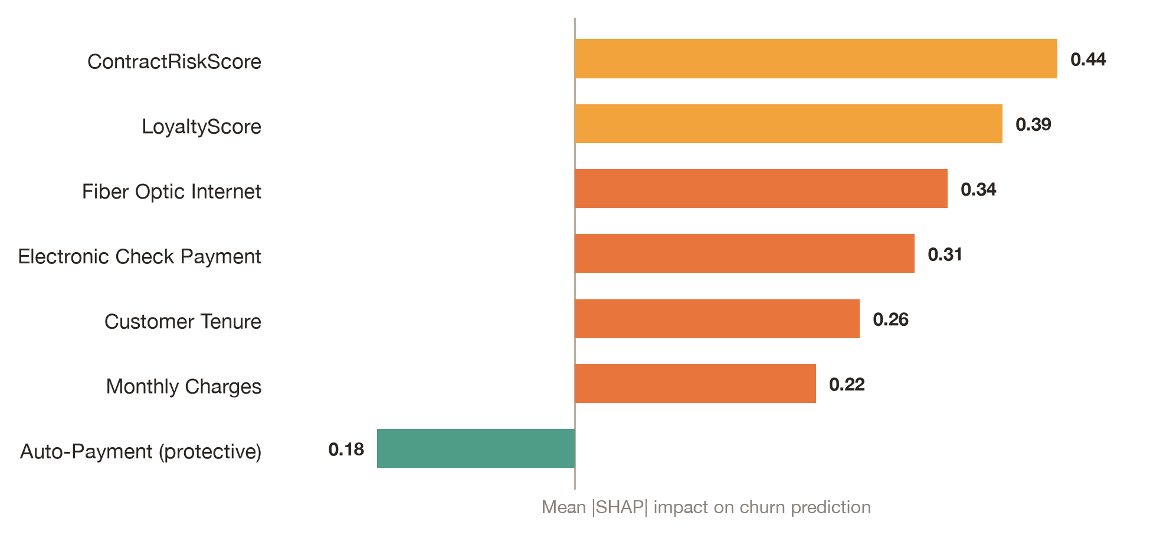
10 · EXPLAINABILITY
Not a black box — we know why
1
ContractRiskScore
Short contracts dominate churn risk
2
LoyaltyScore
Low loyalty signal → high churn
3
Fiber Optic Internet
Premium service, weak retention
4
Electronic Check
Manual payment = friction & exit
Predictive Customer Churn Modelling · Persevex AI Internship
Aaditiya Anjan 11 / 14
Notes:
A model that can't be explained won't be trusted by a business, so I used SHAP, plus logistic
odds ratios and tree importances, to open the box. They agree on the story. The biggest churn
drivers are ContractRiskScore - short contracts - and a low LoyaltyScore, followed by fiber-optic
service and electronic-check payment. Auto-pay, by contrast, is protective. Crucially these are
all actionable levers, which is what makes the next slide - the business case - possible.

Slide 12
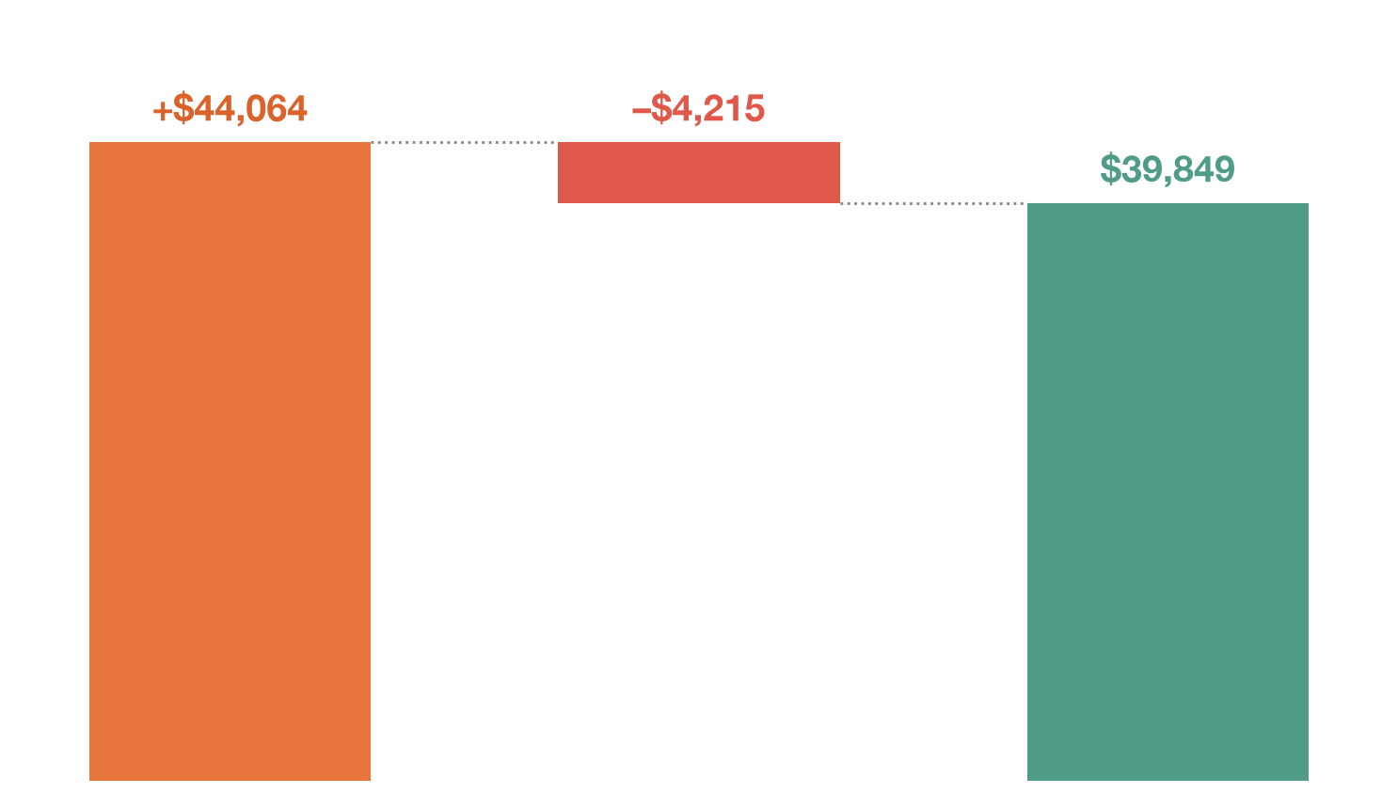
11 · BUSINESS IMPACT
From prediction to $39.8K net benefit
Retention campaign targeting the top 20% highest-risk customers (281 of 1,409 test set)
281
CUSTOMERS CONTACTED
190
REAL CHURNERS IDENTIFIED
$44,064
GROSS REVENUE SAVED
9.5×
RETURN ON CAMPAIGN COST
Predictive Customer Churn Modelling · Persevex AI Internship
Aaditiya Anjan 12 / 14
Notes:
This is the slide that makes it real. I simulated a retention campaign: rank every test customer
by predicted risk, contact only the top 20% - 281 people - and assume a modest 25% of contacted
churners are saved. The model correctly concentrated 190 real churners into that group. The result:
about 44 thousand dollars of gross revenue saved against roughly 4,200 dollars of outreach cost,
for a net benefit near 40 thousand and a return of about nine and a half times. That's the value.

Slide 13
12 · RECOMMENDATIONS
Six retention plays + what's next
1 Lock in contracts
2 Early-tenure care
3 Fiber value boost
Convert month-to-month users to 1–2 year terms with incentives.
Onboarding & check-ins in the first 12 months — the riskiest window.
Bundle support & security to justify premium fiber pricing.
4 Auto-pay nudges
5 Bundle campaigns
6 Risk-based outreach
Incentivise auto-pay to remove billing friction (a protective factor).
Drive multi-service adoption — bundled users churn 8× less.
Focus retention budget on the top-20% model risk tier.
FUTURE SCOPE
Real-time risk scoring · Customer-lifetime-value weighting · Deep-learning models · A/B-tested retention offers · Automated deployment pipeline
Predictive Customer Churn Modelling · Persevex AI Internship
Aaditiya Anjan 13 / 14
Notes:
The analysis converts directly into six retention plays: migrate month-to-month customers onto
longer contracts, invest in first-year onboarding, add value to fiber, nudge customers onto
auto-pay, run bundling campaigns, and - most importantly - target retention budget at the top 20%
risk tier the model identifies. Looking forward, I'd move this to real-time scoring, weight by
customer lifetime value, test deep-learning models, and A/B-test the offers themselves.

Slide 14
Thank You
Predictive Customer Churn Modelling — from raw data to retention strategy.
Questions & discussion welcome.
GITHUB REPOSITORY
PRESENTED BY
github.com/VibecoderAaditiya/ Telco-Customer-Churn-Prediction
Aaditiya Anjan · 24BCS13112 · BE-CSE · Sem 5
Notes:
That brings me to the end. To summarise: I built an explainable churn model that catches 80% of
leavers and, applied to the top 20% risk tier, turns into roughly 40 thousand dollars of net
retention benefit - a 9.5x return. The full code and notebook are on the GitHub repo shown here.
Thank you for your time; I'm happy to take questions on the modelling, the features, or the
business case.

