Slide 1
DEPARTMENT OF PHYSICS • IIT KANPUR
Data-Driven Discovery of Crystalline Semiconductors
with Anomalous Born Effective Charges
Using an E(3)-Equivariant Graph Neural Network (UGP Project)
Author / Presenter: Vibha Narayan | Department of Physics, IIT Kanpur
Project Supervisor: Prof. Koushik Pal | Department of Physics, IIT Kanpur
Repository: https://github.com/Vibha-1729/Equivar_GCNN
E(3)-EQUIVARIANCE
Guarantees 3D rotational & inversion symmetry in tensor predictions
65,322 CRYSTALS
Unified multi-source corpus spanning 89 elements of the periodic table
GNOME SCREENING
Deploying on DeepMind's database to screen novel anomalous semiconductors

Slide 2
SECTION I • MOTIVATION AND PHYSICS TARGET
Born Effective Charge Tensors & Dynamic Anomalies
The Physical Target: Born Effective Charge (Z*)
Mathematical Definition (Rank-2 3×3 Cartesian Tensor):
Z*_{i,αβ} = - (1 / |e|) · ∂²E / (∂E_α ∂u_{i,β}) = (Ω / e) · (∂P_α / ∂u_{i,β})
• Describes the macroscopic polarization change (P_α) induced by sub-lattice atomic displacements (u_{i,β}) under an electric field E_α.
Origin of Anomalous Born Charges:
• Large anomalous deviations from nominal ionic valences originate from dynamic O 2p and metal d-orbital hybridization during atomic motion.
• Functional Importance: Signals soft optical phonon modes, ferroelectric instability, and colossal dielectric permittivity—essential for ferroelectric memory, capacitors, and thermoelectrics.
The Computational Bottleneck: DFPT vs DL
• First-principles Density Functional Perturbation Theory (DFPT) is computationally expensive, scaling as O(N³) with unit cell size.
• High-throughput material exploration requires fast, accurate deep learning surrogate models.
Why E(3)-Equivariant GNNs are Required:
• Scalar GNNs (e.g., standard message passing) only predict invariant scalars and fail to capture angular tensor directions.
• In contrast, an E(3)-equivariant Graph Neural Network directly predicts full 3 × 3 tensors, inherently preserving 3D rotational and inversion symmetries by construction without requiring rotational data augmentation.

Slide 3
SECTION II & IV • DATASET CURATION AND PHYSICAL VALIDATION
Unified 65,322-Structure Corpus & Physical Constraints
Master 3-Way Dataset Integration
While prior literature models were restricted to specific functional oxide families (perovskites, Li3PO4, ZrO2), we generalize across diverse crystal families by aggregating three sources:
1. Baseline Functional Oxides (24,327 structures):
• Substituted perovskites (ABO3), Li3PO4 solid electrolytes, and ZrO2 zirconia across cubic, tetragonal, and monoclinic phases (10 elements).
2. Materials Project (14,530 structures, 85 elements):
• Broad crystallographic semiconductors and insulators.
3. JARVIS-DFT (26,465 structures, 89 elements):
• Computed with the OptB88vdW functional for van der Waals dispersion.
• Master 3-Way Corpus: 65,322 structures across 89 elements of the periodic table, providing a comprehensive training set.
Physical Validation Rules
To guarantee physical viability and exact charge neutrality, model predictions are evaluated against strict physical validation rules:
1. Finite Bandgap Condition (Eg > 0 eV):
• Born effective charges describe dynamic polarization under macroscopic electric fields E.
• In metals (Eg = 0 eV), free conduction electron screening nullifies internal fields, rendering Z* ill-defined. All candidate structures strictly require Eg > 0 eV.
2. Acoustic Sum Rule Physical Conservation:
• Rigid lattice translations require zero net cell polarization change: ∑_{i ∈ cell} Z*_{i,αβ} = 0_{3×3}.
3. Exact Parameter-Free Projection Layer:
• Residual drift in predicted tensors is eliminated via exact projection:
Z̃*_{i,αβ} = Z*_{i,αβ} - (1 / N_cell) ∑_{j ∈ cell} Z*_{j,αβ}
• Guarantees ∑_i Z̃*_{i,αβ} ≡ 0_{3×3} analytically for every predicted crystal cell.

Slide 4
SECTION III • E(3)-EQUIVARIANT ARCHITECTURE
EquivarBECGNN: Symmetry-Preserving Tensor Learning
EquivarBECGNN Architecture
• Crystal Graph Representation:
- Map periodic crystal structures directly to graph representations G = (V, E).
- Atomic node encodings Z_i embedded into 64 hidden channels.
- Edge displacement vectors r_ij defined within spatial cutoff radius r_c = 3.0 Å.
• Message Passing with Spherical Harmonics (e3nn):
- Updates scalar node features and directional tensor representations across 3 graph interaction layers (64 channels).
- Uses spherical harmonics Y_{l,m} (irreps 0e + 1o + 2e up to l_max = 2) and continuous radial basis functions.
• Change-of-Basis Matrix:
- Parameter-free transformation converts spherical irreducible representations into full 3 × 3 Cartesian tensor Z*_{i,αβ}.
Physics-Informed Loss Function
Training utilizes a physics-informed loss function to enforce crystal symmetries and penalize Acoustic Sum Rule violations simultaneously:
L = ||Z* - Ẑ*||₁ + λ_asr · || ∑_{i ∈ cell} Ẑ*_i ||₁
• Z* and Ẑ* are true and predicted Born effective charge tensors.
• Term 1: L₁ error on all rank-2 Cartesian tensor components.
• Term 2 (Penalty Weight λ_asr = 2.0):
- Penalizes net unit-cell charge drift during backpropagation.
- Stabilizes gradient convergence and keeps the model physically realizable.
• Single-Pass Prediction:
- Predicts full rank-2 tensors in a single pass, inherently preserving 3D spatial rotational and inversion symmetries.

Slide 5
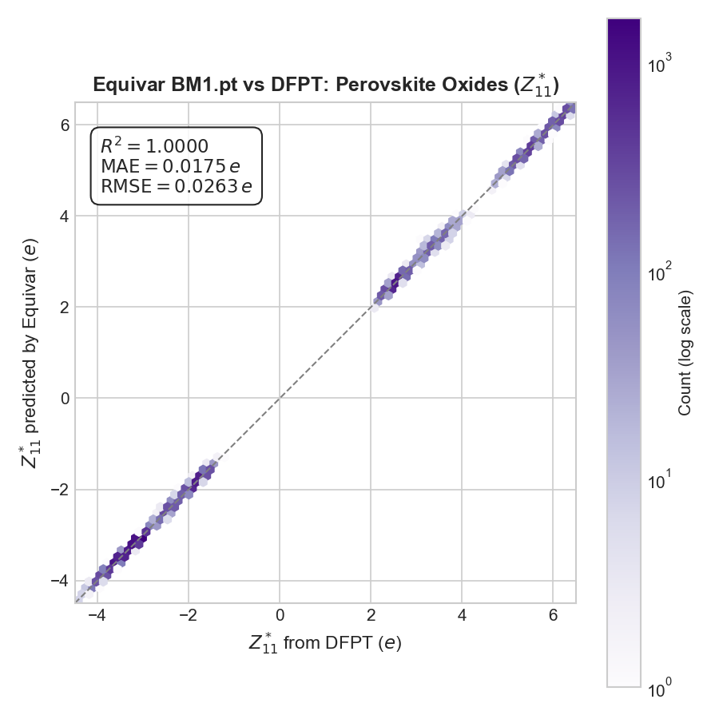
SECTION IV & RESULTS • EMPIRICAL BENCHMARKS & VALIDATION
Model Performance & Parity Validation Across Datasets
Dataset | Total | Train | Val | Test | Elem | MAE (e)
Mendeley Oxides | 24,327 | 19,461 | 2,433 | 2,433 | 10 | 0.382
Materials Project | 14,530 | 11,624 | 1,453 | 1,453 | 85 | 0.506
JARVIS-DFT | 26,465 | 21,172 | 2,646 | 2,647 | 89 | 0.728
Combined Dataset | 65,322 | 52,257 | 6,532 | 6,533 | 89 | 0.480
Key Empirical Findings (Table I Analysis):
• Baseline Accuracy: The Mendeley oxide model achieves a low test MAE of 0.382 e due to dense sampling across 10 functional oxide elements.
• Generalization to 89 Elements: Combining Mendeley, MP, and JARVIS expands chemical coverage across the periodic table to 89 elements, reaching a robust test MAE of 0.480 e on 65,322 structures.
• Cross-Dataset Generalization: MP-trained model tested zero-shot on Mendeley achieves 0.384 e MAE, proving that the architecture captures true physical interactions.
FIG. 1: Parity plot comparing predicted vs. DFPT-calculated Born effective charge component Z*₁₁ for perovskite oxides (R² = 1.000, MAE = 0.0175 e).

Slide 6
SECTION V & VII • DISCOVERY APPLICATION & CONCLUSION
Deployment on DeepMind's GNoME Database & Final Summary
Discovery Application on GNoME
• Google DeepMind's GNoME Dataset:
- The model is applied to Google DeepMind's Graph Networks for Materials Exploration (GNoME) dataset (~554k structures), hosted in Materials Project MPContribs.
• High-Throughput Pipeline:
- Fetch GNoME crystal structures via MPContribs API IDs.
- Filter for Eg > 0 eV semiconductors and insulators.
- Deploy our trained EquivarBECGNN to predict 3D BEC tensors.
• Candidate Semiconductors with Giant Anomalous BECs:
- WO3 (aaaempwf) → Max BEC = 12.08 e (Colossal anomaly)
- Sr2FeH6 (aaaemgin) → Max BEC = 10.66 e (Hydride dielectric)
- W(OF)2 (aaaemfrx) → Max BEC = 8.00 e
- SrTiO3 (aaaemmig) → Max BEC = 7.88 e
- Si3Os2 (aaaemcjc) → Max BEC = 7.33 e
Conclusion & Data Availability
• Summary of Achievements:
- Successfully implemented a data-driven pipeline for predicting 3D Born effective charge tensors in crystalline materials.
- Extended model scope beyond literature oxides to a generalized 65,322-structure corpus spanning 89 elements.
- Enforced non-zero bandgap (Eg > 0 eV) and exact Acoustic Sum Rule (ASR) physical charge conservation.
- Achieved highly accurate, symmetry-preserving tensor predictions (0.480 e MAE) via an E(3)-equivariant architecture.
• Future Work:
- Deploy model on GNoME database via MPContribs to construct an open crystallographic symmetry database.
• Code & Checkpoints:
- Repository: https://github.com/Vibha-1729/Equivar_GCNN

Slide 7
Thank You!
Questions & Discussion
Vibha Narayan | Project Supervisor: Prof. Koushik Pal
Department of Physics, Indian Institute of Technology Kanpur

