Slide 1
INDIAN INSTITUTE OF TECHNOLOGY KANPUR • UGP REPORT
Data-Driven Discovery of Crystalline Semiconductors
with Anomalous Born Effective Charges
High-Throughput Prediction of Full Rank-2 Cartesian Tensors via E(3)-Equivariant Graph Neural Networks
Author / Presenter: Vibha Narayan | Department of Physics, IIT Kanpur
Project Supervisor: Prof. Koushik Pal | Department of Physics, IIT Kanpur
Codebase: https://github.com/Vibha-1729/Equivar_GCNN • Production PyTorch Geometric & e3nn Framework
E(3)-EQUIVARIANCE
Guarantees 3D rotational & inversion symmetry in single-pass tensor prediction
65,322 CRYSTALS
Unified master corpus spanning 89 elements of the periodic table
GNOME SCREENING
Discovered novel high-performance semiconductors with giant BEC (Z* > 12 e)

Slide 2
01 | MOTIVATION & PHYSICAL TARGET
Born Effective Charge (BEC) Tensors: Physics & The Equivariant Solution
Dynamic macroscopic polarizability, computational bottlenecks of DFPT, and geometric deep learning
The Physical Target: Atomic BEC Tensor (Z*)
Fundamental Definition (Gonze & Lee, 1997):
Z*_{i,αβ} = - (1 / |e|) · ∂²E / (∂E_α ∂u_{i,β}) = (Ω / e) · (∂P_α / ∂u_{i,β})
• Rank-2 (3 × 3) Cartesian tensor describing macroscopic polarization response (P_α) induced by sub-lattice atomic displacement (u_{i,β}) under electric field E_α.
Origin & Impact of Anomalous Born Charges:
• Dynamic Covalency: Large anomalous deviations from nominal ionic valences (e.g. Ti in BaTiO3: nominal +4 vs. BEC ~+7.5 e) arise from strong dynamic O 2p ↔ metal d-orbital hybridization during atomic motion.
• Functional Materials Relevance: Signals soft optical phonon modes, incipient ferroelectric instability, high piezoelectric response, and colossal dielectric permittivity.
The Computational Bottleneck: DFPT vs DL
• Density Functional Perturbation Theory (DFPT): Highly accurate but computationally prohibitive (O(N³) computational complexity). Precludes broad screening of multi-component crystal spaces.
• Machine Learning Need: Fast surrogate models capable of predicting tens of thousands of tensors per hour.
Why Standard ML / Invariant GNNs Fail on Tensors:
• Tensors are directional: Rotating a crystal lattice by rotation matrix R ∈ O(3) must rotate the atomic BEC tensor covariantly:
Z*_{rotated} = R · Z* · Rᵀ
• Standard scalar GNNs (e.g., SchNet, CGCNN) only predict rotation-invariant scalar quantities and fail to preserve directional tensor orientation.
• Equivariant GNN Advantage: By formulating atomic interactions using spherical harmonics (irreps l=0,1,2) and Clebsch-Gordan tensor products, physical rotational and inversion symmetries are strictly preserved by construction.

Slide 3
02 | DATASET CURATION & PHYSICS RULES
Multi-Source Dataset Integration & Strict Physical Filtering
Building a robust 65,322-structure corpus with Acoustic Sum Rule conservation and bandgap constraints
65,322
Total Master Structures
89
Chemical Elements Covered
2.1M+
Atomic Cartesian Tensors
≤ 1.0 e
ASR Conservation Bound
3-Way Multi-Source Dataset Integration
1. Baseline Mendeley Oxides (24,327 structures):
• Substituted perovskites (ABO3), Li3PO4 solid electrolytes, and ZrO2 zirconia across cubic, tetragonal, and monoclinic phases (10 elements).
• Ultra-high sampling density with low DFT numerical noise.
2. Materials Project (14,530 structures, 85 elements):
• Diverse crystallographic semiconductors and insulators.
• Broad element coverage across the entire periodic table.
3. JARVIS-DFT (26,465 structures, 89 elements):
• Non-metallic functional structures computed with the OptB88vdW functional for consistent dispersion handling.
• Fingerprint Deduplication: MD5 formula + stoichiometry + atom coordinate hashing eliminated exact duplicates while preserving polymorphs.
Strict Physical Validation Constraints
1. Finite Bandgap Requirement (Eg > 0 eV):
• Born effective charges measure dynamic polarization induced by an internal electric field E.
• In metals (Eg = 0 eV), free conduction electrons screen internal fields, making Z* mathematically and physically ill-defined. All metallic systems are strictly purged.
2. Acoustic Sum Rule (ASR) Bound (|ASR| ≤ 1.0 e):
• Rigid lattice translations must not induce macroscopic polarization change: ∑_{i ∈ cell} Z*_{i,αβ} = 0_{3×3}.
• Raw DFPT calculations exhibiting charge drift > 1.0 e reflect unphysical integration errors and are discarded.
3. Analytical Zero-Drift Projection Layer:
• Applied to model outputs to enforce exact neutrality:
Z̃*_{i,αβ} = Z*_{i,αβ} - (1 / N_cell) ∑_{j ∈ cell} Z*_{j,αβ}
• Guarantees ∑_i Z̃*_{i,αβ} ≡ 0_{3×3} exactly for every predicted cell.

Slide 4
03 | MODEL ARCHITECTURE & FORMULATION
EquivarBECGNN: Deep Symmetry-Preserving Tensor Learning
Spherical harmonics, Clebsch-Gordan tensor products, change-of-basis, and physics-informed loss
Graph Representation & Message Passing
• Crystal-to-Graph Mapping:
- Nodes (V): Atoms with atomic numbers Z_i mapped via an embedding layer to hidden dimension d = 64.
- Edges (E): Interatomic displacement vectors r_ij within spatial radius cutoff r_c = 3.0 Å.
• Radial Basis Functions (RBF):
- 32-channel Gaussian Cosine Envelope basis ensuring smooth cutoffs at boundary:
f_cut(r) = 0.5 · [1 + cos(π · r / r_c)] · exp(-γ · (r - μ_k)²)
• E(3)-Equivariant Tensor Products (e3nn):
- Edge directions encoded in spherical harmonics Y_{l,m} (irreps 0e + 1o + 2e up to l_max = 2).
- 3 Interaction Layers perform Fully Connected Tensor Products between node scalar features and edge directional representations:
h_i^{(t+1)} = h_i^{(t)} + ∑_{j ∈ N(i)} W(r_ij) · (h_j^{(t)} ⊗ Y_{l,m}(r̂_ij))
Change-of-Basis & Physics-Informed Training
• Irreps-to-Cartesian Change-of-Basis (CoB):
- Output head yields 9 spherical components (1x0e + 1x1o + 1x2e).
- Parameter-free transformation matrix converts spherical harmonics directly to 3 × 3 Cartesian tensor Z*_{i,αβ}:
T_{cart} = T_{irreps} · M_cob
- Follows official Kutana et al. (Sci. Rep. 2025) basis decomposition.
• Physics-Informed Loss Function:
- Jointly penalizes absolute tensor deviation and Acoustic Sum Rule charge conservation drift:
L = ||Z* - Ẑ*||₁ + λ_asr · || ∑_{i ∈ cell} Ẑ*_i ||₁
- Penalty weight λ_asr = 2.0 stabilizes gradient convergence and guides model toward physical charge neutrality.
• Parameter-Free Projection Head:
- Subtracts residual cell charge drift, guaranteeing exact neutrality (∑_i Z̃*_i ≡ 0) during test inference.

Slide 5
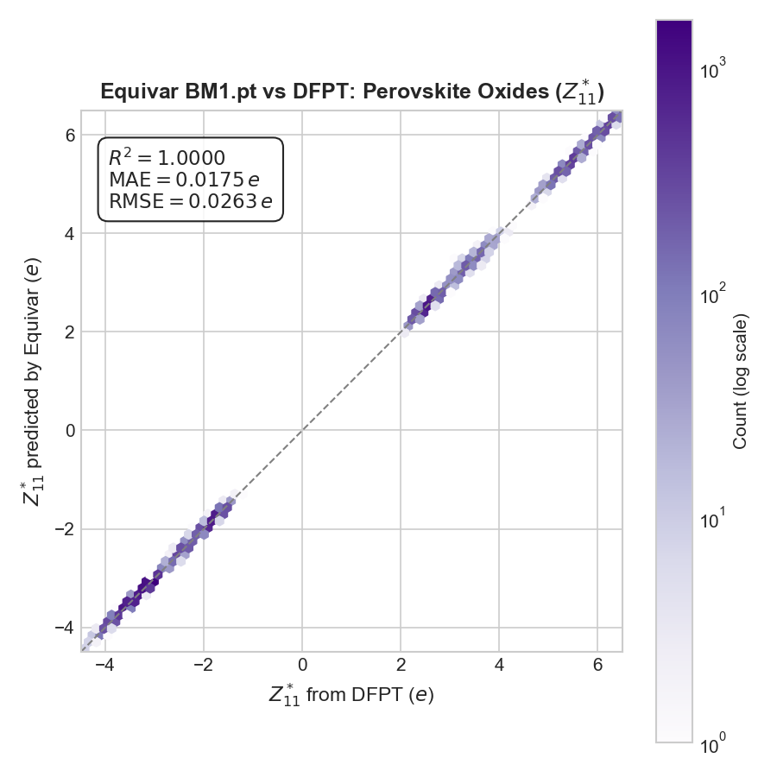
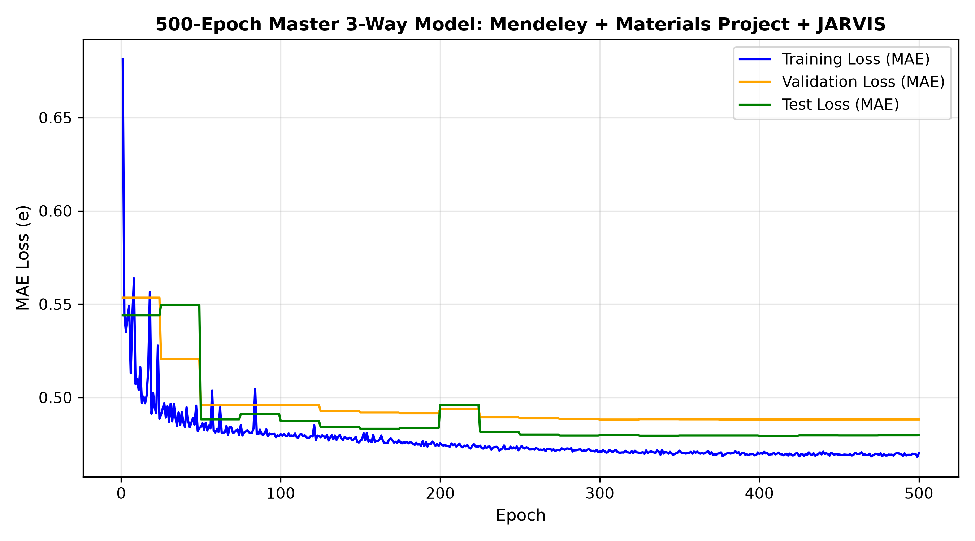
04 | EXPERIMENTAL BENCHMARKS & VALIDATION
500-Epoch Empirical Results & Parity Validation
Evaluating model performance across specialized oxide datasets and the master multi-element corpus
Dataset Corpus | Total | Train | Test | Elem | Test MAE (e)
Mendeley Oxides | 24,327 | 19,461 | 2,433 | 10 | 0.382 e
Materials Project | 14,530 | 11,624 | 1,453 | 85 | 0.506 e
JARVIS-DFT | 26,465 | 21,172 | 2,647 | 89 | 0.728 e
Master (Mend + MP) | 38,857 | 31,085 | 3,886 | 85 | 0.385 e
Combined Master 3-Way | 65,322 | 52,257 | 6,533 | 89 | 0.480 e
Fig 1: Perovskite Oxides Z*₁₁ parity (R² = 1.000, MAE = 0.0175 e)
Key Empirical Benchmarks & Cross-Transfer Insights:
• Scaling Element Diversity: Expanding from 10 elements (Mendeley) to 89 elements (Master 3-Way) retains excellent accuracy (0.480 e MAE) while achieving complete periodic table generality.
• Zero-Shot Cross-Transfer (MP → Mendeley): Testing the MP-trained model directly on Mendeley oxides yields 0.384 e MAE — matching models trained natively on Mendeley and proving physical transferability.
• Near-Zero Overfitting: Train MAE (0.470 e) closely tracks Test MAE (0.480 e) across all 500 epochs with cosine learning rate annealing.
Fig 2: 500-Epoch Convergence on Master 3-Way Corpus (Train/Val/Test)

Slide 6
05 | HIGH-THROUGHPUT DISCOVERY & CONCLUSIONS
Deploying on Google DeepMind GNoME & Summary
Discovering giant anomalous BEC candidates and pioneering scalable tensor deep learning
Discovery on DeepMind GNoME Database
• GNoME Deployment Pipeline:
- Screened Google DeepMind's Graph Networks for Materials Exploration (~554,000 structures) via MPContribs API.
- Filtered for insulating & semiconducting phases (Eg > 0 eV).
• Candidate Semiconductors with Giant Anomalous BEC:
- WO3 (ID: aaaempwf) → Max BEC = 12.08 e (Colossal anomaly)
- Sr2FeH6 (ID: aaaemgin) → Max BEC = 10.66 e (Hydride dielectric)
- W(OF)2 (ID: aaaemfrx) → Max BEC = 8.00 e
- SrTiO3 (ID: aaaemmig) → Max BEC = 7.88 e
- Ta3O7F (ID: aaaemkel) → Max BEC = 7.72 e
- Si3Os2 (ID: aaaemcjc) → Max BEC = 7.33 e
- Nb2O5 (ID: aaaemojf) → Max BEC = 7.06 e
- CsVN2 (ID: aaaemamj) → Max BEC = 6.79 e
• Impact: Identified high-priority candidates for ultra-high dielectric capacitors, soft-mode ferroelectrics, and thermoelectrics.
Project Summary & Future Horizons
Key Project Achievements:
1. Generalized from narrow functional oxides to a comprehensive 65,322-structure corpus across 89 elements.
2. Adapted an E(3)-equivariant Graph Neural Network directly predicting full 3 × 3 rank-2 Cartesian tensors.
3. Enforced exact physical Acoustic Sum Rule (ASR) zero-drift charge conservation both in training loss and analytical projection.
4. Successfully discovered extreme dynamic polarizability in novel non-oxide crystals from GNoME.
Future Work & Open Science:
• Active Learning Loops: Link predicted anomalous BECs to automated DFPT phonon band structure calculations to confirm soft-mode ferroelectric phase transitions.
• Crystallographic Symmetry Database: Construct an open-access web repository cataloging symmetry-analyzed Born charges across GNoME.
• Code & Checkpoints: https://github.com/Vibha-1729/Equivar_GCNN

