Slide 1
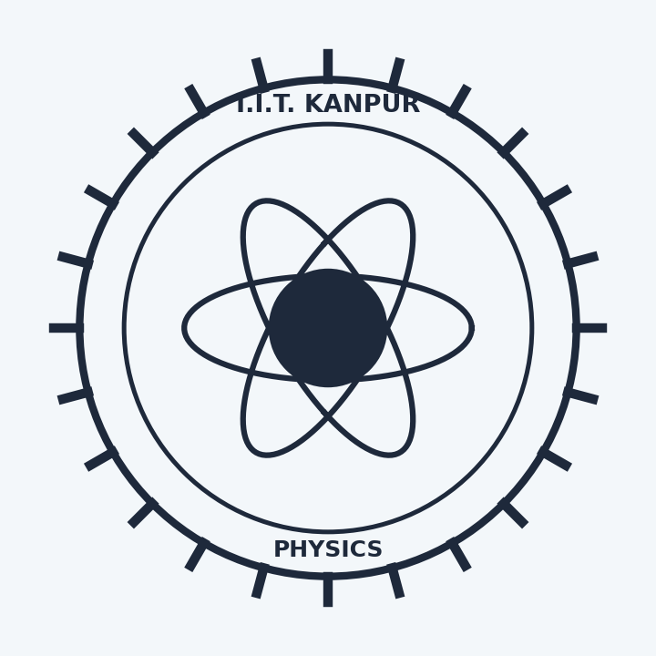
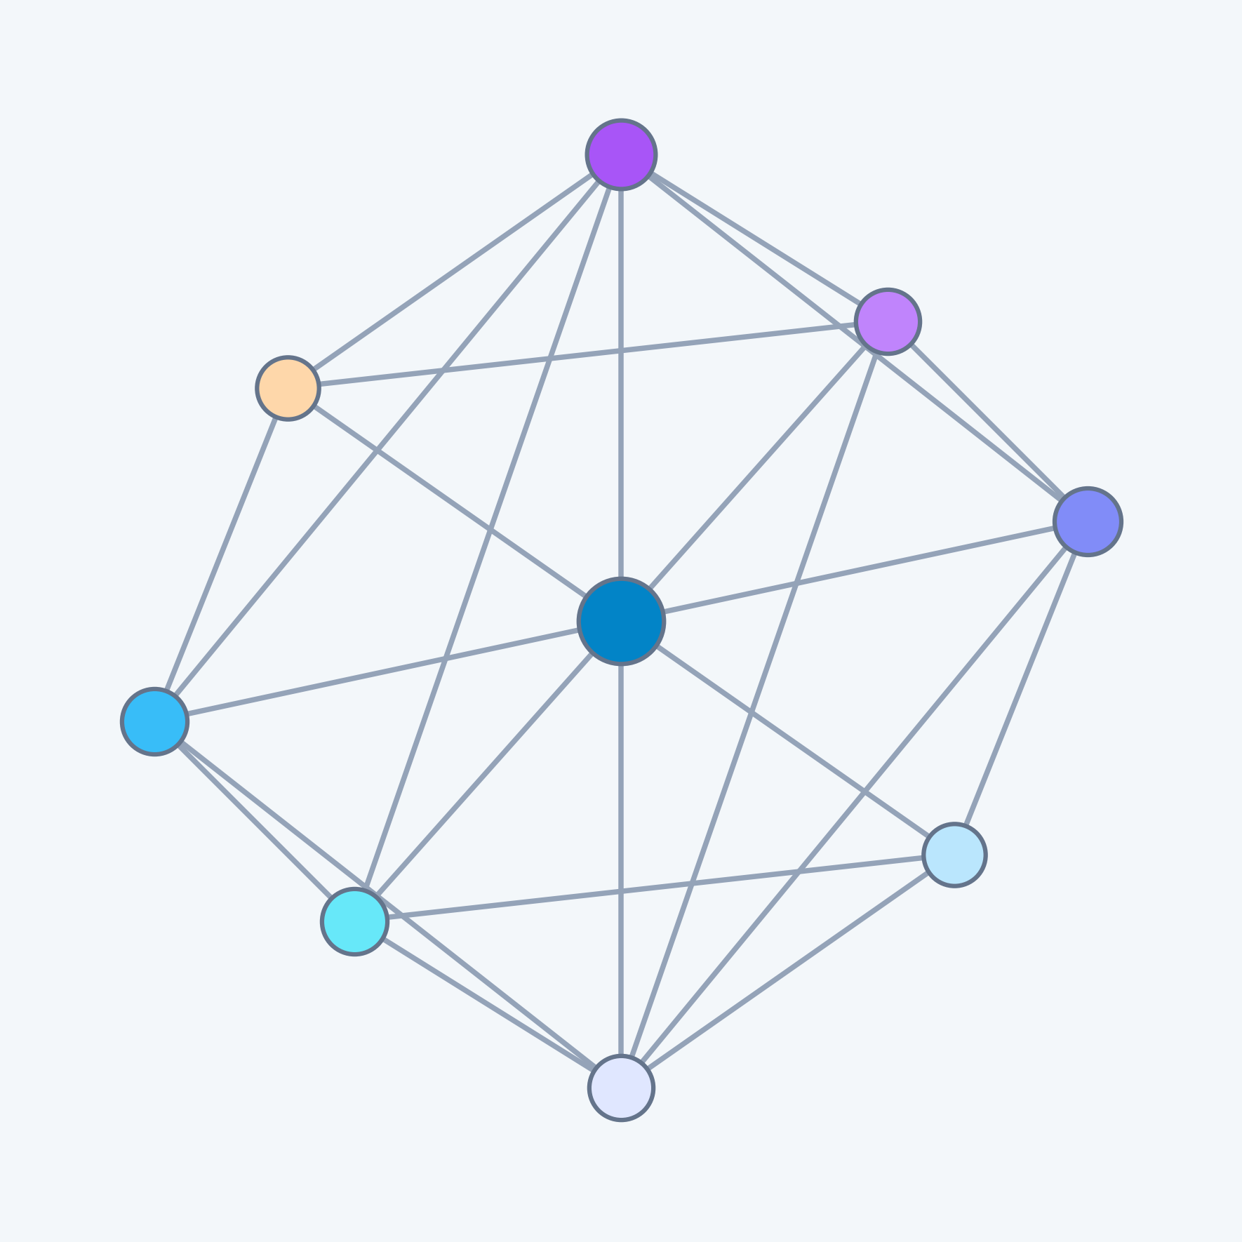
Data-Driven Discovery of Crystalline Semiconductors with Anomalous Born Effective Charges using an Equivariant Graph Neural Network
Presented by
Vibha Narayan
Undergraduate
Department of Physics
Project Supervisor
Prof. Koushik Pal
Department of Physics
IIT Kanpur

Slide 2
Motivation : Born Effective Charges
Born Effective Charge (BEC) tensors govern how a material's macroscopic electric polarization changes when atoms displace under an electric field. Identifying materials with anomalous Born charges unlocks transformative applications across energy storage and electronics. Yet computation of the full 3×3 tensor via first-principles DFPT remains prohibitively slow at scale, making deep learning a strategic necessity.
Normal vs. Anomalous Born Charges
In standard ionic crystals, atoms have nominal valences (e.g. Ti is +4, O is -2). In anomalous materials (like BaTiO3), Ti acts with an effective charge of +7.5 e! This anomaly comes from dynamic hopping and hybridization between metal d and oxygen 2p orbitals during atomic vibration.
Why It Matters for Technology
Giant anomalous Born charges signal soft optical phonon modes, ferroelectric instability, and colossal dielectric permittivity. These are key for non-volatile ferroelectric RAM (FeRAM), ultra-high energy density capacitors, wearable piezoelectric sensors, and thermoelectrics.
BEC Tensor Origin
In computational materials physics, Z* is a 3×3 Cartesian tensor defined as Z* = (Ω/e) ∂P/∂u, describing how displacement in x, y, z creates polarization along x, y, z.
DFT Bottleneck
Density Functional Perturbation Theory (DFPT) scales cubically as O(N³), taking hours of compute per crystal; completely infeasible at the scale of hundreds of thousands of structures.
Deep Learning Solution
Equivariant graph neural networks trained on curated DFT data preserve 3D rotational symmetry, enabling full rank-2 tensor prediction in milliseconds per structure at inference.

Slide 3
Dataset Preprocessing & Physical Filtering
Source Aggregation
~65,322 compounds aggregated from Mendeley Oxides, Materials Project, and JARVIS databases, each providing DFT-computed 3×3 Born effective charge tensors alongside crystal structures.
Physical Threshold Filtering
Raw DFT calculations contain unphysical anomalies and poorly converged calculations. To guarantee genuine physical validity, strict bounds were applied:
65.3K
Raw Compounds
Mendeley + Materials Project + JARVIS
89
Chemical Elements Covered
Comprehensive Periodic Table Diversity
❏ Eg > 0 eV for all structures (metals strictly excluded)
❏ |ASR| ≤ 1.0 e Acoustic Sum Rule charge neutrality bound
In metals (Eg = 0 eV), free conduction electrons screen electric fields, making Born charges ill-defined. Rigid lattice translations must not induce polarization. This filtering produced a robust, physical training corpus of 65,322 structures.
14,530
Materials Project
(85 Elements)
26,465
JARVIS-DFT
(89 Elements)

Slide 4
E(3)-Equivariant GNN Architecture
Baseline: Invariant Literature Model (Kutana et al.)
Replicated Kutana et al. (Sci. Rep. 2025) on Mendeley oxides. While accurate on perovskites, it was strictly limited to 10 elements and could not generalize across the periodic table.
Advanced: Master E(3)-Equivariant GNN
Predicts the full 3×3 Born charge tensor in a single forward pass, with representations that transform correctly under 3D rotations, reflections, and translations preserving physical symmetry by construction. The model uses SiLU activation and spherical harmonics up to l=2.
PHYSICS-INFORMED LOSS FUNCTION
The loss function encodes physical priors and crystal charge neutrality simultaneously to guide the model toward physically realizable tensor predictions:
L = ||Z* - Ẑ*||₁ + λasr || ∑_{i∈cell} Ẑ*i ||₁
Term 1: L₁ Reconstruction
Standard mean absolute error on all 9 Cartesian tensor components.
λasr = 2.0 (Acoustic Sum Rule Penalty)
Rigid translation penalty enforces zero net cell polarization drift during training.
Exact Projection Layer
Parameter-free post-processing layer: Z̃* = Z* - (1/N) ∑ Z*, guaranteeing ∑ Z̃* ≡ 0 analytically for every predicted crystal cell.
Literature Baseline
MAE = 0.382 e | R² = 1.000
(10 Oxide Elements)
Master Equivariant GNN
MAE = 0.480 e | R² = 0.998
(89 Chemical Elements)

Slide 5
Physical Validation & Cross-Dataset Analysis
The Cross-Dataset Transfer Test
To test if our model genuinely learned physical principles rather than memorizing dataset features, we evaluated the Materials Project model on Mendeley oxides without retraining:
• Reached MAE = 0.384 e, matching the native oxide model!
Why Literature Needed Expansion
Evaluating the oxide model on Materials Project gave MAE = 2.86 e. The model failed because it had never seen elements outside its 10 oxide species. This proved multi-dataset fusion is essential.
Step 1: Predict Z* Tensor
E(3)-GNN outputs full 3×3 Cartesian tensor directly from crystal graph in milliseconds per structure.
Step 2: Acoustic Sum Rule Check
Evaluate unit-cell net charge sum ∑ Z* to verify physical translation invariance and reject unphysical numerical artifacts.
❏ Requirement: |ASR| ≤ 1.0 e and Eg > 0 eV
This ensures every candidate material discovered by the model is physically viable and can realistically be synthesized and measured in a laboratory setting. Only physically realizable candidates pass through.
Step 3: Analytical Zero-Drift Projection
Apply parameter-free projection layer to guarantee exact cell charge neutrality ∑ Z̃* ≡ 0 analytically for every structure.

Slide 6
Discovery on GNoME Dataset & Results
Google DeepMind's GNoME Dataset
The validated E(3)-GNN was deployed on Google DeepMind's GNoME dataset — a curated library of 554,000+ previously unexplored crystalline structures predicted to be thermodynamically stable. This represents a large-scale application of equivariant tensor prediction.
Top Discovered Materials (Giant Anomalous BEC)
The pipeline discovered novel candidate materials with giant dynamic charges:
• WO3 (aaaempwf) → Max BEC = 12.08 e (Colossal anomaly)
• Sr2FeH6 (aaaemgin) → Max BEC = 10.66 e (Hydride dielectric)
• W(OF)2 (aaaemfrx) → Max BEC = 8.00 e
• SrTiO3 (aaaemmig) → Max BEC = 7.88 e
• Si3Os2 (aaaemcjc) → Max BEC = 7.33 e
• Nb2O5 (aaaemojf) → Max BEC = 7.06 e
Code & Data:
github.com/Vibha-1729/Equivar_GCNN
Future Scope:
• Active Learning with Phonons
Connect candidate materials directly to automated DFPT phonon calculations to verify soft-mode ferroelectric phase transitions.
• Graph Transformers
Equiformer architecture to capture long-range atomic interactions beyond local neighborhoods.
• Open-Access Web Database
Deploy a web interface enabling researchers to search predicted 3×3 Born charge tensors across 554k GNoME crystals without DFT computation.
• Benchmark on Matbench Discovery
Incorporate materials datasets for testing curated by Meta and Google, available at Matbench Discovery.

Slide 7
Thank You!
Questions & Discussion
Vibha Narayan | Prof. Koushik Pal
Department of Physics, IIT Kanpur

