Slide 1
Capstone Project 3 Cardiovascular disease prediction
Submitted by :
Vibha Kumari

Slide 2
Business Context:
The dataset is from ongoing cardiovascular study on resident of the town of Framingham, Massachusetts. Goal is to predict whether the patient has a 10-year risk of future coronary disease. dataset provides a patients information .each attribute is a potential risk factor. there are both demographic ,behavioral and medical risk factors.

Slide 3
Problem Statement
Goal is to predict whether the patient has a 10-year risk of future coronary disease.

Slide 4
Data Set
Demographic:
Sex: male or female ("M" or "F")
Age: Age of the patient (Continuous - Although the recorded ages have been truncated to whole numbers, the concept of age is continuous)
Education: The level of education of the patient (categorical values - 1,2,3,4)
Behavioral:
is_smoking: whether or not the patient is a current smoker ("YES" or "NO")
Cigs Per Day: the number of cigarettes that the person smoked on average in one day.(can be considered continuous as one can have any number of cigarettes, even half a cigarette.)
Medical (history):
BP Meds: whether or not the patient was on blood pressure medication (Nominal)
Prevalent Stroke: whether or not the patient had previously had a stroke (Nominal)
Prevalent Hyp: whether or not the patient was hypertensive (Nominal)
Diabetes: whether or not the patient had diabetes (Nominal)
Medical (current):
Tot Chol: total cholesterol level (Continuous)
Sys BP: systolic blood pressure (Continuous)
Dia BP: diastolic blood pressure (Continuous)
BMI: Body Mass Index (Continuous)
Heart Rate: heart rate (Continuous - In medical research, variables such as heart rate though in fact discrete, yet are considered continuous because of large number of possible values.)
Glucose: glucose level (Continuous)
Predict variable (desired target):
10-year risk of coronary heart disease CHD(binary: “1”, means “Yes”, “0” means “No”)

Slide 5
Handling Missing Data:
total null values:
df.isna().sum().sum()
Replacing the missing values in the categorical columns with its mode
df['education'] = df['education'].fillna(df['education'].mode()[0])
df['bp_meds'] = df['bp_meds'].fillna(df['bp_meds'].mode()[0])

Slide 6
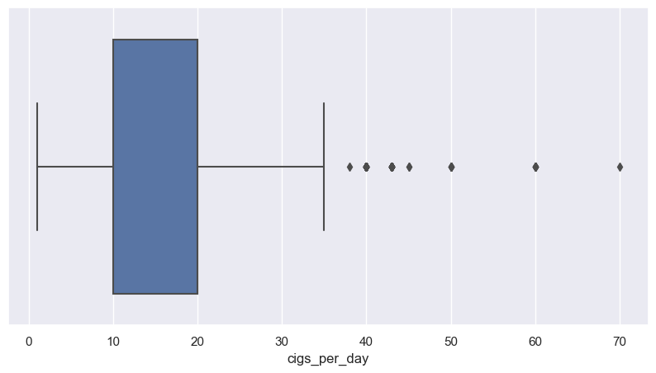
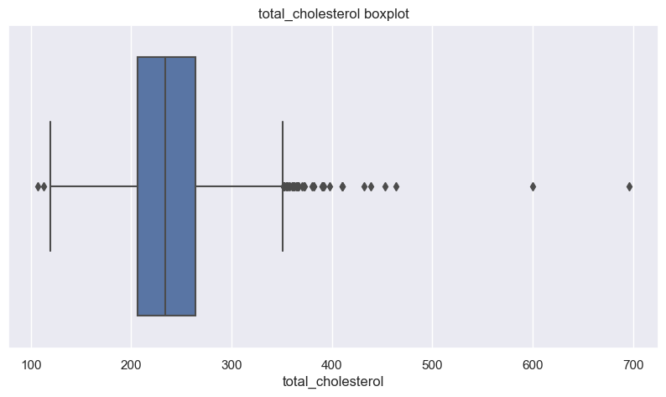
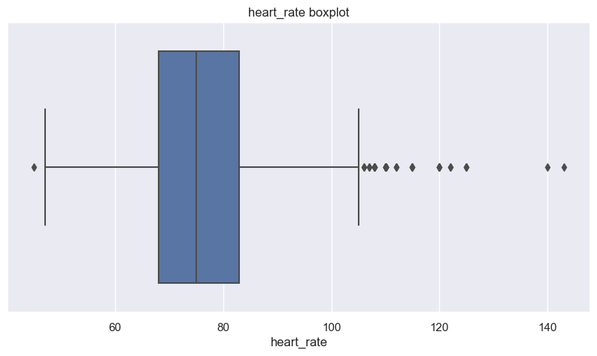
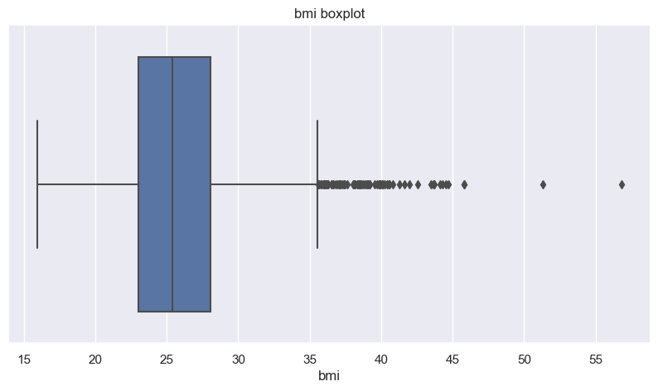
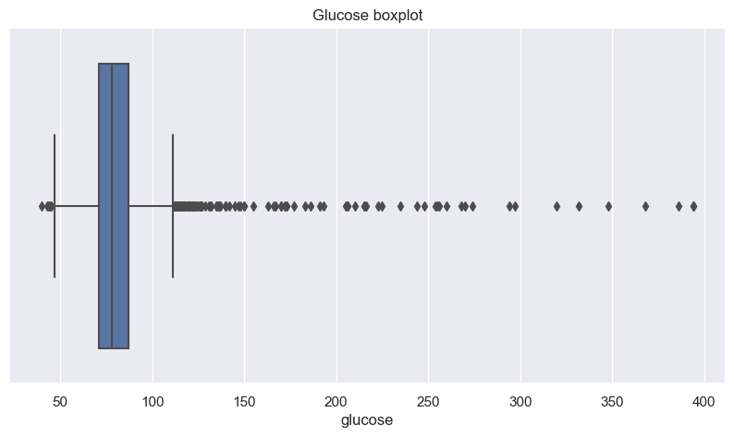
Checking outliers

Slide 7
Handling outliers
Since the total_cholestrol, bmi, and heart_rate columns are positively skewed, and also contains outliers. We can impute the missing values with its median.
There are 304 missing values in the glucose column. If we choose to impute them with a single value of mean / median, we will be adding high bias at that point. To avoid this we can impute the missing values using KNN imputer. If the dataset in question had been a time series, we could have used the interpolation method to impute the missing values.
# Imputing missing values in the total_cholesterol, bmi, and heart_rate with their medain values
df['total_cholesterol'] = df['total_cholesterol'].fillna(df['total_cholesterol'].median())
df['bmi'] = df['bmi'].fillna(df['bmi'].median())
df['heart_rate'] = df['heart_rate'].fillna(df['heart_rate'].median())
# Using KNN imputer with K=10
imputer = KNNImputer(n_neighbors=10)
imputed = imputer.fit_transform(df)
df = pd.DataFrame(imputed, columns=df.columns)
After KNN imputation, there is no massive change in the values of mean. And the values of median and mode remain the same.
KNN imputer has converted all the columns to the float64 datatype. Hence, changing the column datatype accordingly as per the kind of data stored in the respective column
# changing datatypes
df = df.astype({'age': in

Slide 8
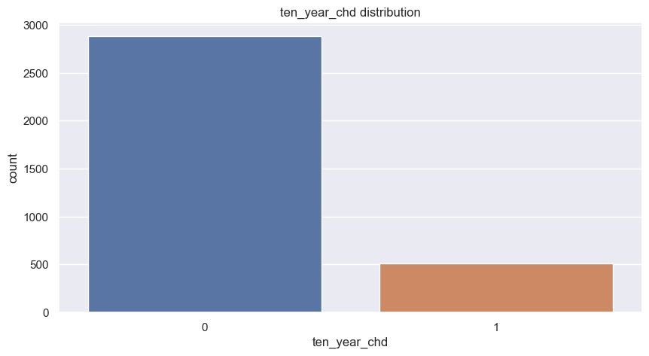
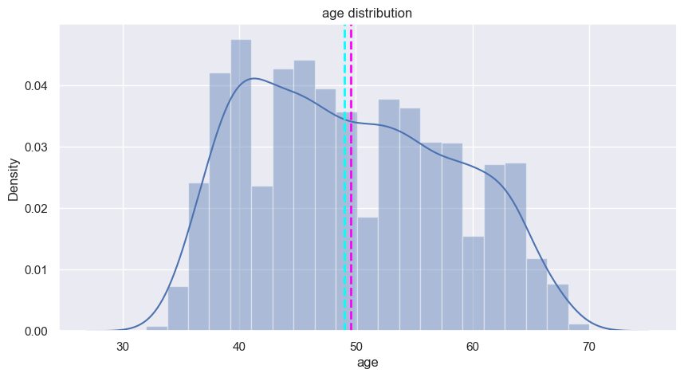
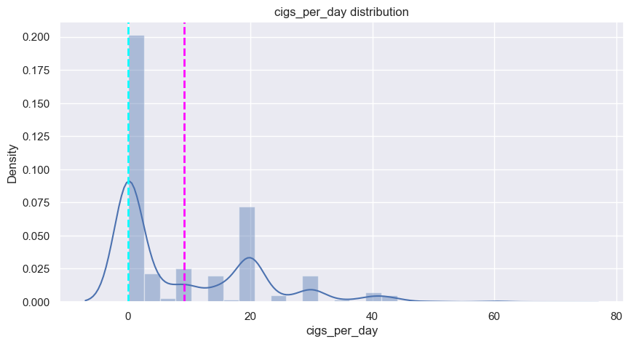
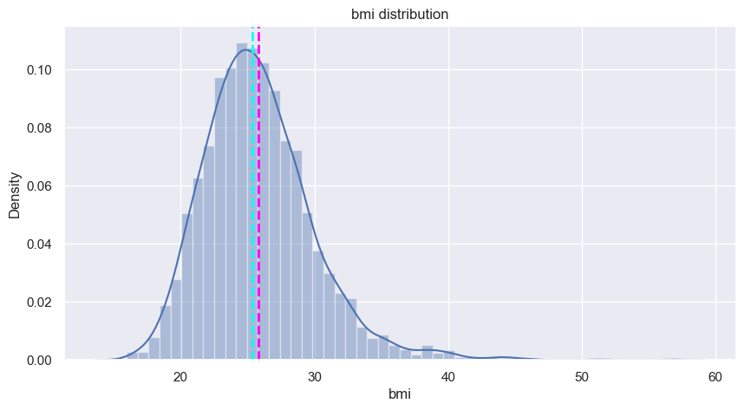
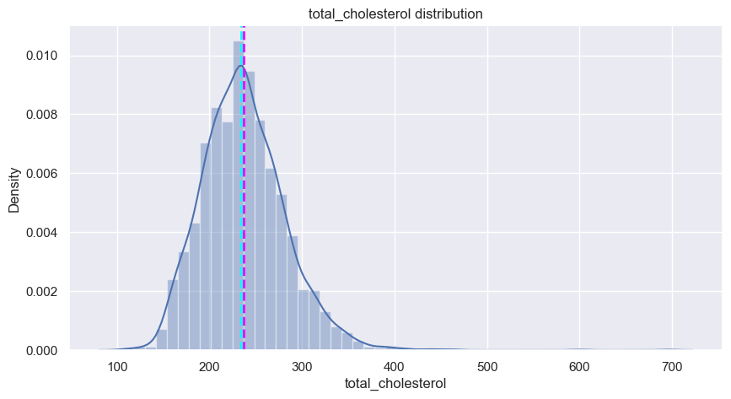
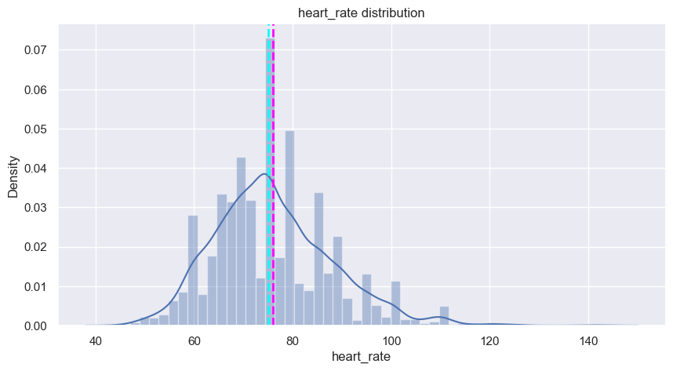
Exploratory Data Analysis:
Analysing the distribution of continuous varaibles after transformation
The dependent variable - 10 year risk of CHD is unbalanced.
Except cigs_per_day, we have successfully been able to reduce the skewness in the continuous variables. Now these distributions are closer to symmetric distribution.

Slide 9
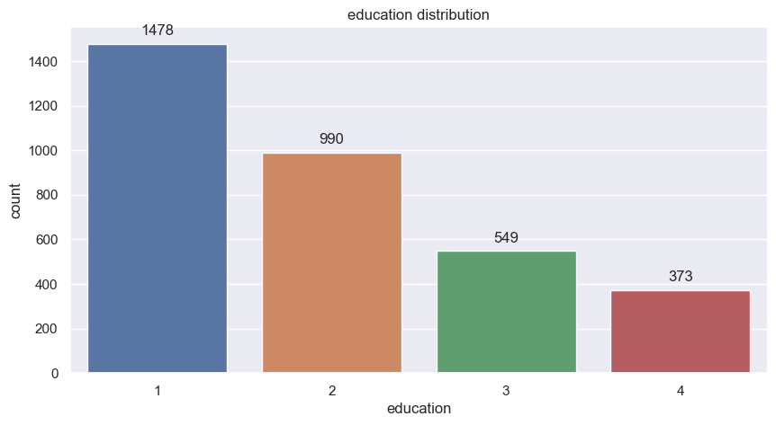
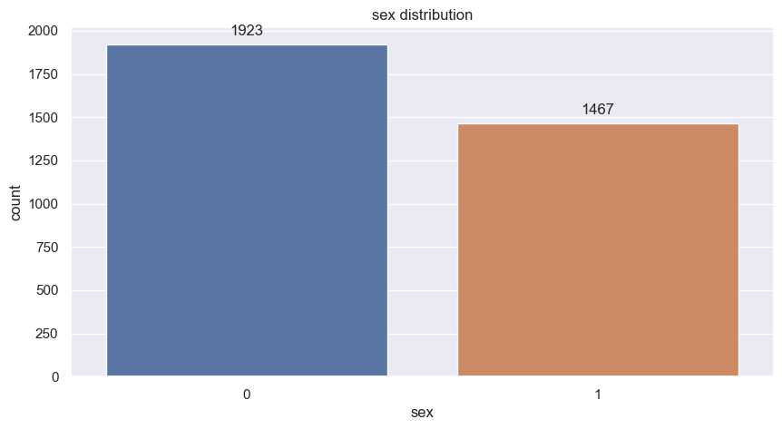
Analysing the distribution of categorical variables in the dataset
Majority of the patients belong to the education level 1, followed by 2, 3, and 4 respectively. There are more female patients compared to male patients.

Slide 10
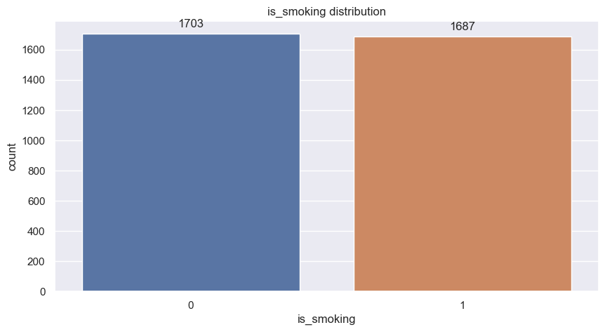
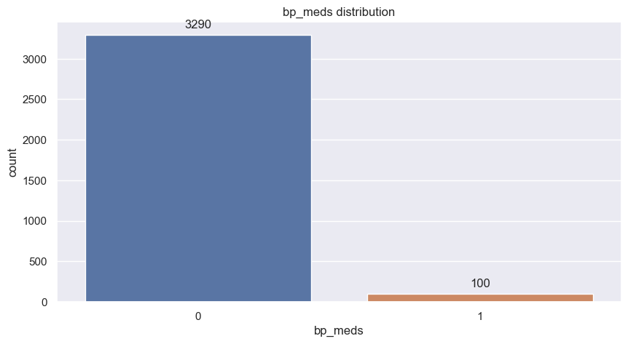
Almost half the patients are smokers.
100 patients under the study are undertaking blood pressure medication.

Slide 11
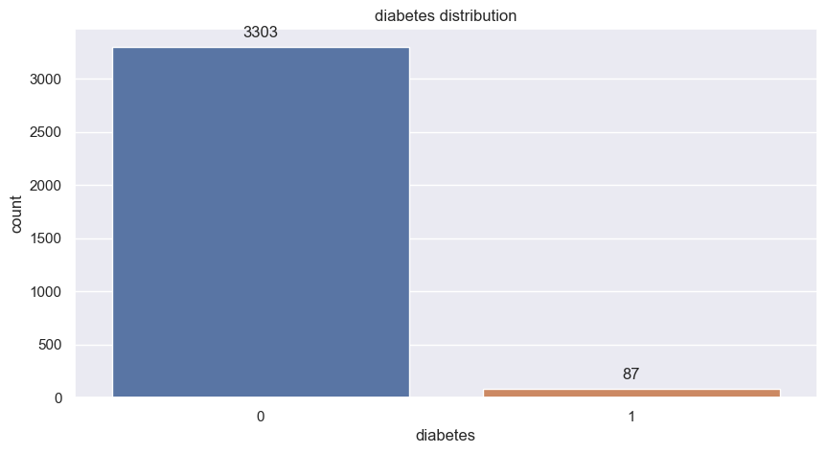
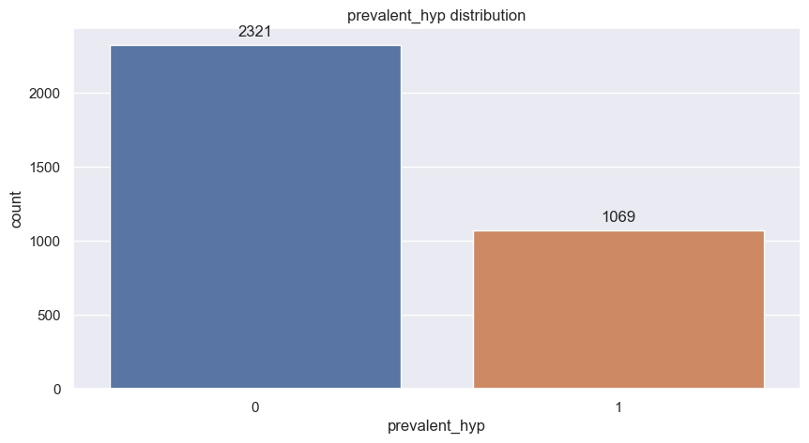
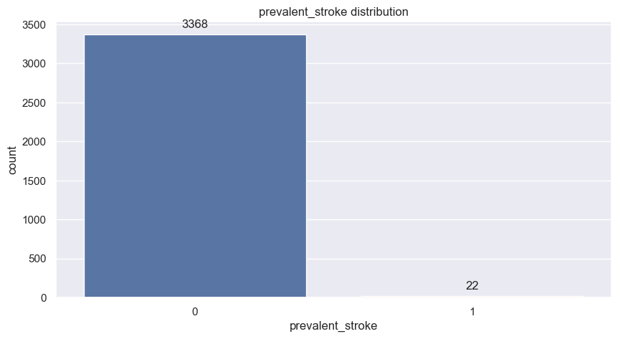
22 patients under the study have experienced a stroke.
1069 patients have hypertension.
87 patients have diabetes.

Slide 12
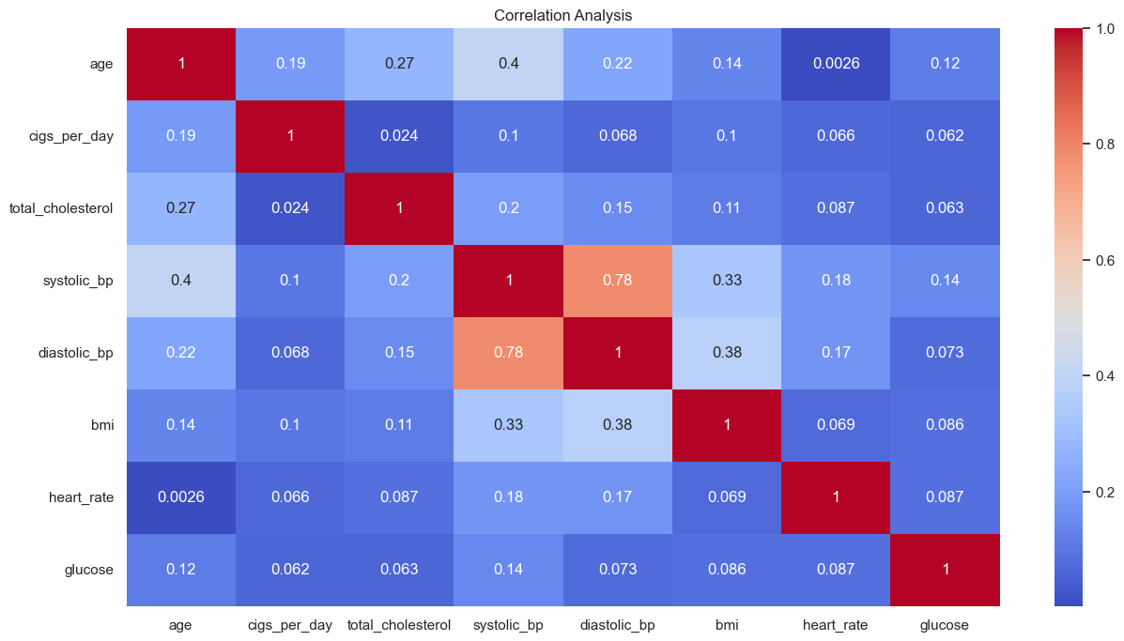
Correlation magnitude & Handling Multicollinearity:
Above is the correlation magnitude heatmap for all the continuous variables in the dataset.
The variables systolic BP and diastolic BP are highly correlated.
To handle multicollinearity between these two independent continuous variables, we can replace these two columns with a new variable 'pulse pressure', which is given as follows:
Pulse Pressure = Systolic BP - Diastolic BP
# Creating a new column pulse_pressure
# and dropping systolic_bp and diastolic_bp
df['pulse_pressure'] = df['systolic_bp']-df['diastolic_bp']

Slide 13
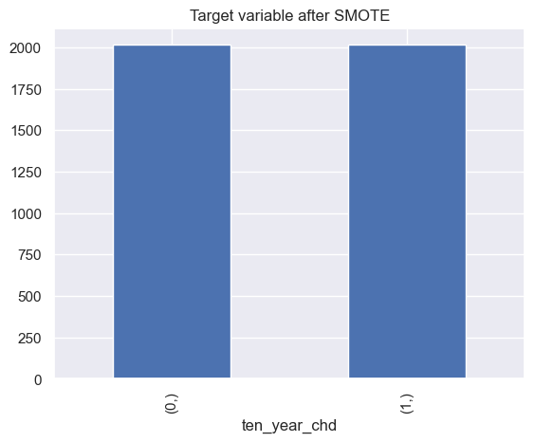
# train test split
X_train, X_test, y_train, y_test = train_test_split(X, y, test_size=0.3, random_state=0, stratify=y, shuffle=True)
visualize the target variable after SMOTE
Scaling the data:
Since the predictions from the distance based models will get affected if the attributes are in different ranges, we need to scale them.
We can use StandardScaler to scale down the variables.
The results obtained from scaling can be stored and used while building those models.
Tree algorithms do not necessarily require scaling.

Slide 14
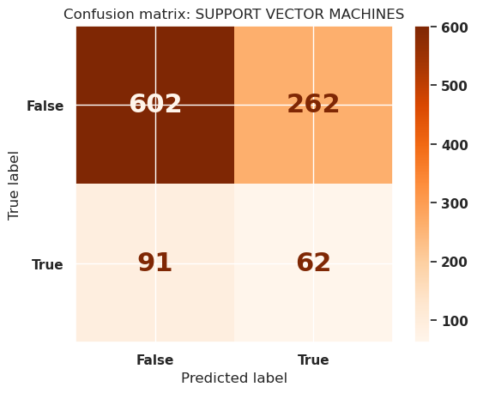
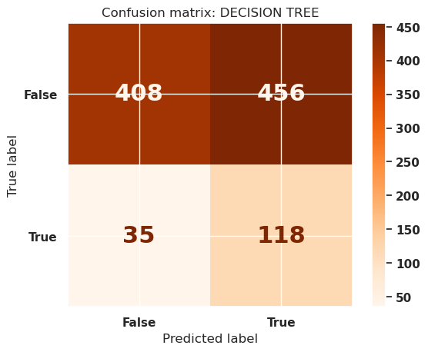
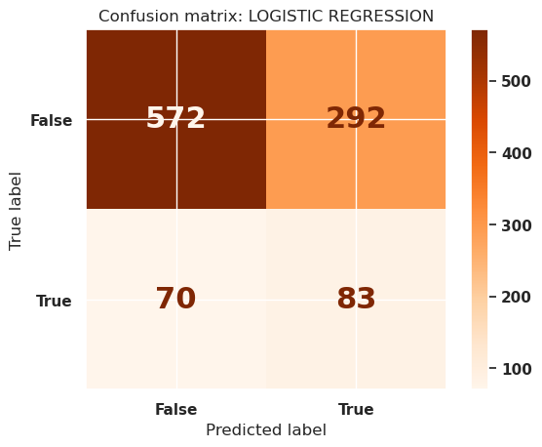
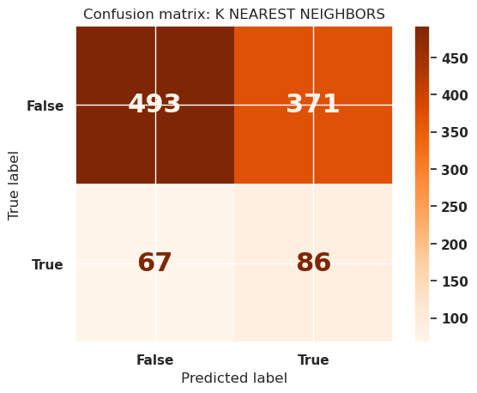
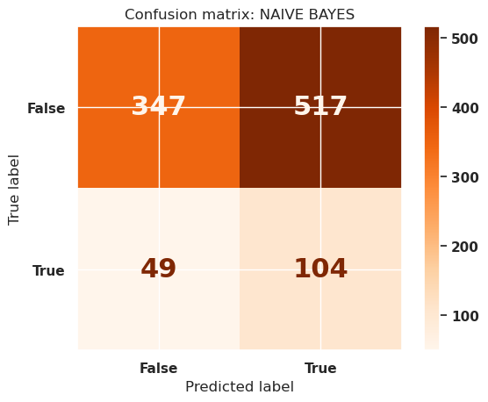
ML Model Implementation: and Confusion Matrix
False negatives obtained : 70,91,35,67,49 it means the model falsely predicted the pos class level to negative.

Slide 15
Summarizing the results obtained
| Sl. No. | Classification Model | Train Recall (%) | Test Recall +-------------------+-----------------| 1 | Logistic Regression | 72.20843672456576| 54.248366013071895 |
| 2 | K Nearest Neighbors | 84.96277915632754| 56.209150326797385 |
|
3| Naive Bayes | 90.02481389578165| 67.97385620915033 |
4 | Decision Tree | 85.4590570719603 | 77.12418300653596 |
5 | Support Vector Machines | 80.24813895781637 | 40.52287581699346 | +--------+-----------------------+

Slide 16
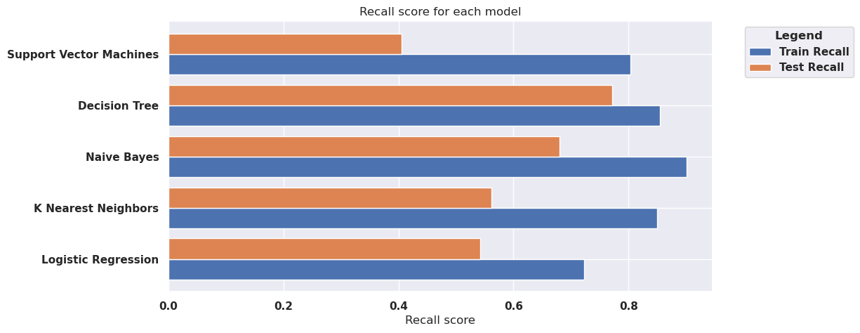
Plotting Recall scores
The decision tree has the highest train and test recall score compared to other models built.

Slide 17
Summary and Conclusion:
Trained 5 Machine Learning models using the training dataset, and hyperparameter tuning was used in some models to improve the model performance.
To build the models, missing values were handled, feature engineering and feature selection was performed, and the training dataset was oversampled using SMOTE to reduce bias on one outcome.
Recall was chosen as the model evaluation metric because it was very important that we reduce the false negatives.
Initial set of predictions were obtained using the baseline model, i.e., logistic regression model, and other commonly used classification models were also build in search of better predictions.
Predicting the risk of coronary heart disease is critical for reducing fatalities caused by this illness. We can avert deaths by taking the required medications and precautions if we can foresee the danger of this sickness ahead of time.
It is critical that the model we develop has a high recall score. It is OK if the model incorrectly identifies a healthy patient as a high risk patient because it will not result in death, but if a high risk patient is incorrectly labelled as healthy, it may result in fatality.

Slide 18
We were able to create a model with a recall of just 0.77 because of limited data available and limited computational power available.
A recall score of 0.77 indicates that out of 100 individuals with the illness, our model will be able to classify only 77 as high risk patients, while the remaining 33 will be misclassified.
Future developments must include a strategy to improve the model recall score, enabling us to save even more lives from this disease. This includes involving more people in the study, and include people with different medical history, etc. build an application with better recall score.
From our analysis, it is also found that the age of a person was the most important feature in determining the risk of a patient getting infected with CHD, followed by pulse pressure, prevalent hypertension and total cholesterol.
Diabetes, prevalent stroke and BP medication were the least important features in determining the risk of CHD.

