Slide 1
UE18CS390B - Capstone Project Phase - 2
END SEMESTER ASSESSMENT
Project Title: Optimal Scheduling of Processing Unit using Convolutional Neural Network Architecture
Project ID: 38
Project Guide: Dr. Pooja Agarwal
Project Team: Bhavin G Chennur PES2201800682, CSE 7A
Nishanth S Shastry PES2201800533, CSE 7A
Vibha V Hegde PES2201800493, CSE 7D
S Monish PES2201800380, CSE 7A

Slide 2
ABSTRACT
CPU Scheduling is the process of allocating the CPU time to various requesting processes. This project makes use of a CNN to combine the advantages of all the primitive scheduling algorithm.

Slide 3
MAJOR REQUIREMENTS
01
02
03
REDUCE WAITING TIME
PREFER HIGHER PRIORITY PROCESSES
TRADE-OFF LONG AND SHORT PROCESSES

Slide 4
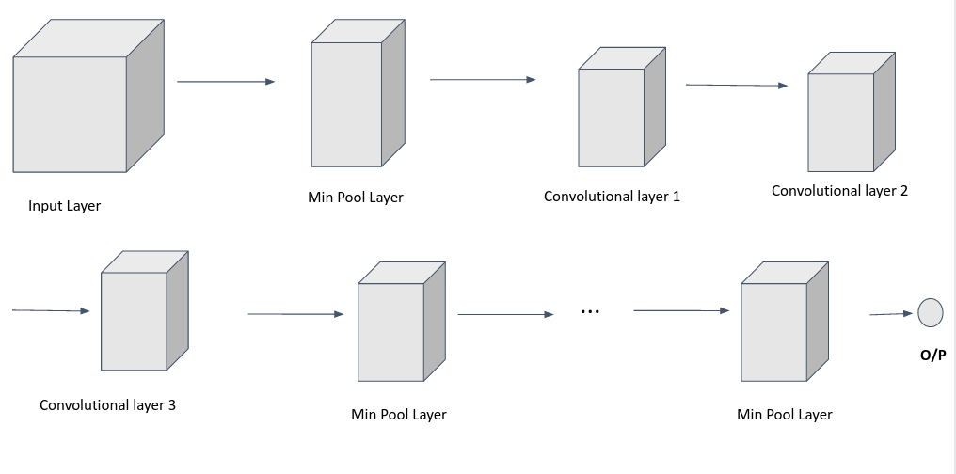
HIGH LEVEL DESIGN

Slide 5
BENEFITS OF THE ARCHITECTURE
DATA
INTEGRATION
SIZE REDUCTION
The data does not become non-human readable in the hidden layers
More than one features could be integrated in Neural Networks
Lesser data implies lesser processing power, in CNN we can concentrate data with the help of the pooling layers

Slide 6
MODULES AND IMPLEMENTATION DETAILS
WAITING TIME
PRIORITY
LONG AND SHORT PROCESSES
FAIR SHARE OF CPU TIME
Min Pooling Layers
1:1:2 - Feature Extraction Kernels
Median - Feature Extraction Kernels
Median - Feature Extraction Kernels

Slide 7
BROAD CLASSIFICATION
 | TECHNOLOGY | DESCRIPTION
MIN POOLING | Data Concentration | Picks the local minimum element.
1:1:2 KERNEL | Feature Extraction | Increases the importance of the values in the priority channel.
MEDIAN KERNEL | Feature Extraction | Picks a process that is neither too short nor too long.

Slide 8
TESTING CATEGORIZATION
—WAITING TIME
—TURNAROUND TIME
—LOSS
Designing the edge cases, with respect to our algorithm, for getting good waiting time.
Designing the edge cases, with respect to our algorithm, to get good turnaround time.
Designing cases to make sure the total loss of our algorithm is less than the other algorithms.

Slide 9
Project Timeline
SCHEDULING AND NN REQUIREMENT ANALYSIS
CUSTOM CNN IMPLEMENTATION
PHASE 01
PHASE 02
PHASE 01
PHASE 02
TESTING
CNN HIGH LEVEL DESIGN

Slide 10
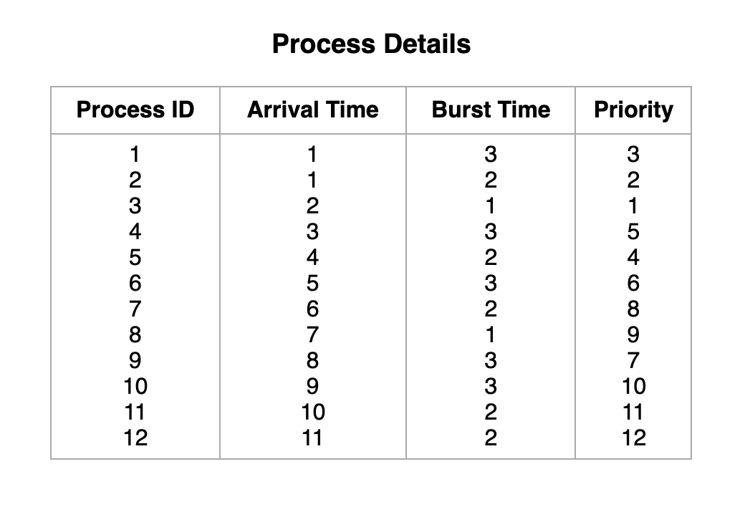
RESULTS AND DISCUSSIONS
To perform CPU Scheduling, the following details are required: -
The scheduling algorithms considered are: -
FCFS - First Come First Serve
SJF (NP) - Shortest Job First (Non-Preemptive)
SJF (P) - Shortest Job First (Preemptive)
RR (Q=1) - Round Robin (Quantum time = 1)
RR (Q=2) - Round Robin (Quantum time = 2)
Priority (NP) - Priority based (Non-Preemptive)
Priority (P) - Priority based (Preemptive)
CPU_CNN - Algorithm w.r.t Proposed work
The values shown are predefined and are not necessarily required to be the same.

Slide 11
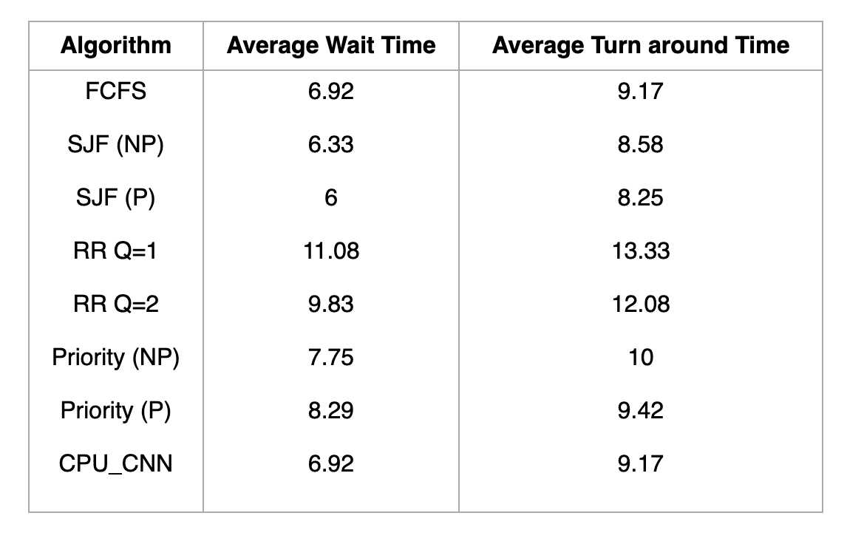
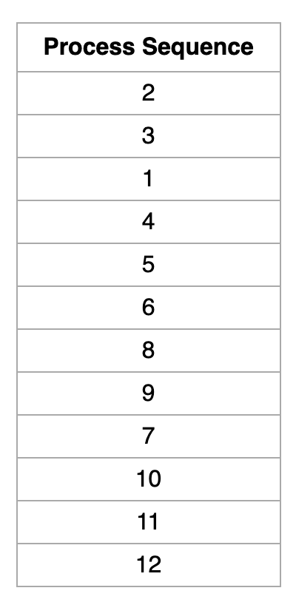
RESULTS AND DISCUSSIONS
Results obtained after implementing the algorithms: -
Sequence of processes after scheduling: -
Algorithm w.r.t Proposed work

Slide 12
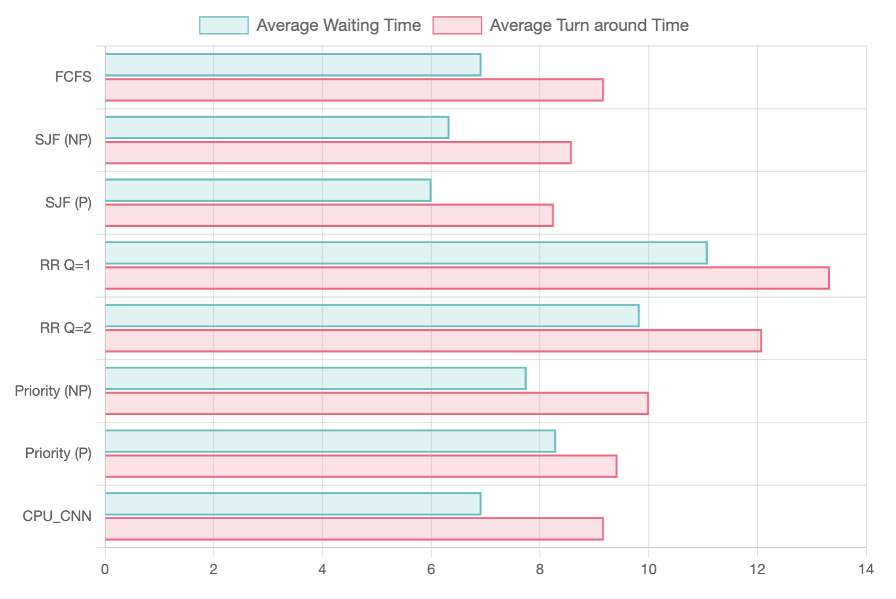
RESULTS AND DISCUSSIONS
Comparing the results of the algorithms (graphical representation)
Algorithm w.r.t Proposed work

Slide 13
DOCUMENTATION
Project Report - Submitted to department
IEEE Paper Status - Submitted to Confluence (Confluence-2022:12th International Conference on Cloud Computing, Data Science & Engineering) Paper Id - 513
Github Repository link - Click here to view GitHub Repository

Slide 14
LESSONS LEARNT
Oral Communication
Punctuality
Research Skills

Slide 15
REFERENCES
Presentation supported by Slidesgo, Flatikon and Freepik.

Slide 16
THANK YOU

