Slide 1
Differential Privacy Based Access Control
Project for CS 6301.0U1
By
Vibha BElavadi

Slide 2
Differential Privacy Based Access Control
This project is an implementation of Differential Privacy Based Access Control
Adapted from the book On the Move to Meaningful Internet Systems: OTM 2016 Conferences.
Paper by Metoui, Nadia and Bezzi, Michele
Motivation: Allow data access to people based on their privacy clearance levels
Privacy Clearance levels of individuals are based on their roles and operation
Mixture of RBAC and anonymization to implement this
Use case used: HR management

Slide 3
Need for such a system
For his/her department, HR manager can have a full view on the HR information of the employees
However, he/she has an aggregated view for the HR data from other departments.
For certain situations like employee satisfaction survey, employee feedback, etc. a certain level of anonymity is needed even for the data.
Also a realistic estimate of data may be needed for testing and development of certain HR applications. However they need to be anonymized.
Sometimes HR data needs to be sent to organizations like Bureau of Labor Statistics for benchmarking purposes. This data needs to make sense but also be anonymized.

Slide 4
Access based utility of data:
# | Role | Operation | Risk | Utility
1 | HR Manager | HR view (internal) | Low Risk | Full access
2 | HR Manager | HR view (external) | Medium Risk | Aggregated
3 | HR Developer | Testing data | Medium-High Risk | Anonymized
4 | HR Benchmarking | Benchmark | High Risk | Anonymized

Slide 5
Architecture:

Slide 6
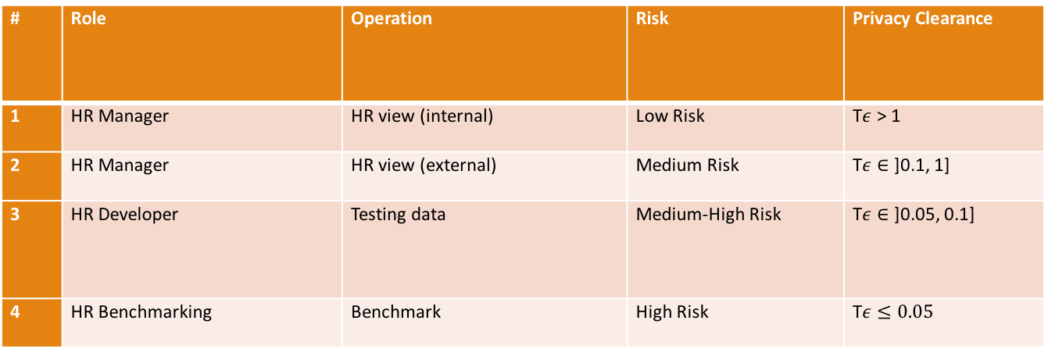
Example privacy clearance levels
# | Role | Operation | Risk | Privacy Clearance
1 | HR Manager | HR view (internal) | Low Risk | T$ε$ > 1
2 | HR Manager | HR view (external) | Medium Risk | T$ε$ $∈$ ]0.1, 1]
3 | HR Developer | Testing data | Medium-High Risk | T$ε$ $∈$ ]0.05, 0.1]
4 | HR Benchmarking | Benchmark | High Risk | T$ε$ $≤0.05$

Slide 7
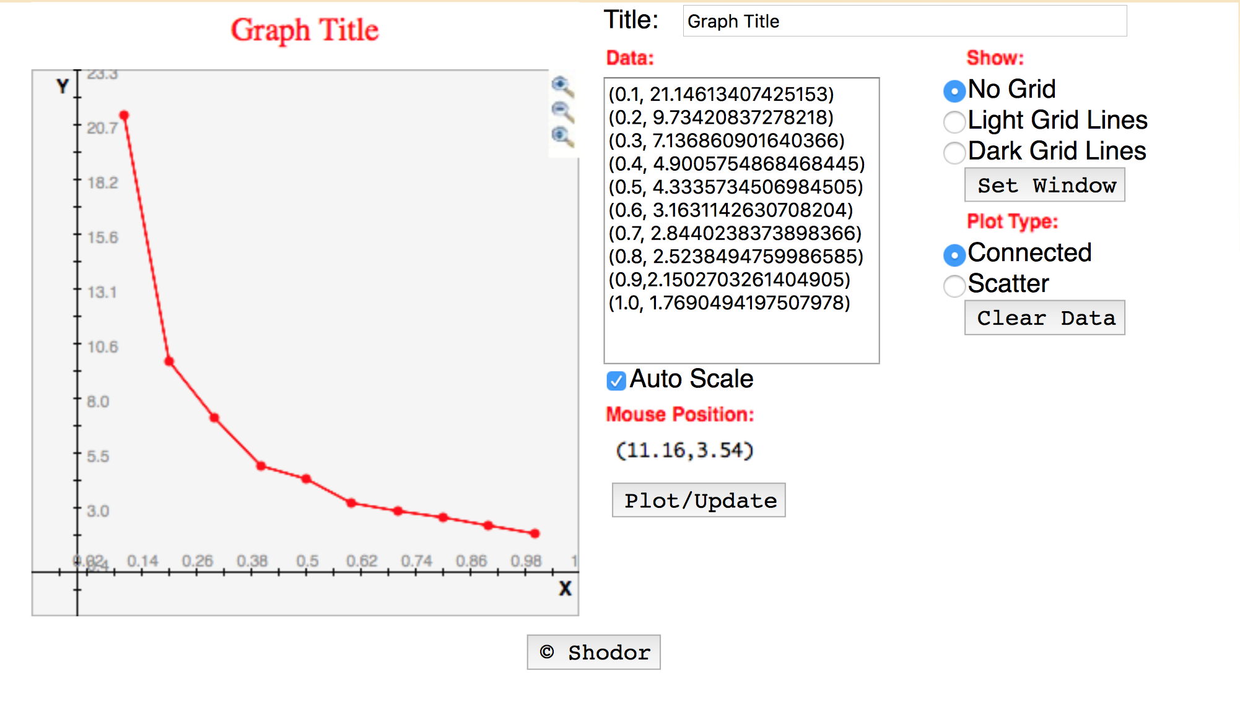
Correlation between normalized error and Privacy Clearance:

Slide 8
References:
All tables and images taken from:
https://link.springer.com/chapter/10.1007/978-3-319-48472-3_61#Sec8
Implementation of the following paper:
N. Metoui and M. Bezzi. Differential Privacy Based Access Control . In C&TC 2016: On the Move to Meaningful Internet Systems: OTM 2016 Conferences

