Slide 1
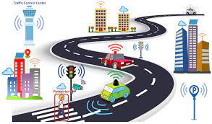
NETWORK TRAFFIC CONTROLLING SYSTEM
Team: SVSH
Supadma Kadabi
Vibhashree Hippargi
Sachin Kumar
Hamida Aliveya
Git: https://github.com/VibhaHippargi/ESE_SmartCity
TinkerCad: https://www.tinkercad.com/things/bVgn3KlB4Fw?sharecode=xnIgK360KLeYYH-lOFKQRjDNJV30t0tzFYQwTk_7K0Q

Slide 2
What and How?
SMART? - When the components of a traffic control system, for example, traffic signals and autonomous vehicles can interact with each other about the situations and take decisions without the need for human intervention, we can term them ‘Smart’.
HOW? - With the help of cellular V2X (C-V2X) or dedicated short-range communication (DSRC). This allows vehicles to ‘see through the eyes’ of their traffic fellows and significantly extend the sensing range provided by their own sensors, such as cameras, radar, or lidar.

Slide 3
V2X:
V2X sends around 10messages/second
Messages contain important parameters viz. accurate geographical location, the actual speed, velocity and direction of the vehicle, and the status of brakes and hazard warning lights.
For building Smart infrastructure, VS2X RSU (Road Side units) are used. They have their own processing power, send and receive messages.
Several elements of traditional road elements can be linked to RSUs
By this, buses and urban maintenance fleets can request priority at V2X-enabled intersections.
E.g.: In Denver, Colorado, snowplow trucks cross intersections by requesting a green light, causing less disruption to traffic.

Slide 4
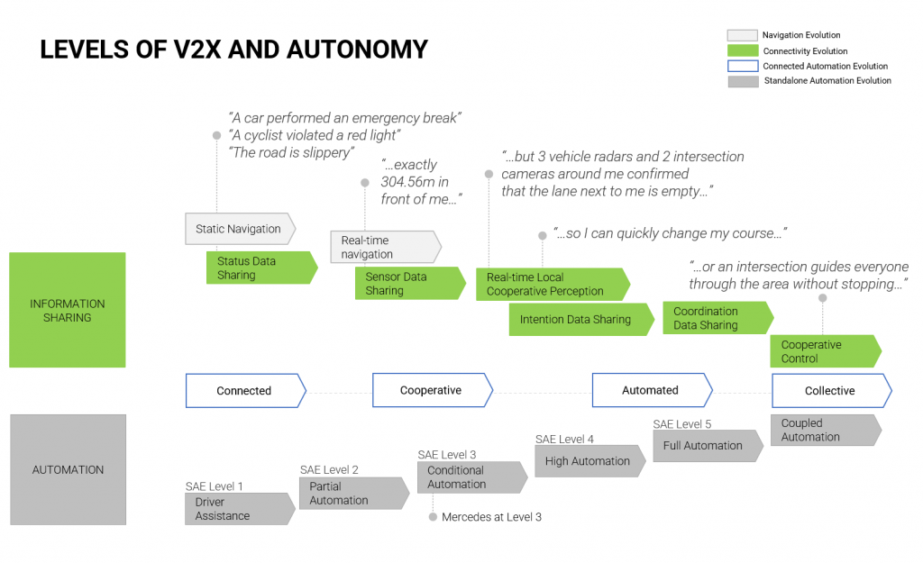
Reference: Commsignia

Slide 5
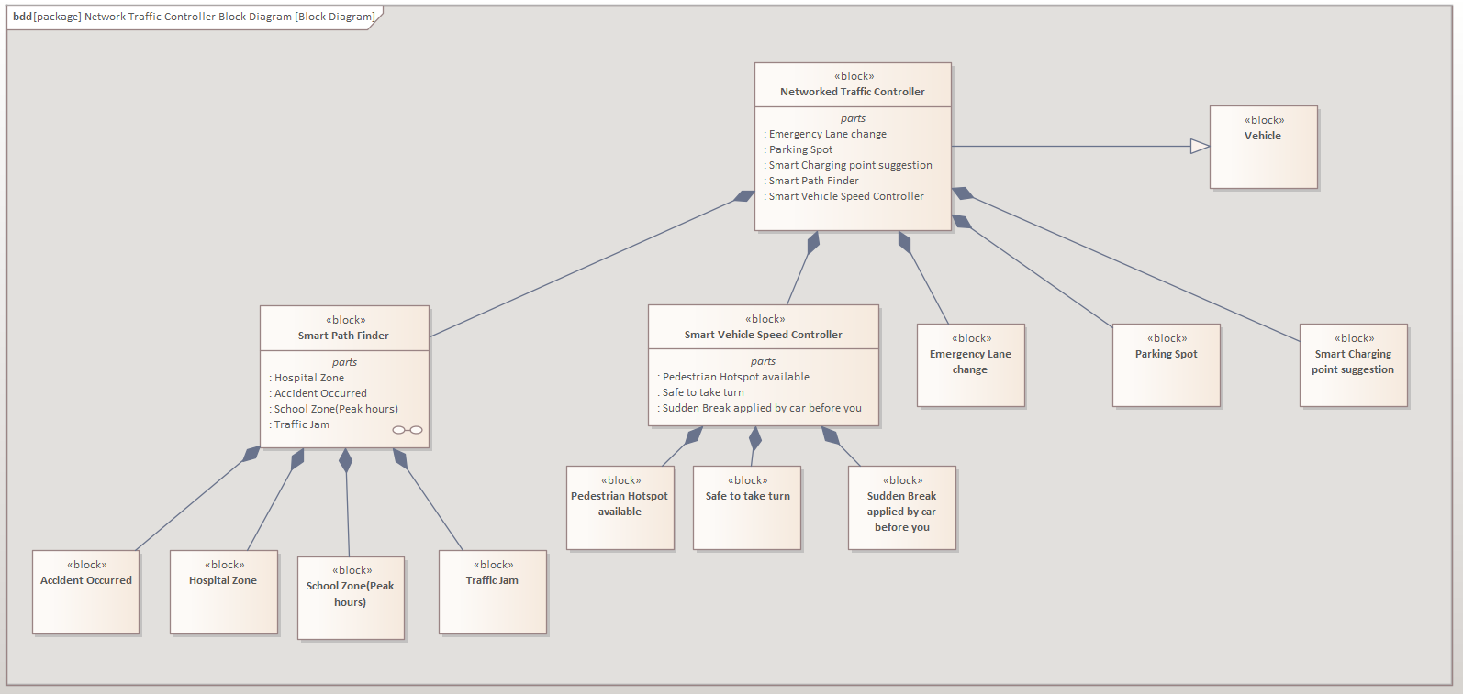
Block Diagram

Slide 6
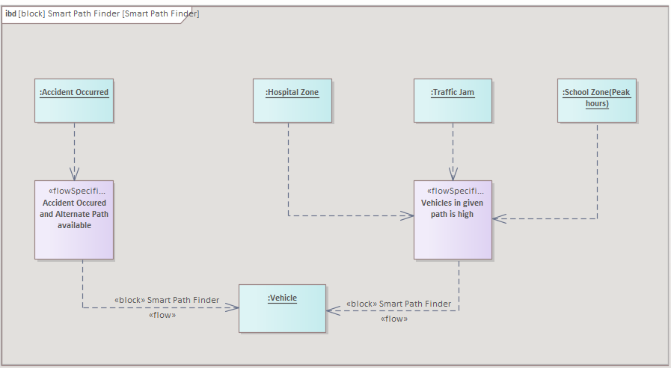
Internal Block diagram

Slide 7
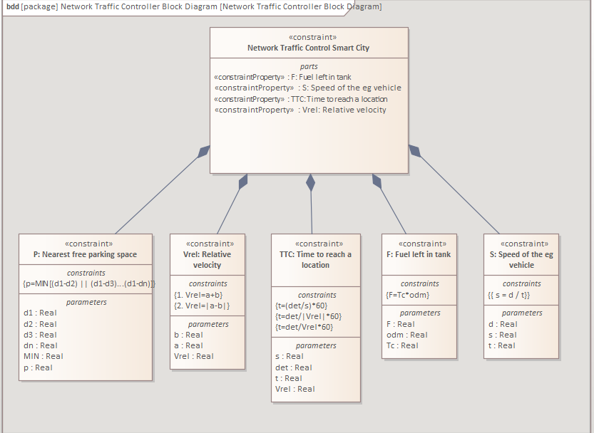
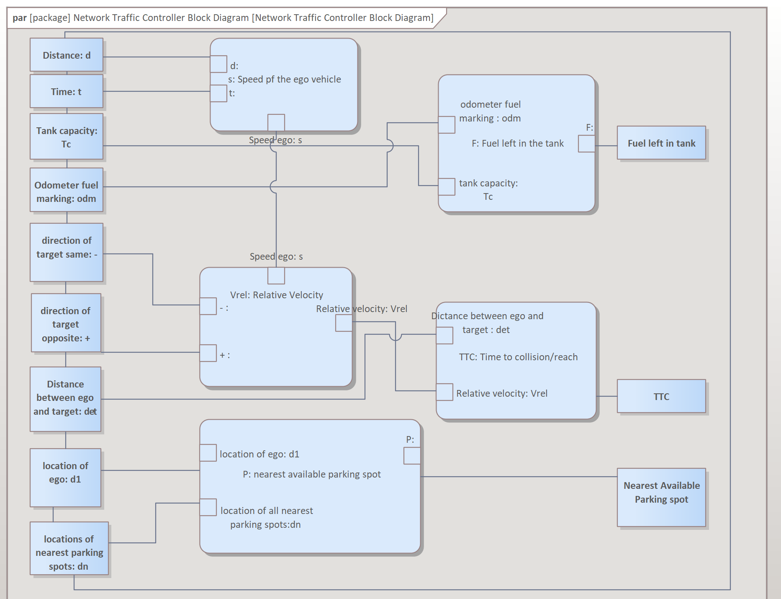
Constraints and Parametric Diagrams

Slide 8
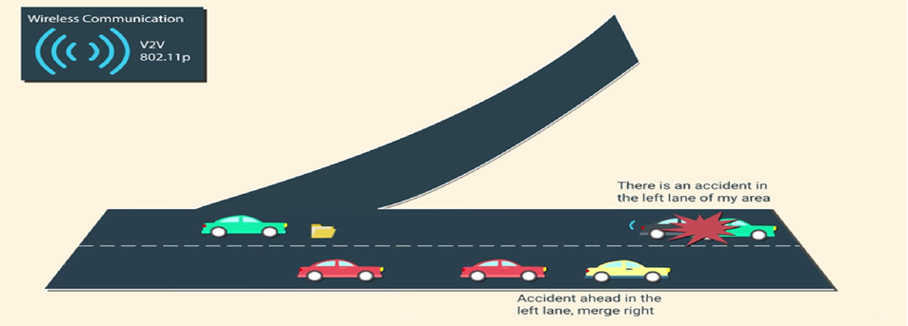
Accident Occurred scenario

Slide 9
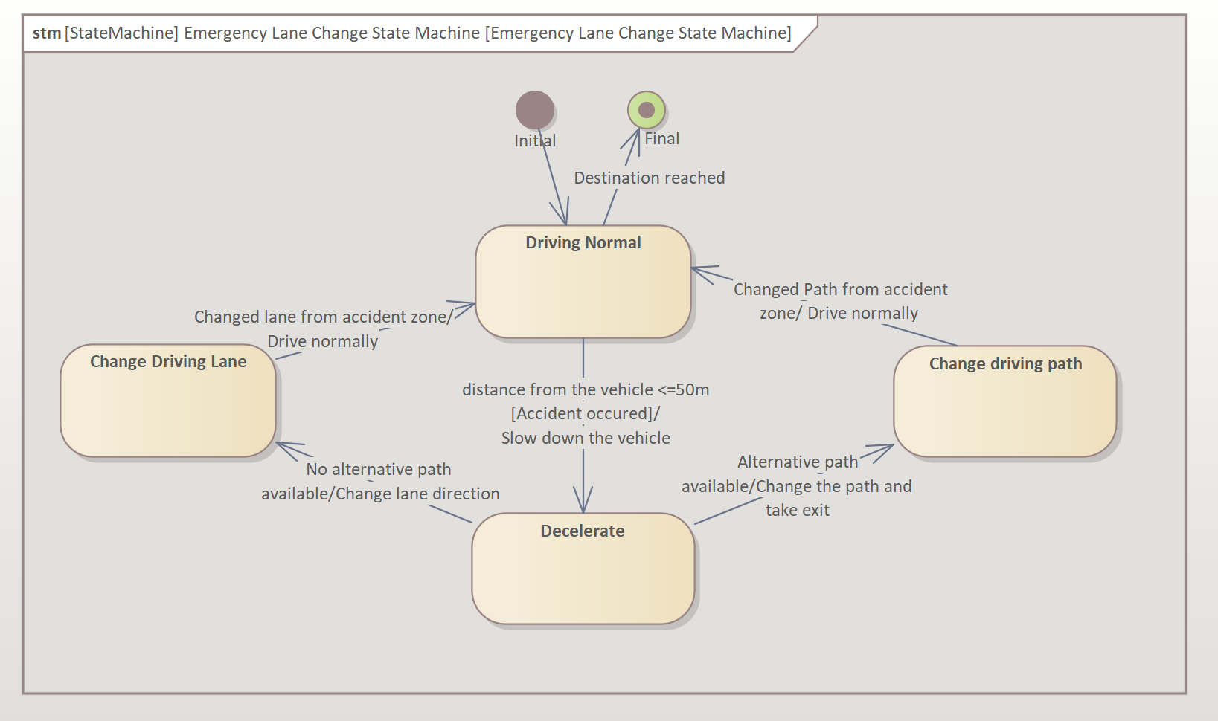
State Machine
Use case : Accident Occurred

Slide 10
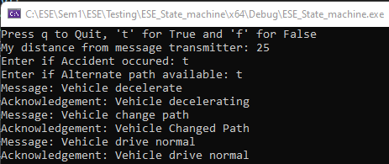
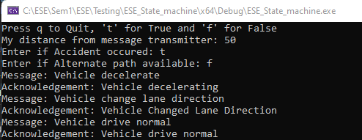
Code for the state machine:
A : Distance from message transmitter <=50m
B: Accident Occurred ?
C: Alternate Path available ?
A | B | C | State change
T | T | T | Decelerate -> Changed Path -> Driving Normal
T | T | F | Decelerate -> Changed lane direction -> Driving Normal
T | F | T | Driving Normal
T | F | F | Driving Normal
F | T | T | Driving Normal
F | T | F | Driving Normal
F | F | T | Driving Normal
F | F | F | Driving Normal
** Current state = Driving_Normal

Slide 11
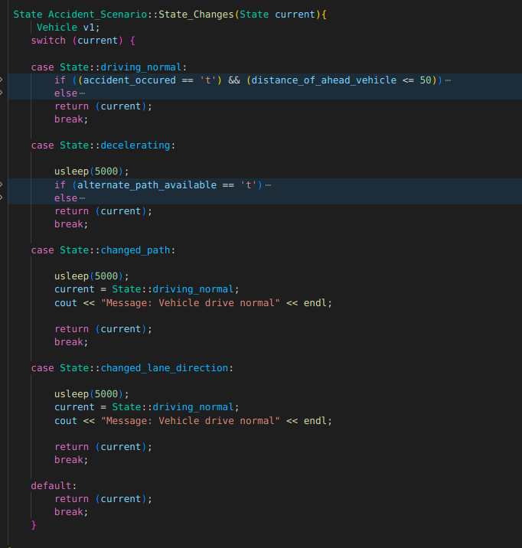
Code Walkthrough
Classes: Vehicle and Accident_Scenario States: driving_normal, decelerating, changed_path, changed_lane_direction Accident_Scenario: distance_from_message_transmitter, accident_occurred, alternate_path_available State Transition: Condition Check in Switch Case

Slide 12
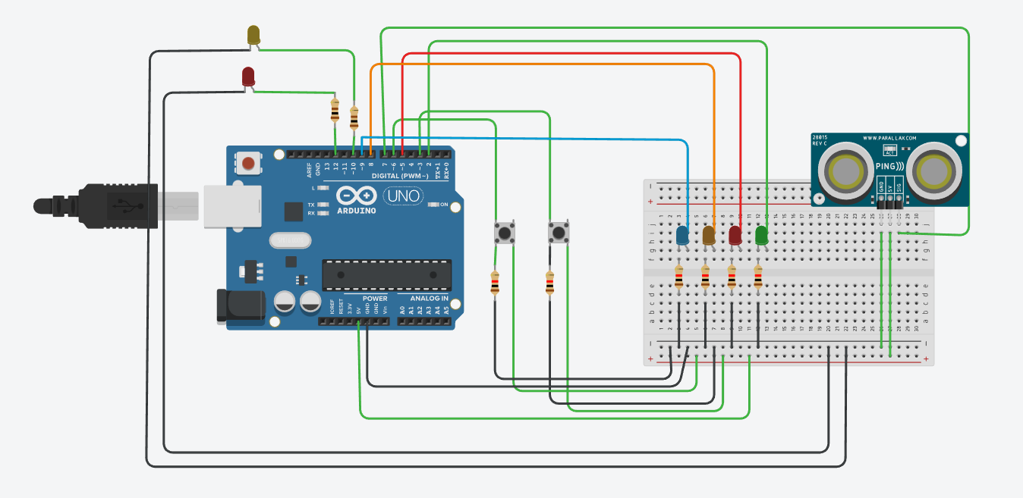
Tinker Cad
Push button to set if alternate path(exit) is available or not
Push button to set if accident occurred or not
Ultrasonic distance sensor to check distance
Let us see the states in Action!
Driving_Normal
Decelerate
LED – alternate path available
Changed Path
LED – accident occurred
Changed Lane direction
Arduino

Slide 13
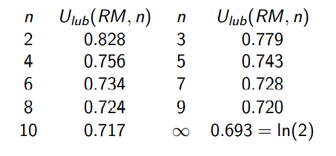

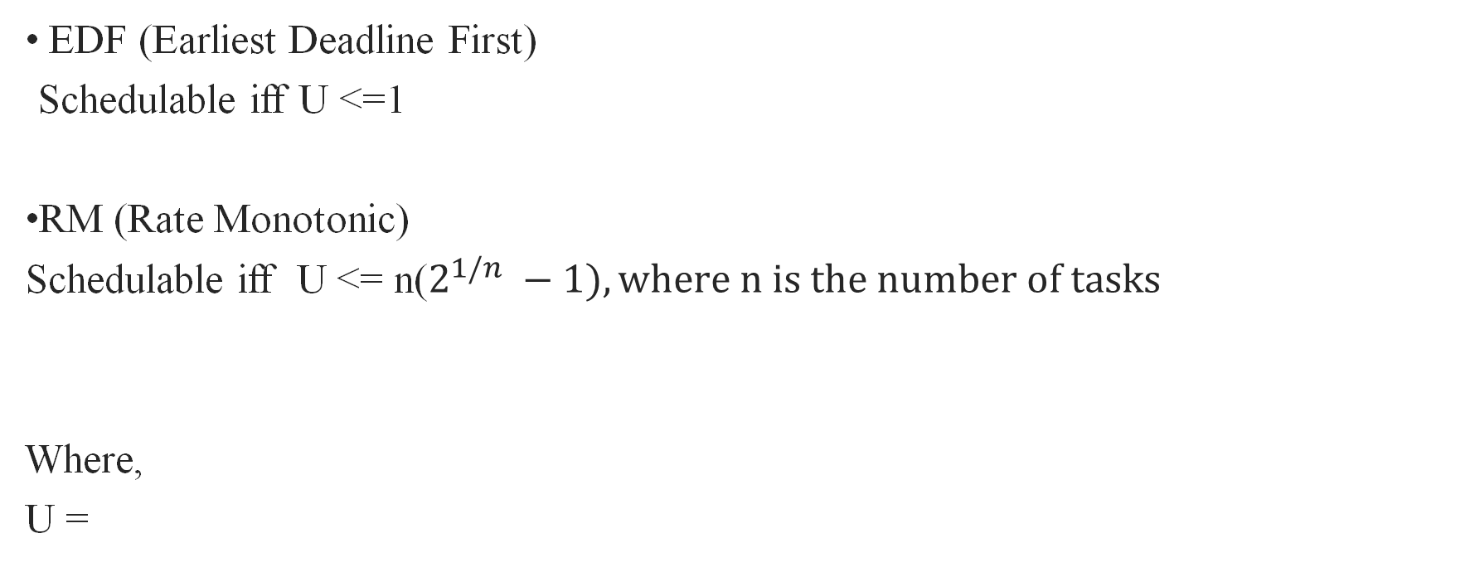
Scheduling
EDF (Earliest Deadline First)
Schedulable iff U <=1
RM (Rate Monotonic)
Schedulable iff U <= n($2^{1/n} −1), where n is the number of tasks$
Where,
U =

Slide 14
Tasks are as follows
 | Accident Occurred (AO) | Emergency Vehicle approaching (EV) | Pedestrian Hotspot ahead (PH)
Ci (Execution time) | 1 | 2 | 3
Ti (Period) | 4 | 6 | 8
Di(deadline) | 4 | 6 | 8
Tasks
Time in ms
U = 1/4 + 2/6 + 3/8 = 0.95

Slide 15
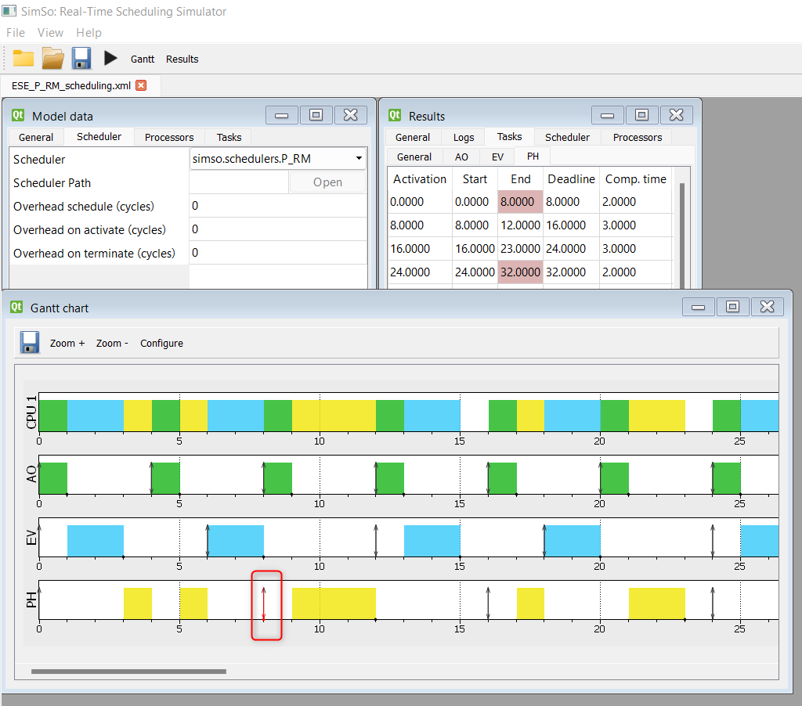
P_RM
U (0.95) NOT <=0.77. Hence it is NOT safe to schedule in RM.
From the image, we can clearly see that Task 3 i.e. Pedestrian Hotspot ahead has missed the deadline. In Hard-RTOS, it would cause severe impacts.
Missed deadline!

Slide 16
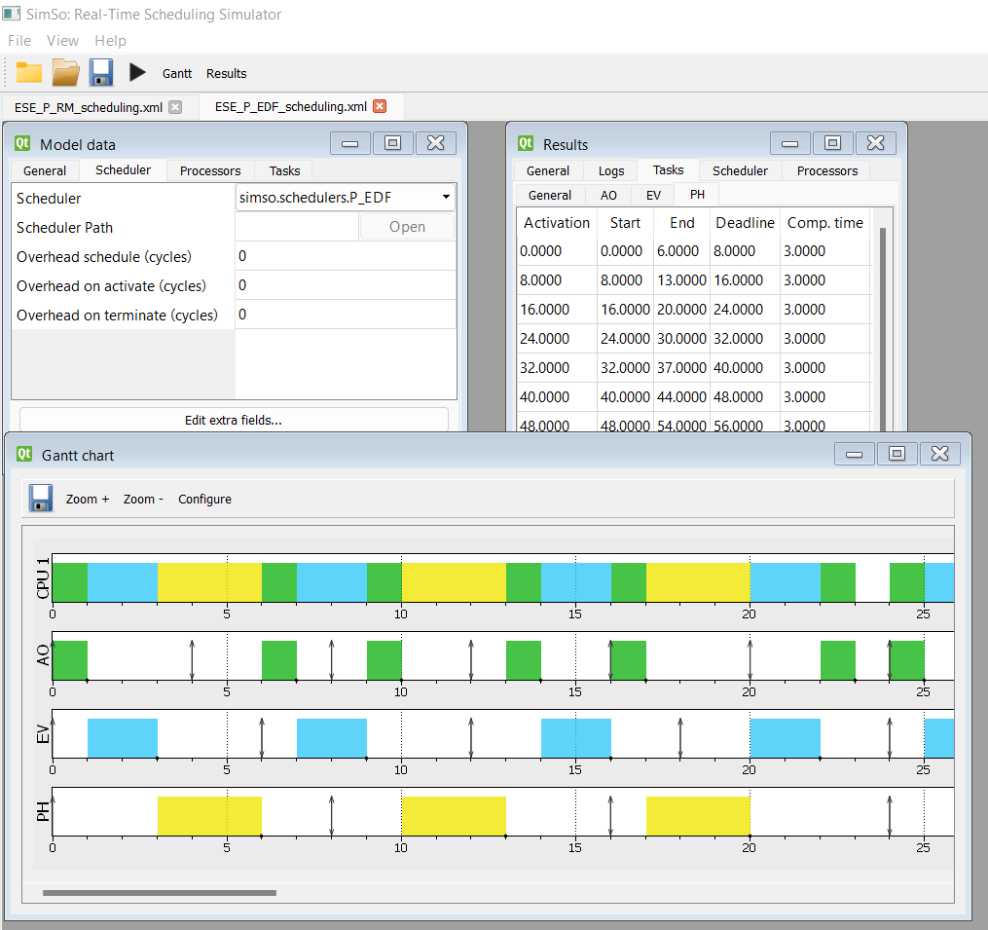
P_EDF
U (0.95) is <=1.
Hence it can be scheduled
in EDF.
From the image, we can see
That, no task has missed
its deadline

Slide 17
Inspection Time!
Inspection, in any field, plays a significant factor in the success of a product. During this phase, potential errors could be identified, and the shortcomings can be overcome in a new release. It also saves the project time and money caused by late detection of bugs.
Below listed are the original and improved versions that lead to our final documents:
1. State Machine code has been improved
2. Diagrams have been improved
3. Test cases were reviewed before the execution
4. Push buttons were added to Tinker Cad

Slide 18
Testing
Tool: Visual Studio 2022
Framework: Gtest
Coding Language: C++
Test scenarios: Positive test, negative test, interface test

Slide 19
Test Cases
Test Scenarios
Unit Tests
Check whether there's an accident
Defect Tests
Check if vehicle accepts negative input
Interface Tests
Check whether there's an alternative path
Check if system accepts negative distance
Vehicle change speed or path according to corresponding state

Slide 20
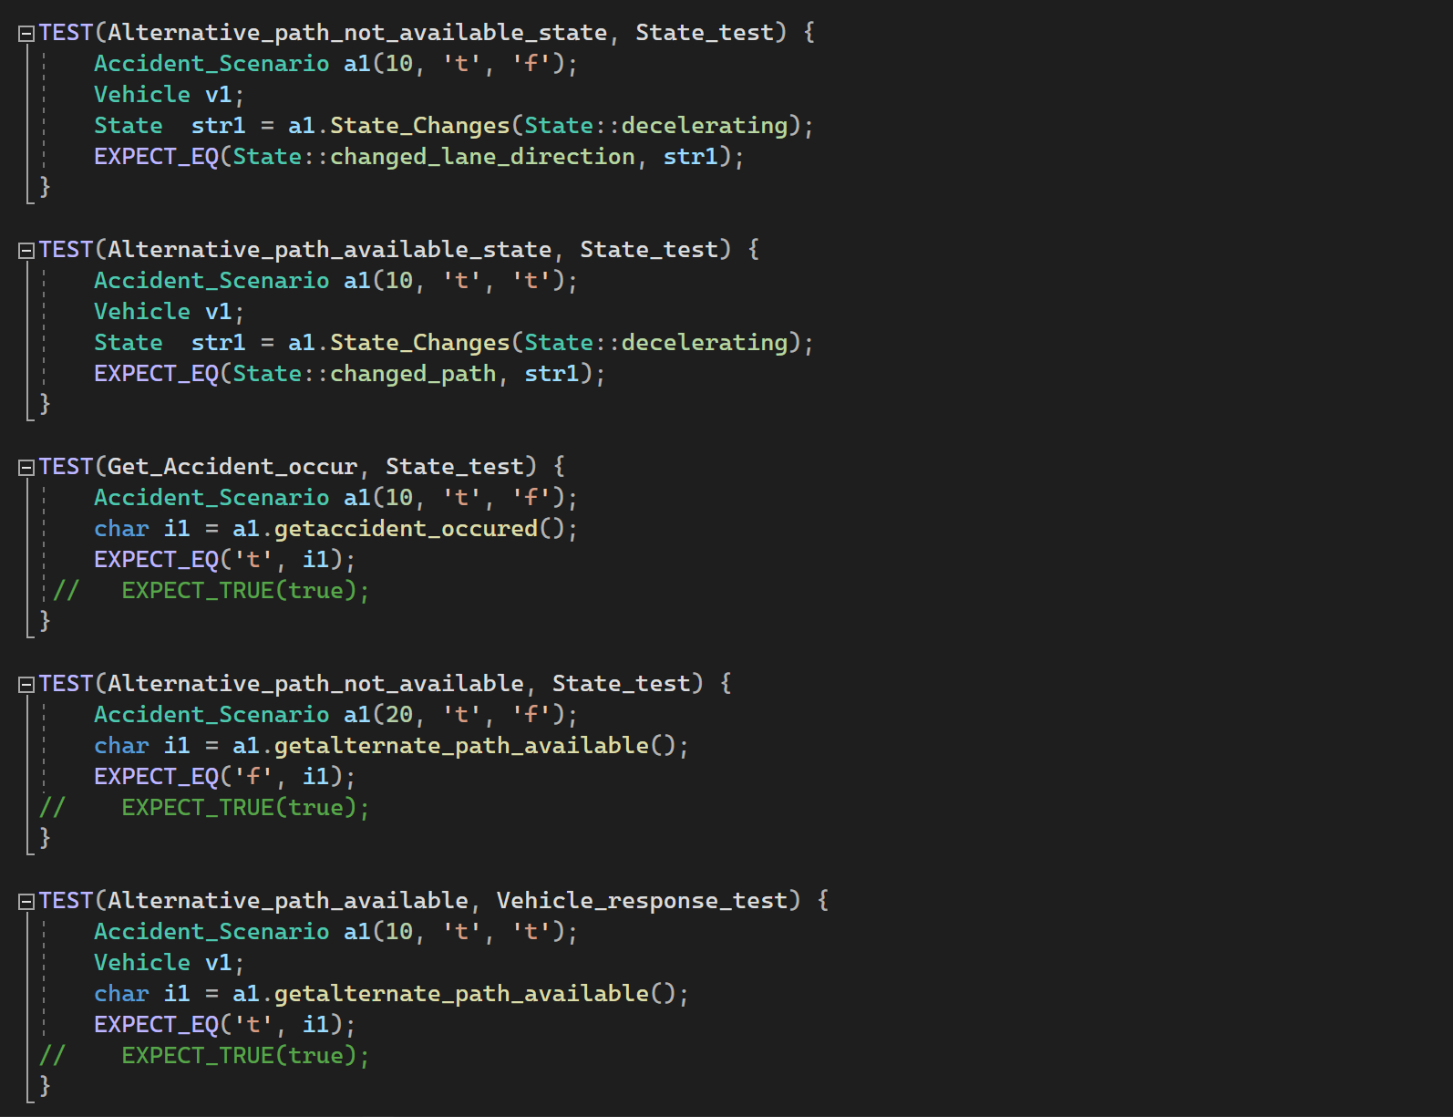
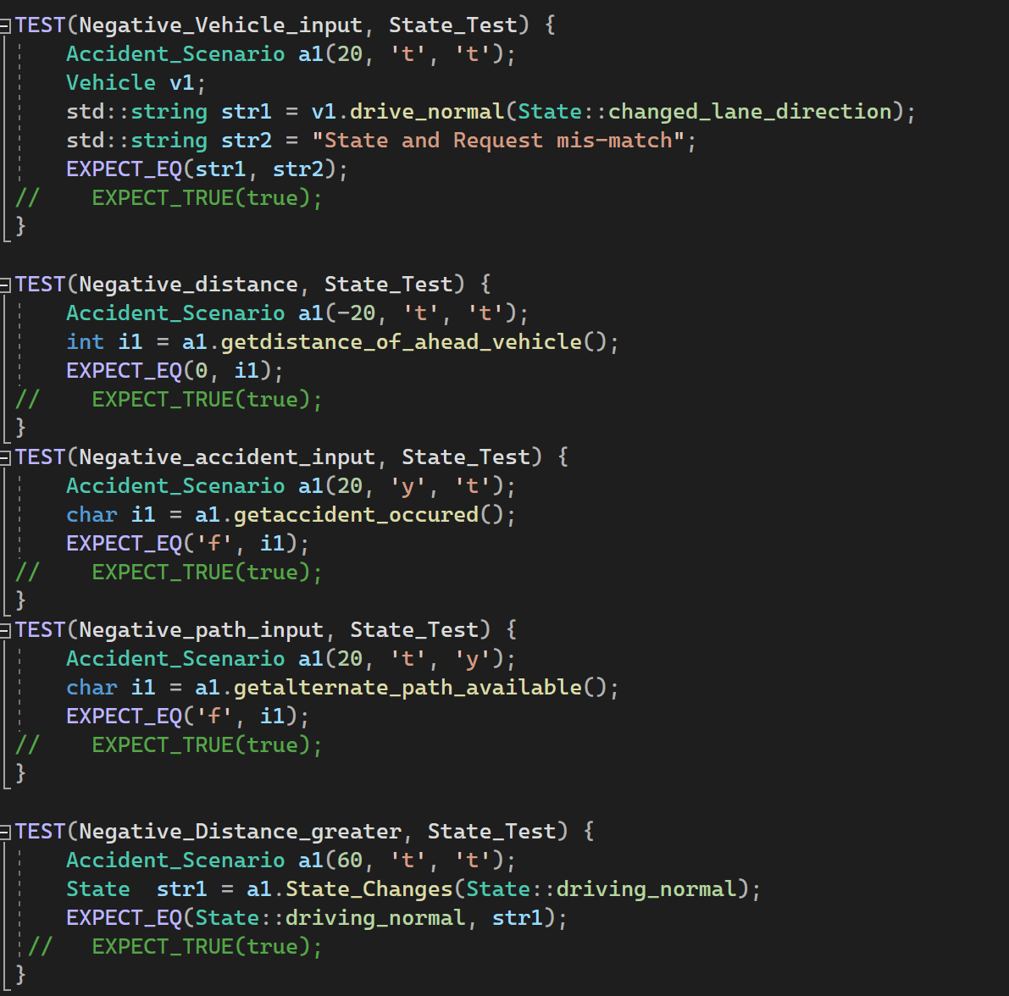
Test cases
Unit tests
Defect test

Slide 21
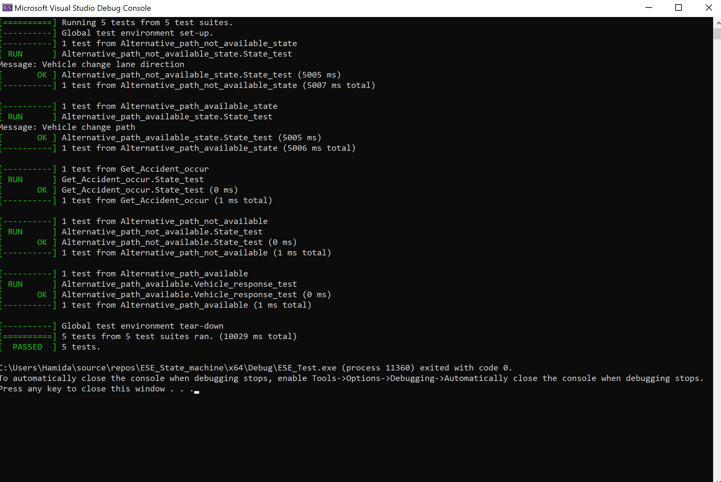
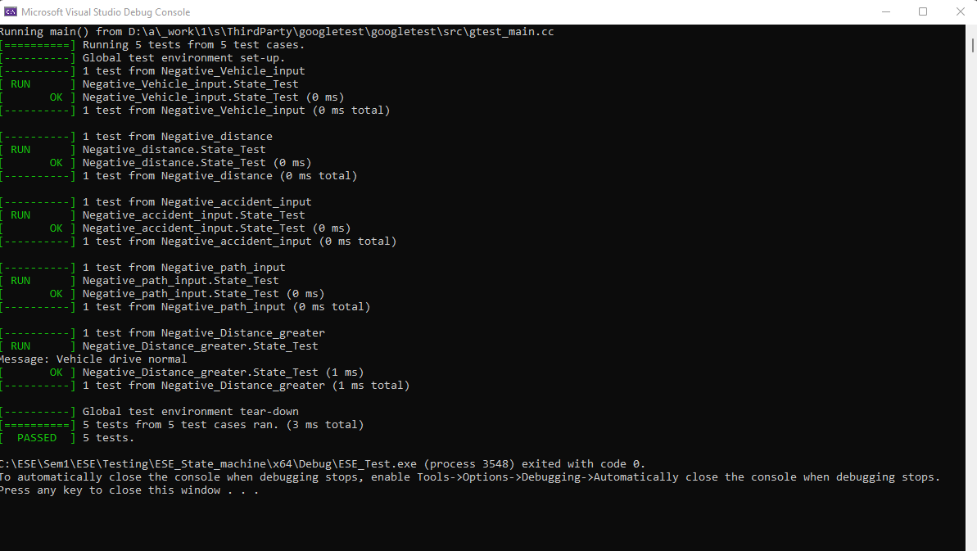
Test case output
POSITIVE TESTS
NEGATIVE TESTS

Slide 22
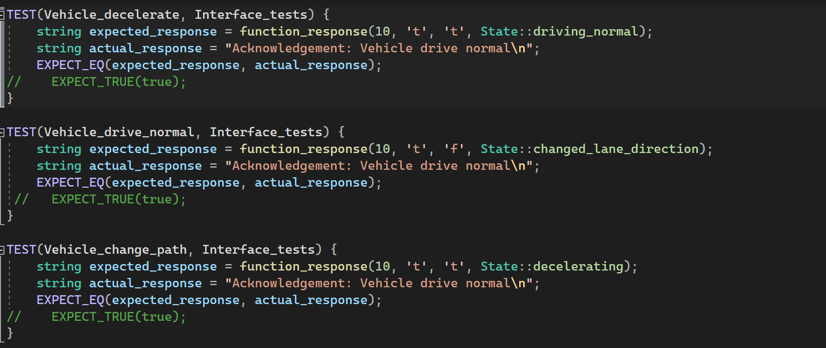
Interface Tests

Slide 23
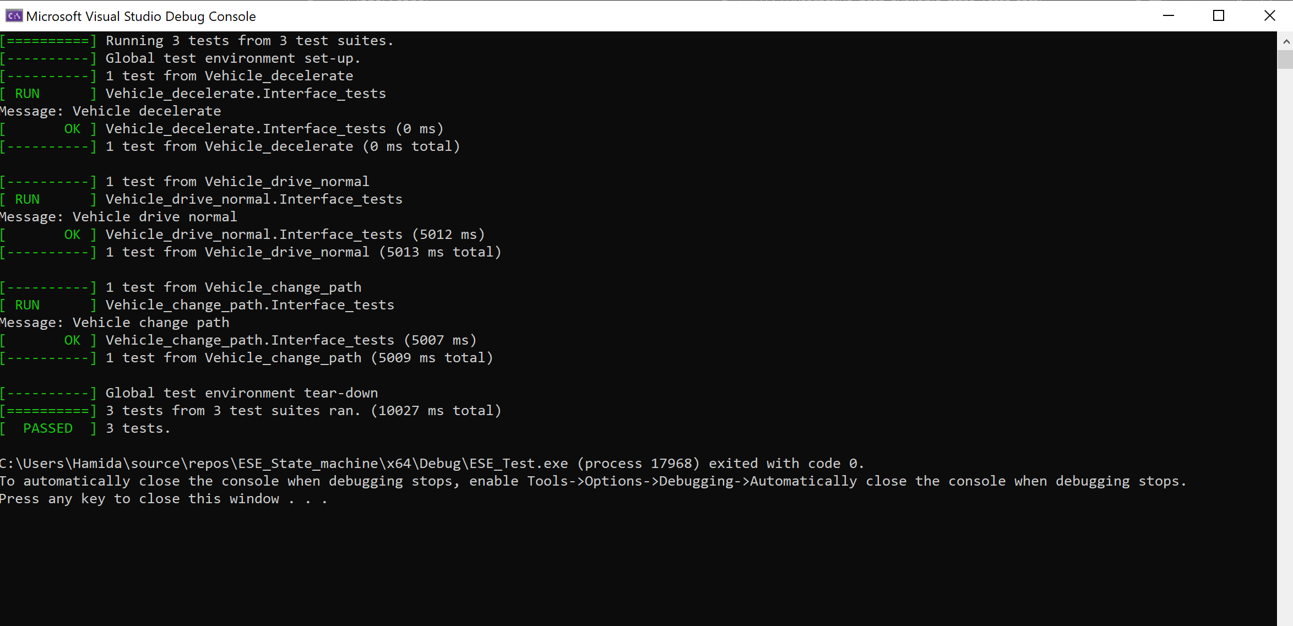
Test case output
INTERFACE TESTS

