Slide 1

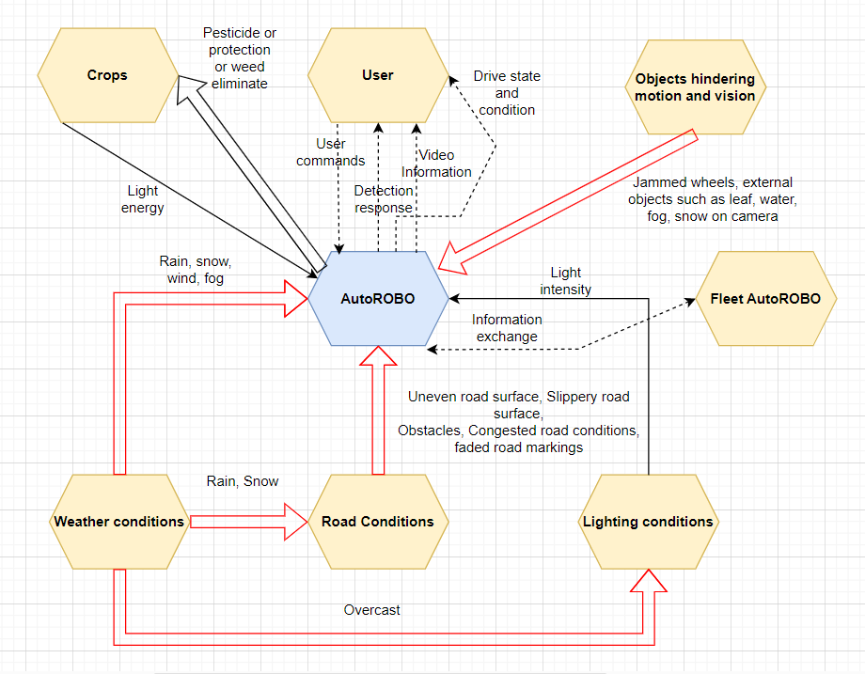
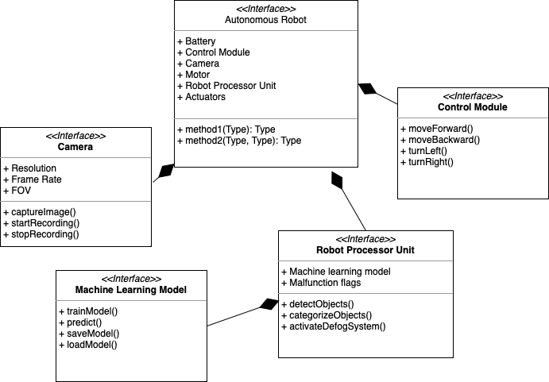
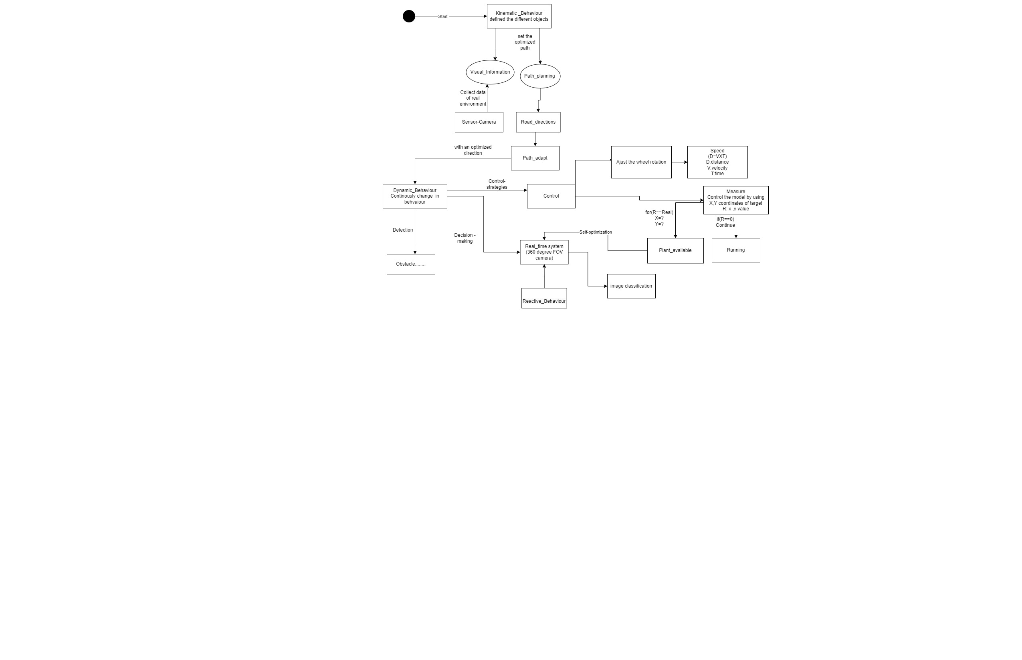
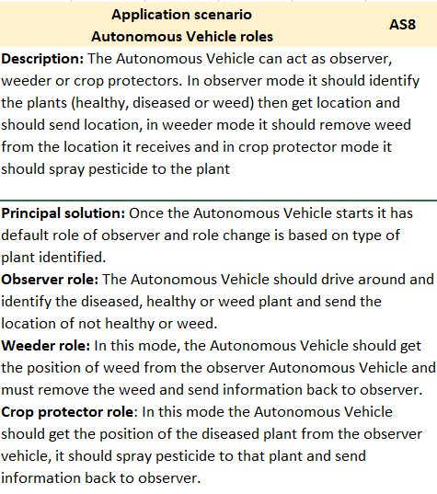
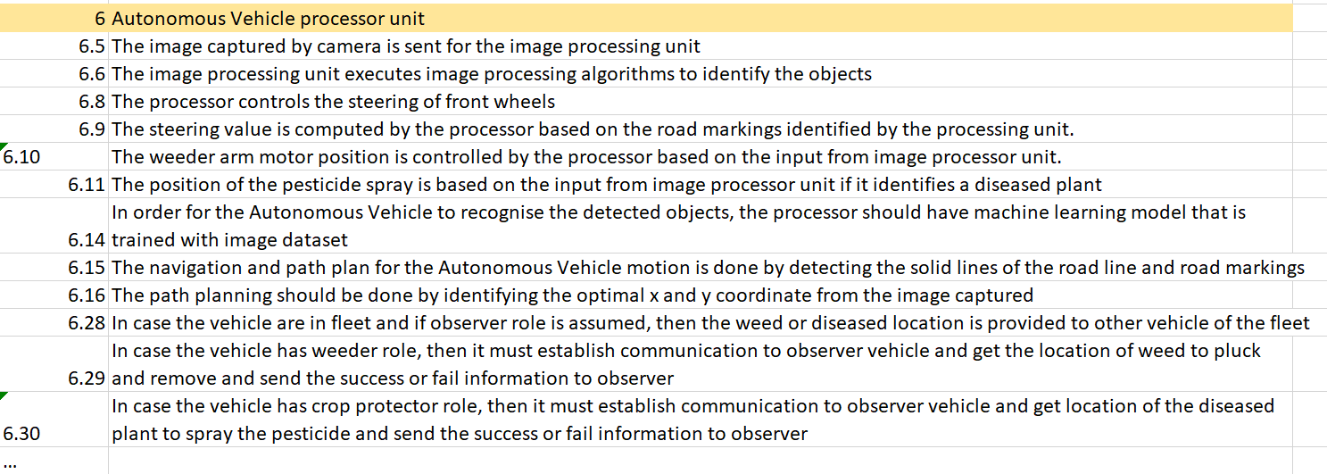
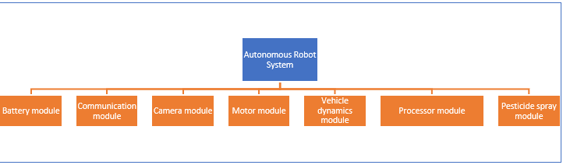
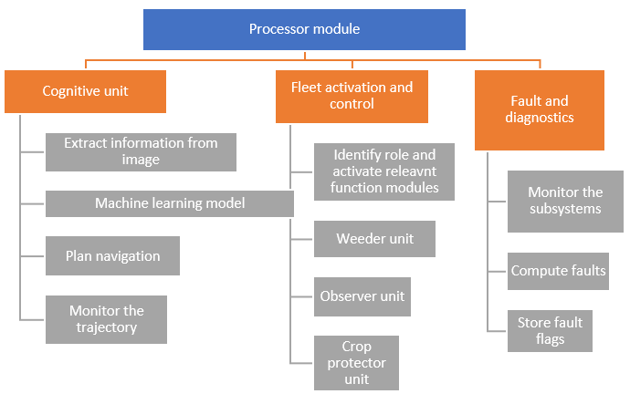

Divya Sharma
Vibha Hippargi
Hamida Aliyeva
Supadma Kadabi
Suhrut Heroorkar
RoboFarmer
Consens
Summer School
Embedded Systems Engineering
Environment model
Active Structure Diagram
Behavioural-model Diagram
Application scenario
Requirement model
Function hierarchy
Notes:
Envi & Fun – Vibha
Behavi – Divya
Appl. Req. Active - Hamida

Slide 2
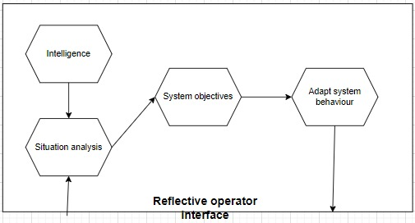
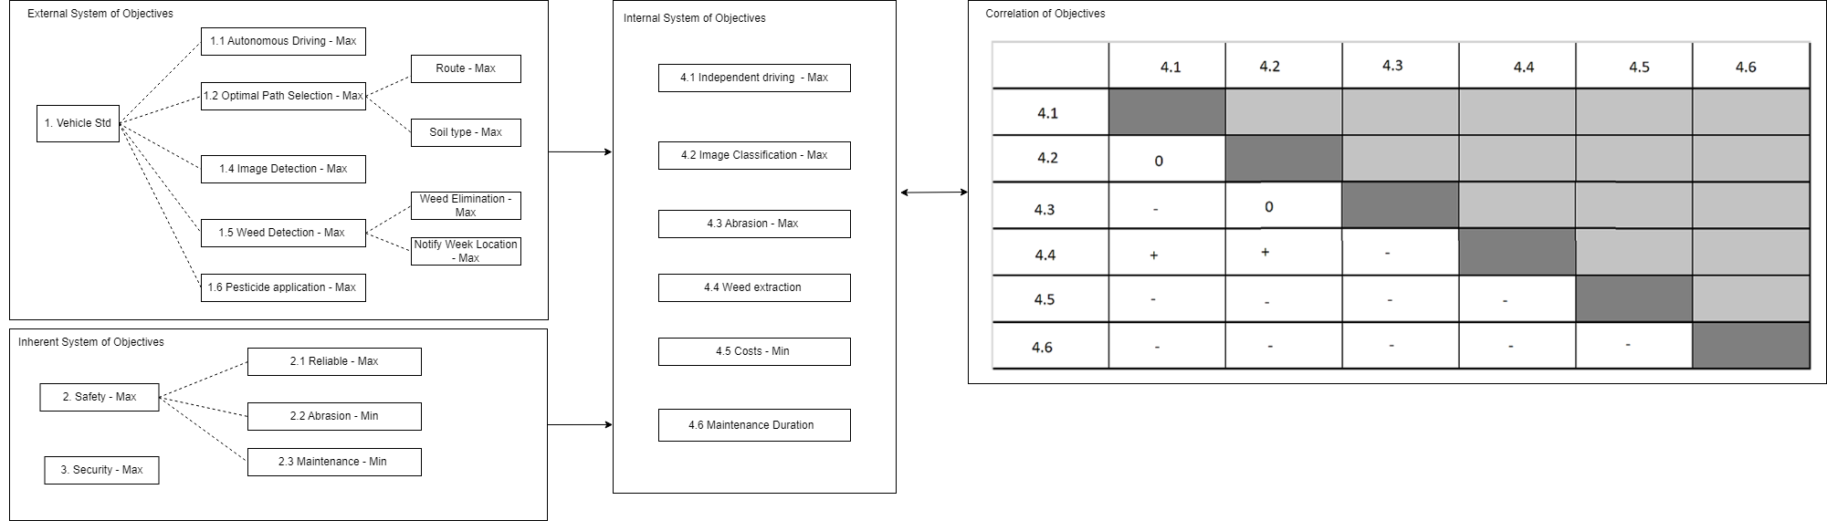
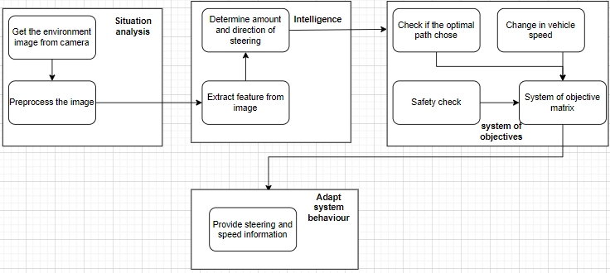
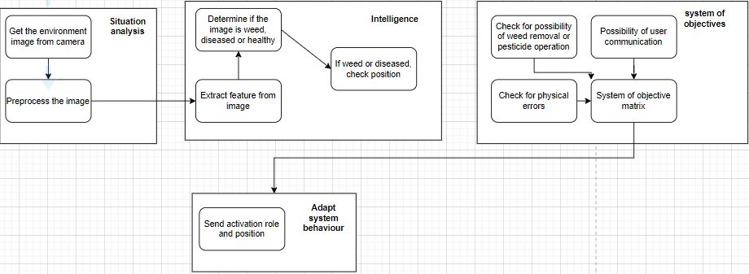
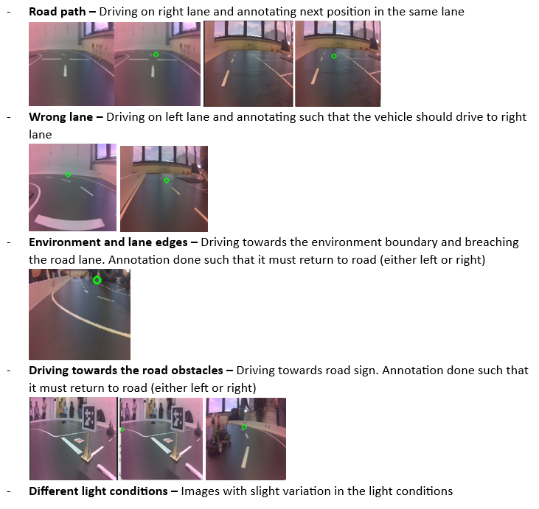
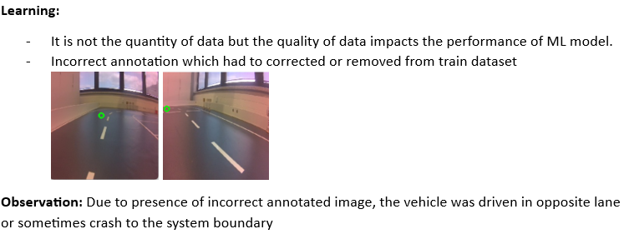
Divya Sharma
Vibha Hippargi
Hamida Aliyeva
Supadma Kadabi
Suhrut Heroorkar
RoboFarmer
Cognitive Behavior
Summer School
Embedded Systems Engineering
Cognitive behavior
System of Objectives
Image classification:
Data acquisition and annotation
Notes:
1. Hamida – Data acquisition and Annotation – Positive and Negative scenarios
2. Suhrut - Congitive remaining

Slide 3
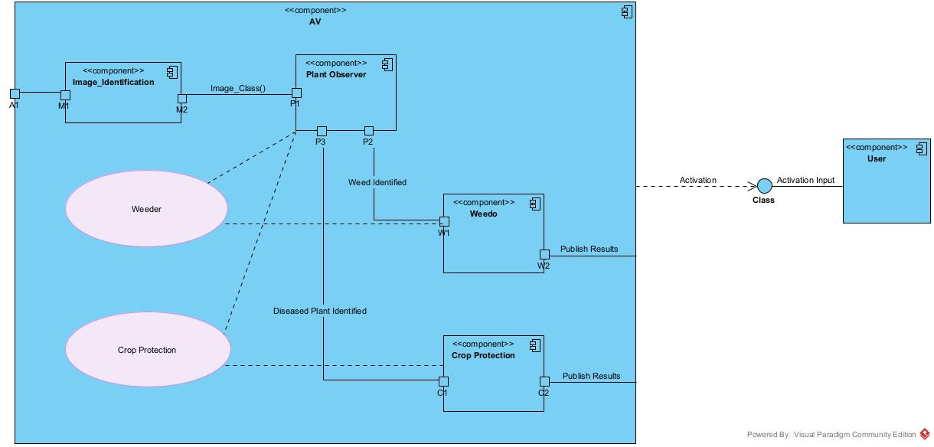
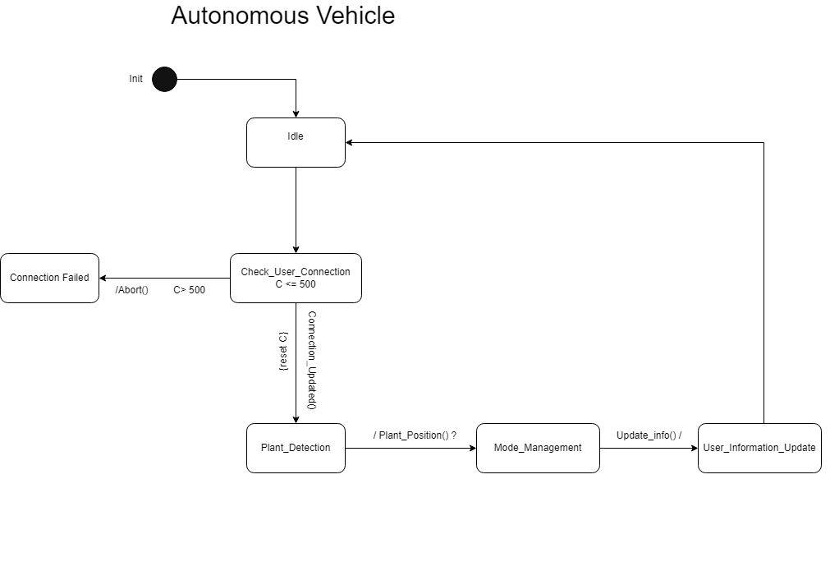
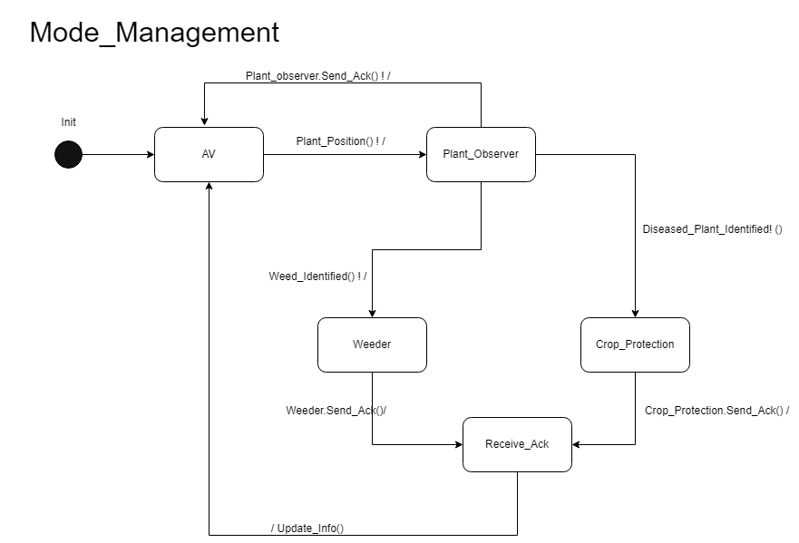
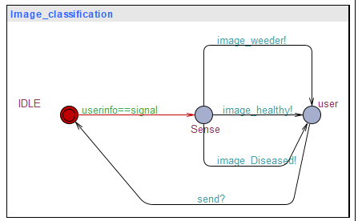
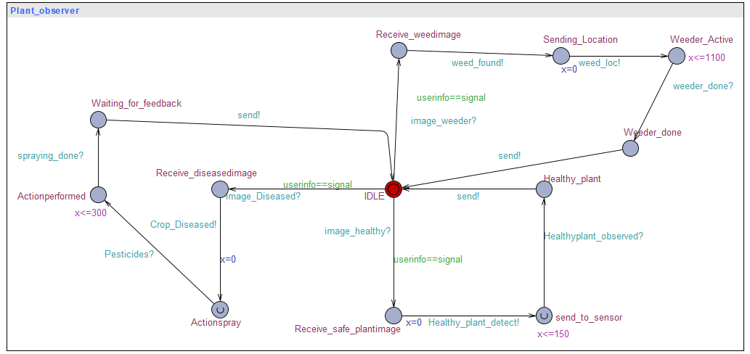
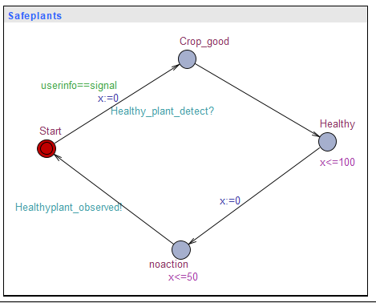
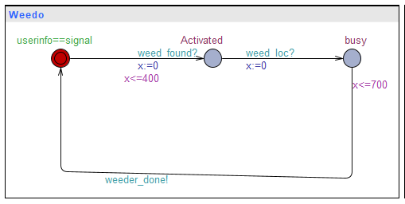
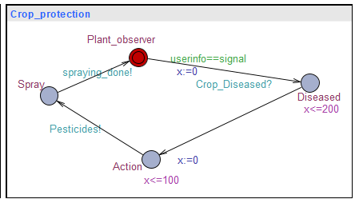
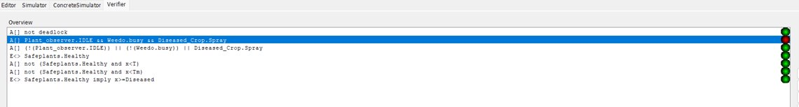
Divya Sharma
Vibha Hippargi
Hamida Aliyeva
Supadma Kadabi
Suhrut Heroorkar
RoboFarmer
MUML
Summer School
Embedded Systems Engineering
COMPONENT DIAGRAM
Real Time State Charts
UPPAAL
VERIFIER
Notes:
Supadma – MUML(Overall model and understanding)
Vibha – Uppaal(Introduction)
Divya – Uppaal (Verifier and diagrams)

