Slide 1
☕
AI JAVA MIGRATION ASSISTANT
Automated migration assessment, dependency analysis, and
Java 21 upgrade planning — powered by AI.
Python 3.12+
FastAPI
Java 11 → 21
Spring Boot 3.3.4
Maven Central
GPT-4o
Enterprise-grade modernization • Full audit trail • Zero manual research

Slide 2
The Problem
Migrating Java 11 → 21 is not a one-line version bump
1
2
3
javax → jakarta
Spring Boot 2 → 3
JUnit 4 → JUnit 5
Hundreds of imports across the codebase need renaming, one namespace at a time.
Core APIs break; WebSecurityConfigurerAdapter is removed entirely in Spring Security 6.
Annotations and Assert.* calls no longer compile under the new test engine.
4
5
6
Dependency research
Build plugin drift
Silent breakage risk
Dozens of Maven dependencies each need a manually researched, compatible version.
Plugins need reconfiguration for the modern <release> compiler flag.
Every hand-made change risks quietly breaking the application in production.
For enterprise codebases with hundreds of files, this takes experienced engineers days or weeks — and is still error-prone.
Section 01 — The Problem
AI Java Migration Assistant

Slide 3
The Solution
Drop in a ZIP. Get back a fully assessed, refactored, and documented project.
01
02
03
04
Upload
Assess
Refactor
Report
Any Maven or Gradle project ZIP, validated for structure and Java ≥ 11.
→
A full 9-section migration assessment with risk scoring and refactor signals.
→
pom.xml auto-updated; 26 transformation rules applied to Java sources.
→
An HTML change report — every file, rule, and version bump — full audit trail.
No manual research. No missed imports. No forgotten dependency upgrades.
Section 02 — The Solution
AI Java Migration Assistant

Slide 4
Who Is This For
Automate the mechanical parts of a Java 21 upgrade.
👩‍💻
Java Developers
Assess migration complexity before committing to a sprint.
🧭
Tech Leads
Migrate multiple projects consistently, with full audit reports.
🏢
Enterprise Teams
End-to-end pipeline with a live API and interactive HTML dashboards.
🏆
Hackathon Judges
Section 03 — Audience
AI Java Migration Assistant

Slide 5
Key Features
18 implemented capabilities across ingestion, analysis, and refactoring
📦
🔍
☕
🔨
Project ZIP Upload
Project Validation
Java Version Detection
Maven & Gradle Support
Upload any Maven/Gradle project as a .zip
Validates structure, magic bytes, build files
Reads pom.xml properties & compiler plugin
Handles pom.xml and build.gradle(.kts)
🛡️
📊
🔗
📝
Java Version Gate
9-Section Assessment
Live Dependency Resolution
pom.xml Auto-Update
Rejects projects below Java 11
Deps, Java, Spring Boot, code, plugins, DB, Docker
Queries Maven Central for every version
Java version, parent, plugins, dependencies
♻️
🏷️
🔐
🧪
26 Refactoring Rules
javax → jakarta
Spring Security 6
JUnit 4 → JUnit 5
Applied precisely across all .java files
All 9 Jakarta EE namespaces migrated
Removes WebSecurityConfigurerAdapter safely
Annotations, imports, Assert → Assertions
+ 6 more: backups, HTML change reports, DB driver & Docker detection, workspace isolation, health checks
Section 04 — Features
AI Java Migration Assistant

Slide 6
Architecture & Tech Stack
ZIP Upload
→
Validation &
Detection
→
AI Assessment
Engine
→
Maven Central
Resolver
→
Refactor
Engine
→
HTML
Reports
Backend
AI / Analysis
Java Target Stack
Build & Data
• Python 3.12+
• OpenAI GPT-4o
• Java 21 (LTS)
• Maven Central API
• FastAPI 0.115
• Custom rule engine
• Spring Boot 3.3.4
• Gradle support
• Uvicorn
• Risk scoring
• Jakarta EE
• HTML reporting
Section 05 — Architecture
AI Java Migration Assistant

Slide 7
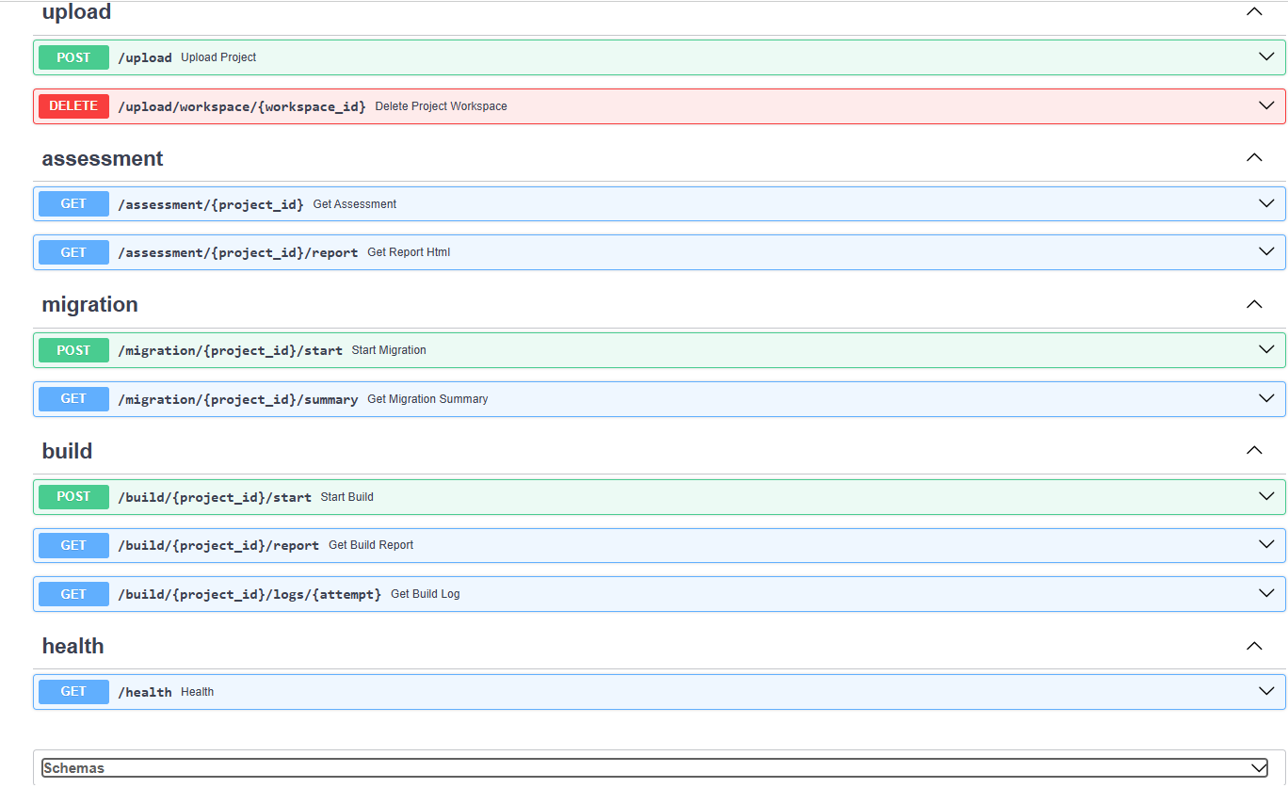
The Complete API Surface
Beyond upload — a full pipeline from assessment through build
1
upload 2 routes
Ingest a project, or delete its workspace when done.
2
assessment 2 routes
Fetch the structured assessment or its HTML report.
3
migration 2 routes
Start the automated refactor and check its summary.
4
build 3 routes
Compile the migrated project; inspect attempts and logs.
5
health 1 route
A liveness endpoint for uptime monitoring.
Section 06 — API Overview
AI Java Migration Assistant

Slide 8
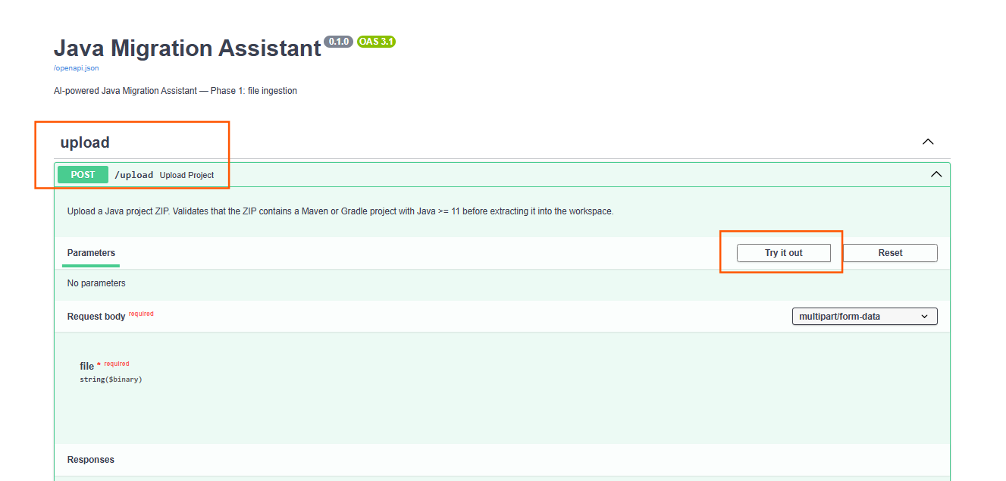
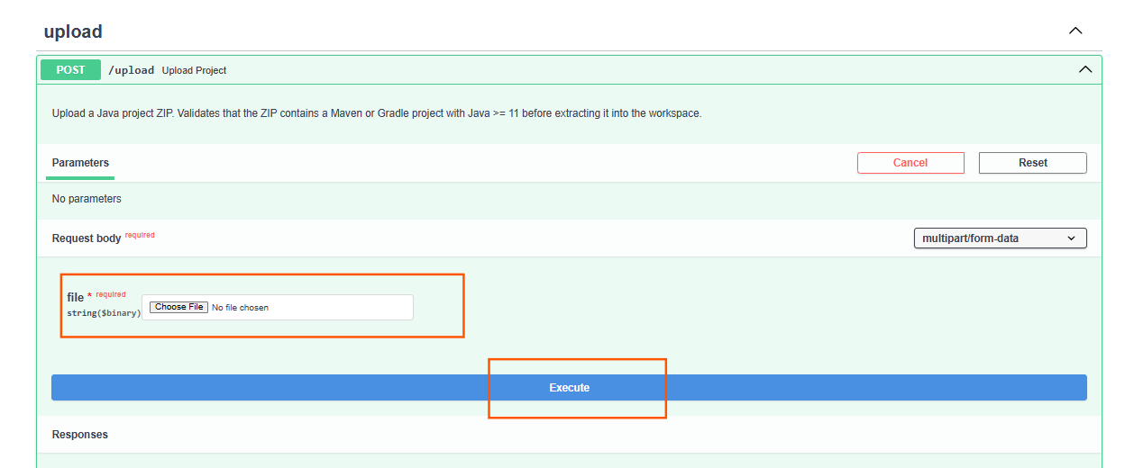
Live Demo — Swagger API
1
Phase 1: file ingestion — POST /upload
The auto-generated OpenAPI docs expose a single POST /upload endpoint. Selecting “Try it out” opens the live request form.
2
A Java project ZIP is chosen and submitted. The API validates the archive before extracting it into an isolated workspace.
Section 07 — Demo: Upload (1/2)
AI Java Migration Assistant

Slide 9
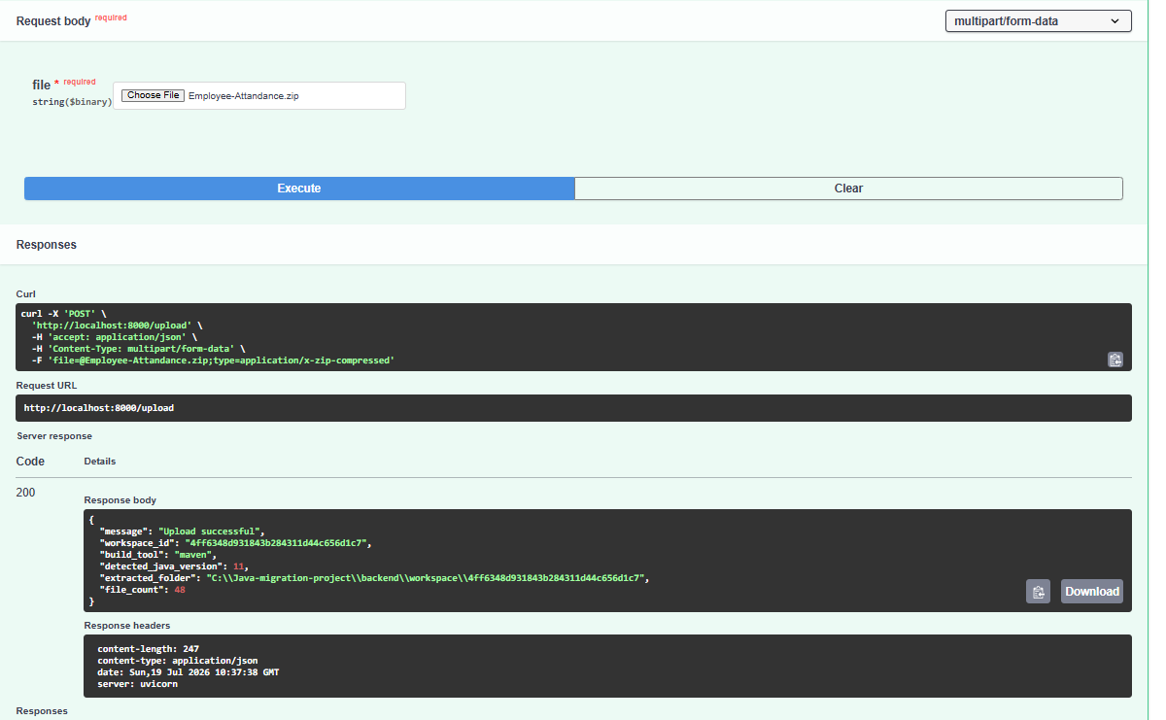
Live Demo — Instant Assessment
Employee-Attandance.zip → detected, validated, and extracted in seconds
Response Highlights
maven
Build tool detected
Java 11
Detected version
48 files
Extracted into workspace
200 OK
Upload successful
Each upload gets a UUID-isolated workspace on disk, ready for the assessment and refactoring phases.
Section 07 — Demo: Upload (2/2)
AI Java Migration Assistant

Slide 10
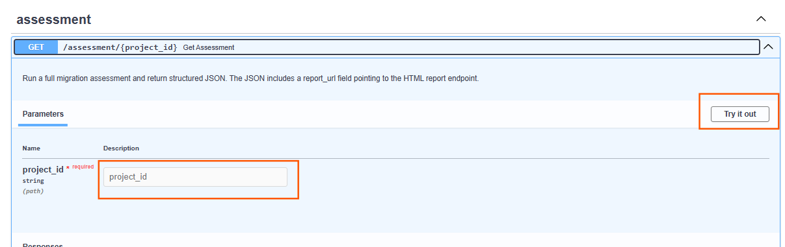
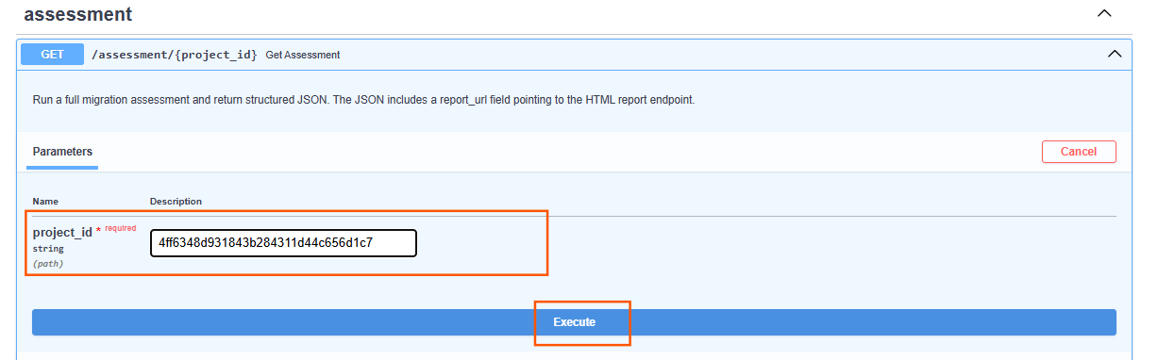
Live Demo — Assessment API
1
GET /assessment/{project_id} — run the full migration assessment
Open GET /assessment/{project_id}, select “Try it out”, and paste in the workspace ID returned by the upload step.
2
With the project_id filled in, hit “Execute” to trigger the full 9-section AI-powered assessment.
Where does project_id come from?
It’s the workspace_id from the /upload response — the same UUID folder created on disk for that project.
Section 08 — Demo: Assessment (1/2)
AI Java Migration Assistant

Slide 11
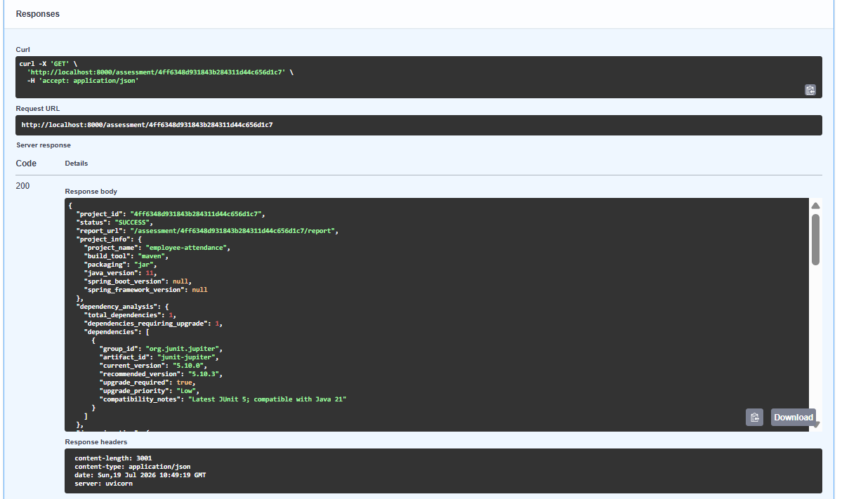
Live Demo — Assessment Results
employee-attendance → a complete, structured migration assessment
Assessment Highlights
Java 11 → 21
High risk — a multi-version jump
17 files
Java source files scanned
73 imports
Estimated imports affected
1 dependency
Requires upgrade (JUnit 5.10.0 → 5.10.3)
Medium
Overall migration complexity
The response also flags Spring Boot 3 breaking changes, build-plugin updates, and Docker readiness — with a full HTML report at report_url.
Section 08 — Demo: Assessment (2/2)
AI Java Migration Assistant

Slide 12
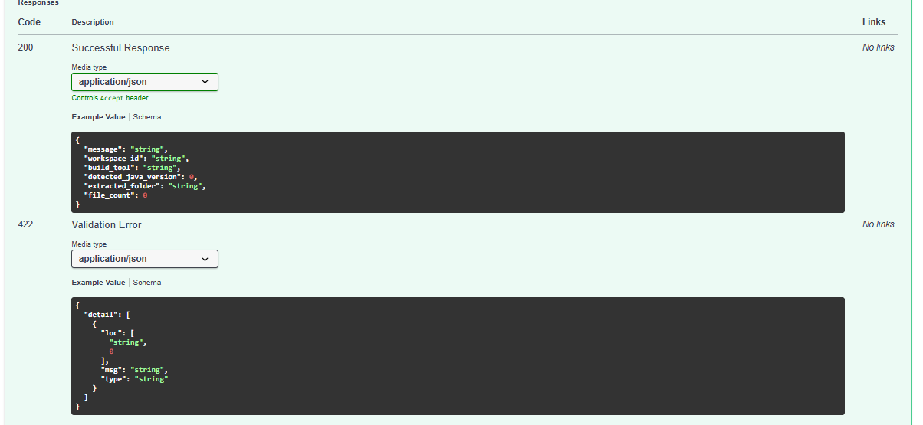
Built for Reliability
A typed API contract with clear success and validation paths
200 — Successful Response
Returns workspace ID, detected build tool, Java version, extraction path, and file count — everything downstream phases need.
422 — Validation Error
Bad archives, missing build files, or unsupported Java versions fail fast with a structured, per-field error detail.
Plus: pre-migration backups, path-traversal-safe workspace deletion, and a /health liveness endpoint.
Section 09 — Reliability
AI Java Migration Assistant

Slide 13
Roadmap
What ships next after the current phase-1 assessment & refactor pipeline
1
2
3
4
Automated PR Generation
CI/CD Integration
Multi-Module Support
Interactive Rule Editor
Open a pull request with the migrated code, ready for review.
Run assessments automatically on every push or pull request.
Extend refactoring rules across multi-module Maven/Gradle builds.
Let teams customize or add their own transformation rules.
☕
From ZIP to Java 21 — automatically.
No manual research. No missed imports. No forgotten dependencies. Full audit trail, every time.
Section 10 — Roadmap & Closing
AI Java Migration Assistant

