Slide 1


NEXT GEN EMPLOYABILITY PROGRAM
CREATING A FUTURE-READY WORKFORCE
Student Name :
Vibhor Singh
Student ID :
STU65ce5427dc6651708020775
Mobile No:
7761923571
Mail ID:
singhvibhor@kbtcoe.org
College Name :
Maratha Vidya Prasarak Samaj’s Karmaveer Adv. Baburao Ganpatrao Thakare College of Engineering

Slide 2
CAPSTONE PROJECT SHOWCASE
Project Title
Power BI Enabled Comprehensive Analysis on Unicorn Businesses (P7)
Abstract | Problem Statement | Project Overview | Proposed Solution | Technology Used | Modelling & Results | Conclusion | Q&A

Slide 3
Abstract
1
Formatting visuals and canvas background.
2
Approaches of testing strategies.
3
Cross-checking with functionality.
4
Validation of the Project.

Slide 4


Problem Statement
Current unicorn business data lacks in-depth analysis.
This Power BI project aims to create an interactive report for comprehensive analysis of unicorn growth trends, geographic distribution, industry landscape, and funding patterns.
This will provide valuable insights for investors, entrepreneurs, and policymakers.

Slide 5

Project Overview
This Power BI project dives into the world of unicorns.
It will provide an interactive dashboard and reports to analyze:
Growth: Track unicorn creation trends.
Geography: See where unicorns are born.
Industry: Explore which sectors dominate.
Funding: Understand how unicorns get financed.

Slide 6
Proposed Solution
This project proposes a Power BI solution to create an interactive dashboard for comprehensive analysis of unicorn businesses.
Data Acquisition: We will gather data on unicorn companies, including founding year, location, industry, valuation, and funding details.
Data Transformation & Modeling: Clean and transform the data using Power Query Editor. Build a dimensional data model in Power BI to facilitate analysis across various dimensions.
Report Design & Visualization: Design an interactive dashboard with key performance indicators (KPIs) to visualize trends in unicorn growth, geographic distribution, and industry breakdown. Create drill-down capabilities to explore specific industries, regions, or funding rounds in more detail. Utilize charts and graphs like time series, maps, and pie charts for clear and engaging data presentation.
Analysis & Insights: Identify key trends and patterns in unicorn creation over time. Analyze the geographic distribution of unicorns and highlight emerging innovation hubs. Understand industry dominance and uncover potential under-represented sectors with high growth potential. Compare funding patterns for unicorns against other businesses to identify investor preferences and funding stages.

Slide 7
Technology used
Microsoft Power BI
This project will rely solely on Microsoft Power BI, a suite of business intelligence tools specifically designed for data visualization and analysis. Power BI encompasses the following technologies within itself:
Power BI Desktop: This application will be used to connect to data sources, clean and transform data, build the data model, and design the interactive dashboard with reports and visualizations.
Power Query Editor: This built-in tool within Power BI Desktop facilitates data cleansing, transformation, and shaping for optimal analysis.
Data Model: Power BI Desktop allows creating a dimensional data model to establish relationships between different data points, enabling insightful analysis across various dimensions.

Slide 8
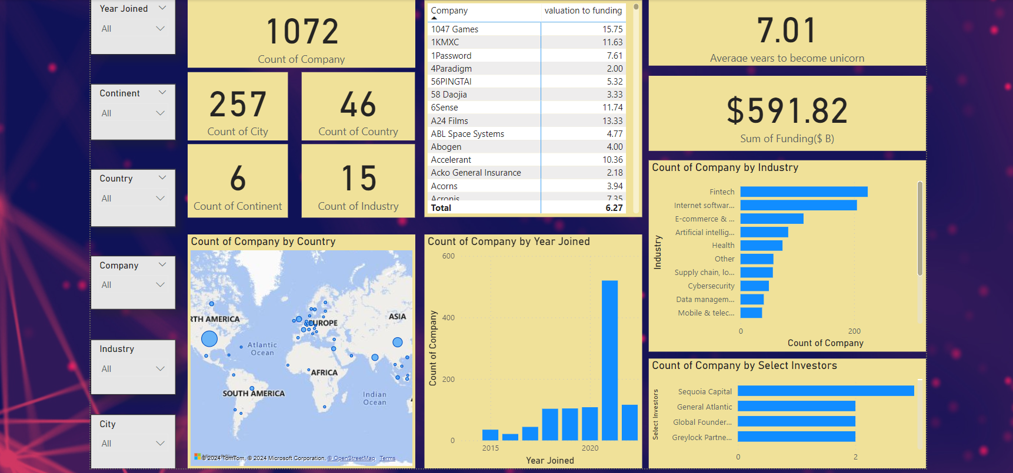
Modelling & Result

Slide 9
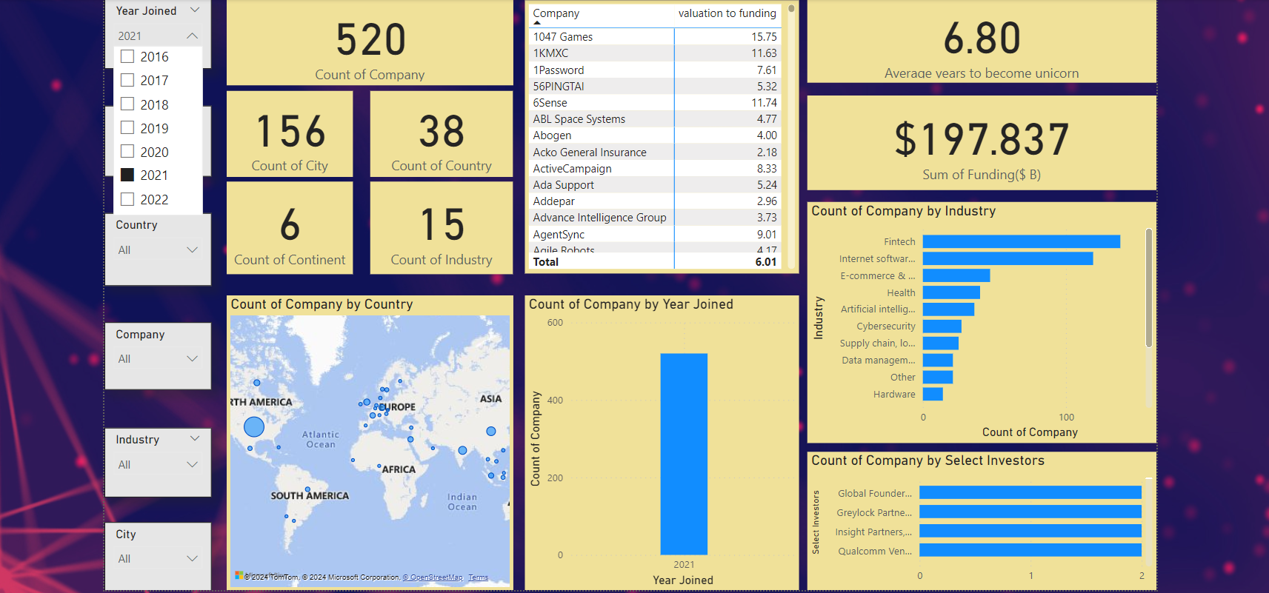
Modelling & Result

Slide 10
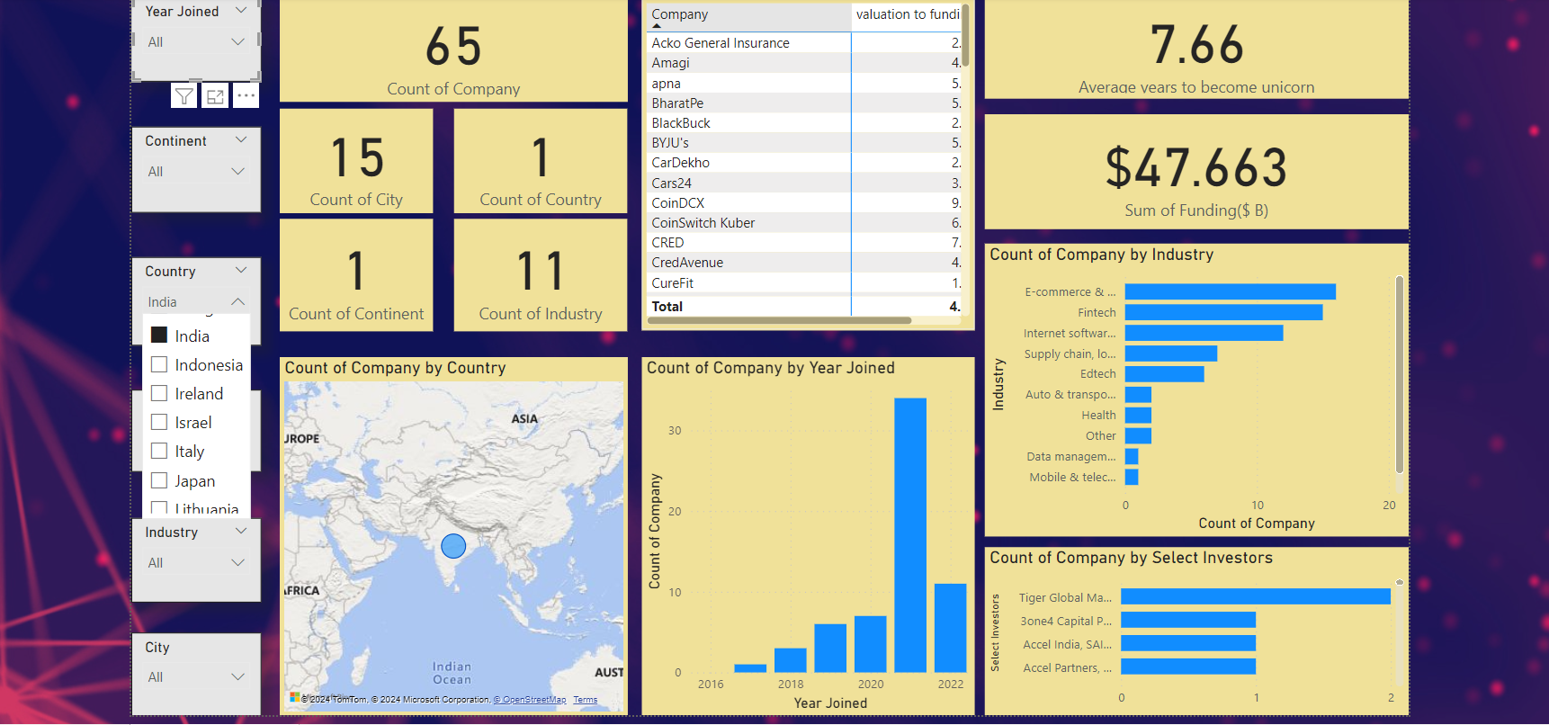
Modelling & Result

Slide 11

Conclusion
This Power BI report provides a powerful lens for analyzing the dynamic world of unicorn businesses. By leveraging interactive visualizations, we gained valuable insights into key areas like growth trends, geographic distribution, industry dominance, and funding patterns.
As the unicorn landscape continues to evolve, this report serves as a foundation for ongoing analysis. Future iterations can incorporate new data sources and delve deeper into specific industry segments or funding mechanisms.

Slide 12


Notes:
Thank You !!

