Slide 1
Finance Analytics of a Hardware Industry
The slides showcase some of the most business valuable insights from the provided database of a hardware industry which has B2C business of selling various hardware parts to its costumers globally.
The Company has multiple customers like flipkart, croma, bestbuy, staples, etc., who are purchasing various items produced by it for their online/offline stores.
Further, the product buying audience is referred as ‘consumers’ of the product who are buying through these customers.
Along with the financial measures, it also showcases performance improvement required during one of the specific scenario occurred during the project.

Slide 2

Business Model of this Industry
Customers
Consumers
Flipkart
Flipkart
Croma
Hardware Industry
BestBuy
Staples

Slide 3
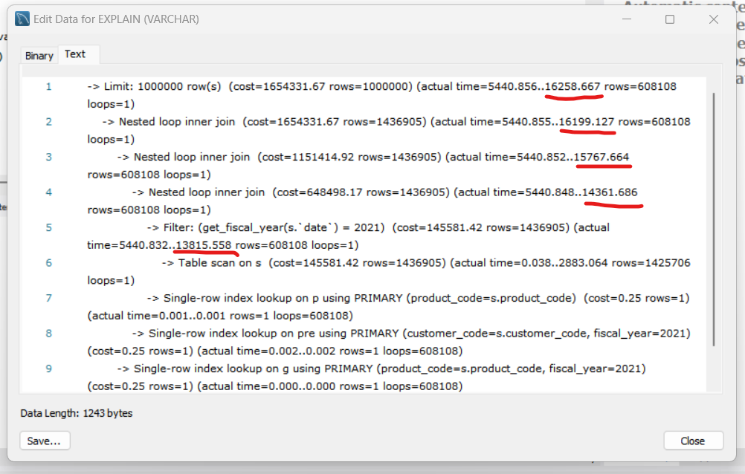
While executing the query to retrieve a report for ‘gross sales’ of all the customers for financial year 2021: It took too much “actual time to get all rows (in milliseconds)” for the queries.

Slide 4
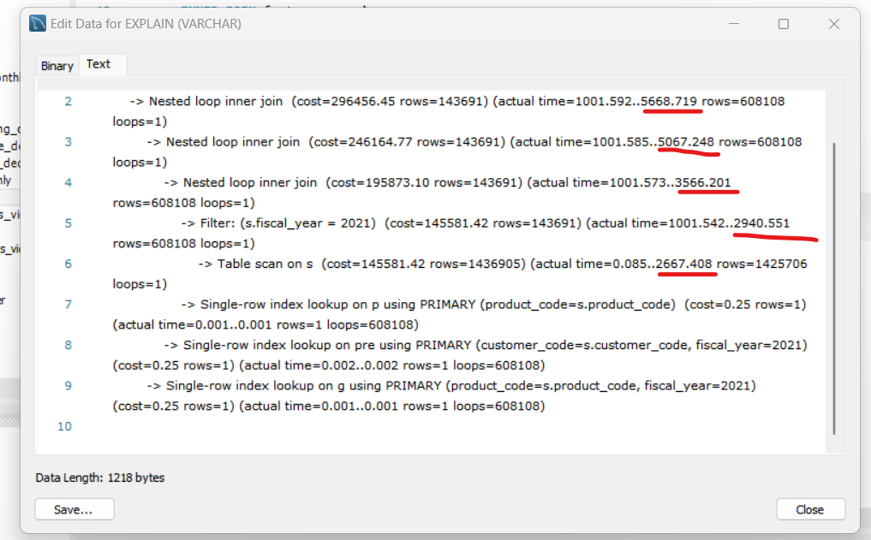
So, performance improvement was done and “actual time to get all rows (in milliseconds)” reduced. Performance was improved by a really good 186% .

Slide 5
Bar Chart Report for Financial Year 2021, Representing top 10 markets as per their % net sales

Slide 6
Pie Chart Report for Financial Year 2021, Region wise % net sales breakdown by customers in their respective region
% net sales in Latin America Region
% net sales in Latin America Region

Slide 7
% net sales in European Union Region
% net sales in North America Region

Slide 8
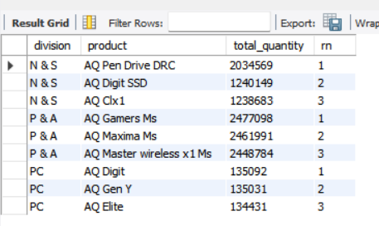
Report showing Top 3 products in each division by their quantity sold for financial year 2021:-

Slide 9
Thank You!

