Slide 1
FAR AWAY 2026 | SPACE & AEROSPACE | TEAM 404_SHINOBI
14 JUN 2026
KAVACH
कवच — Autonomous Space Weather Shield for India
"It called the farmer before the lights went out."
28
12,400
0
DISCOMs warned
Farmers per storm
Human triggers
LIVE: frontend-rust-xi-79.vercel.app
REPO: github.com/VibhorJain1974/kavach-faraway-2026
01/12

Slide 2
PROBLEM
Zero Warning.
May 10-11, 2024 | Kp = 9.0 | G5 EXTREME | India's grid nearly failed | 0 warnings issued
!!
X
?
No Indian System
Wrong Language
Feature Phone Gap
28 DISCOMs
English-only
300M farmers
Zero automated alerts across all power utilities
Internet-only western tools useless at India's last mile
No smartphone, no internet no way to receive any warning
Rs.3,000 Cr transformer assets at risk every G5 event | 4.5 hours of actionable warning window lost forever
02/12

Slide 3
SOLUTION
KAVACH
Autonomous | Real-time | Hindi voice | No human trigger
NASA DONKI
NOAA SWPC
KAVACH Brain
28 DISCOMs
Farmer Phone
->
->
->
->
15 min
5 min
FastAPI
warned
no app
01
02
03
MONITOR
MAP RISK
CALL
NASA + NOAA every 5–15 min autonomously
28 zones north-first real DISCOM data
Hindi TTS feature phone 0 internet needed
"Namaste. Main KAVACH bol raha hoon. Ek bada solar toofan aa raha hai. Bijli band kar dijiye."
03/12

Slide 4
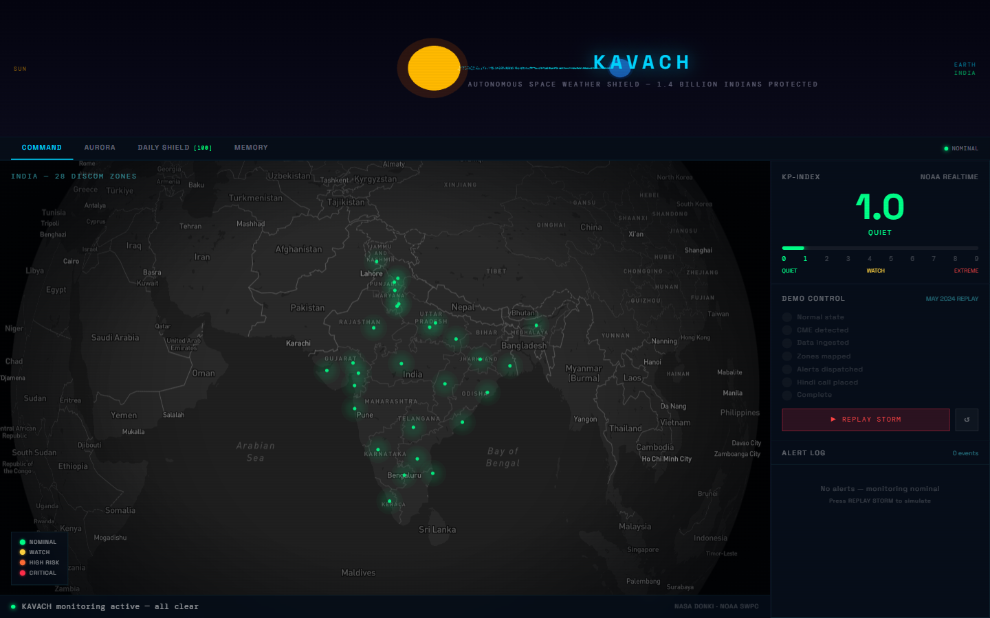
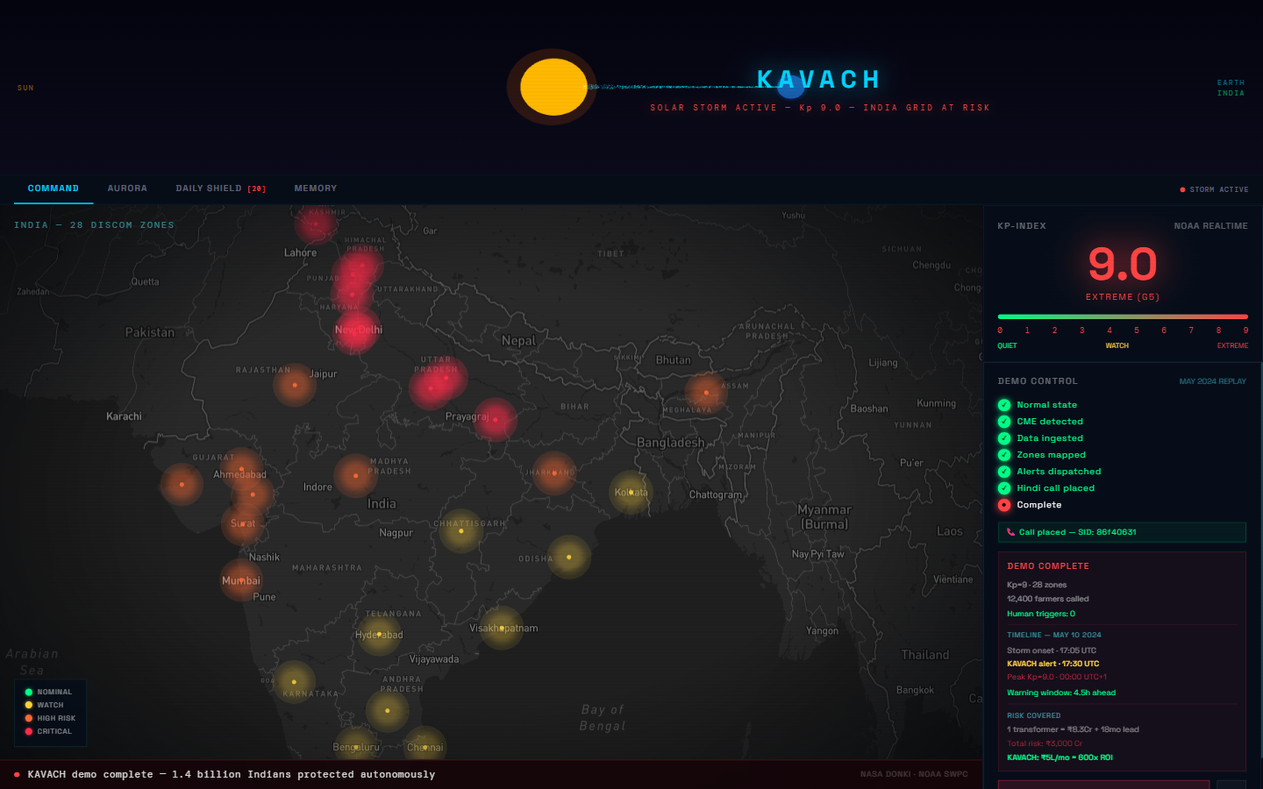
KEY FEATURES
Four layers.
Realtime + Predictive + Historical + Daily
MAP
Command Center
Live India map | 28 DISCOM zones | Kp gauge | alert feed
AUR
Aurora Predictor
6 Indian locations | Kp-based visibility | Hindi alerts
SHD
Daily Shield
[ MAY 2024 REPLAY ]
Score 0-100 | 6:30 AM IST | GPS + grid + aurora status
MEM
Storm Memory
4 storms since 2003 | 847 alerts fired | counterfactual
04/12

Slide 5
TECH STACK
Real APIs. Zero mocks.
Every data source is live. Every call is real Twilio. Every map pin is a real DISCOM.
FRONTEND
Next.js 14
TypeScript + Tailwind CSS + Mapbox GL JS + Three.js
BACKEND
FastAPI 0.110
APScheduler + Python 3.13 + httpx + Supabase client
DATABASE
Supabase
PostgreSQL + realtime | 28 DISCOMs + alert log + v2 tables
VOICE
Twilio + Polly
Amazon Polly Aditi (hi-IN) | TTS -> MP3 fallback | call recording proof in UI
DATA
NASA DONKI
NOAA SWPC Kp 5-min + NASA CME/GST 15-min + local storm archive
DEPLOY
Vercel + Railway
frontend-rust-xi-79.vercel.app + powerful-respect-production.up.railway.app
LIVE
Vercel deploy
LIVE
Railway backend
LIVE
Twilio tested
6 DAYS
Concept to ship
05/12

Slide 6
ARCHITECTURE
Autonomous loop.
No human in the trigger path. Polls every 5-15 min. Fires alerts in parallel.
KAVACH
Supabase
NASA DONKI
->
->
CME + GST 15 min
FastAPI + APScheduler
Alert log + history
Farmer's Phone
Storm Classifier
Twilio
->
No app needed No internet Just a call
NOAA SWPC
DISCOM Mapper (x28)
->
Hindi voice call
->
Kp-index 5 min
Aurora Predictor
Daily Shield
Next.js Map
->
28 zones realtime
ISRO VEDAS
Alert Generator
Phase 2 ionosphere
Farmer Phone
->
Feature phone no app
06/12

Slide 7
DEMO
[ LIVE DEMO ]
22.6 seconds.
May 10, 2024 | Kp = 9.0 | G5 EXTREME
T+0s
NOMINAL
Monitoring active
T+3s
CME
X-class flare detected
T+5s
Kp = 9.0
EXTREME G5 confirmed
T+14s
MAP RED
All 28 zones -> red
T+17s
ALERTS
28 DISCOMs + 12,400 farmers
India map: all 28 DISCOMs in RED | Alerts firing in parallel
T+20s
CALL LIVE
Hindi rings + recording proof
22.6s
demo runtime
4.5h
warning window
LIVE
Vercel + Railway
07/12

Slide 8
STORM MEMORY
21 years of storms.
KAVACH applied retroactively to every major Indian geomagnetic event since 2003.
YEAR
STORM
Kp
WARNING
ALERTS
2003
Halloween Superstorm
Kp 9.0+
8h avg
294 alerts
2015
St. Patrick's Day
Kp 8.0
6h avg
216 alerts
2017
September X9.3 Flare
Kp 8.0
5h avg
192 alerts
2024
May G5 [SOURCE]
Kp 9.0
4.5h
145 alerts
847
12,400
6h
total alerts fired
subscribers per storm
average warning window
08/12

Slide 9
DAILY SHIELD
365 days a year.
KAVACH [ 06:30 AM IST ]
NOMINAL
Space Weather Score | 6:30 AM IST | Hindi + English
95
0-100
Space Weather Score
India's space weather AQI Green 80+ = normal ops
/ 100 SHIELD NOMINAL
GPS
GPS Accuracy Forecast
Precision ag tractors Fishing boat GPS alert
GPS OK
GRID OK
AURORA LOW
GRID
DISCOM Risk Zones
KAVACH सुरक्षा संदेश तारीख: आज आज का स्कोर: 95 / 100 GPS: सामान्य | ग्रिड: सुरक्षित कोई सौर तूफान नहीं KAVACH सक्रिय है।
Per-zone transformer risk Operator dashboard feed
AUR
Aurora Visibility
6 Himalayan locations Kp-based prediction nightly
LANG
Bilingual Brief
Hindi for farmers English for DISCOM operators
INDIA'S SPACE WEATHER AQI | DAILY AT 06:30 IST
09/12

Slide 10
REVENUE
600x ROI
Rs.5L/month subscription protects Rs.3,000 Cr in transformer assets per DISCOM
FREE
Citizens / Farmers / Fishermen
Public alerts + Hindi voice calls
Rs. 0
DISCOM API
28 Electricity Utilities
72h forecast + SCADA integration + Portal
Rs.2-5L/month
5 DISCOMs
Year 1 anchor contracts (target)
Pilot -> ARR target -> Round 2 expansion
Rs.1.8Cr/year
PHASE 2
Aviation / Telecom / Insurance
DGCA + BSNL + LIC APIs as risk oracles
TBD
Rs.3,000 Cr [transformer asset exposure] vs Rs.5L [monthly subscription] = 600x protection
10/12

Slide 11
FUTURE SCOPE
Round 2 / Tokyo.
FLAGSHIP #1
Multi-Language: Hindi + Tamil + Telugu + Marathi + Bengali + Punjabi + Gujarati + Kannada
VEDAS
ISRO VEDAS Integration
WA/SMS
WhatsApp + SMS Alerts
India-specific ionospheric scintillation data
Multi-channel delivery zero missed notifications
REPLY
Two-Way Voice Reply
CME
CME Transit Model
Farmer presses 1 to confirm 2 for help — KAVACH escalates
4-18h precise countdown per-zone impact window
SaaS
DISCOM Operator Dashboard
Operator-facing SaaS portal | Custom alerting | SCADA integration | Contractual ARR path
11/12

Slide 12

FAR AWAY 2026 | TEAM 404_SHINOBI | SPACE & AEROSPACE
KAVACH
demo complete | all 28 zones warned
"It called the farmer before the lights went out."
LIVE DEMO
GITHUB REPO
frontend-rust-xi-79.vercel.app
github.com/VibhorJain1974/kavach-faraway-2026
CONTACT
TEAM
jvibhor202@gmail.com
404_SHINOBI | FAR AWAY 2026
Deploy: Vercel + Railway | Voice: Twilio + Amazon Polly Aditi | Data: NASA DONKI + NOAA SWPC + Local archive
12/12

