Slide 1
FAR AWAY 2026 | SPACE & AEROSPACE | TEAM 404_SHINOBI
14 JUN 2026
KAVACH
कवच — Autonomous Space Weather Shield for India
"It called the farmer before the lights went out."
28
12,400
0
DISCOMs warned
Farmers per storm
Human triggers
LIVE: frontend-rust-xi-79.vercel.app
REPO: github.com/VibhorJain1974/kavach-faraway-2026
01/12

Slide 2
PROBLEM
Zero Warning.
May 10-11, 2024 | Kp = 9.0 | G5 EXTREME | India's grid nearly failed | 0 warnings issued
!!
X
?
No Indian System
Wrong Language
Feature Phone Gap
28 DISCOMs
English-only
300M farmers
Zero automated alerts across all power utilities
Internet-only western tools useless at India's last mile
No smartphone, no internet no way to receive any warning
₹3,000 Cr transformer assets at risk every G5 event | 4.5 hours of actionable warning window lost forever
02/12

Slide 3
SOLUTION
KAVACH
Autonomous | Real-time | Hindi voice | No human trigger
NASA DONKI
NOAA SWPC
KAVACH Brain
28 DISCOMs
Farmer Phone
→
→
→
→
15 min
5 min
FastAPI
warned
no app
01
02
03
MONITOR
MAP RISK
CALL
NASA + NOAA every 5–15 min autonomously
28 zones north-first real DISCOM data
Hindi TTS feature phone 0 internet needed
"Namaste. Main KAVACH bol raha hoon. Ek bada solar toofan aa raha hai. Bijli band kar dijiye."
03/12

Slide 4
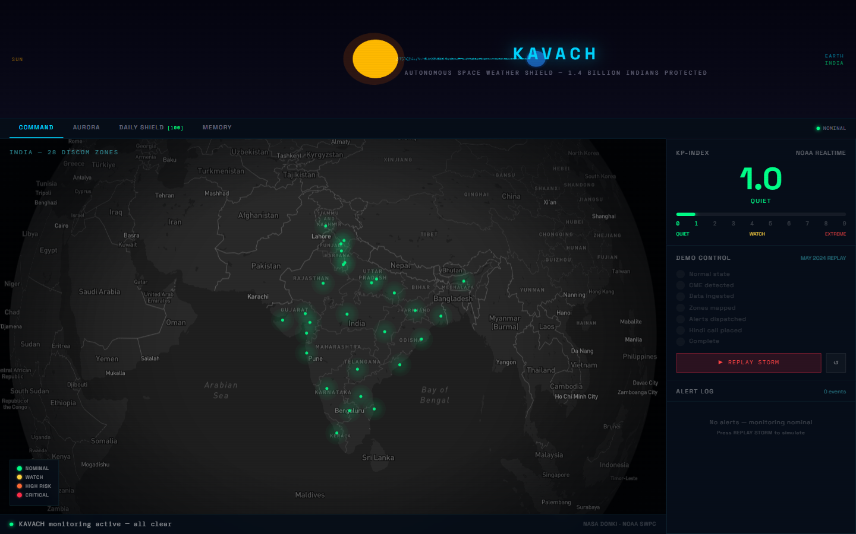
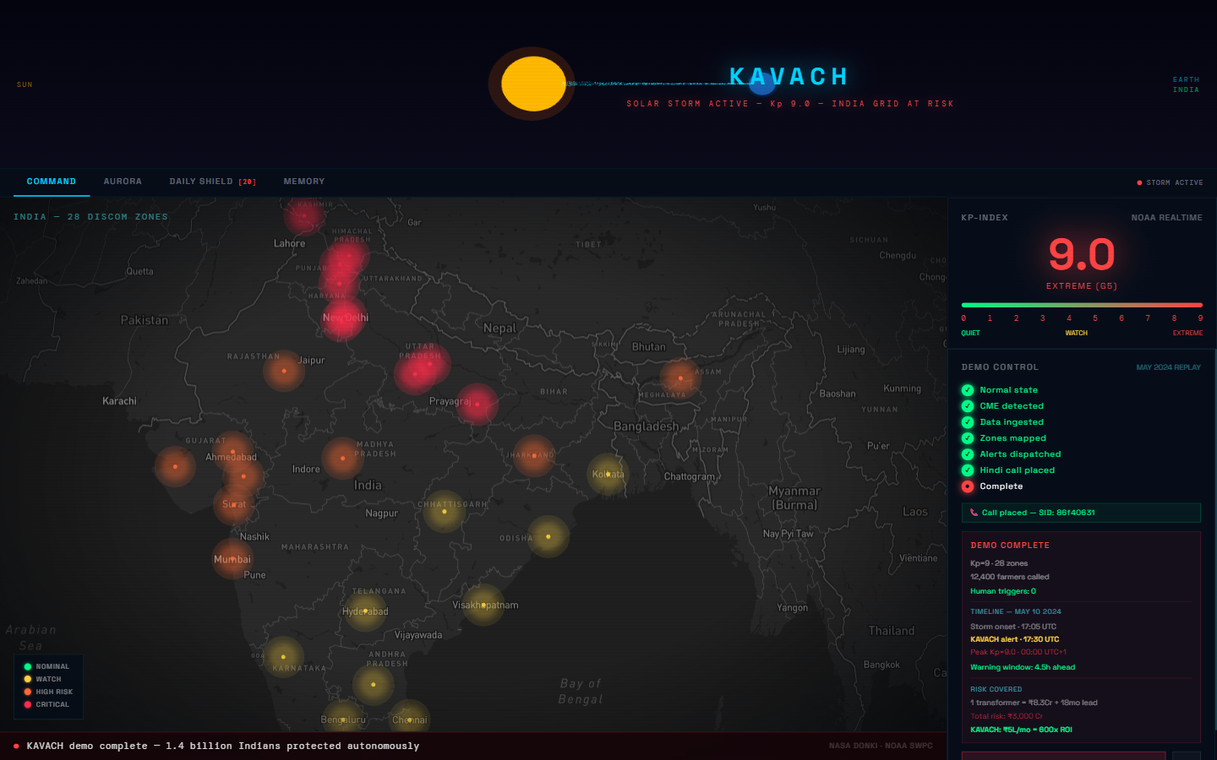
KEY FEATURES
Four layers.
Realtime + Predictive + Historical + Daily
MAP
Command Center
Live India map | 28 DISCOM zones | Kp gauge | alert feed
AUR
Aurora Predictor
6 Indian locations | Kp-based visibility | Hindi alerts
SHD
Daily Shield
[ MAY 2024 REPLAY ]
Score 0-100 | 6:30 AM IST | GPS + grid + aurora status
MEM
Storm Memory
4 storms since 2003 | 847 alerts fired | counterfactual
04/12

Slide 5
TECH STACK
Real APIs. Zero mocks.
Every data source is live. Every call is real Twilio. Every map pin is a real DISCOM.
FRONTEND
Next.js 14
TypeScript + Tailwind CSS + Mapbox GL JS + Three.js
BACKEND
FastAPI 0.110
APScheduler + Python 3.13 + httpx + Supabase client
DATABASE
Supabase
PostgreSQL + realtime | 28 DISCOMs + alert log + v2 tables
VOICE
Twilio + Polly
Amazon Polly Aditi (hi-IN) | TTS → MP3 fallback | call recording proof in UI
DATA
NASA DONKI
NOAA SWPC Kp 5-min + NASA CME/GST 15-min + local storm archive
DEPLOY
Vercel + Railway
frontend-rust-xi-79.vercel.app + powerful-respect-production.up.railway.app
LIVE
Vercel deploy
LIVE
Railway backend
LIVE
Twilio tested
6 DAYS
Concept to ship
05/12

Slide 6
ARCHITECTURE
Autonomous loop.
No human in the trigger path. Polls every 5-15 min. Fires alerts in parallel.
KAVACH
Supabase
NASA DONKI
→
→
CME + GST 15 min
FastAPI + APScheduler
Alert log + history
Farmer's Phone
Storm Classifier
Twilio
→
No app needed No internet Just a call
NOAA SWPC
DISCOM Mapper (x28)
→
Hindi voice call
→
Kp-index 5 min
Aurora Predictor
Daily Shield
Next.js Map
→
28 zones realtime
ISRO VEDAS
Alert Generator
Phase 2 ionosphere
06/12

Slide 7
DEMO
[ LIVE DEMO ]
22.6 seconds.
May 10, 2024 | Kp = 9.0 | G5 EXTREME
T+0s
NOMINAL
Monitoring active
T+3s
CME
X-class flare detected
T+5s
Kp = 9.0
EXTREME G5 confirmed
T+14s
MAP RED
All 28 zones → red
T+17s
ALERTS
28 DISCOMs + 12,400 farmers
India map: all 28 DISCOMs in RED | Alerts firing in parallel
T+20s
CALL LIVE
Hindi rings + recording proof
22.6s
demo runtime
4.5h
warning window
LIVE
Vercel + Railway
07/12

Slide 8
STORM MEMORY
21 years of storms.
KAVACH applied retroactively to every major Indian geomagnetic event since 2003.
YEAR
STORM
Kp
WARNING
ALERTS
2003
Halloween Superstorm
Kp 9.0+
8h avg
294 alerts
2015
St. Patrick's Day
Kp 8.0
6h avg
216 alerts
2017
September X9.3 Flare
Kp 8.0
5h avg
192 alerts
2024
May G5 [SOURCE]
Kp 9.0
4.5h
145 alerts
847
12,400
6h
total alerts fired
subscribers per storm
average warning window
08/12

Slide 9
DAILY SHIELD
365 days a year.
KAVACH [ 06:30 AM IST ]
NOMINAL
Space Weather Score | 6:30 AM IST | Hindi + English
95
0-100
Space Weather Score
India's space weather AQI Green 80+ = normal ops
/ 100 SHIELD NOMINAL
GPS
GPS Accuracy Forecast
Precision ag tractors Fishing boat GPS alert
GPS OK
GRID OK
AURORA LOW
GRID
DISCOM Risk Zones
KAVACH सुरक्षा संदेश
KAVACH Safety Message
तारीख: आज
Date: Today
आज का स्कोर: 95 / 100
Today's Score: 95 / 100
GPS: सामान्य | ग्रिड: सुरक्षित
GPS: Normal | Grid: Safe
कोई सौर तूफान नहीं
No solar storm
KAVACH सक्रिय है।
KAVACH is active.
Per-zone transformer risk Operator dashboard feed
AUR
Aurora Visibility
6 Himalayan locations Kp-based prediction nightly
LANG
Bilingual Brief
Hindi for farmers English for DISCOM operators
INDIA'S SPACE WEATHER AQI | DAILY AT 06:30 IST
09/12

Slide 10
REVENUE
600x ROI
₹5L/month subscription protects ₹3,000 Cr in transformer assets per DISCOM
FREE
Citizens / Farmers / Fishermen
Public alerts + Hindi voice calls
₹ 0
DISCOM API
28 Electricity Utilities
72h forecast + SCADA integration + Portal
₹2-5L/month
5 DISCOMs
Year 1 anchor contracts (target)
Pilot → ARR target → Round 2 expansion
₹1.8Cr/year
PHASE 2
Aviation / Telecom / Insurance
DGCA + BSNL + LIC APIs as risk oracles
TBD
₹3,000 Cr [transformer asset exposure] vs ₹5L [monthly subscription] = 600x protection
10/12

Slide 11
FUTURE SCOPE
Round 2 / Tokyo.
FLAGSHIP #1
Multi-Language: Hindi + Tamil + Telugu + Marathi + Bengali + Punjabi + Gujarati + Kannada
VEDAS
ISRO VEDAS Integration
WA/SMS
WhatsApp + SMS Alerts
India-specific ionospheric scintillation data
Multi-channel delivery zero missed notifications
REPLY
Two-Way Voice Reply
CME
CME Transit Model
Farmer presses 1 to confirm 2 for help — KAVACH escalates
4-18h precise countdown per-zone impact window
SaaS
DISCOM Operator Dashboard
Operator-facing SaaS portal | Custom alerting | SCADA integration | Contractual ARR path
11/12

Slide 12

FAR AWAY 2026 | TEAM 404_SHINOBI | SPACE & AEROSPACE
KAVACH
demo complete | all 28 zones warned
"It called the farmer before the lights went out."
LIVE DEMO
GITHUB REPO
frontend-rust-xi-79.vercel.app
github.com/VibhorJain1974/kavach-faraway-2026
CONTACT
TEAM
jvibhor202@gmail.com
404_SHINOBI | FAR AWAY 2026
Deploy: Vercel + Railway | Voice: Twilio + Amazon Polly Aditi | Data: NASA DONKI + NOAA SWPC + Local archive
12/12

