Slide 1


Accenture Innovation Challenge
Harness Generative AI to develop innovative solutions that boost business and societal growth

Slide 2
Instructions Reference slide– Remove before submission
Use the given template for your idea submission.
Follow file naming format: Team name_Idea Name.pptx
Ensure the spell check is done before submitting
Use standard Arial font, alignment and relevant images (as required)

Slide 3

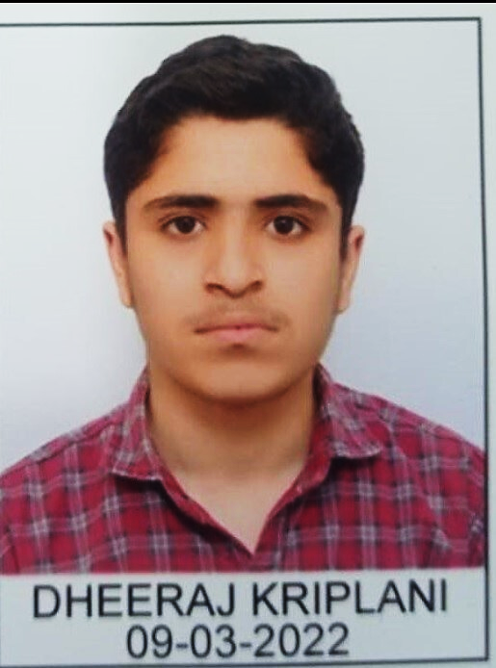
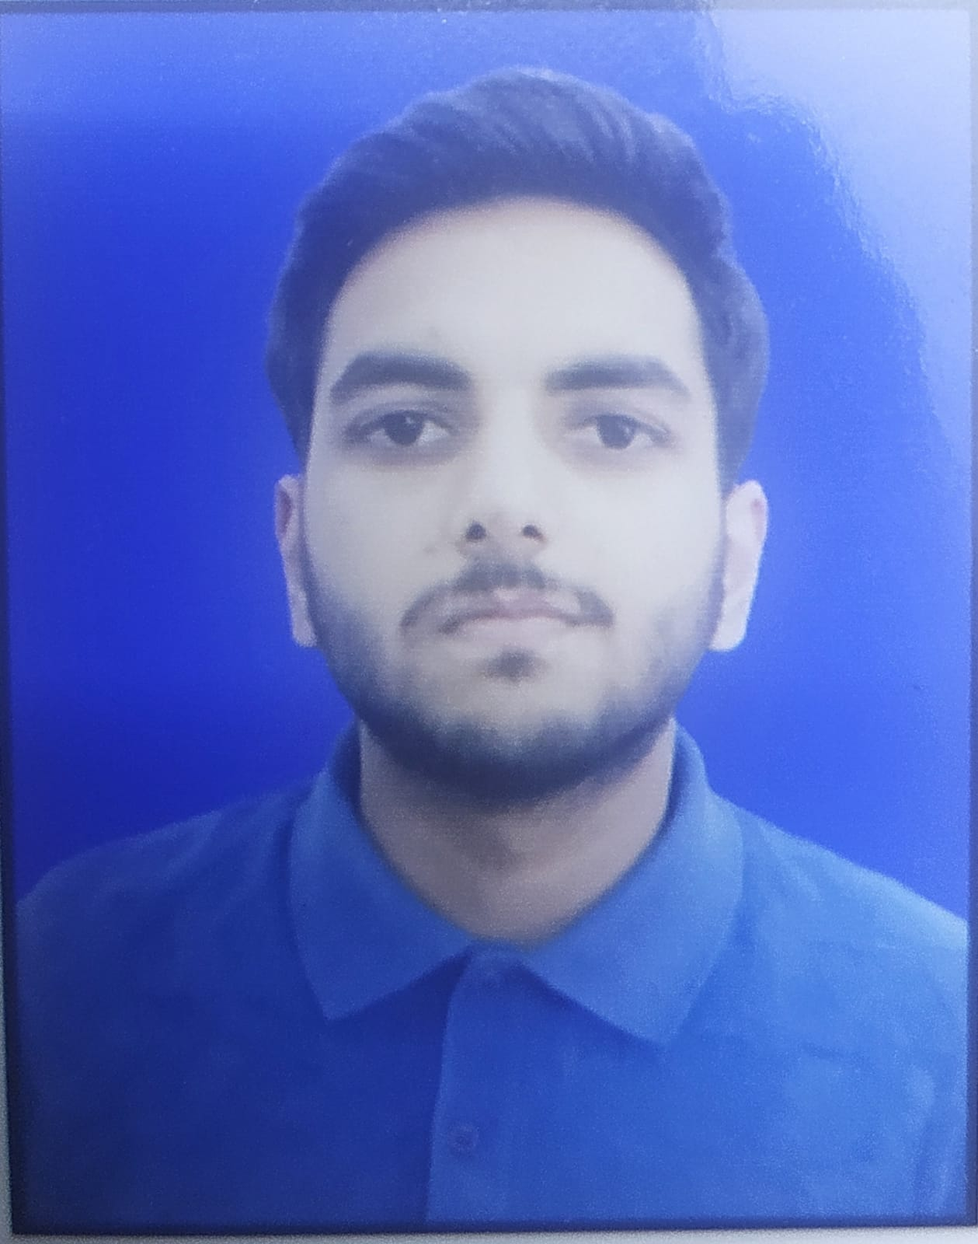
Team details
TEAM NAME: Jan Dhan Worriors
Vibhu Dixit (Team Leader)
Dheeraj Kriplani
College: Gla University,Mathura
Stream:Btech-CS
Year of graduation:2026
College: Gla University,Mathura
Stream: Btech-CS
Year of graduation: 2026
Ankit Singh
Photo
College: Gla University,Mathura
Stream: Btech-CS
Year of graduation: 2026
All fields are mandatory

Slide 4
Describe the problem statement (200 words)
As urban areas expand, effective waste management and sanitation systems are crucial for maintaining a healthy environment. Inefficient waste collection, disposal, and sanitization can result in environmental hazards, health problems, and disease outbreaks. Municipal bodies and communities often struggle with improper waste segregation, delayed pickups, lack of real-time tracking, and inadequate disposal methods, which worsen these issues.
Objective: Develop an innovative and scalable solution to improve waste collection, disposal, and sanitation in both urban and rural areas. The solution should focus on:
Efficient Waste Collection: Optimize waste pickup schedules, track waste volume, and ensure proper segregation at the source.
Disposal and Recycling: Promote eco-friendly disposal methods, enhance recycling efforts, and reduce landfill use.
Sanitization Improvement: Keep waste-prone areas clean and sanitized to mitigate health risks.
Community Engagement: Foster awareness and participation in better waste management practices.
Solutions can utilize technologies such as IoT, AI, and data analytics to automate waste management, provide real-time monitoring, and support sustainable waste disposal methods. Proposals should integrate with existing government systems or offer easily adaptable platforms for municipalities and communities.

Slide 5
Proposed solution / your big Idea (200 words)
Waste Collection: Users can upload a photo of the garbage they wish to dispose of to the website. After AI verification of the waste, the location is automatically sent to the nearest garbage collector for pickup. This ensures prompt and efficient waste collection, reducing littering in communities and improving overall cleanliness.
Waste Disposal: We will partner with startups that use recyclable waste as raw material, ensuring they purchase waste directly from our platform. A tracking system will be implemented to monitor the location and status of the waste, ensuring it is delivered to the appropriate disposal site efficiently and with minimal delays.
Sanitization: Our platform will collaborate with NGOs to organize community events focused on sanitation and cleanliness. Additionally, the site will provide educational resources such as waste management guides, interactive flipbooks, quizzes, and an AI-based chatbot to keep users informed and engaged in eco-friendly practices.
Self-Financed Model: The platform will generate revenue through subscription services for waste collectors and commission fees from waste disposal startups that partner with us.
Waste Sorting Technologies: Our platform will employ advanced waste sorting technologies based on the 3 Rs (Reduce, Reuse, Recycle), categorizing waste for more effective recycling and disposal.

Slide 6
How does your innovation accelerate change with the power of Technology? (200 words)
Our innovation accelerates change by harnessing advanced technology to revolutionize waste management. Using AI, users can upload photos of their garbage, which are automatically verified. The system then sends the location to the nearest garbage collector, ensuring quick and efficient pickups. This reduces the need for manual intervention, optimizes collection routes, and cuts down on emissions by minimizing fuel consumption.
We also implement IoT-based real-time tracking to monitor the waste journey from collection to disposal. This enhances transparency and ensures that waste reaches the correct recycling or disposal site. By partnering with startups that use recyclable materials, we create a circular economy where waste is repurposed into raw materials for new products.
To further engage users, we integrate educational tools like interactive guides, quizzes, and an AI-based chatbot to promote awareness and responsible waste management. This fosters community participation, driving behavioral change for a cleaner, more sustainable environment.
Our platform employs advanced waste sorting technologies based on the 3 Rs (Reduce, Reuse, Recycle), ensuring proper categorization for recycling. This minimizes landfill use and supports eco-friendly waste disposal. By leveraging technology, our solution accelerates positive environmental impact and creates a more efficient waste management system.

Slide 7
How is your solution different/unique from other solutions in market? (150 words)
Our platform’s uniqueness lies in its innovative features designed to enhance engagement and promote effective waste management.
The ML-based Feed Section uses machine learning to deliver personalized content and updates, boosting user involvement.
Wallet Coins reward users with redeemable coupons for participating in waste management activities, adding a gamified element to the process.
Users can earn money by selling collected recyclable waste, providing a financial incentive for proper disposal. The Colony Ranking/Leaderboard ranks areas based on their cleanliness efforts, fostering friendly competition and motivating communities to improve their sanitation practices.
Additionally, our platform offers Certificates to recognize user achievements.
The Business Section/Event allows users to post before-and-after photos of area transformations, earning virtual coins that can be redeemed for exciting coupons. This integration of rewards, community recognition, and financial incentives makes our platform a distinctive and effective solution for waste management.

Slide 8
Any testimonials received?
1. "The ML-based Feed Section is a game changer! It keeps me informed about updates and tips tailored to my needs. I've never been more engaged in keeping my community clean!" — Riya Patel, Resident of Green Valley Colony
2. "Wallet Coins have made waste disposal fun! My family competes to see who can earn the most coupons, and it's encouraging us all to recycle more. A fantastic initiative!" — Karan Mehta, Urban Resident
3."Selling recyclable waste for money is a brilliant idea. It’s helped me earn extra cash while contributing to a cleaner environment. It's a win-win for both my pocket and the planet." — Siddharth Roy, Eco-Conscious Citizen
4."The Colony Ranking has sparked friendly competition in our neighborhood. We're constantly
improving, and it feels great to see our efforts reflected in the rankings.
It motivates everyone to do their part." — Sonal Shah, Housing Community Member
Share the links/photos of the testimonials you’ve received

Slide 9
Please share a 1-minute video of your idea (embed on this PPT or add a downloadable link)
https://youtu.be/Q1bEQviGgzM

Slide 10
Thank you!

