Slide 1


SMART INDIA HACKATHON 2024
TITLE PAGE
Problem Statement ID – 1591
Problem Statement Title- A solution/idea that can boost the current situation of the tourism industries including hotels, travel and others. write this in better way.
Theme- Travel & Tourism
PS Category- Software
Team ID- GLAUS(T-29)
Team Name – Jan Dhan Warriors

Slide 2
IDEA TITLE
Jan Dhan Warriors
Proposed Solution
User Accounts: Travelers can create personalized profiles, sharing their travel details, including destination and travel dates. Machine learning algorithms suggest like-minded travelers based on shared preferences & travel histories.
Smart Suggestions: The platform uses AI and ML to recommend profiles of people traveling to the same destination during the same period, encouraging connections and shared experiences. This enhances social interaction by identifying compatible travel companions.
Local Service Providers: Locals offering services like accommodation, food, guides, and transportation can create profiles. An AI-driven rating system analyzes client feedback, providing real-time insights for other travelers to make informed decisions.
Local Travel Agency Connections: Travelers can connect with local travel agencies, accessing exclusive services and tour packages. AI-driven chatbots can assist users in finding the best travel deals, while VR tours offered by agencies allow users to explore destinations virtually before booking.
Uniqueness
Travel Information Requests: Travelers can input details about their intended destination and travel dates, using AI-powered algorithms to receive personalized suggestions and recommendations about the location, including popular attractions and off-the-beaten-path spots.
Travel Information Requests: Travelers can input details about their intended destination and travel dates, using AI-powered algorithms to receive personalized suggestions and recommendations about the location, including popular attractions and off-the-beaten-path spots.
Travel Destinations: The site uses AI to suggest popular tourist spots and hidden gems in the selected travel locations, curating tailored experiences for each user based on previous preferences and behavior patterns.
Ratings and Reviews: Clients can rate and review local service providers. Machine learning models analyze these reviews to surface the most trusted and highly recommended providers, ensuring that the best services rise to the top.

Slide 3










TECHNICAL APPROACH
Jan Dhan Warriors
Platform Architecture: Use Node.js for the backend, React for the frontend, and a hybrid database with MongoDB (NoSQL)
for storing user profiles, travel details, and content.
AI-powered Suggestions: Implement AI algorithms with TensorFlow for personalized travel suggestions and location
recommendations. Integrate travel data APIs such as Google Places for real-time information about popular attractions and hidden gems.
Profile Matching (ML): Use machine learning models like K-means clustering or collaborative filtering for suggesting like-minded travelers
based on shared preferences and travel histories. Store and manage user data using MongoDB.
Smart Suggestions (AI/ML): Develop a recommendation engine using AI and ML models to suggest compatible travel companions.
Integrate WebSockets for real-time profile matching and user notifications.
Content Sharing & VR Support: Store user-generated content such as photos and videos with Cloudinary or AWS S3. Plan for future
VR support by integrating WebVR API or A-Frame to allow users to upload and view immersive 360-degree travel experiences.
Local Service Providers: Allow local providers to create profiles. Use AI-driven feedback analysis with NLP libraries like SpaCy or NLTK
to analyze reviews, providing real-time insights on service quality.
Security and Data Privacy: Ensure data protection with SSL/TLS, AES-256 encryption, OAuth 2.0 authentication, and MFA.
Perform regular security audits to safeguard user data.
Travel Destinations (AI): Develop a tailored experience recommendation engine using AI to suggest popular tourist spots and hidden gems,
pulling data from APIs like Google Places or Yelp.
Scalability & Infrastructure: Deploy the platform on AWS or Google Cloud with auto-scaling and load balancers for handling high traffic.
Utilize Kubernetes or Docker for containerization to ensure efficient resource management and scalability.

Slide 4
FEASIBILITY AND VIABILITY
Human Resources: Skilled staff needed for operations.
Jan Dhan Warriors
Your Team Name
Potential Challenges and Risks
Technical Challenge: Ensuring seamless integration of AI, ML, and VR technologies for personalized travel suggestions and virtual tours.
User Engagement: Attracting and retaining users without strong engagement strategies or incentives.
Partnership Challenge: Onboarding and maintaining reliable local service providers across different locations.
Operational Risk: Coordinating effectively with local travel agencies to ensure smooth service delivery.\
Data Privacy and Security: Safeguarding user data and complying with privacy regulations like GDPR.
Financial Risk: Difficulty in monetizing the platform through commissions or premium services in a competitive market.
Strategies to Overcome Challenges
Technical Solutions: Collaborate with experienced tech partners to ensure smooth integration of AI, ML, and VR. Invest in regular testing and updates to improve performance and user experience
User Engagement: Implement gamification features like rewards, badges, and leaderboards. Offer personalized recommendations and exclusive deals to increase user retention and interaction.
Partnership solution: Create a clear onboarding process for local service providers, offer them training and support, and incentivize quality service through performance-based rewards.
Operational Solutions: Establish clear communication and service-level agreements (SLAs) with local travel agencies and use tracking tools to monitor service delivery and maintain quality control.
Enhance Data Security: Invest in robust encryption technologies, regularly audit security measures, and ensure compliance with data protection regulations (GDPR, CCPA, etc.).
6.Financial Solutions: Diversify revenue streams by offering tiered subscription models, premium services, and affiliate marketing with travel-related brands. Seek partnerships and sponsorships to cover initial operational costs.

Slide 5
IMPACT AND BENEFITS
Jan Dhan Warriors
Your Team Name
Potential Impact on the Target People
Enhanced Travel Experience: Travelers can share and explore detailed travel experiences through photos and videos.
Local Connections: Travelers connect with local service providers for personalized services and support.
Informed Decisions: Ratings and reviews help travelers make better choices for local services.
Increased Visibility for Providers: Local service providers gain exposure and attract more customers.
Expanded Reach for Agencies: Travel agencies can showcase their services to a broader audience.
Revenue Opportunities: The platform creates monetization avenues through service listings and advertisements.
Personalized Suggestions: Travelers receive recommendations for profiles and local attractions based on their travel details.
Benefits of the Solution
Social Benefits:
Enhanced Connections: Strengthens links between travelers and locals.
Increased Engagement: Boosts community involvement in the travel ecosystem.
Economic Benefits:
Local Revenue: Increases visibility and customer base for local businesses.
Economic Boost: Stimulates local economies through travel-related activities.
Environmental Benefits:
Reduced Impact: Minimizes travel’s environmental footprint.
Sustainable Practices: Supports eco-friendly local businesses.
Technological Benefits:
Personalized Recommendations: Offers tailored travel suggestions.
Innovative Solutions: Promotes new travel technologies and integrations.

Slide 6

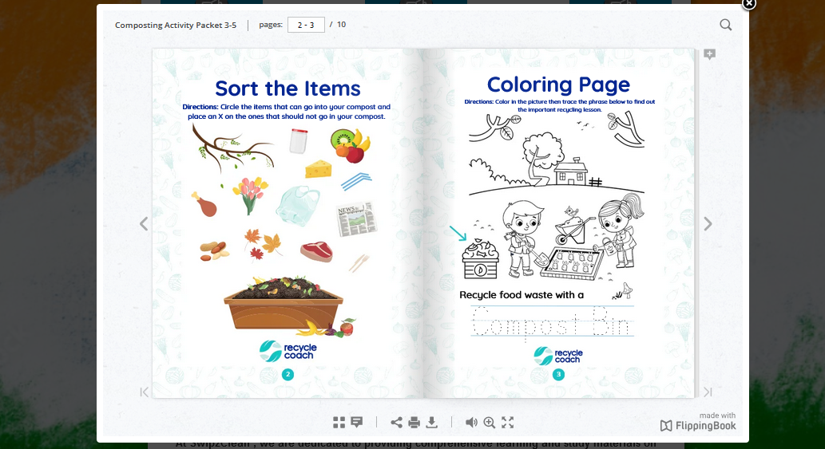
RESEARCH AND REFERENCES
Jan Dhan Warriors
Your Team Name
1. National Portal of India:- https://services.india.gov.in/service/listing?cat_id=106&ln=en
2.Central Pollution Control Board:- https://services.india.gov.in/service/listing?cat_id=106&ln=en
Swipe2Clean
3.Swachh Bharat Mission(Grameen):- https://swachhbharatmission.ddws.gov.in/about_sbm
4.Maps-API:- https://mapsplatform.google.com/india
Others:-
1.Flow-Chart Designer:- https://miro.com
2.Exalidraw:- https://excalidraw.com/
3.Flip-Book:- https://flippingbook.com/online-flipbook
Je Tum log Khud Kro itno hi ave mope

