Slide 1


Parking
Management
System
Teacher: Mr. Konguvel E.
Teacher Adeline Palmerston

Slide 2

Team Details
Name
Reg. No
Vibhu Kumar Singh
19BCE0215
Mihir Gupta
19BCE0619
Avnish Tiwari
19BCE0634
Tushar Goel
19BCE2185

Slide 3

Abstract
We have broken-down the abstract in the following slides

Slide 4
Need of the Project
In this newly developing world, the amount are cars are drastically increasing and hence raising the issue of parking.
It has happen many times with all of us that we spend 30 mins finding a parking spot for 5 min job.
To avoid that and save our precious time, we decided to develop a Parking Management System.

Slide 5
Objective/Goal
The main objective of our project would be to theoretically solve the issue of congestion as much as possible.
The goal would be to implement our solution and depict it in a user-friendly manner using Assembly Language.

Slide 6
Outcome of the Project
Smart parking System have consistently been the center of developing keen urban communities.
The framework gives a constant interaction and data of the parking slots. It assists with settling the developing issue of traffic congestion.
Concerning the future work, the clients can book a parking spot from a far off area.

Slide 7
Advantages/Beneficiaries
Smart Parking arrangements are intended to give drivers an extreme arrangement on their excursion from the start to end without looking for stopping, cost, travel time and so on.
Smart Parking innovation will assist enhancing parking spot utilization, work on the proficiency of the stopping tasks and assist smoother traffic flow.

Slide 8
Societal Impact
Time saving.
Discrete access.
Diminishes Clamor effect and contamination.
Meeting additionally city needs necessities.

Slide 9
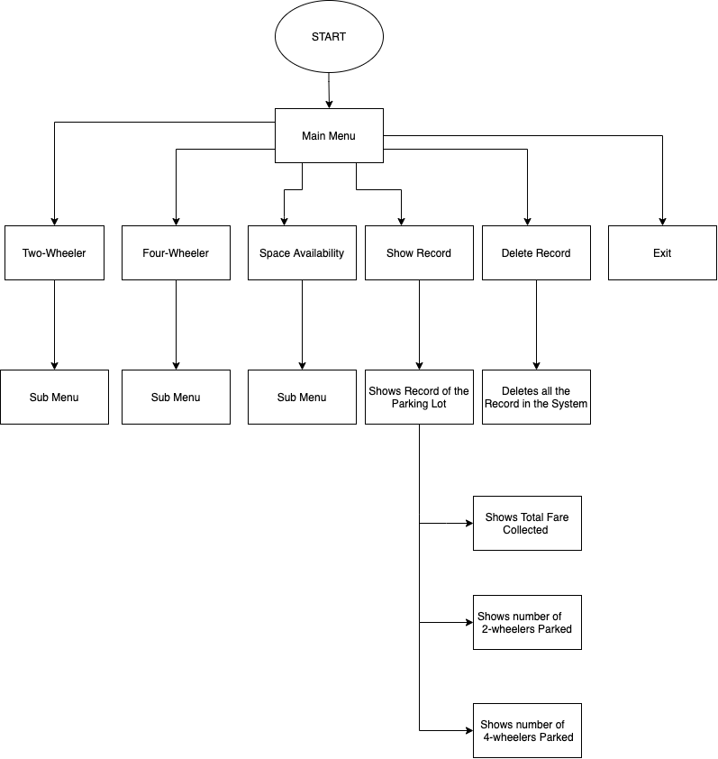
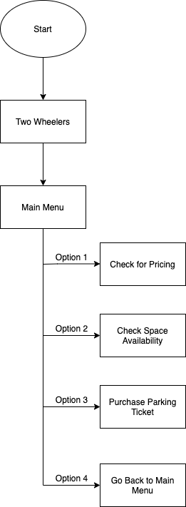


Program Flow

Slide 10
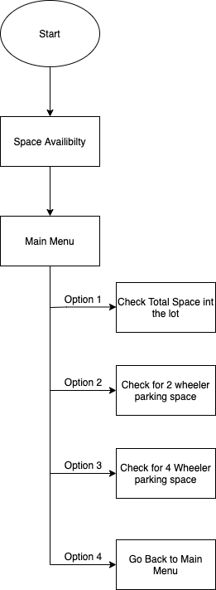

Slide 11
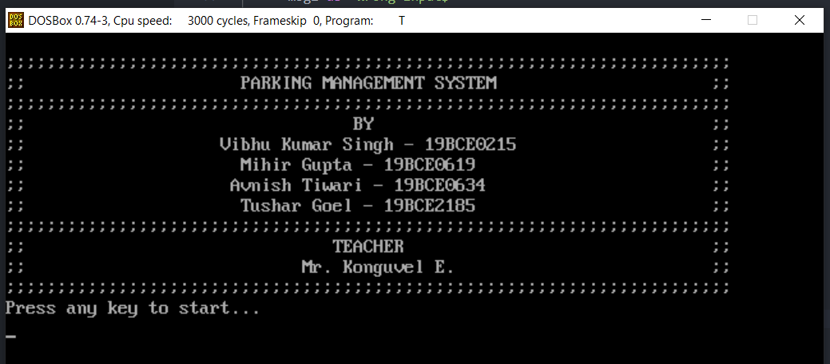
Demo Screenshots

Slide 12
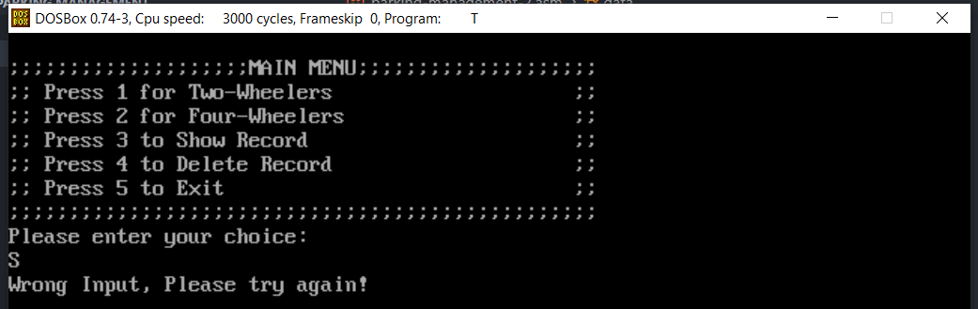

Slide 13
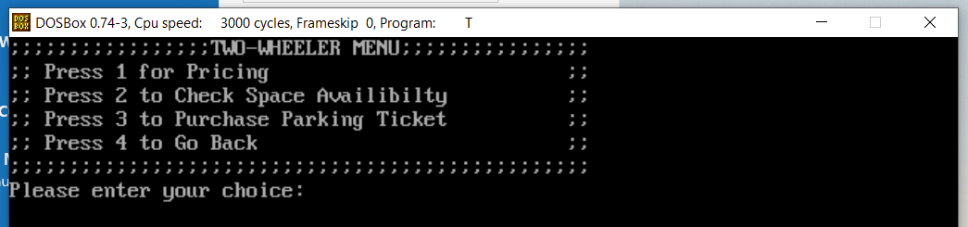
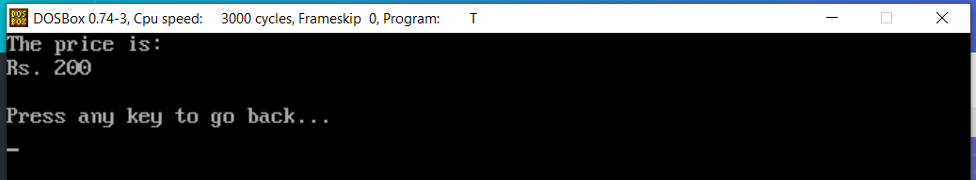

Slide 14
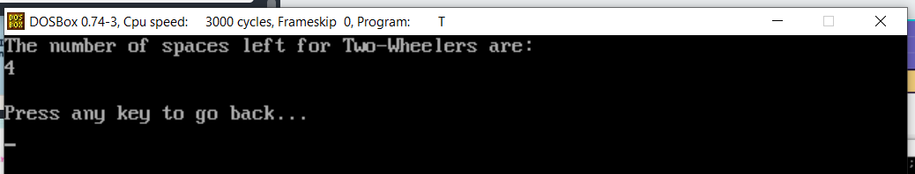
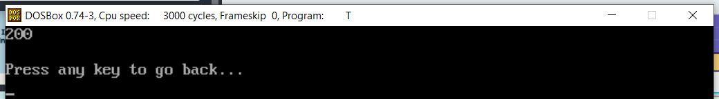

Slide 15

Thank You!

