Slide 1
Welcome

Slide 2
Artificial Intelligence with ML
What is AI ?
Umbrella term for different concepts. We can think of AI as a technique that allows computers to bring meaning to data in ways humans would.
Notes:
AI is focused on specific domains like NLP or Computer Vision a good example would be computer playing chess or a chatbot, to replicate any task a human could is called Strong AI
AI refers to any type of machine with intelligence. This does not mean the machine is self-aware or similar to human intelligence; it only means that the machine is capable of solving a specific problem.

Slide 3
Artificial Intelligence with ML
ML is a subset of AI.
Definition : It is a field of study that gives computers the ability to learn without being explicitly programmed.
What is ML ?
Notes:
We want to give insight to computer into problems without explicitly programming them to do so The main idea in ML always revolves around prediction
Machine learning refers to a particular type of AI that learns by itself. And as it gets more data, it gets better at learning.

Slide 4
Artificial Intelligence with ML
What is DL ?
It is a subset of ML which deals with neural networks. Herein we try to replicate the working of human brain.
Notes:
Deep learning refers to a particular type of machine learning that uses neural networks. It typically gives the best results by far out of any type of machine learning.

Slide 5
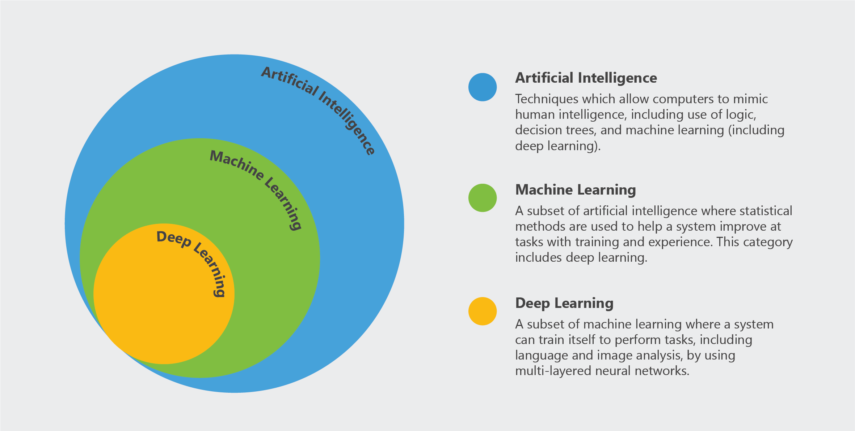
Notes:
So what is an example of AI that is not machine learning? “Expert systems” basically set a number of “if this, then do that” statements. It does not learn by itself (so it is not machine learning), and it still can be very useful for use cases like medical diagnosis and treatment.

Slide 6
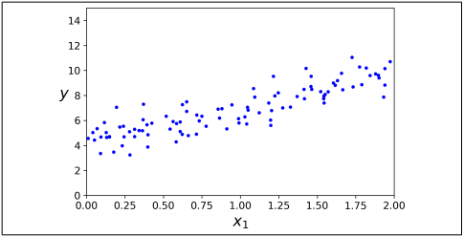

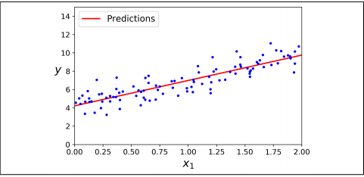
Classification of Machine Learning and Deep Learning
Notes:
Set predefined algo in ML more about optimisation
DL you would create your own network!

Slide 7
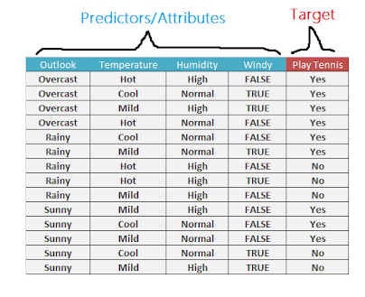

Slide 8
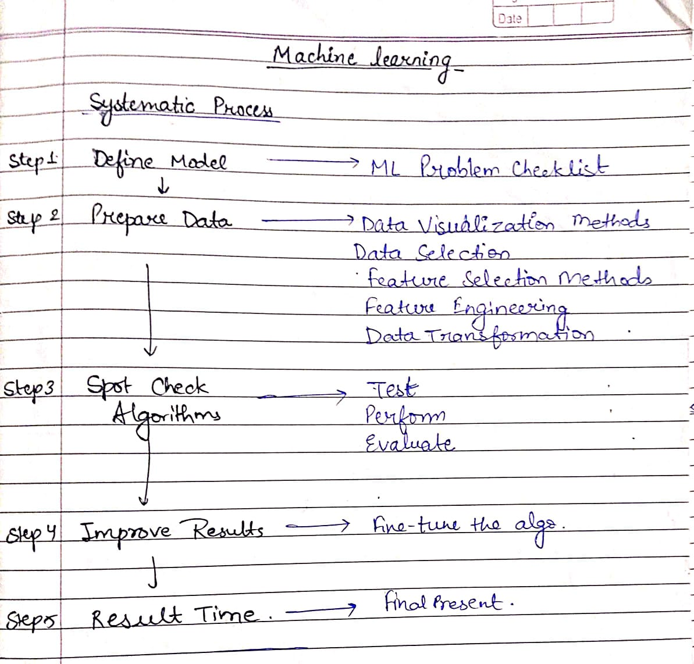
Machine Learning System Design
Notes:
Model aur algo

Slide 9
Types of Data
DATA
NUMERICAL
CATEGORICAL
ORDINAL
DISCRETE
CONTINUOUS
Notes:
Data can also be labelled data or unlabelled data. Whiteboard

Slide 10
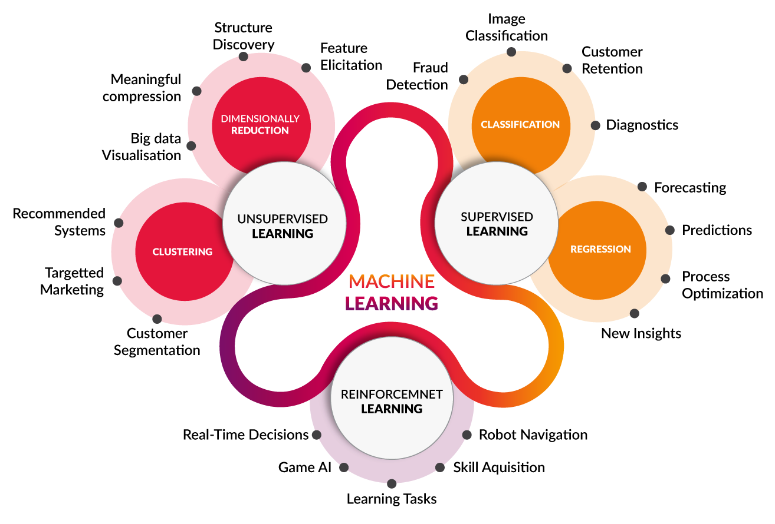
Types of Machine Learning
Notes:
Reinforcement learning is the training of machine learning models to make a sequence of decisions. The agent learns to achieve a goal in an uncertain, potentially complex environment. In reinforcement learning, an artificial intelligence faces a game-like situation. The computer employs trial and error to come up with a solution to the problem. To get the machine to do what the programmer wants, the artificial intelligence gets either rewards or penalties for the actions it performs. Its goal is to maximize the total reward.Although the designer sets the reward policy–that is, the rules of the game–he gives the model no hints or suggestions for how to solve the game. It’s up to the model

Slide 11
Regression
CONTINUOUS DATA
Predicts continuous values - Salary of employees, Stock Market Price

Slide 12
Linear Regression
Here we fit Straight Line to Scattered Data
X = features , Y = output value , Y = Wx+b
We have X,Y here the variable is W,b
If we know the equation of line we would be able to predict Y for any given X

Slide 13
Step 1
Step 2 - Loss function
Step 3 - Minimize J(x)
Predict a value for every datapoint, h(x₀) = W*x₀+b
Actual value is y₀
J(x) = (1/2m)*[h(x₀)-y]²
Method of differentiating cost to increase accuracy is Gradient Descent

Slide 14
The two losses available :
L1 norm = | h(x) - y |
L2 norm : Euclidean Distance J(x) = (1/2m)*[h(x₀)-y]²
Notes:
Less influenced by Outliers

Slide 15
Step 1
Step 2 - Loss function
Step 3 - Minimize J(x)
Predict a value for every datapoint, h(x₀) = W*x₀+b
Actual value is y₀
J(x) = (1/2m)*[h(x₀)-y]²
Method of differentiating cost to increase accuracy is Gradient Descent

Slide 16
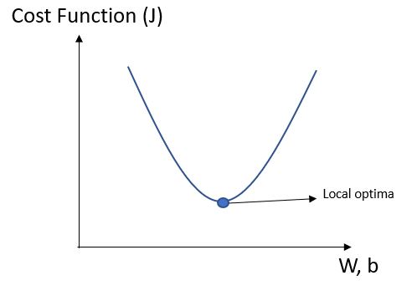
Gradient Descent
W = W - α *(∂J/∂W)
b = b - α * (∂J/∂b)
What is alpha ?
Notes:
To minimize the cost function:
The cost function is minimum where it’s slope with
respect to W and b is Zero
Partial differentiation of J is calculated with respect
to the coefficient W and intercept b
These values update the weight (coefficient) and
bias (intercept).
Method of differentiating cost to increase accuracy is Gradient Descent

Slide 17
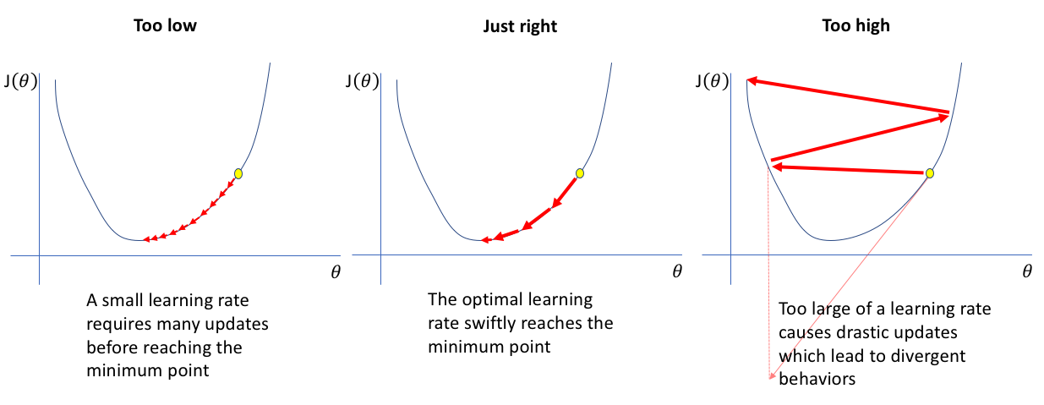
Alpha is the order of 1e-3 or 1e-4 usually

Slide 18
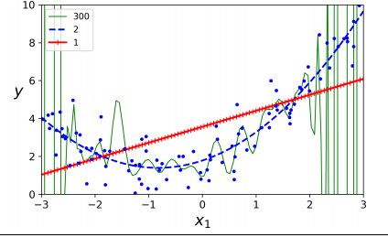
Training error
Underfitting
Overfitting
If the model isn’t trained enough
Low training error may indicate that model has started to “memorize” training samples
Minimizing training error does not show how the model will perform on previously unseen data.
Notes:
Whiteboard

Slide 19
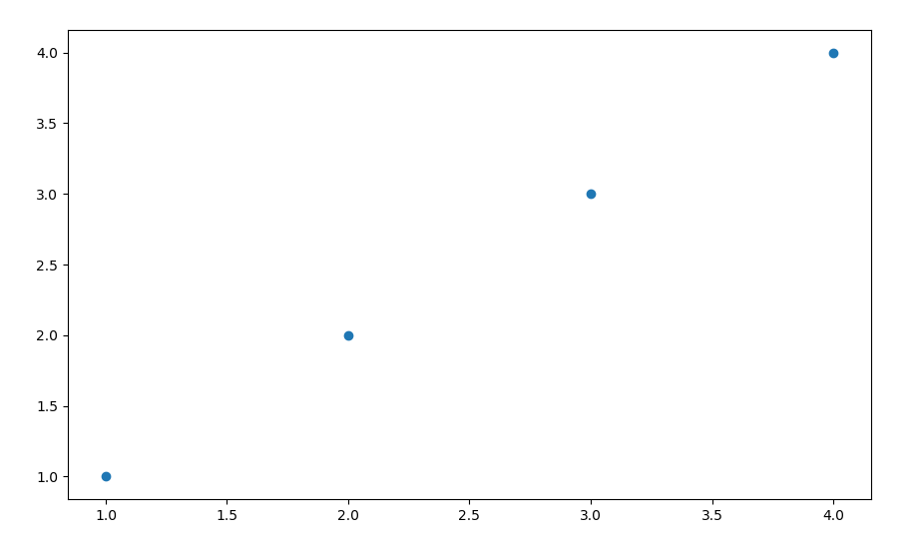
Y = x , w = 1 ,b =0;
X | y
1 | 1
2 | 2
3 | 3
4 | 4

Slide 20
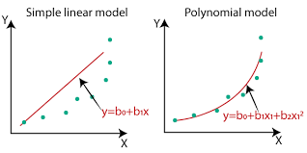
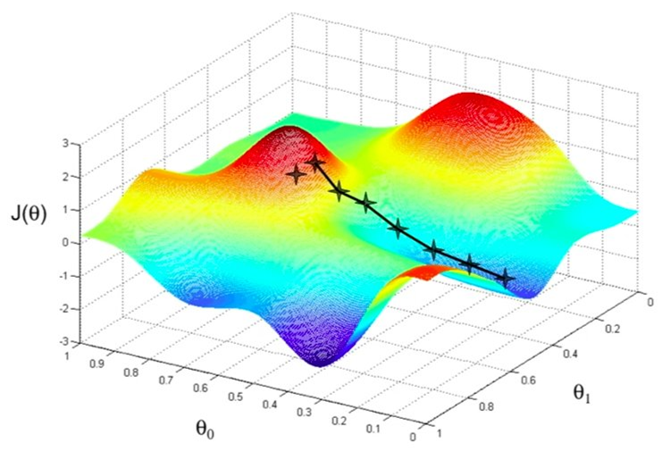
Polynomial Regression
Here y = ax^2+bx+c
Note : We still have single feature/variable X

Slide 21
Batch
Batch size is a term used in machine learning and refers to the number of training examples utilized in one iteration.
Epoch
an epoch refers to one cycle through the full training dataset.
Notes:
Epoch iteration difference

Slide 22
Coding time !

Slide 23
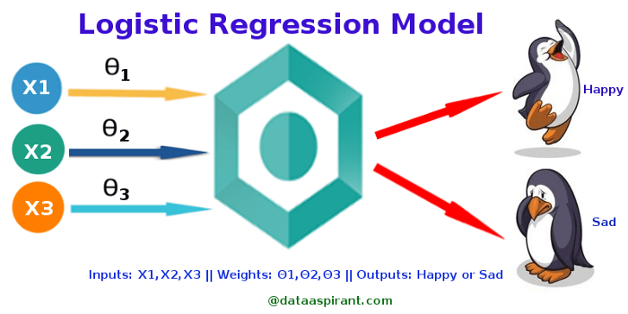
Logistic Regression

Slide 24
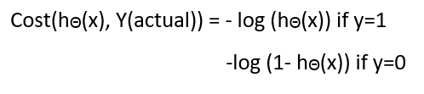
Step 1
Step 2 - Loss function
Step 3 - Minimize J(x)
Predict a value for every datapoint, Hypothesis =>
Z = WX + B
hΘ(x) = sigmoid (Z)
Method of differentiating cost to increase accuracy is Gradient Descent
J = −[ylog p+(1−y)log (1−p)]
Notes:
But why do we have a different cost function? If this is used for logistic regression, then it will be a non-convex function of parameters (theta). Gradient descent will converge into global minimum only if the function is convex.

Slide 25
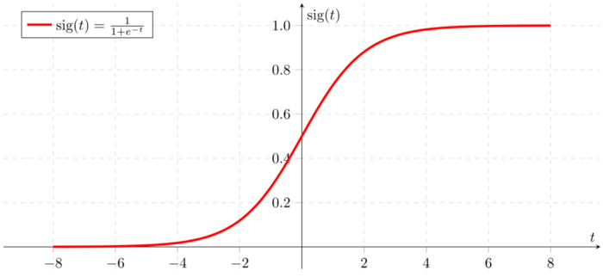
Notes:
If ‘Z’ goes to infinity, Y(predicted) will become 1 and if ‘Z’ goes to negative infinity, Y(predicted) will become 0

Slide 26
Feature Scaling
Feature scaling is often combined with mean normalization, which subtracts every value in a data set by the mean, resulting in a new mean of 0.
Combining feature scaling and mean normalization, we achieve a new feature z:
z = (x - μ) / s
where μ is the mean of the value, s is the range of values, and x is the original feature.

Slide 27
Detailed derivation :
https://towardsdatascience.com/logistic-regression-detailed-overview-46c4da4303bc

Slide 28
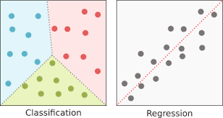
Classification
Classification is a process of categorizing a given set of data into classes, It can be performed on both structured or unstructured data. The aim is to predict the class of given data points.
Notes:
Use cases : If the mail is spam or not, if its a cat or dog etc.

Slide 29
Is accuracy enough?
Notes:
Suppose there is a classifier, with 100 data points , 95 out of them are YES 5 are NO , and it classifies all 100 as yes accuracy is 95%

Slide 30
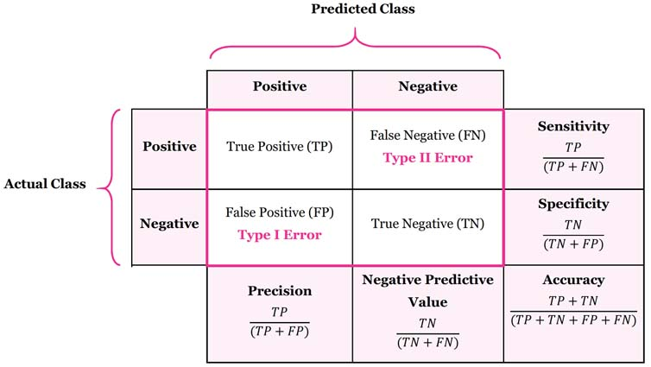
Confusion Matrix is the answer
Notes:
Precision and recall/sensitivity jitne positive predict hue usme kitne correctly predict kr paye !A trivial way to have perfect precision is to make one single positive prediction and ensure it is correct (precision = 1/1 = 100%). This would not be very useful since the classifier would ignore all but one positive instance. So precision is typically used along with another metric named recall,

Slide 31

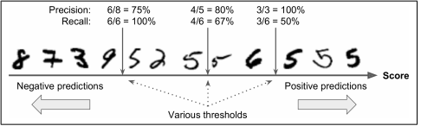
f1 score
Notes:
It is often convenient to combine precision and recall into a single metric called the F1 score, in particular if you need a simple way to compare two classifiers. The F1 score is the harmonic mean of precision and recall (Equation 3-3). Whereas the regular mean 94 | Classication treats all values equally, the harmonic mean gives much more weight to low values. As a result, the classifier will only get a high F1 score if both recall and precision are high.Decision threshold and precision/recall tradeo Think of threshold as confidence %. This confirms that raising the threshold decreases recall.Jitne 5 thay unko +ve 5 boldia yes but jitne classify kiye woh sare 5 hai nhi
100,50 - 75,66.67

Slide 32
f1 score
Notes:
It is often convenient to combine precision and recall into a single metric called the F1 score, in particular if you need a simple way to compare two classifiers. The F1 score is the harmonic mean of precision and recall (Equation 3-3). Whereas the regular mean 94 | Classication treats all values equally, the harmonic mean gives much more weight to low values. As a result, the classifier will only get a high F1 score if both recall and precision are high.Decision threshold and precision/recall tradeo Think of threshold as confidence %. This confirms that raising the threshold decreases recall.Jitne 5 thay unko +ve 5 boldia yes but jitne classify kiye woh sare 5 hai nhi
100,50 - 75,66.67

Slide 33
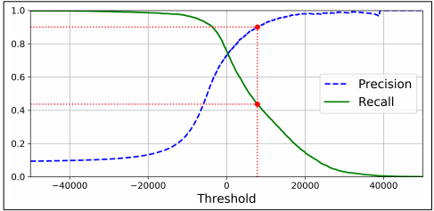
Notes:
Graph of precision and recall vs threshold

Slide 34
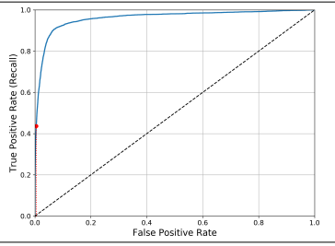
ROC Curve
The receiver operating characteristic (ROC) curve is another common tool used with binary classifiers.
Notes:
True positive rate - recall
False positive rate - 1-specificity
Maximize area AUC

Slide 35
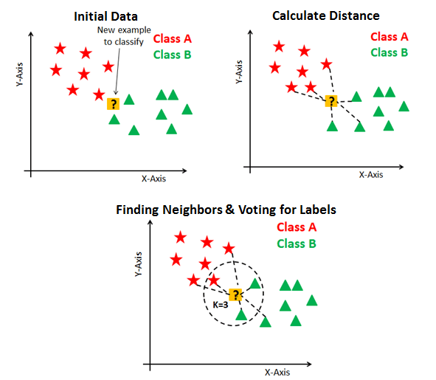
KNN Algorithm
Notes:
Step 1 : choose the value of K default = 5
Step 2 : Take k number of nearest neighbours to the datapoint whose class needs to be predicted
Step 3; among these neighbours : count the class with max data points
Step 4: Label the point with that class
Discuss tie

Slide 36
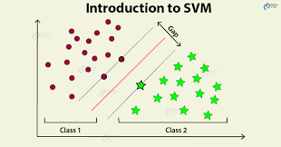
SVM - Support Vector Machines
Notes:
You can think of an SVM classifier as fitting the widest possible street (represented by the parallel dashed lines) between the classes. This is called large margin classification. Eg orange and apple

Slide 37
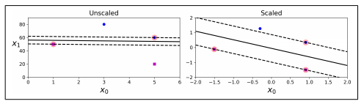
SVM - Sensitive to feature scaling
Notes:
Feature Scaling : Is used no matter

Slide 38
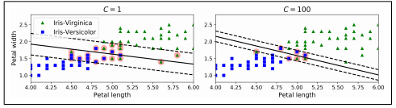
Soft margin v/s Hard margin
Notes:
C is inversely proportional to width of street between classes, hyperparameter tuning!

Slide 39
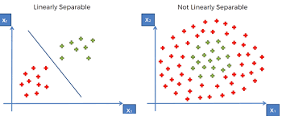
Notes:
For non linearly separable data circular arranged data example
Move to higher dimension space can be expensive
explain example of line
Can be expensive and time taking

Slide 40

SVM kernels -
Polynomial
Sigmoid
Gaussian RBF
Notes:
This is when the kernel trick comes in. It allows us to operate in the original feature space without computing the coordinates of the data in a higher dimensional space. ... In essence, what the kernel trick does for us is to offer a more efficient and less expensive way to transform data into higher dimensions.The hyperparameter coef0 controls how much the model is influenced by high degree polynomials versus low-degree polynomials.There are more than 2 kernels
Gaussian RBf - Gaussian Radial Basis Function

Slide 41
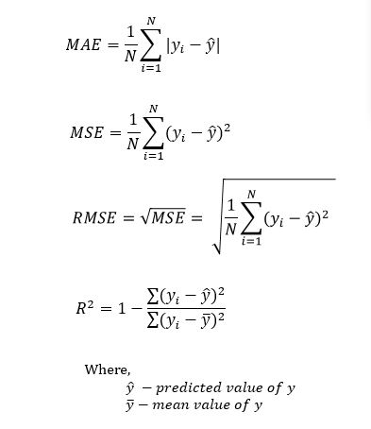

Slide 42
Deep Learning

Slide 43
ANN - Artificial Neural Networks
Autoencoders. An autoencoder is an artificial neural network that is capable of learning various coding patterns. ...
Convolutional Neural Networks. ...
Recurrent Neural Networks. ...
Reinforcement Learning to Neural Networks.

Slide 44
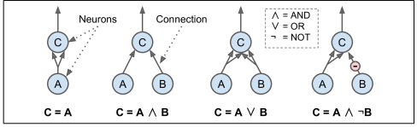
Simplest ANN
Notes:
The first network on the left is simply the identity function: if neuron A is activa‐ ted, then neuron C gets activated as well (since it receives two input signals from neuron A), but if neuron A is off, then neuron C is off as well. • The second network performs a logical AND: neuron C is activated only when both neurons A and B are activated (a single input signal is not enough to acti‐ vate neuron C). • The third network performs a logical OR: neuron C gets activated if either neu‐ ron A or neuron B is activated (or both). • Finally, if we suppose that an input connection can inhibit the neuron’s activity (which is the case with biological neurons), then the fourth network computes a slightly more complex logical proposition: neuron C is activated only if neuron A is active and if neuron B is off. If neuron A is active all the time, then you get a logical NOT: neuron C is active when neuron B is off, and vice versa.

Slide 45
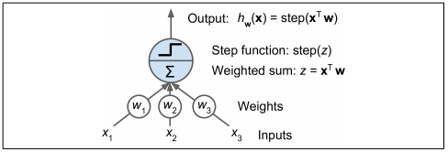
TLU Threshold Logic Unit
Notes:
the inputs and output are now numbers (instead of binary on/off values) and each input con‐ nection is associated with a weight. The TLU computes a weighted sum of its inputs (z = w1 x1 + w2 x2 + ⋯ + wn xn = x T w), then applies a step function to that sum and outputs the result: hw(x) = step(z), where z = x T w.
Step function is a function which would decide the neuron is activated or not

Slide 46
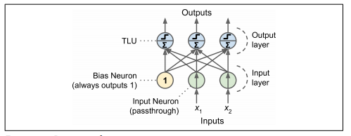
The Perceptron is one of the simplest ANN architectures,
Notes:
A Perceptron is simply composed of a single layer of TLUs,6 with each TLU connected to all the inputs. When all the neurons in a layer are connected to every neuron in the previous layer (i.e., its input neurons), it is called a fully connected layer or a dense layer. To represent the fact that each input is sent to every TLU, it is common to draw special passthrough neurons called input neurons: they just output whatever input they are fed. All the input neurons form the input layer. Moreover, an extra bias fea‐ 282 | ture is generally added (x0 = 1): it is typically represented using a special type of neuron called a bias neuron, which just outputs 1 all the time. A Perceptro
As all the information is being passed only in the forward direction it is called feedforward network……
Input from neurons of layer i will be fed into neurons of layer i+1

Slide 47

Notes:
As always, X represents the matrix of input features. It has one row per instance, one column per feature. • The weight matrix W contains all the connection weights except for the ones from the bias neuron. It has one row per input neuron and one column per artifi‐ cial neuron in the layer. • The bias vector b contains all the connection weights between the bias neuron and the artificial neurons. It has one bias term per artificial neuron. • The function ϕ is called the activation function: when the artificial neurons are TLUs, it is a step function (but we will discuss other activation functions shortly).

Slide 48
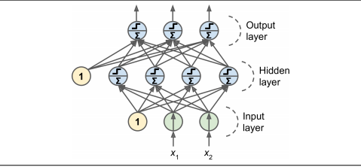
Notes:
An MLP is composed of one (passthrough) input layer, one or more layers of TLUs, called hidden layers, and one final layer of TLUs called the output layer (see Figure 10-7). The layers close to the input layer are usually called the lower layers, and the ones close to the outputs are usually called the upper layers. Every layer except the output layer includes a bias neuron and is fully connected to the next layer
When an ANN contains a deep stack of hidden layers8 , it is called a deep neural net‐ work (DNN)

Slide 49
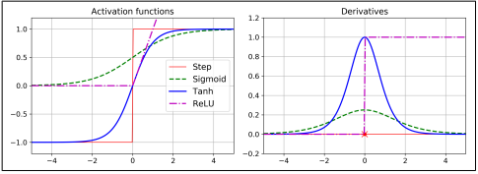
Notes:
The hyperbolic tangent function tanh(z) = 2σ(2z) – 1 Just like the logistic function it is S-shaped, continuous, and differentiable, but its output value ranges from –1 to 1 (instead of 0 to 1 in the case of the logistic function), which tends to make each layer’s output more or less centered around 0 at the beginning of training. This often helps speed up convergence. The Rectified Linear Unit function: ReLU(z) = max(0, z) It is continuous but unfortunately not differentiable at z = 0 (the slope changes abruptly, which can make Gradient Descent bounce around), and its derivative is 0 for z < 0. However, in practice it works very well and has the advantage of being 288 | Chapter 10: Introduction to Articial Neural Networks with Keras 11 Biological neurons seem to implement a roughly sigmoid (S-shaped) activation function, so researchers stuck to sigmoid functions for a very long time. But it turns out that ReLU generally works better in ANNs. This is one of the cases where the biological analogy was misleading. fast to compute. Most importantly, the fact that it does not have a maximum output value also helps reduce some issues during Gradient Descent (we will come back to this in Chapter 11).heaviside z = 0 if z < 0 1 if z ≥ 0

