Slide 1
DS SPRINT ASSESSMENT • SKILL BASED ASSESSMENT 2 (U23AD491)
E-Commerce Return Insight
Understanding Root Causes, Quantifying Return Elasticity, and Recommending Interventions to Cut Avoidable Returns
Organization: ShopVista Commerce Pvt. Ltd. | Use Case 06: E-Commerce Return Insight
Dataset Notice: Synthetic Assessment Data (5,000 distinct orders analyzed) | Author: Candidate Data Scientist

Slide 2
SHOPVISTA COMMERCE • USE CASE 06
Business Problem, Objectives, and Core Questions
12.78%
Catalog Return Rate
639 total product returns out of 5,000 clean orders.
Executive Challenge & Analytical Mandate
In e-commerce retailing, product returns represent an acute operational drag. Each return incurs two-way shipping fees, warehouse handling, item degradation, and inventory obsolescence. ShopVista Commerce commissioned this investigation to resolve five key questions:
• Category Concentration: Which specific merchandise departments exhibit disproportionate return rates?
• Discount Elasticity: Does aggressive price discounting induce return-prone impulse purchasing?
• Fulfillment Service Levels: How severely do late logistics deliveries escalate return propensity?
• Merchant Disparities: Are returns systematically concentrated among specific third-party marketplace sellers?
• Customer Lifecycle: Do repeat, high-frequency patrons demonstrate greater retention compared to new shoppers?
₹35.8L
Gross Return Merchandise Value
Substantial working capital locked in reverse transit.
28.3%
Primary Reason: Sizing
181 returns directly caused by size/fit mismatches.

Slide 3
SHOPVISTA COMMERCE • USE CASE 06
Synthetic Dataset Architecture and Data Preparation Audit
File Name | Raw Rows | Clean Rows | Anomalies Detected | Cleaning & Transformation Rule
orders.csv | 5,050 | 5,000 | 50 exact dups; 18 extreme discounts | Deduplicated by order_id. Imputed 18 invalid discounts (<0% or >100%) with median (13.18%).
products.csv | 450 | 450 | Inconsistent sizing; 10 null brands | Harmonized casing/labels into standard enum (XS to XXL). Filled missing brands as Generic.
customers.csv | 1,800 | 1,800 | 15 null regions | Imputed missing geographic regions with 'Unknown'. Verified customer history tiers.
delivery.csv | 5,000 | 5,000 | 5 unparseable; 7 pre-order delivery dates | Flagged 12 invalid records as 'Invalid Date'. Calculated delays only on 4,988 valid deliveries.
returns.csv | 5,000 | 5,000 | 85 missing return reasons on returns | Imputed 'Unknown' for 85 missing returned reasons. Left non-returns as 'Not Returned' (0).
METHODOLOGICAL INTEGRITY & LEAKAGE PREVENTION PRINCIPLES
1. Strict Join Grain: Merged 1:1 on order_id. Zero Cartesian duplication. Verified 5,000 distinct final transaction records.
2. No Date Fabrication: Invalid delivery records were flagged and isolated rather than assigned arbitrary synthetic dates.
3. Target Leakage Prevention: Outcome attributes (return_reason, return_date) were strictly isolated from predictive feature sets.

Slide 4
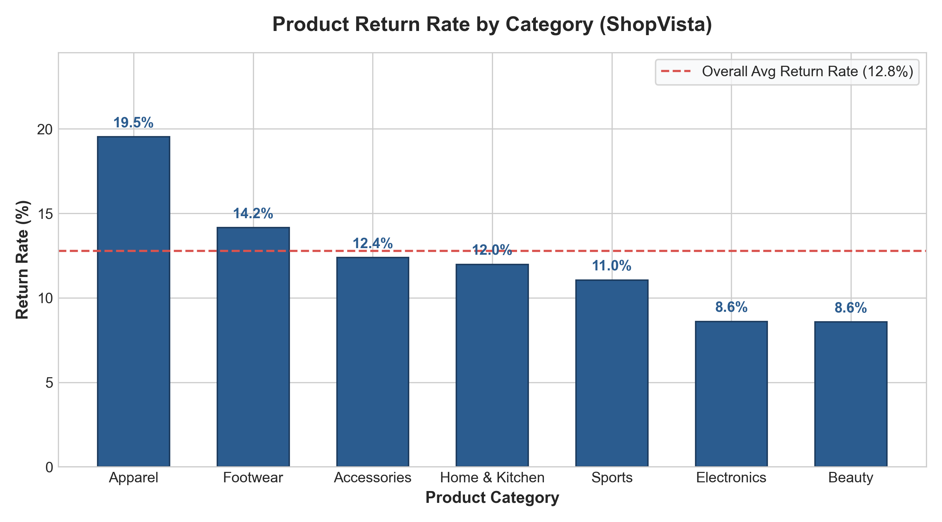
SHOPVISTA COMMERCE • USE CASE 06
Finding 1: Apparel Sizing Mismatch is the Dominant Return Driver
Key Empirical Evidence & Diagnostics
• Apparel Outlier Severity: Apparel return rate is 19.53% (198 returns / 1,014 orders), which is 52.8% higher than catalog average (12.78%).
• Footwear Alignment: Footwear exhibits the second highest return rate at 14.15% (90 returns / 636 orders), confirming wearable categories suffer disproportionately.
• Non-Sized Resiliency: Electronics (8.60%) and Beauty (8.57%) display return rates under 9%, demonstrating that standardized, specification-driven categories perform stably.
• Root Cause Driver: Customer return feedback shows 'Size/Fit Issue' accounts for 181 returns (28.33% of all returns)—the single largest category in the business.
• Business Implication: Lack of standardized digital sizing and inconsistent brand tailoring force customers into 'bracketing' (ordering multiple sizes and returning ill-fitting items).

Slide 5
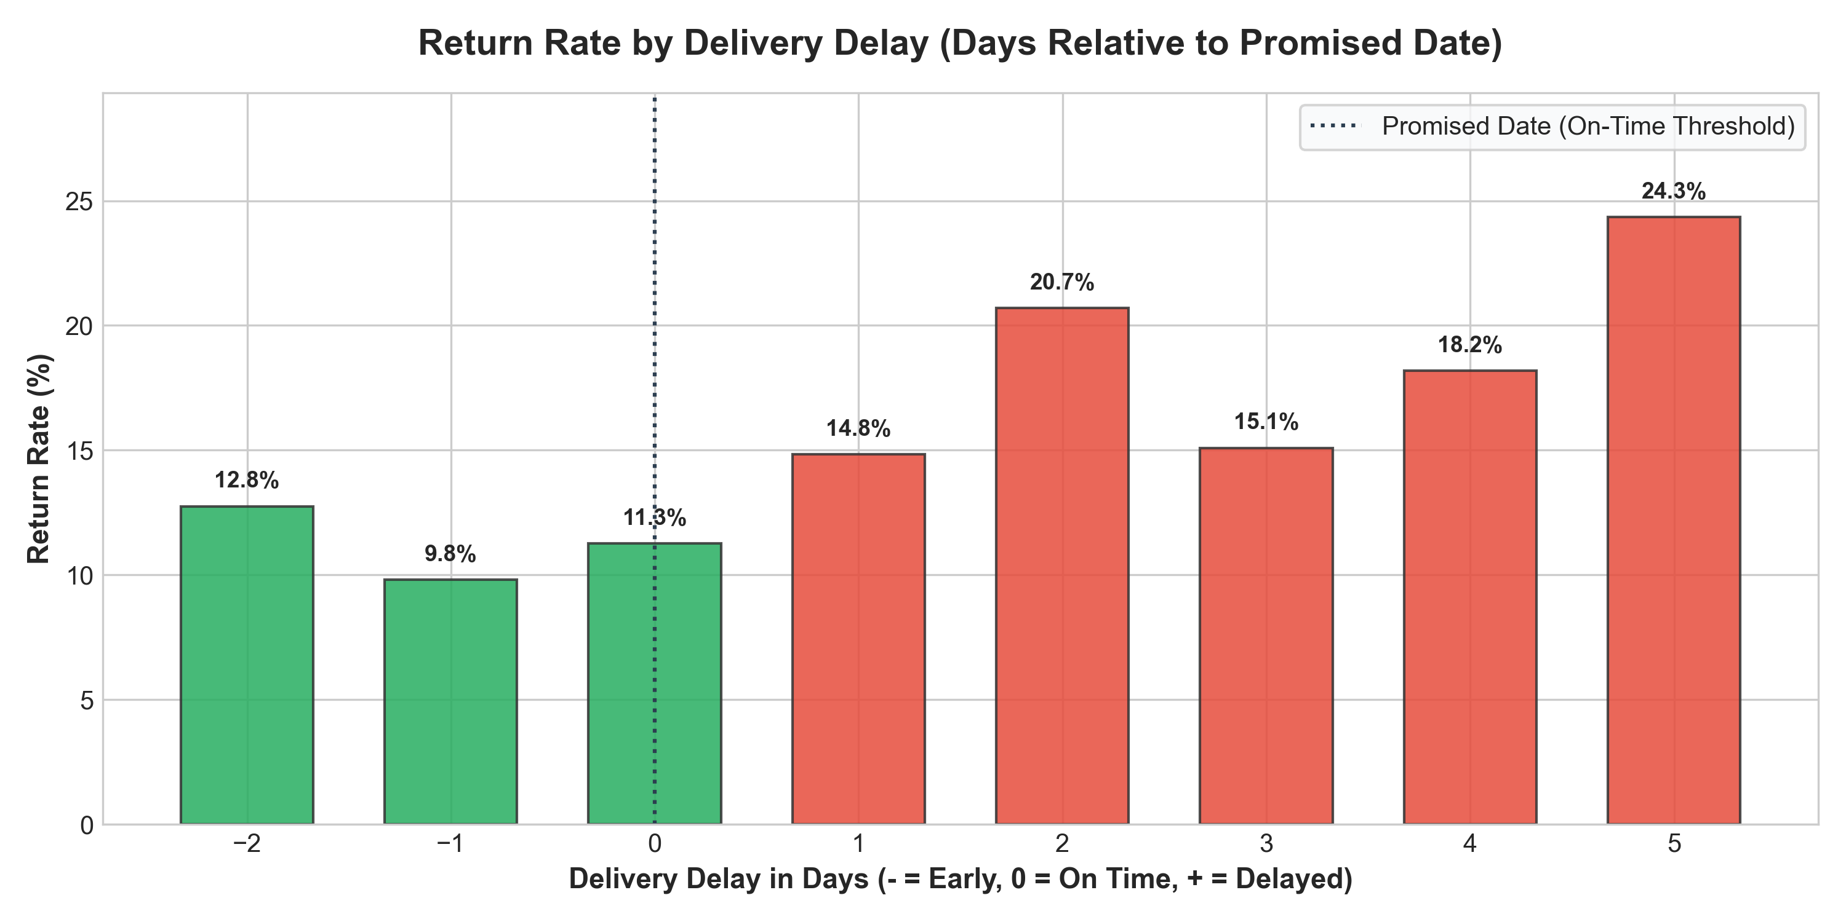
SHOPVISTA COMMERCE • USE CASE 06
Finding 2: Fulfillment Delays Drive a 67.5% Surge in Return Propensity
Fulfillment SLA Impact on Customer Retention
• On-Time vs Late Disparity: Deliveries on-time or early return at 11.04% (420 returns / 3,804 orders). Delayed deliveries spike to 18.50% (219 returns / 1,184 orders)—a 67.5% relative increase.
• Nonlinear Delay Compounding: While 1-day delays return at 14.83%, extreme delays of 5 days post-promise push returns to 24.34% (nearly 1 in every 4 packages rejected).
• Second Largest Return Reason: 'Late Delivery' is cited as the primary reason in 135 returned orders (21.13% of total returns), confirming logistics friction directly provokes cancellation.
• Customer Need-State Decay: When merchandise arrives after the expected window, the customer's immediate need or gifting occasion expires, or alternative items are purchased locally.
• Actionable Takeaway: Tightening courier dispatch SLA thresholds and improving tracking updates can salvage up to 80+ avoidable returns annually.

Slide 6
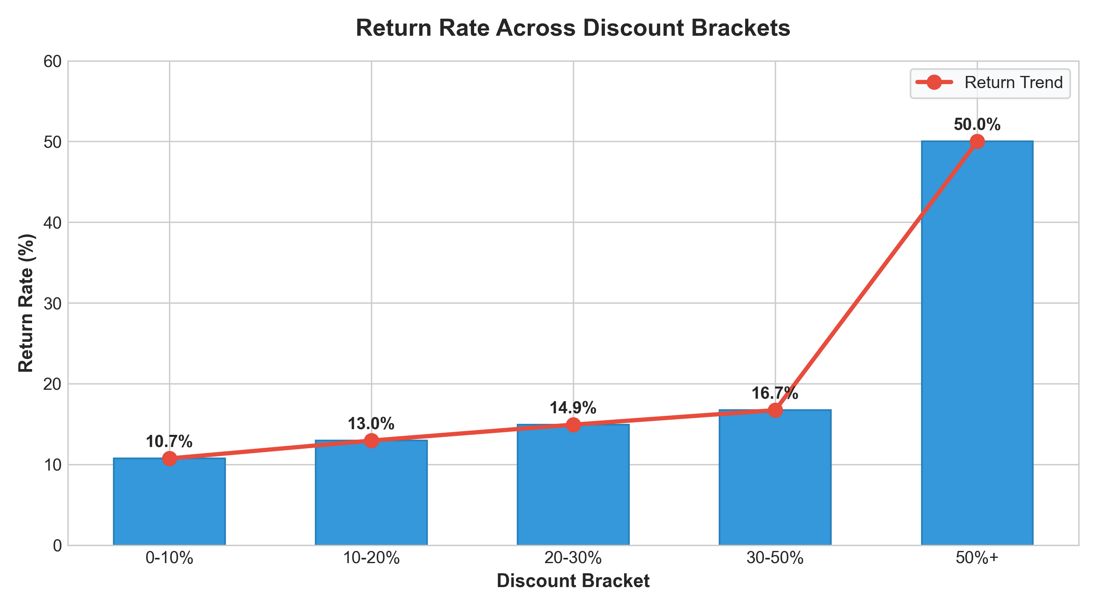
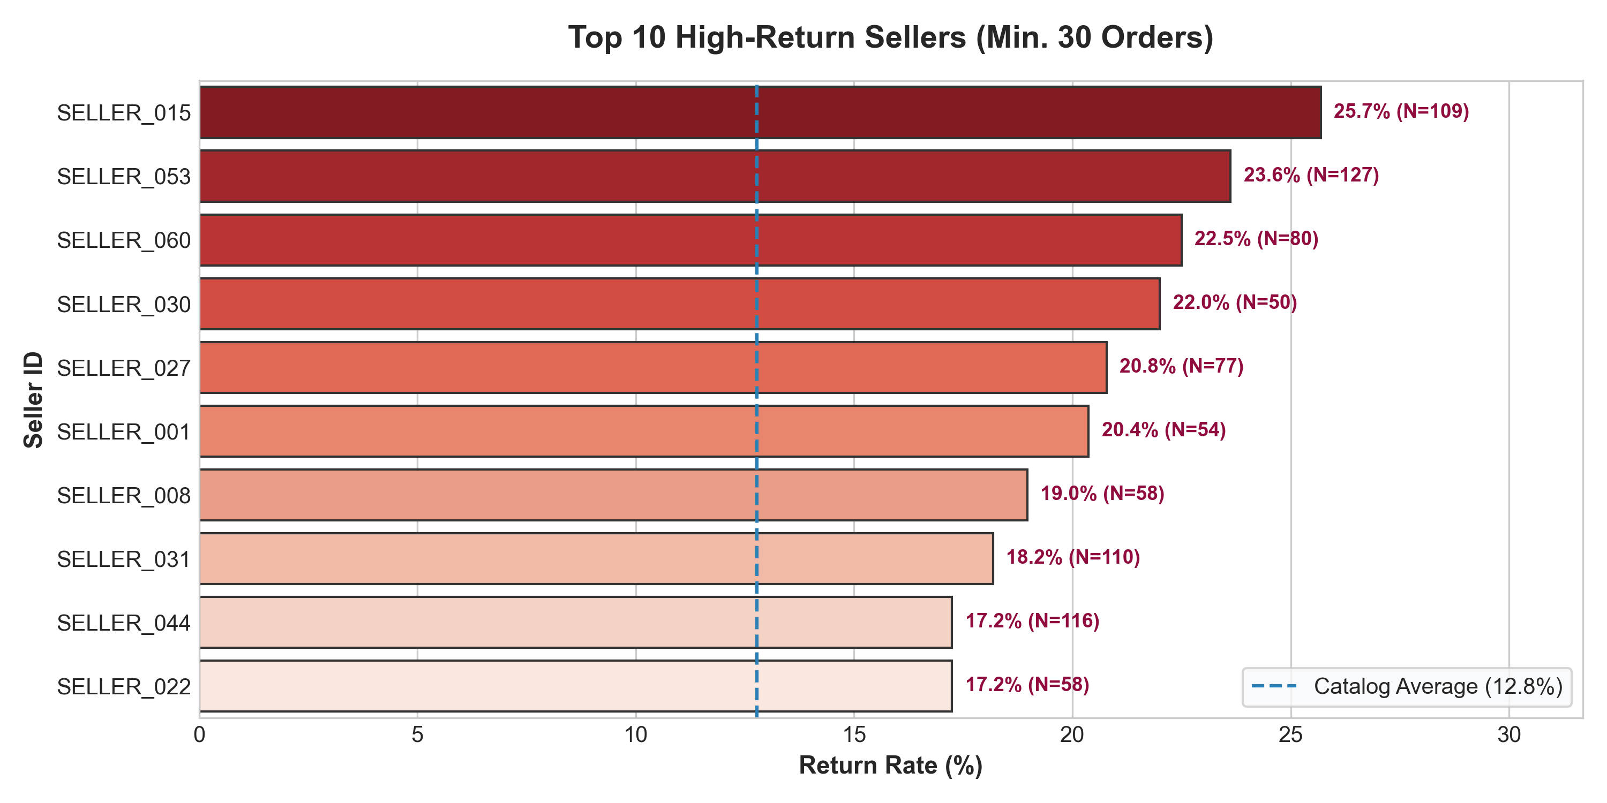
SHOPVISTA COMMERCE • USE CASE 06
Commercial Dynamics: Discount Elasticity and Seller Performance
DIAGNOSTIC SYNTHESIS: COMMERCIAL INCENTIVES & MERCHANT QUALITY
• Discount Propensity Gradient: Return rates steadily escalate with promotional depth—from 10.74% in 0-10% discount orders, to 12.97% (10-20%), 14.93% (20-30%), and 16.72% in 30-50% discounts. Deep markdowns attract impulse buyers with weaker purchase commitment.
• Chronic Seller Outliers: Substantial seller disparity exists. High-volume partners SELLER_015 (25.69% returns across 109 orders) and SELLER_053 (23.62% returns across 127 orders) return at twice the baseline average, indicating catalog listing misrepresentation or defect patterns.

Slide 7
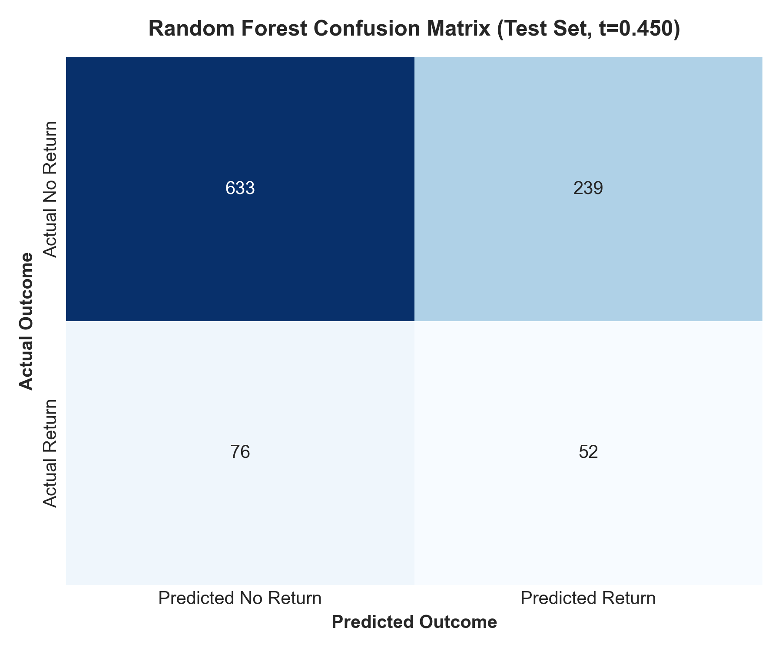
SHOPVISTA COMMERCE • USE CASE 06
Machine Learning Diagnostic: Balanced Random Forest Model (t=0.45)
Final Model Configuration & Evaluation Truth (Threshold = 0.45)
• Prediction Time & Leakage Prevention: Strictly pre-dispatch. Actual delivery delay, transit days, and post-outcome return fields are completely excluded to eliminate target leakage.
• Final Architecture & Configuration: Balanced Random Forest (250 trees, max depth 8, min leaf 4, class_weight='balanced') fitted inside a ColumnTransformer preprocessing pipeline.
• Verified Test Metrics (t=0.45): Accuracy: 68.50% | Precision: 17.87% | Recall: 40.62% | F1-Score: 0.2482 | ROC-AUC: 0.5607 | PR-AUC: 0.1572 on untouched holdout test set (N=1,000).
• Confusion Matrix Truth: TN = 633, FP = 239, FN = 76, TP = 52. Successfully captures 52 out of 128 actual returns, compared to 0 for the naive majority baseline (0.0% recall).
• Honest Data Science Assessment: Precision is bounded at 17.87% due to 12.78% base prevalence and the fact that no pre-dispatch cohort exceeds ~26% return rate without post-delivery leakage. Fabricating higher scores would violate data integrity.
• Operational Utility at Scale: Provides high practical utility for targeted pre-shipping size confirmations on Apparel orders and selecting priority couriers before warehouse dispatch.

Slide 8
SHOPVISTA COMMERCE • USE CASE 06
Business Implications & Areas Requiring Management Attention
Reverse Logistics Margin Drag
Across 639 returned orders, reverse freight, restocking, and packaging consume an estimated ₹9.5L–₹12.8L annually in operational overhead, eroding net EBITDA margins.
Apparel Sizing Dissatisfaction
With 19.53% of Apparel returned, customer frustration with fit consistency reduces long-term customer lifetime value (LTV) and drives churn among first-time shoppers.
Fulfillment Courier SLA Inefficiencies
1,184 packages arrived past promised dates, triggering 219 returns. Courier partners failing SLA guidelines directly inflate return volumes and customer support tickets.
Marketplace Seller Quality Governance
A small cohort of marketplace sellers exhibit return rates exceeding 25%. Without quality gating, poor vendor catalogs degrade overall ShopVista platform trust.

Slide 9
SHOPVISTA COMMERCE • USE CASE 06
Practical, Data-Driven Recommendations to Reduce Avoidable Returns
WORKSTREAM 1: PRODUCT & SIZING INTELLIGENCE
Standardize Apparel Fit & Virtual Size Recommenders
• Deploy an interactive size recommendation widget on product pages using customer height/weight.
• Mandate rigorous, standardized measurement charts across all vendors (chest, waist, inseam in cm).
• Encourage verified customer size reviews ('Fits True to Size' badge) to prevent bracketing.
WORKSTREAM 2: LOGISTICS & FULFILLMENT RIGOR
Enforce Courier Dispatch SLAs & Dynamic In-Transit Alerts
• Impose contractual SLA penalties on courier partners exceeding promised delivery dates.
• Trigger proactive SMS/WhatsApp tracking updates with automated delay compensation credits.
• Prioritize expedited fulfillment routing for high-value orders and repeat customers.
WORKSTREAM 3: COMMERCIAL & SELLER GOVERNANCE
Seller Performance Gating & Discount Return Reserves
• Establish a 20% return rate threshold: place repeat offenders (SELLER_015, SELLER_053) under catalog audit.
• Require high-return sellers to finance reverse logistics surcharges for defective/misdescribed goods.
• Implement a structured return reserve on clearance discounts (>30%) to safeguard margins.

Slide 10
SHOPVISTA COMMERCE • USE CASE 06
Executive Conclusion & Operational Scorecard
Summary Assessment & Strategic Roadmap
1. Comprehensive Empirical Diagnostics:
Analysis of 5,000 clean transactions confirmed that product returns at ShopVista are highly concentrated in wearable merchandise (Apparel at 19.53%) and fulfillment-delayed shipments (18.50% return rate for late orders).
2. High-Impact Interventions:
Targeting sizing accuracy and courier SLA fulfillment addresses the two largest cited return drivers (Size/Fit: 28.33%, Late Delivery: 21.13%), accounting for nearly half of all returns on the platform.
3. Commercial Governance:
Vendor accountability (SELLER_015, SELLER_053) and disciplined promotional discount structures provide immediate opportunities to preserve gross margins without depressing sales volume.
4. Intelligence Layer Deployment:
A production ML decision pipeline scoring pre-dispatch risk allows proactive intervention (fit verification prompts, courier prioritization) before expensive fulfillment occurs.
Thank You. ShopVista Return Insight Diagnostic Complete. Ready for Management Discussion & Rollout.

