Slide 1
Aviation Industry Data Analysis and Business Recommendations
Risk Analysis Presentation

Slide 2
Overview and Business Understanding
This analysis was conducted to evaluate accident risks across various aircraft makes and models with the aim of guiding strategic procurement and investment decisions in the aviation sector. Understanding which manufacturers and models demonstrate higher safety performance is essential for minimizing operational risks, insurance liabilities, and reputational exposure.
The target audience for this report includes aviation procurement committees, regulatory authorities, and safety oversight bodies. The analysis supports decisions related to fleet acquisition and renewal, focusing on identifying aircraft types with lower accident frequencies and fatality rates. Key performance indicators include total accident counts, severity distribution, and average fatality per incident.

Slide 3
Data and Methods
The dataset, 'Aviation_Data.csv', encompasses reported aviation incidents and accidents across different aircraft makes and models. Key fields include event date, location, severity classification, aircraft make, model, and injury details. Data integrity was verified through type conversion and categorical standardization. The dataset supports both descriptive and inferential insights into aircraft safety trends.
A descriptive risk analysis was performed focusing on incident frequency, severity patterns, and fatality rates by make and model. The data was grouped and summarized using Python (pandas, matplotlib, seaborn). Visualization techniques such as bar and count plots were applied to communicate the relative risk levels effectively. The analysis does not infer causality but provides a reliable quantitative foundation for strategic risk assessment.

Slide 4
Results and Insights
The analysis revealed significant disparities in accident frequencies and severities across aircraft makes and models. Certain makes exhibit disproportionately higher incident counts, while specific models show elevated fatal injury averages. These variations highlight the importance of safety record evaluation prior to procurement. The visuals in this presentation illustrate the findings.

Slide 5
Recommendations
Prioritize acquisition of aircraft models with low recorded fatal injury averages and fewer historical incidents.
Avoid makes or models with repeated severe or fatal accident records unless mitigated by verifiable safety improvements.
Integrate accident history and severity metrics into procurement evaluation criteria alongside cost and performance factors.

Slide 6
Next Steps
Extend analysis by incorporating fleet exposure (number of aircraft in service) to normalize risk levels per flight hour.
Cross-reference with maintenance, age, and utilization data to identify underlying causes of risk concentration.
Collaborate with aviation safety boards to update procurement standards with data-driven safety indicators.

Slide 7
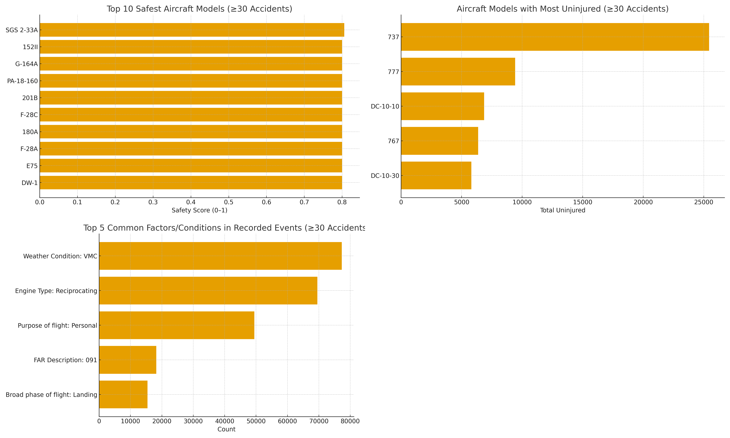
Aircraft Safety Insights (≥30 Accidents) – Combined Overview

Slide 8
THANK YOU

Slide 9
QUESTIONS
PRESENTED BY: JOHN AWALLAH
LINKEDIN PROFILE: https://www.linkedin.com/in/john-o-b8b14b119?

