Slide 1
BOX OFFICE ANALYSIS FOR STRATEGIC MOVIE PRODUCTION
Using historical movie performance to guide profitable production decisions
Presented by:
Monicah Wairimu
Jeffrey Gathigi
Jared Mongeri
John Awallah

Slide 2
OVERVIEW
Purpose of This Analysis:
Support data-driven production decisions
Identify drivers of box office success
Reduce financial risk
What We Delivered:
Analysis of historical movie data
Actionable business recommendations

Slide 3
PROJECT OBJECTIVES
Goal 1:
Identify movie genres that generate the highest
worldwide revenue to guide prioritization.
Goal 2:
Analyze the correlation between IMDb ratings and
box office revenue to understand how audience
approval impacts financial success.
Goal 3:
Determine the optimal movie runtime range for
commercial performance.

Slide 4
BUSINESS PROBLEM
The Challenge:
Movie production is capital-intensive and high-risk
Poor genre, quality, or runtime choices lead to losses
Key Questions:
Which genres generate the highest revenue?
Do ratings influence revenue?
What runtime performs best?

Slide 5
BUSINESS UNDERSTANDING
A new movie studio wants to make data-driven decisions to maximize box office success. We analyzed historical movie data to uncover patterns in:
Genre popularity and revenue potential
The impact of audience ratings on financial performance
Ideal movie runtimes for commercial appeal

Slide 6
DATA UNDERSTANDING
Data Sources:
IMDB SQLite database (im.db)
Box Office Mojo dataset (bom.movie_gross.csv.gz)
Cleaning & Merging:
Filtered IMDB data to include only movie-like entries
Cleaned and standardized titles for merging
Combined datasets with a 29.41% match rate
Created worldwide_gross from domestic and foreign revenue

Slide 7
DATA ANALYSIS I: GENRE PERFORMANCE
Findings:
Specific genres dominate the top-performing films globally and
deliver significantly higher financial returns than others.
Adventure, Animation, and Sci-Fi earn the highest revenue
These genres dominate global box office results
Recommendation:
The studio should focus on these high-earning genres to increase the likelihood of competing effectively with major established studios.

Slide 8
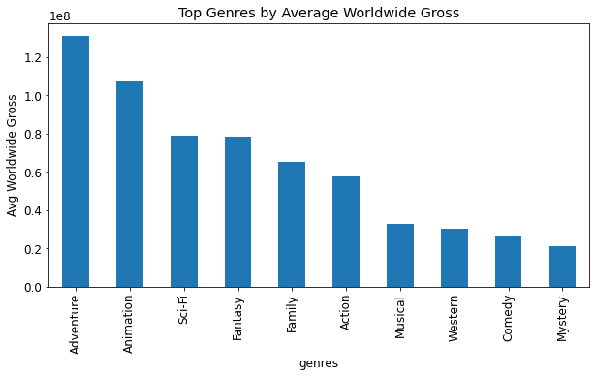

Slide 9
DATA ANALYSIS II: RATINGS VS REVENUE
Findings:
Movies with IMDb ratings in the 6.5–8.0 range produce the strongest and most consistent box-office returns.
Very low ratings underperform
High ratings alone do not guarantee success
Recommendation:
Focus on quality storytelling and strong direction to achieve ratings above 7.5, which drive higher box office returns.

Slide 10
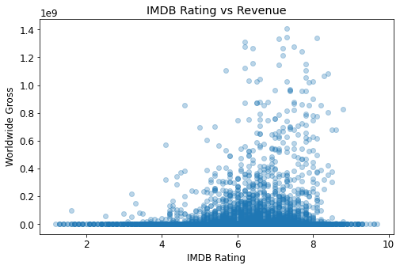

Slide 11
DATA ANALYSIS III: Runtime vs Revenue
Findings:
Films between 120–140 minutes earn higher revenue
Very short films underperform
Longer films can succeed if well executed
Recommendation:
Audiences prefer feature-length films

Slide 12
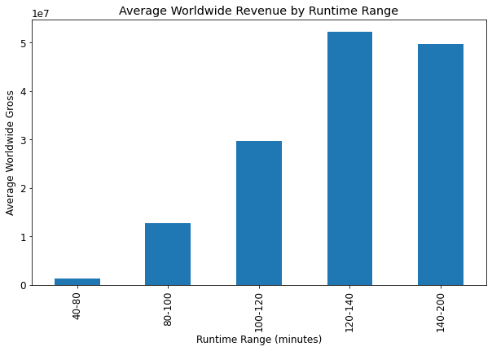

Slide 13
BUSINESS RECOMMENDATIONS
1. Prioritize Genre:
Focus development on top-tier global genres identified in the analysis.
2. Target Quality:
Aim for a "sweet spot" of audience approval (IMDb 6.5–8.0) through excellence in casting and production.
3. Optimize Length:
Target a runtime between 2 and 2.3 hours to align with the highest-earning historical data.

Slide 14
NEXT STEPS
Analyze production budgets vs returns and release timing analysis
Assess marketing spend impact
Explore regional revenue trends to determine the most profitable.
Test combined genre, budget, and runtime strategies

Slide 15
THANK YOU
Thank you for your time.

Slide 16
Q&A
We welcome your questions.
Contacts:
Monicah Wairimu : https://www.linkedin.com/in/monicah-wairimu-44667837a?utm_source=share&utm_campaign=share_via&utm_content=profile&utm_medium=android_app
Jeffrey Gathigi : https://www.linkedin.com/in/jeffrey-gathigi-38a373363?utm_source=share&utm_campaign=share_via&utm_content=profile&utm_medium=android_app
Jared Mongeri : www.linkedin.com/in/jared-ateka-a9064426
John Awallah : https://www.linkedin.com/in/john-o-b8b14b119?

