Slide 1

Design Space Exploration of FPGA - based CNN
Presentation By : Under The Guidance Of :
Vibha Pant Dr. Madhura Purnaprajna
BL.EN.P2EBS15022
M.Tech : Embedded Systems
Amrita School Of Engineering

Slide 2
Contents
Introduction
Motivation
Problem Statement
Convolution Neural Networks
Literature Survey
Proposed Design
Initial Analysis Results
Target Conference
References

Slide 3
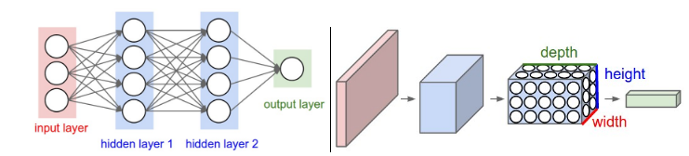
Introduction
Artificial Neural Networks Convolution Neural Network
Ref[1]
CNN Layers:
Convolution : Computationally Intensive
Pooling
Fully Connected : Memory Intensive
Notes:
Artificial Neural Networks
Composed of multiple nodes imitate the biological neuron
Nodes take in inputs , perform simple functions on the data and return activation value, nodes connected by weight
Fc each neuron connected to all neurons of the the previous layer so we have a lot of weights

Slide 4
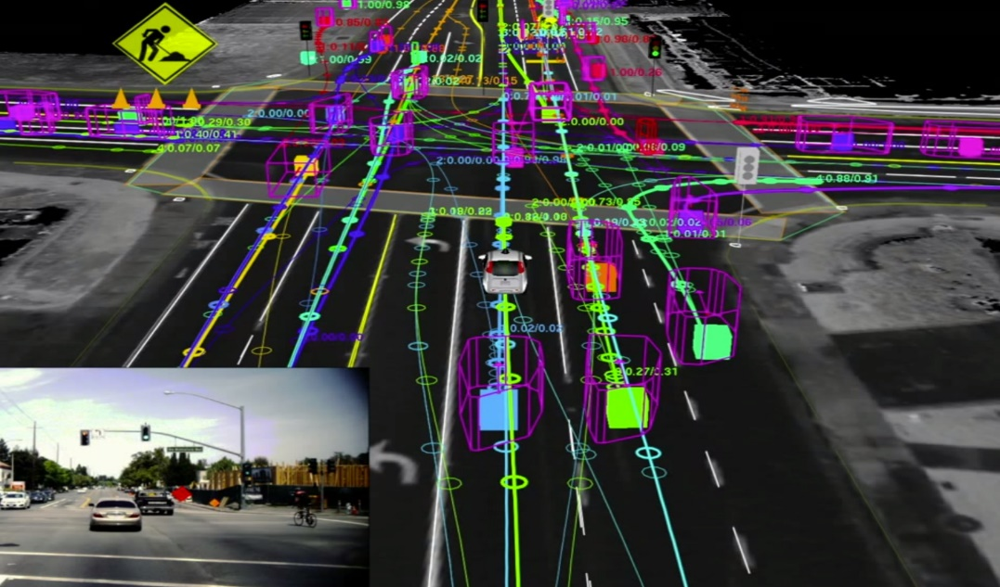
Motivation
Advanced Driver Assistance Systems(e.g. TI SoC - TDA3x[2])
Affordable, high performance and low power
Self Driving Cars(Nvidia Drive PX [3])
Map raw pixels to steering commands
[ref Google]
Notes:
Combining deep learning, sensor fusion and surround vision

Slide 5
Problem Statement
Design Space Exploration of FPGA - based CNN achieving high throughput (30-40 TOPs) and high accuracy.
Notes:
fpga as cortex of brain general purpose, highly parallel
reconfig,prototyping for using fpga
Conv higher parallel degree and more reources
In FC reduce the mem bandwidth
Performance analysis
Cnn accelerator: reduce memory space vs explore parallelism
We cant store all the weights on chip as well
Data reuse/ data precision reduction
Parallelism: inter op, intra op, parallelism within cnv
Optimizaton of mem badwicth and computuin

Slide 6
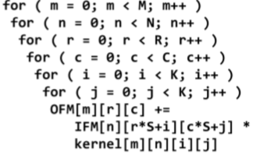


Convolution Layer: Algorithm
IFM 8 Bit array of N*R*C Dimension*
OFM 8 Bit Array of M*R*C Dimension
Kernel 2 Bit Array of M*N*K*K Dimension
N
C
C
N
M
R
M
R
Ref[4]: Pseudo code Convolution Layer
Input Feature Map(IFM)
Output Feature Map(OFM)
K
Kernel(Weights)
K
*Assuming S=1, Padding of (K-1)/2 to ensure output dimensions are same as the input dimensions

Slide 7
Problem Size
Problem size: Architecture based on Lenet-5 : 32 @ 5×5 CONV
N=1
M=32
K=5
R=C=28
Network | #Adders | #Multiplier | Memory Utilization
Full Precision | NMK²RC+1 = 627201 | NMK²RC =627200 | 106.688 KBytes

Slide 8
Computational Optimization
Network Binarization:
Deterministic Binarization using sign function or clipping
Weights /and activation functions
Eg. Binary Connect[7]
Network Ternarization:
Ternarization of weights using optimal thresholds
32 bit weights to be replaced by 2-bit ternary weights(-1,0,1)
Multiply-Accumulate as Multiplexer, two’s complement and adders(eliminate multiplication in inference)
Network | #Adders | #Multiplier | #Mux | #Invertor | Memory Utilization
Ternary | 1254401 (8 Bit adders) | 0 | 627200 | 627200 | 26.072KBytes

Slide 9
Literature Review
CNN | Weight | Activation | Scheme | Accuracy(MNIST)
Binary Connect[7] | -1,1 | Full Precision | Deterministic Binarization | 98.82%
Ternary WN[1] | -1,0,1 | Full Precision | Optimization with threshold-based Ternarization function | 99.35%
Planned Ternary Weight Network | -1,0,1 | 8 bit | Optimization with threshold-based Ternarization function | To be Analyzed

Slide 10
Existing Work: CNN on FPGA
 | Technique | Performance |  | Platform
FINN, Feb 2017[3] | Weights and Activation function are binarized |  | MNIST | Zynq , Xilinx.
 |  | Accuracy | 95.8%
 |  | Latency | 12.3M/ 0.31 us
 |  | Power | 11.3W
 |  | GOPS | 11600
Ternary Neural Networks for Resource-Efficient AI Applications[2] | Weights and Inputs are ternarized | Accuracy | 96.58 | Kintex 7, Xilinx
 |  | Latency | 195K images/s20.5us
 |  | Power | 3.8W
 |  | GOPS
Notes:
FINN binary ip and wts , sigmoid
Ternary uses student teacher approach, thershold

Slide 11
AlexNet: Memory /MAC requirements
 | N | M | Rout | Cout | K | Rin | Cin | Bias | Stride | #MACs | Memory Req(Kbits)
Conv1 | 3 | 96 | 55 | 55 | 11 | 227 | 227 | 96 | 4 | 2.11E+08 | 5959.945313
Conv2 | 48 | 256 | 27 | 27 | 5 | 27 | 27 | 256 | 1 | 4.48E+08 | 2878.125
Conv3 | 256 | 384 | 13 | 13 | 3 | 13 | 13 | 384 | 1 | 2.99E+08 | 3249
Conv4 | 192 | 384 | 13 | 13 | 3 | 13 | 13 | 384 | 1 | 2.24E+08 | 2563.5
Conv5 | 192 | 256 | 13 | 13 | 3 | 13 | 13 | 383 | 1 | 1.5E+08 | 1962.5
FC6 | 9216 | 4096 | 1 | 1 | - | 1 | 1 | 4096 | - | 37752832 | 73976
FC7 | 4096 | 4096 | 1 | 1 | - | 1 | 1 | 4096 | - | 16781312 | 32896
FC8 | 4096 | 1000 | 1 | 1 | - | 1 | 1 | 1000 | - | 4097000 | 8103.8125

Slide 12
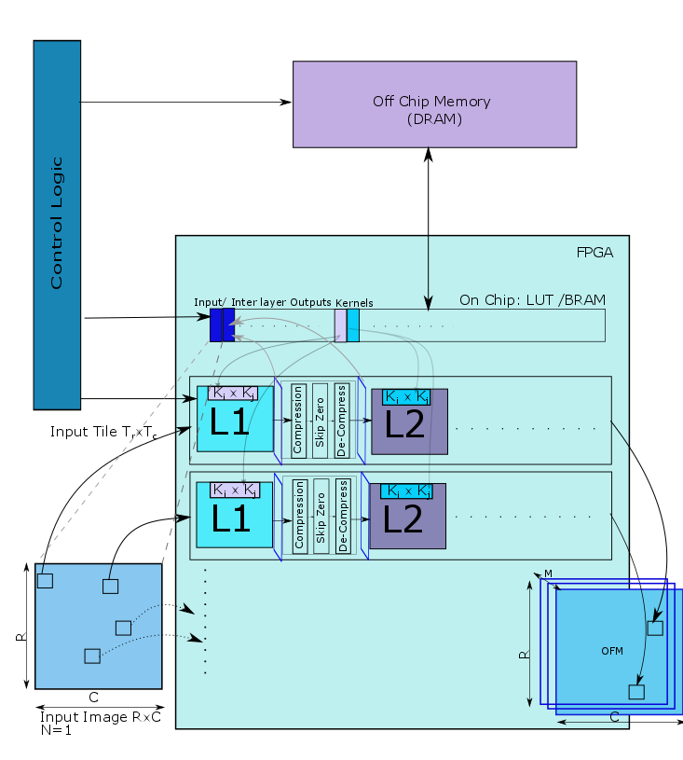
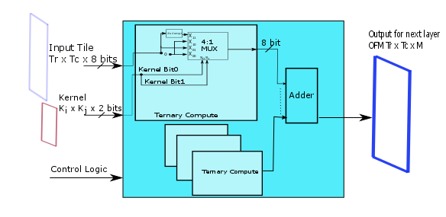
Proposed Block Diagram

Slide 13
Initial Implementation Results K Variation
Parameter Assumption
N,M=1
RxC=28x28
Input 8 bit
Kernel 2 bit

Slide 14
Target Conference
7th IEEE International Conference on consumer electronics(ICCE,Berlin) :April End
(http://www.icce-berlin.org/)

Slide 15
References
Li, Fengfu, Bo Zhang, and Bin Liu. "Ternary weight networks." arXiv preprint arXiv:1605.04711 (2016).
H. Alemdar, N. Caldwell, V. Leroy, A. Prost-Boucle, and F. P´etrot. Ternary Neural Networks for Resource-Eﬃcient AI Applications. CoRR, abs/1609.00222, 2016
Yaman Umuroglu, Nicholas J. Fraser, Giulio Gambardella, Michaela Blott, Philip Leong, Magnus Jahre, Kees Vissers ,FINN: A Framework for Fast, Scalable Binarized Neural Network Inference, CoRR, 2017
Gysel, Philipp. "Ristretto: Hardware-oriented approximation of convolutional neural networks." arXiv preprint arXiv:1605.06402 (2016).
Rahman, Atul, Jongeun Lee, and Kiyoung Choi. "Efficient FPGA acceleration of Convolutional Neural Networks using logical-3D compute array." Design, Automation & Test in Europe Conference & Exhibition (DATE), 2016. IEEE, 2016.

Slide 16
References
Courbariaux, Matthieu, Bengio, Yoshua, and David, Jean-Pierre. Training deep neural networks with low precision multiplications. ArXiv e-prints, abs/1412.7024, December 2014.
Courbariaux, Matthieu, Bengio, Yoshua, and David, Jean-Pierre. Binaryconnect: Training deep neural networks with binary weights during propagations. ArXiv e-prints, abs/1511.00363, November 2015.
Courbariaux, M., Bengio, Y.: Binarynet: Training deep neural networks with weights and activations constrained to +1 or -1. CoRR (2016)
Gupta, S., Agrawal, A., Gopalakrishnan, K., and Narayanan, P. Deep Learning with Limited Numerical Precision. In Proceedings of the 32nd International Conference on Machine Learning (ICML-15), pp. 1737–1746, 2015.
Gysel, P., Motamedi, M., and Ghiasi, S. Hardwareoriented approximation of convolutional neural networks. arXiv:1604.03168, 2016.
Rastegari, V. Ordonez, J. Redmon, and A. Farhadi, “XNORNet: ImageNet classification using binary convolutional neural networks,” CoRR, vol. abs/1603.05279, 2016.

Slide 17
Reference
cs231n.github.io/convolutional-networks/
Prashanth Viswanath ,Mihir Mody, Mathew Manu et all,” A Diverse Low Cost High Performance Platform for Advanced Driver Assistance System (ADAS) Applications”, Texas Instruments
www.nvidia.come/object/drive-px.html
Ristretto
ImageNet Classiﬁcation with Deep Convolutional Neural Networks, Alex Krizhevsky, Ilya Sutskever, Geoffrey E. Hinton
DNPU: An 8.1TOPS/W Reconfigurable CNN-RNN Processor for General-Purpose Deep Neural Networks, Dongjoo Shin, Jinmook Lee, Jinsu Lee, Hoi-Jun Yoo, ISSCC 2017 / SESSION 14 / DEEP-LEARNING PROCESSORS / 14.2
Li, Huimin, et al. "A high performance FPGA-based accelerator for large-scale convolutional neural networks." Field Programmable Logic and Applications (FPL), 2016 26th International Conference on. IEEE, 2016.

Slide 18
Thank You!

