Slide 1

Design Space Exploration of FPGA - based CNN
Presentation By : Under The Guidance Of :
Vibha Pant Dr. Madhura Purnaprajna
BL.EN.P2EBS15022
M.Tech : Embedded Systems
Amrita School Of Engineering

Slide 2
Contents
Motivation
Introduction
Abstract
Convolution Neural Networks
Literature Survey
TileNet: Proposed Architecture
Estimation Model
Estimation Results
Conclusion
References

Slide 3
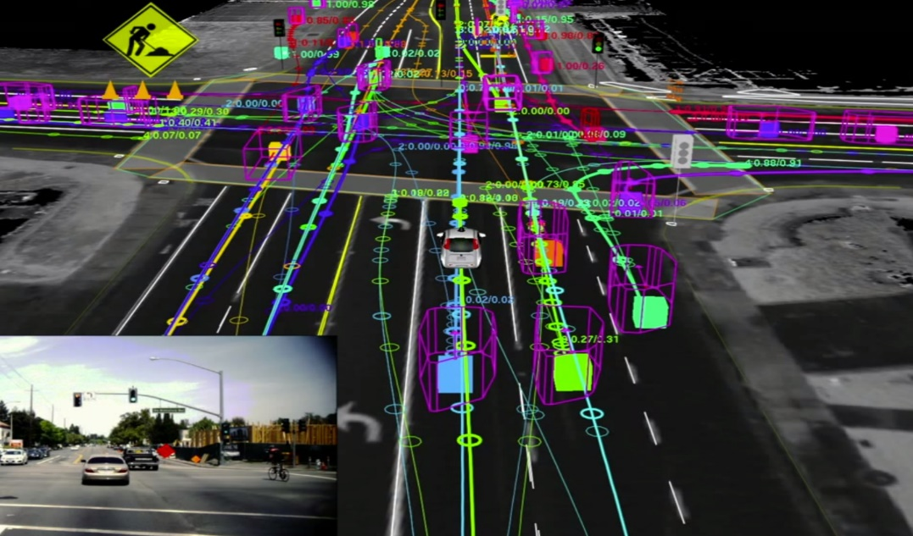
Motivation
Advanced Driver Assistance Systems(e.g. TI SoC - TDA3x[13])
Affordable, high performance and low power
Self Driving Cars(Nvidia Drive PX [14])
Map raw pixels to steering commands
[ref Google]
Notes:
Combining deep learning, sensor fusion and surround vision

Slide 4
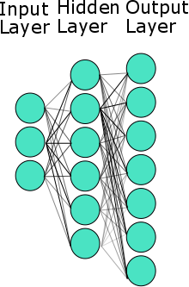
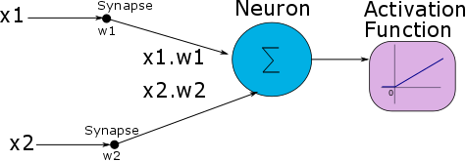
Introduction
Artificial Neural Networks
Notes:
Artificial Neural Networks
Composed of multiple nodes imitate the biological neuron
Nodes take in inputs , perform simple functions on the data and return activation value, nodes connected by weight
Fc each neuron connected to all neurons of the the previous layer so we have a lot of weights

Slide 5
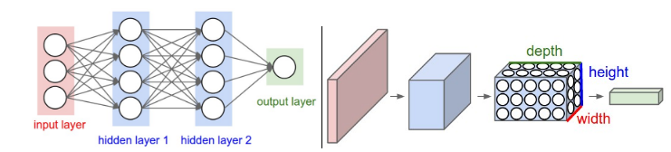
Convolutional Neural Networks
ANN
CNN
Ref[12]
CNN Layers:
Convolution : Computationally Intensive
Pooling
ReLu:f(x) = max(0,x)
Fully Connected : Memory Intensive

Slide 6
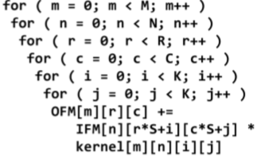


Convolution Layer: Algorithm
IFM 8 Bit array of N*R*Col Dimension*
OFM 8 Bit Array of M*R*Col Dimension
Kernel 2 Bit Array of M*N*K*K Dimension
N
Col
Col
N
M
R
M
R
Ref[4]: Pseudo code Convolution Layer
Input Feature Map(IFM)
Output Feature Map(OFM)
K
Kernel(Weights)
K
*Assuming S=1, Padding of (K-1)/2 to ensure output dimensions are same as the input dimensions

Slide 7
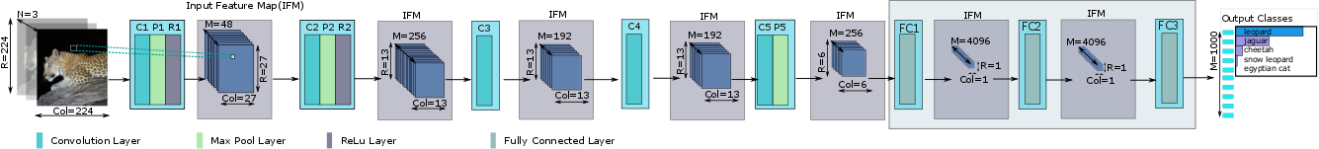
Deep CNN: AlexNet

Slide 8
AlexNet
Layer | Input Depth(N) | RinxCin | Output Depth(M) | RoutxCout | Weight Vector
Conv1 | 3 | 227x227 | 96 | 55x55 | 11x11
Pool1 | 96 | 55x55 | 96 | 27x27 | 3x3
Conv2 | 48 | 27x27 | 256 | 27x27 | 5x5
Pool2 | 256 | 27x27 | 256 | 13x13 | 3x3
Conv3 | 256 | 13x13 | 384 | 13x13 | 3x3
Conv4 | 192 | 13x13 | 384 | 13x13 | 3x3
Conv5 | 192 | 13x13 | 256 | 13x13 | 3x3
Pool 5 | 256 | 13x13 | 256 | 6x6 | 3x3
FC6 | 9216 | 1x1 | 4096 | 1x1 | -
FC7 | 4096 | 1x1 | 4096 | 1x1 | -
FC8 | 4096 | 1x1 | 1000 | 1x1 | -

Slide 9
EXISTING WORK

Slide 10
Computational Optimization
Network Binarization:
Deterministic Binarization using sign function or clipping
Weights /and activation functions
Eg. Binary Connect[7]
Network Ternarization:
Ternarization of weights using optimal thresholds
32 bit weights to be replaced by 2-bit ternary weights(-1,0,1)
Multiply-Accumulate as Multiplexer, two’s complement and adders(eliminate multiplication in inference) [1]
Compressing pre-trained deep networks:
Pruning redundant, non-informative weights in a previously trained network reduces the size of the network at inference time [4]

Slide 11
Binary Vs Ternary NN
CNN | Weight | Activation | Scheme | Accuracy(MNIST)
Binary Connect[7] | -1,1 | Full Precision | Deterministic Binarization | 98.82%
Ternary WN[1] | -1,0,1 | Full Precision | Optimization with threshold-based Ternarization function | 99.35%
Planned Ternary Weight Network | -1,0,1 | 8 bit | Optimization with threshold-based Ternarization function | To be Analyzed

Slide 12
Existing Work: CNN on FPGA
 | Technique | Performance |  | Platform
FINN, Feb 2017[3] | Weights and Activation function are binarized |  | MNIST | Zynq , Xilinx.
 |  | Accuracy | 95.8%
 |  | Latency | 12.3M/ 0.31 us
 |  | Power | 11.3W
 |  | GOPS | 11600
Ternary Neural Networks for Resource-Efficient AI Applications[2] | Weights and Inputs are ternarized | Accuracy | 96.58 | Kintex 7, Xilinx
 |  | Latency | 195K images/s20.5us
 |  | Power | 3.8W
 |  | GOPS | Not Reported
Notes:
FINN binary ip and wts , sigmoid
Ternary uses student teacher approach, thershold

Slide 13
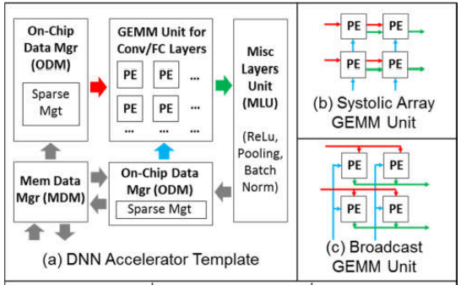
Existing Work: Ternary CNN on FPGA
Nurvitadhi et al Ref[19]
Ternary Scheme for weights
32 bit floating point Adders
Approx. 60% better than Titan X
Best case performance is still limited to 16 TOPS

Slide 14
Abstract
TileNet: a novel tiled architecture for CNNs with ternarized weights achieving high throughput (30-40 TOPs) and high accuracy.
Notes:
fpga as cortex of brain general purpose, highly parallel
reconfig,prototyping for using fpga
Conv higher parallel degree and more reources
In FC reduce the mem bandwidth
Performance analysis
Cnn accelerator: reduce memory space vs explore parallelism
We cant store all the weights on chip as well
Data reuse/ data precision reduction
Parallelism: inter op, intra op, parallelism within cnv
Optimizaton of mem badwicth and computuin

Slide 15
Challenges
High throughput(10’s of TOPS)
High Accuracy
Large Data Sets (ImageNet)

Slide 16
Proposed Architecture
TileNet
Generic tiled architecture
Ternary CNNs
Independent of the network architecture
High Throughput 30-40 TOPS
High Accuracy

Slide 17
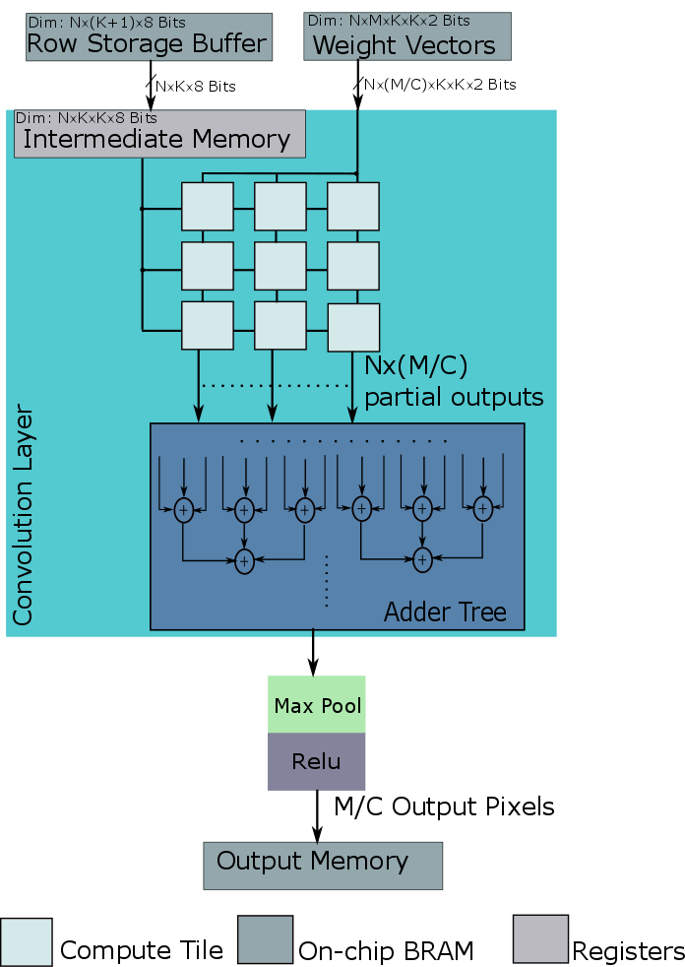
TileNet: Architecture
Compute Tile
Memory
RSB
Weight Memory
Intermediate Memory

Slide 18
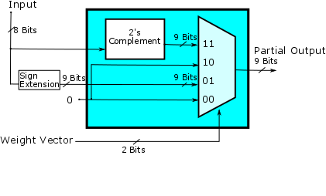
Ternary Multiplier
Weights as +1,0,-1
Multiplier replaced by Mux Logic
Weight Vector | Output
"00" | 0
"01" | Input
"10" | 0
"11" | 2's compl (Input)

Slide 19
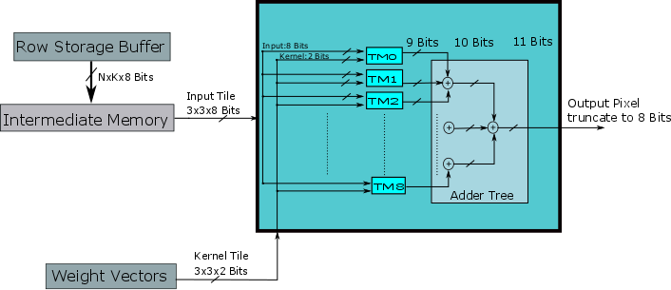
Compute Tile

Slide 20
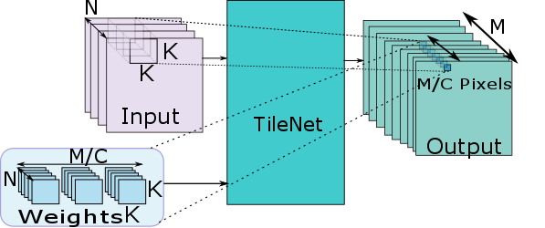
Parallelization of Compute
Parallelization Factor “C”

Slide 21
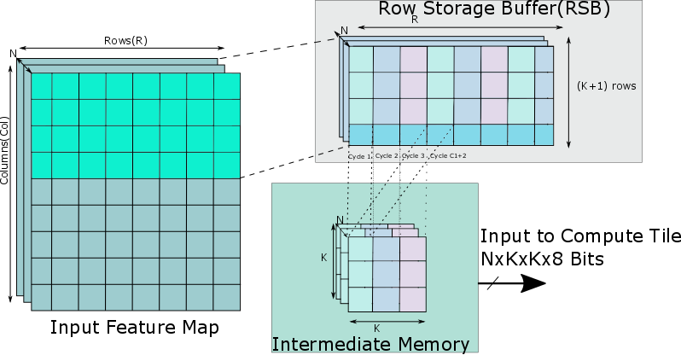
Memory Organization

Slide 22
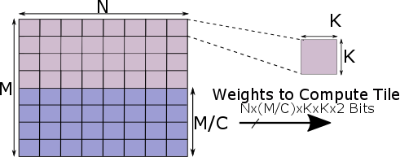
Memory Organization

Slide 23
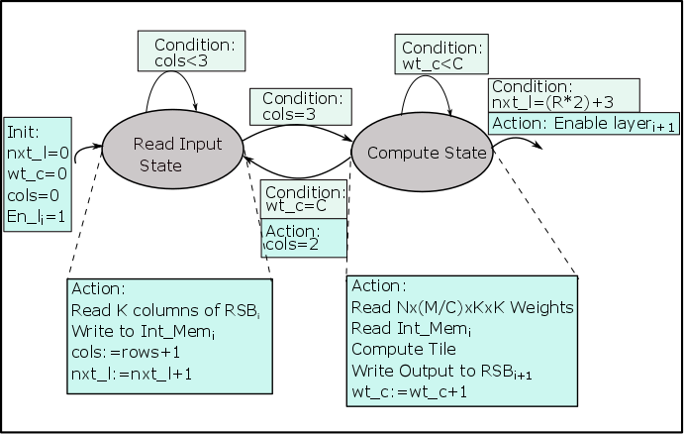
Control FSM for Layer_{i}
Wt_c: count for parallelization factor C
Int_Mem: Intermediate Memory
Cols: Columns written into Int_Mem
Nxt_l: indicate when next layer can begin

Slide 24
Streaming Architecture

Slide 25
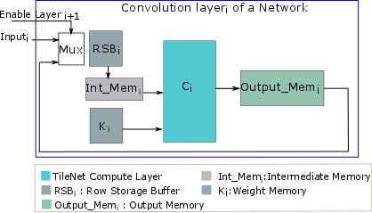
Systolic Architecture

Slide 26
ESTIMATION MODEL

Slide 27
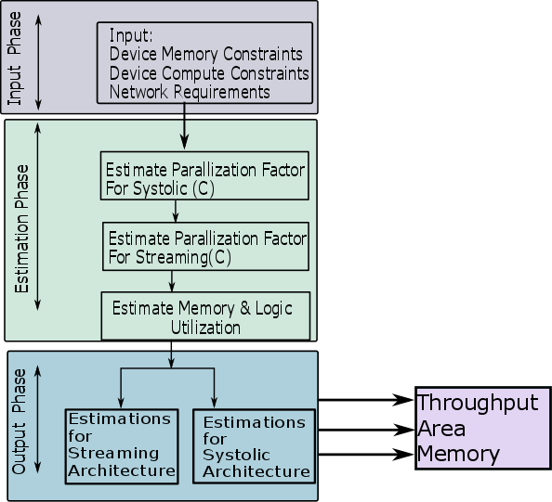
Estimation Model
Based on constraints and architecture
Throughput
Memory Utilization
Area Utilization
Determine Parallelization

Slide 28
ESTIMATION RESULTS

Slide 29
Compute Estimation :AlexNet
Layer | N | M | K | N_T | Rin | Cin | Rout | Cout | C | M/C value | Max Pooling | Ternary Compute | LUTS
Conv1 | 3 | 96 | 11x11 | 16 | 224 | 224 | 55 | 55 | 16 | 6 | 3x3 | 2592 | 50688
Conv2 | 48 | 256 | 5x5 | 4 | 55 | 55 | 27 | 27 | 128 | 2 | 3X3 | 3456 | 67584
Conv3 | 256 | 384 | 3x3 | 1 | 13 | 13 | 13 | 13 | 64 | 6 | NA | 13824 | 270336
Conv4 | 192 | 384 | 3x3 | 1 | 13 | 13 | 13 | 13 | 64 | 6 | NA | 10368 | 202752
Conv5 | 192 | 256 | 3x3 | 1 | 13 | 13 | 13 | 13 | 64 | 4 | 3X3 | 6912 | 135168
Total |  |  |  |  |  |  |  |  |  |  |  | 37152 | 726528
Throughput = Total ternary compute*2*Frequency
Parameters:
N - Depth of Input feature Map
M - Depth of Output feature Map
k - Weight Vector width
N_T - No. of tiles in Weight Vector
Rin,Cin - IFM width and height
Rout,Cout - OFM width and height
C - Parallelization factor
M/C - No. of pixels computed in parallel
Device | xc7vx1140(Virtex 7)
LUTS | 712000
FFS | 1424000
BRAMS | 1880
%LUTS | 102.04
Freq | 500MHz
Throughput | 37.15 TOPS
Time to complete(ms) | 0.101024

Slide 30
Memory Estimation :AlexNet
Layer | N | M | K | Input Memory(BRAMS) | Kernel Memory(BRAMS) | Total | % Utilization
Conv1 | 3 | 96 | 11x11 | 6 | 72 | 78 | 4.14893617
Conv2 | 48 | 256 | 5x5 | 36 | 96 | 132 | 7.021276596
Conv3 | 256 | 384 | 3x3 | 96 | 284 | 380 | 20.21276596
Conv4 | 192 | 384 | 3x3 | 72 | 288 | 360 | 19.14893617
Conv5 | 192 | 256 | 3x3 | 72 | 192 | 264 | 14.04255319
 |  |  |  |  |  | 1214 | 64.57446809

Slide 31
Estimation vs Implemented Results

Slide 32
Compute Estimation : AlexNet Systolic
Layer | N | M | K | N_T | Rin | Cin | Rout | Cout | C | M/C value | Max Pooling | Ternary Compute | LUTS
Conv1 | 3 | 96 | 11x11 | 16 | 224 | 224 | 55 | 55 | 2 | 48 | 3x3 | 20736 | 405504
Conv2 | 48 | 256 | 5x5 | 4 | 55 | 55 | 27 | 27 | 16 | 16 | 3X3 | 27648 | 540672
Conv3 | 256 | 384 | 3x3 | 1 | 13 | 13 | 13 | 13 | 24 | 16 | NA | 36864 | 720896
Conv4 | 192 | 384 | 3x3 | 1 | 13 | 13 | 13 | 13 | 24 | 16 | NA | 27648 | 540672
Conv5 | 192 | 256 | 3x3 | 1 | 13 | 13 | 13 | 13 | 16 | 16 | 3X3 | 27648 | 540672
Total |  |  |  |  |  |  |  |  |  |  |  | 36864 | 720896
Device | xc7vx1140(Vertex 7)
LUTS | 712000
FFS | 1424000
BRAMS | 1880
%LUTS | 101.02
Freq | 500MHz
Throughput | 36.864 TOPS
Time to complete(ms) | 0.315648

Slide 33
AlexNet: Across Devices
Resource | Virtex | Kintex | Atrix | Zync
#Logic slices | 178000 | 74650 | 33650 | 69350
#BRAMS(36 kb) | 1880 | 955 | 365 | 755

Slide 34
Across Networks

Slide 35
Conclusion
High parallelism in FPGAs achieves TOPS required
Generic TileNet Architecture Scaling
Across Network
Devices
Across Systolic and Streaming architecture

Slide 36
References
Li, Fengfu, Bo Zhang, and Bin Liu. "Ternary weight networks." arXiv preprint arXiv:1605.04711 (2016).
H. Alemdar, N. Caldwell, V. Leroy, A. Prost-Boucle, and F. P´etrot. Ternary Neural Networks for Resource-Eﬃcient AI Applications. CoRR, abs/1609.00222, 2016
Yaman Umuroglu, Nicholas J. Fraser, Giulio Gambardella, Michaela Blott, Philip Leong, Magnus Jahre, Kees Vissers ,FINN: A Framework for Fast, Scalable Binarized Neural Network Inference, CoRR, 2017
Gysel, Philipp. "Ristretto: Hardware-oriented approximation of convolutional neural networks." arXiv preprint arXiv:1605.06402 (2016).
Rahman, Atul, Jongeun Lee, and Kiyoung Choi. "Efficient FPGA acceleration of Convolutional Neural Networks using logical-3D compute array." Design, Automation & Test in Europe Conference & Exhibition (DATE), 2016. IEEE, 2016.

Slide 37
References
Courbariaux, Matthieu, Bengio, Yoshua, and David, Jean-Pierre. Training deep neural networks with low precision multiplications. ArXiv e-prints, abs/1412.7024, December 2014.
Courbariaux, Matthieu, Bengio, Yoshua, and David, Jean-Pierre. Binaryconnect: Training deep neural networks with binary weights during propagations. ArXiv e-prints, abs/1511.00363, November 2015.
Courbariaux, M., Bengio, Y.: Binarynet: Training deep neural networks with weights and activations constrained to +1 or -1. CoRR (2016)
Gupta, S., Agrawal, A., Gopalakrishnan, K., and Narayanan, P. Deep Learning with Limited Numerical Precision. In Proceedings of the 32nd International Conference on Machine Learning (ICML-15), pp. 1737–1746, 2015.
Gysel, P., Motamedi, M., and Ghiasi, S. Hardware oriented approximation of convolutional neural networks. arXiv:1604.03168, 2016.
Rastegari, V. Ordonez, J. Redmon, and A. Farhadi, “XNORNet: ImageNet classification using binary convolutional neural networks,” CoRR, vol. abs/1603.05279, 2016.

Slide 38
References
cs231n.github.io/convolutional-networks/
Prashanth Viswanath ,Mihir Mody, Mathew Manu et all,” A Diverse Low Cost High Performance Platform for Advanced Driver Assistance System (ADAS) Applications”, Texas Instruments
www.nvidia.come/object/drive-px.html
ImageNet Classiﬁcation with Deep Convolutional Neural Networks, Alex Krizhevsky, Ilya Sutskever, Geoffrey E. Hinton
DNPU: An 8.1TOPS/W Reconfigurable CNN-RNN Processor for General-Purpose Deep Neural Networks, Dongjoo Shin, Jinmook Lee, Jinsu Lee, Hoi-Jun Yoo, ISSCC 2017 / SESSION 14 / DEEP-LEARNING PROCESSORS / 14.2
Li, Huimin, et al. "A high performance FPGA-based accelerator for large-scale convolutional neural networks." Field Programmable Logic and Applications (FPL), 2016 26th International Conference on. IEEE, 2016.
Nurvitadhiet.al, 2017). Can fpgas beat gpus in accelerating next-generation deep neural networks? In Proceedings of the 2017 ACM/SIGDA International Symposium on Field-Programmable Gate Arrays , FPGA ’17, pages 5–14, New York, NY, USA. ACM
Simonyan, K. and Zisserman, A. (2014). Very deep convolutional networks for large-scale image recognition. CoRR, abs/1409.1556.

Slide 39
Thank You!

