Slide 1
Crypto-CTF

Slide 2
Pragyan 2016
Cryptography 20: BAIL Cipher
Bob and Alice have come up with a new encryption to communicate. But they want you to figure out if its possible to decipher their messages easily.
Can you decipher it?
VGF4ME9GaGxnIHdXMkZqaDVlZiBzeFFtNHY5IGlsdWI=
Hint! BAIL is made of BAse and raIL
https://github.com/ctfs/write-ups-2016/tree/master/pragyan-ctf-2016/cryptography/bail-cipher-20

Slide 3
base64 decode:
Tax0OFhlg wW2Fjh5ef sxQm4v9 ilub

Slide 4
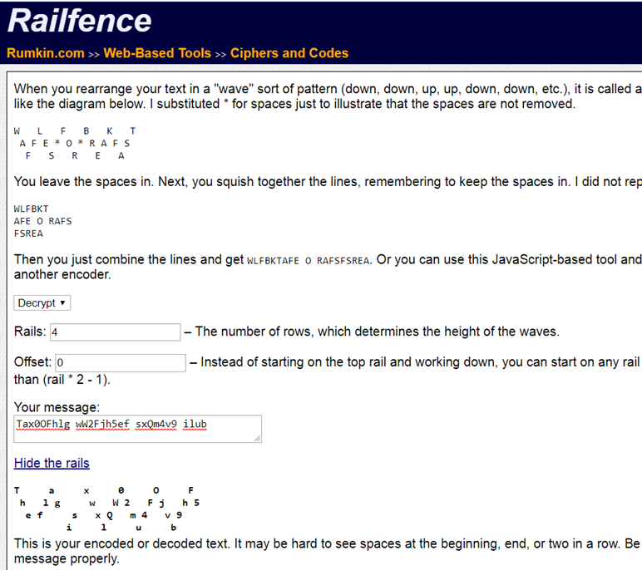
http://rumkin.com/tools/cipher/railfence.php

