Slide 1
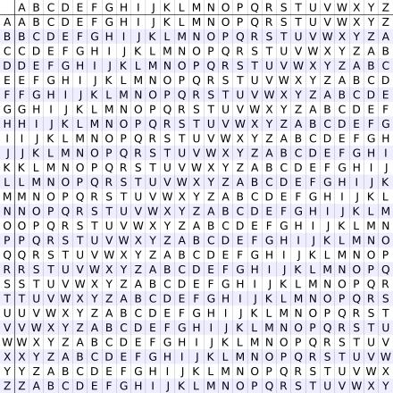
Vigenère cipher
https://en.wikipedia.org/wiki/Vigen%C3%A8re_cipher
Plaintext明文: ATTACKATDAWN
Key密鑰: LEMON
Plaintext: ATTACKATDAWN
Key: LEMONLEMONLE
Ciphertext: LXFOPVEFRNHR

