Slide 1


Sprint review 1
Indigo van Hoof, Mike Schardijn, Jan Vos, Darian Kardjo, Victor Hoegy, Richard van Breugel & Bryan van Riesen
15-05-2025
Notes:
Amin

Slide 2

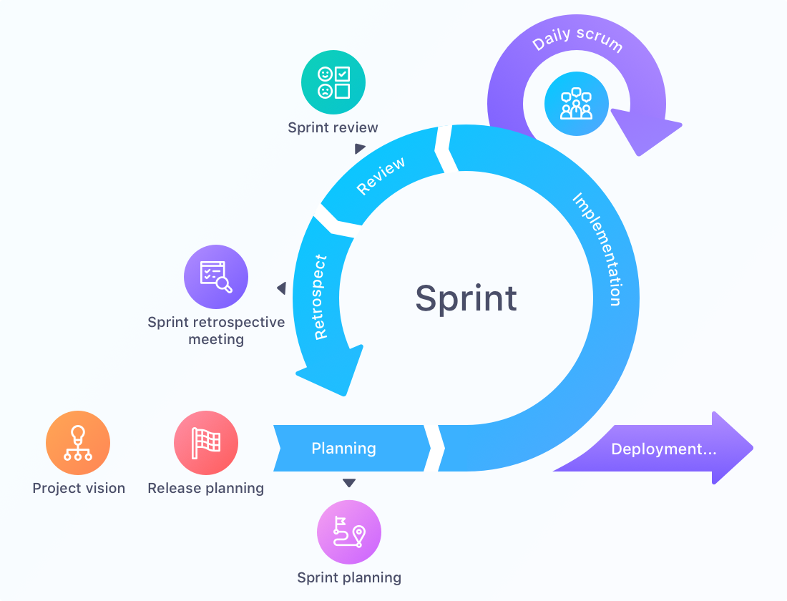
Agenda
Achievements
What user stories did we finish?
Refinements
What user stories should have been altered?
Additions
What new user stories should be added?
Removals
What user stories should be removed?
Priorities
What user stories were the most important?
Notes:
Amin

Slide 3

Achievements
Notes:
Amin

Slide 4
Refinements
Notes:
Amin

Slide 5
Additions
Notes:
Amin

Slide 6
Removals
Notes:
Amin

Slide 7
Priorities
Notes:
Amin

