Slide 1
MACHINE LEARNING • NLP
Sentiment
Analysis
on Movie Reviews
FINAL MODEL • LINEAR SVM
91.86%
91.99%
Test accuracy
F1-score
TF-IDF • Unigram + Bigram • C = 0.5

Slide 2
01 • THE PROBLEM
Can a machine understand a movie review?
The project turns free-form review text into a binary sentiment decision.
RAW TEXT
"The movie started well but became boring and predictable towards the end."
Review
→
TF-IDF
→
SVM → POSITIVE / NEGATIVE
Human interpretation → mixed / negative sentiment
Goal: build a reliable classical NLP pipeline and deploy it as an interactive app.

Slide 3
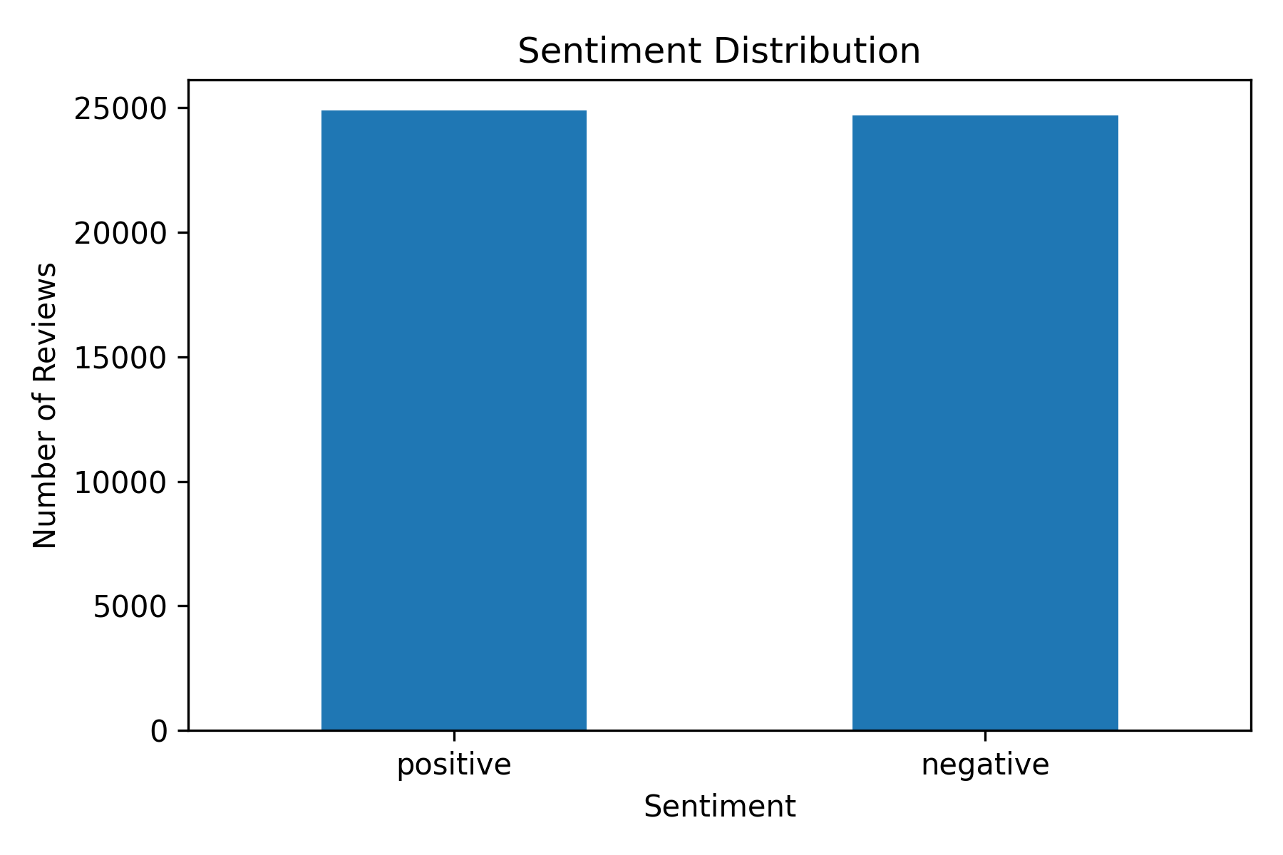
02 • DATA
50,000 reviews → 49,577 clean reviews
50,000
418
49,577
≈ 50 / 50
Initial reviews
Duplicates removed
Final reviews
Class balance
EDA TAKEAWAY
The dataset is nearly balanced between positive and negative reviews, so the classifier is not dominated by one class.

Slide 4
03 • PREPROCESSING
From messy HTML to model-ready text
01
02
03
04
Remove duplicates
Clean HTML
Normalize text
Stratified split
Prevent repeated reviews from biasing training.
Strip tags such as <br /> from reviews.
Prepare consistent text for vectorization.
39,665 train • 9,916 test

Slide 5
04 • TEXT REPRESENTATION
TF-IDF gives the model words + context
UNIGRAM
BIGRAM
"excellent"
"not good"
One-word features capture individual sentiment-bearing terms.
Two-word features capture short phrases and improve contextual signal.
Final representation: 613,727 unigram + bigram TF-IDF features

Slide 6
05 • MODEL BENCHMARK
Three classical classifiers. One clear winner.
Naive Bayes
Naive Bayes
Logistic Regression
SVM
SVM
86.64%
89.59%
90.55%
89.95%
91.86%
Unigram
Uni + Bigram
Uni + Bigram
Unigram
Uni + Bigram
SVM + Unigram/Bigram wins on accuracy and F1.

Slide 7
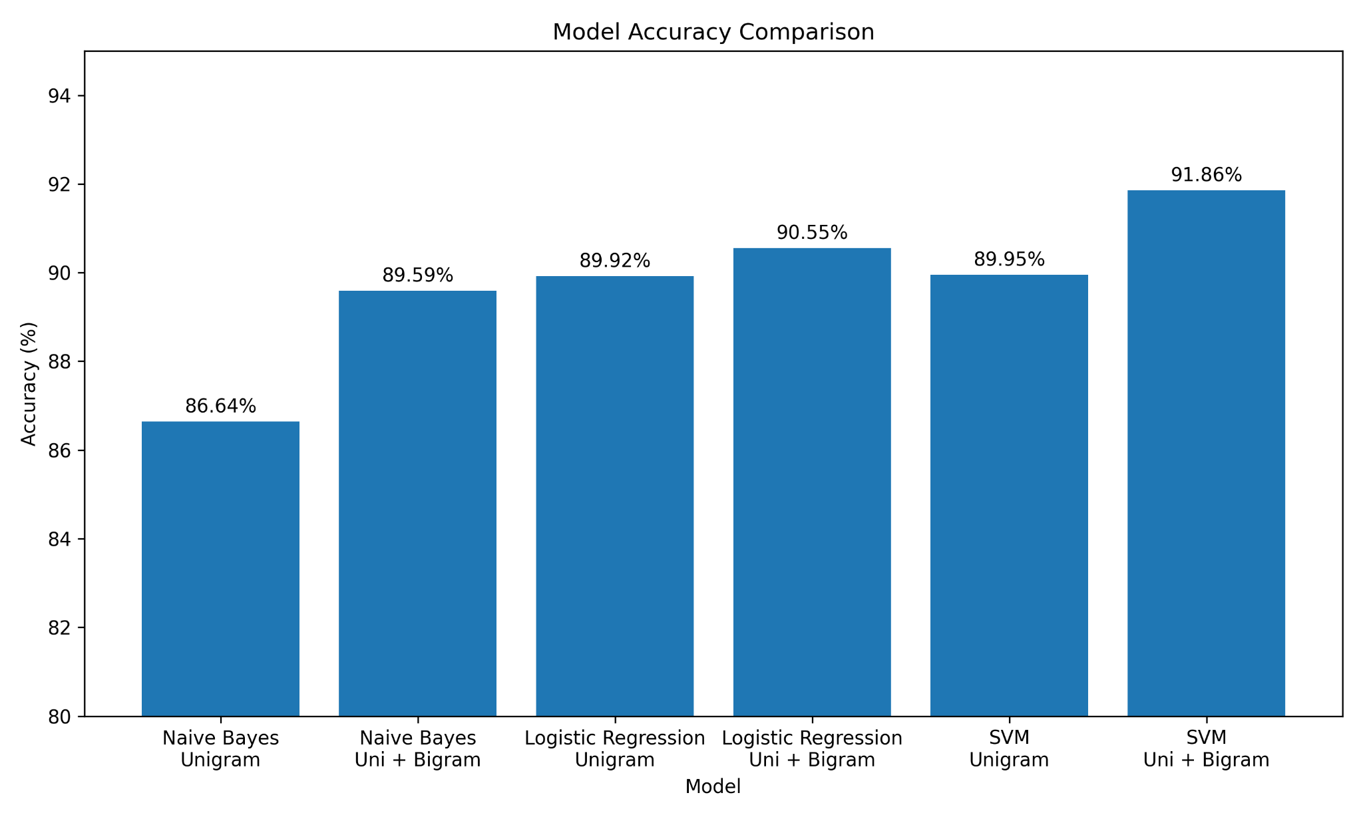
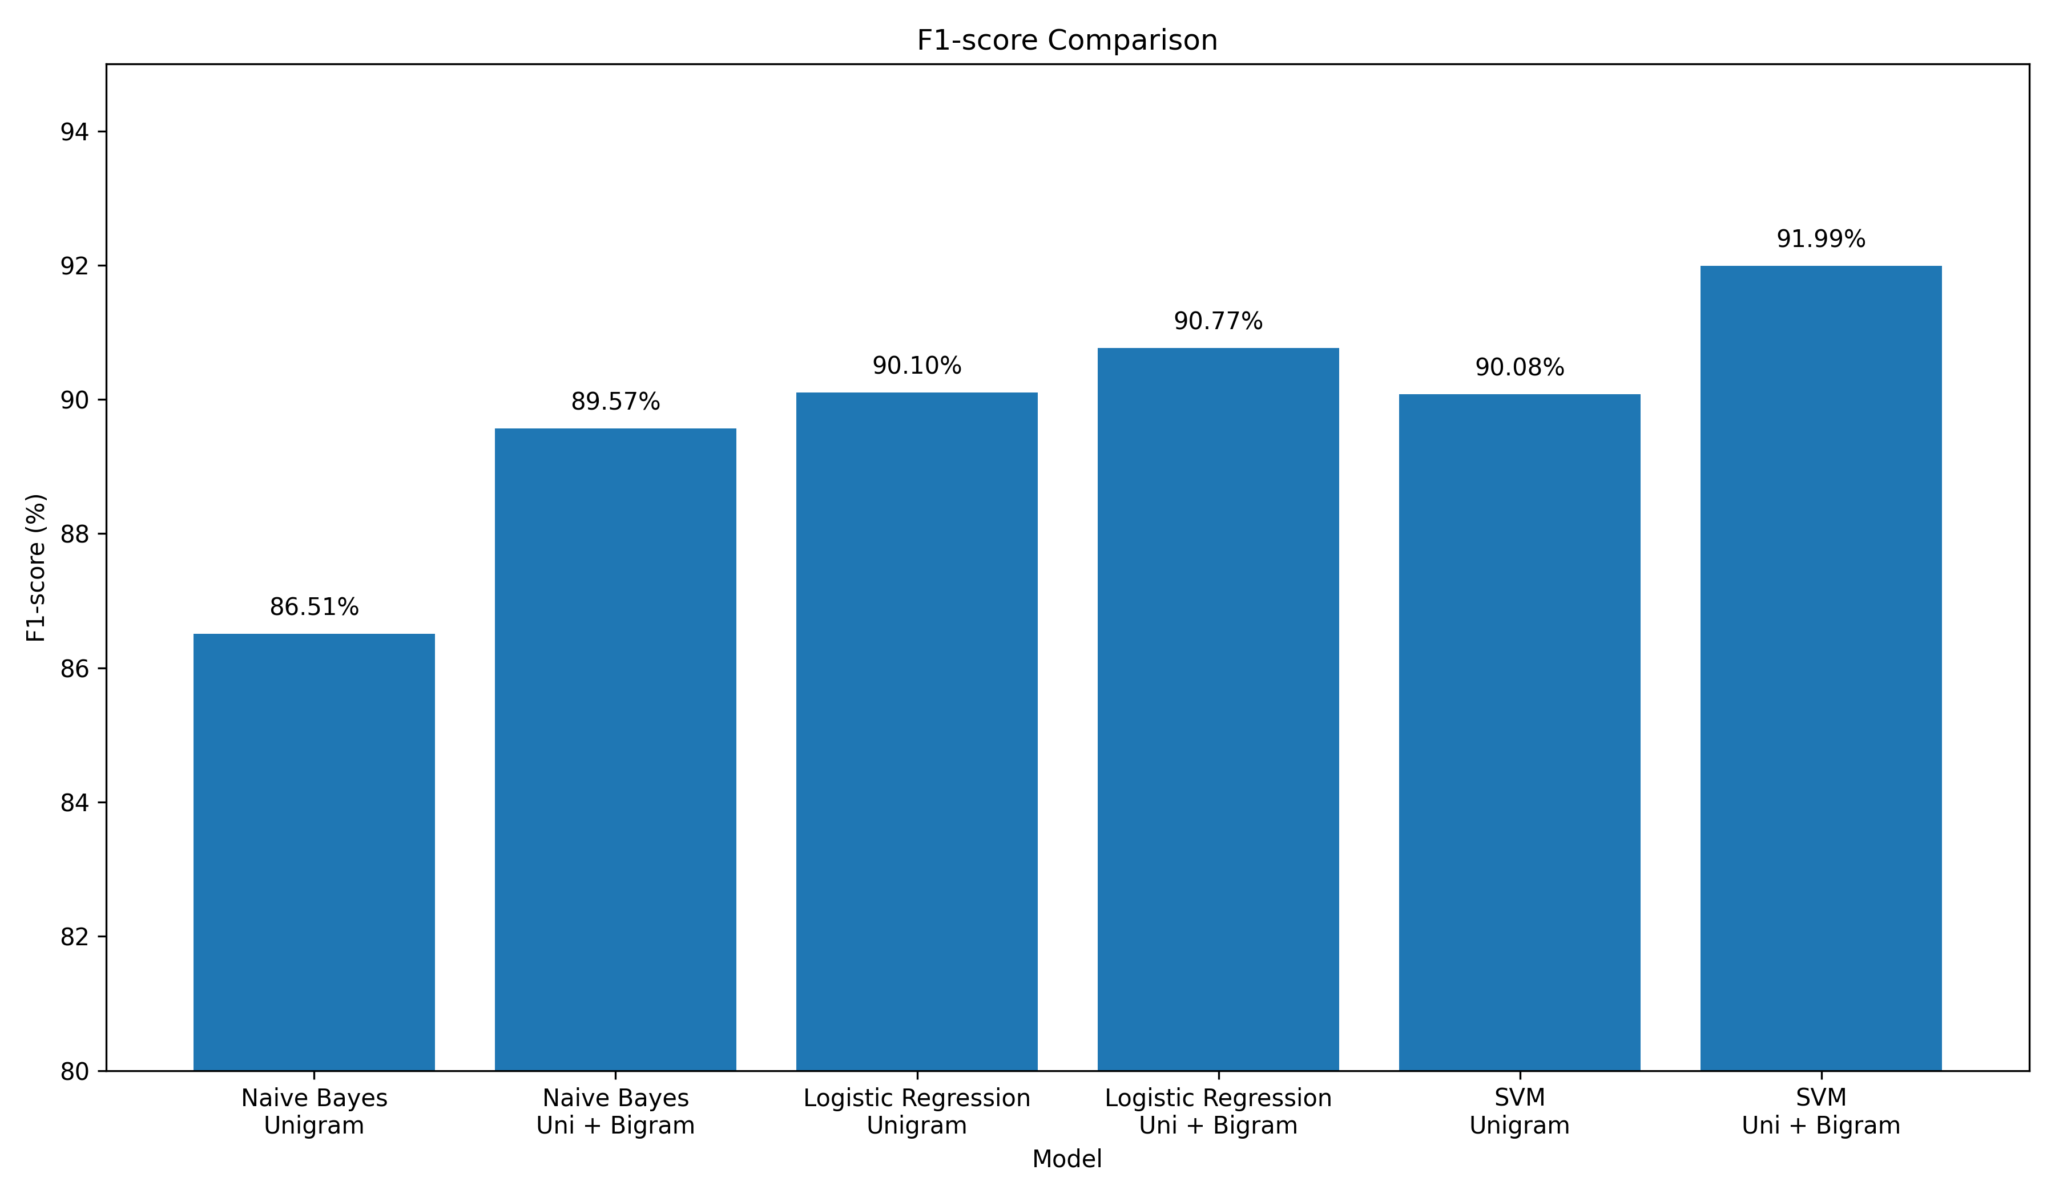
06 • RESULTS
The performance gap is visible
91.86%
best accuracy

Slide 8
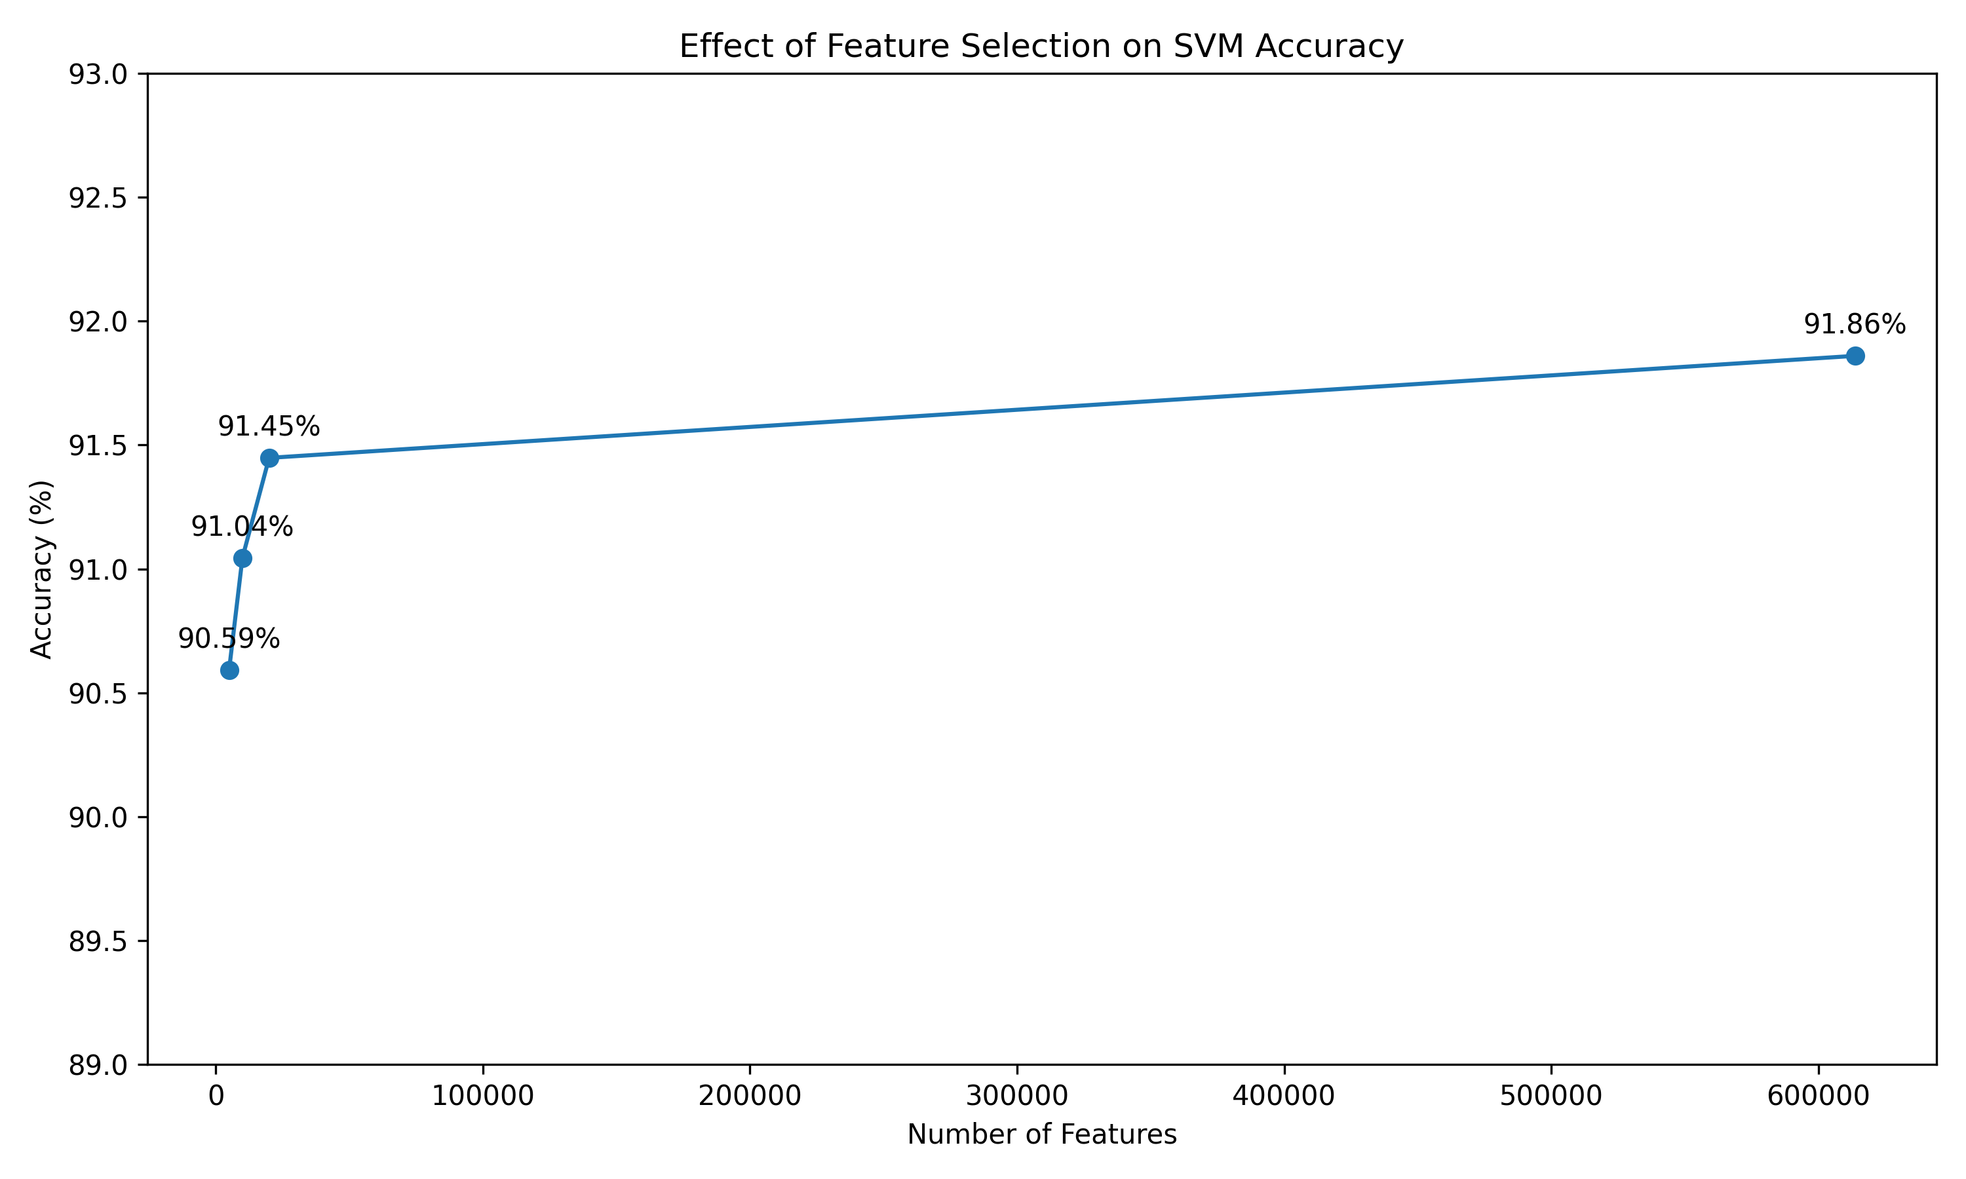
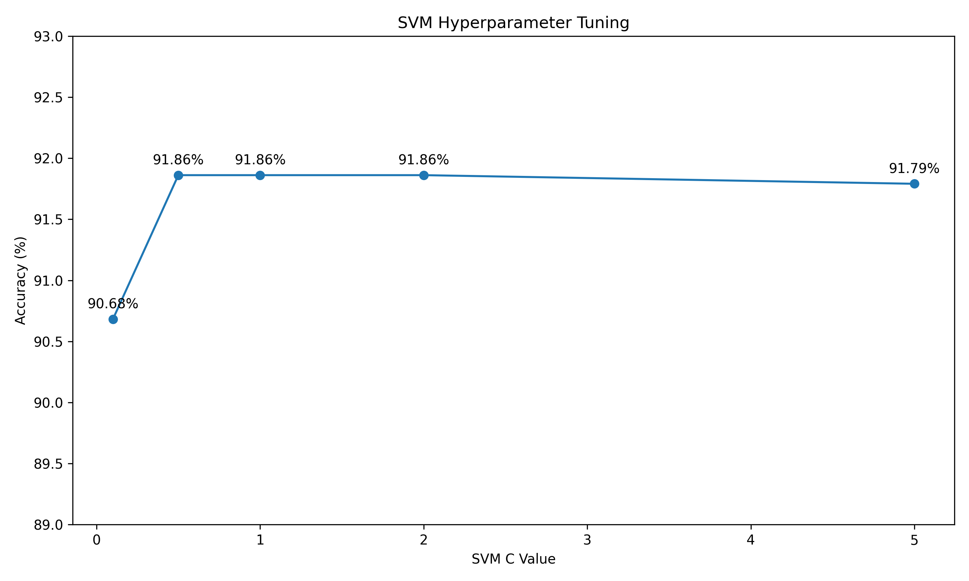
07 • OPTIMIZATION
We didn't stop at the first good model
SELECTED C = 0.5

Slide 9
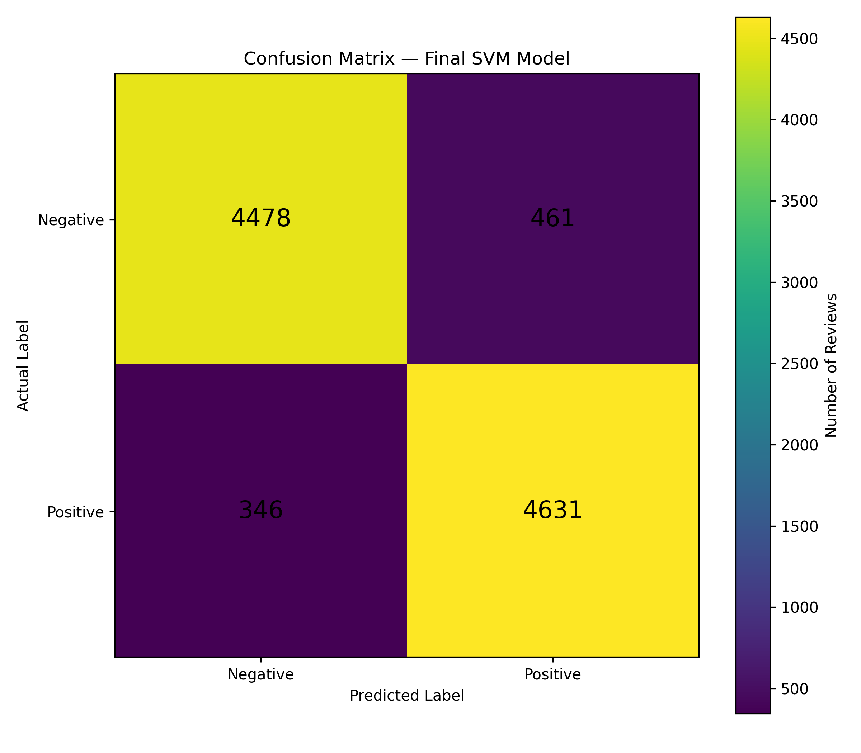
08 • FINAL MODEL
Linear SVM + TF-IDF Unigram/Bigram
91.86%
90.95%
Accuracy
Precision
93.05%
91.99%
Recall
F1-score
C = 0.5 • 6.13 lakh TF-IDF features

Slide 10
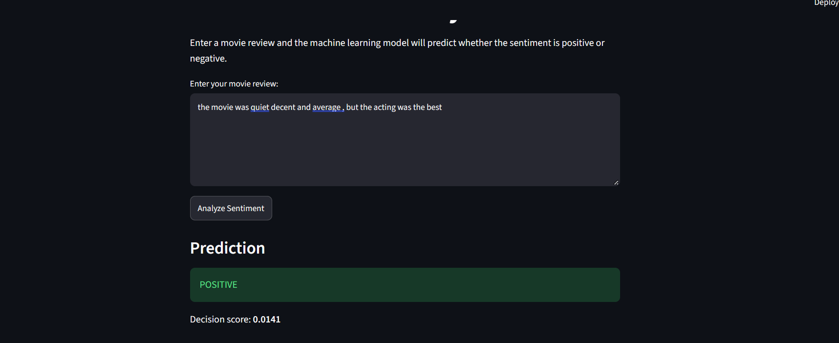
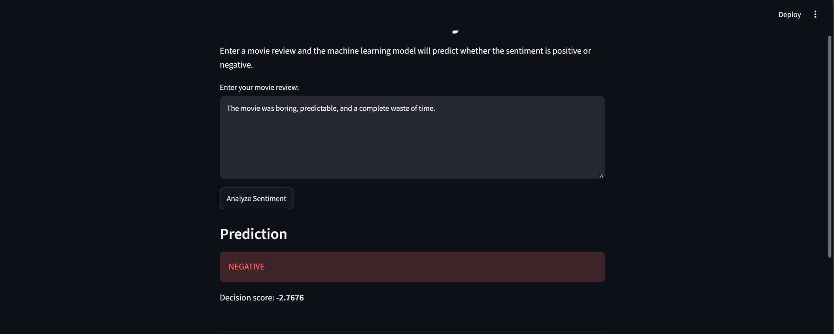
09 • DEPLOYMENT
From terminal experiment to usable application
POSITIVE
NEGATIVE

Slide 11
10 • SYSTEM FLOW
How one review becomes a prediction
INPUT
→
CLEAN
→
VECTORIZE
→
CLASSIFY
→
OUTPUT
Movie review
Text preprocessing
TF-IDF
Linear SVM
Positive / Negative
Saved artifacts: sentiment_svm.pkl + tfidf_vectorizer.pkl
Interactive UI built with Streamlit

Slide 12
11 • TAKEAWAY
A strong classical NLP baseline
91.86%
91.99%
49,577
613,727
Accuracy
F1-score
Clean reviews
TF-IDF features
What worked
Unigram + bigram features gave SVM the strongest overall performance.
Next step
Explore transformer-based models for deeper contextual understanding.

Slide 13
THANK YOU
Sentiment Analysis on Movie Reviews
QUESTIONS?
Linear SVM • TF-IDF • 91.86% accuracy

