Slide 1
NHS BSA - Automation Suite & Test Strategy Presentation
Vignesh Venkataraman

Slide 2
Testing Approach & Ticket Analysis
Analyzed the user story to understand user expectations.
Mapped each acceptance criterion to Cucumber scenarios.
Built modular step definitions for reuse across scenarios.
Used Gherkin syntax to maintain user-centric BDD practices.
Covered best match, closing date, and date posted filters.

Slide 3
Tech Choices & Reusability
Java 21, Cucumber, Selenium WebDriver, JUnit, Maven.
WebDriverManager used to avoid local driver dependencies.
Reusable page actions and step definitions.
Test execution supported in Chrome and Firefox.
Clean test structure separating feature files and logic.

Slide 4
Element Locators, Issues & Improvements
Used By.id, By.cssSelector, and dynamic waits (WebDriverWait).
Locators: search fields, sort dropdown, result date selectors.
Issues: occasional dynamic loading delays resolved with staleness checks.
Improvement: parameterize test data with DataTables or external files.
Use Page Object Model for long-term maintainability.

Slide 5
Accessibility & Compatibility Testing
Tools: axe-core, WAVE, NVDA for screen reader testing.
Test with keyboard only navigation (Tab, Shift+Tab)
Browser compatibility tests: Chrome, Firefox, Edge.
Device compatibility via BrowserStack or Selenium Grid/ responsive viewport testing.

Slide 6
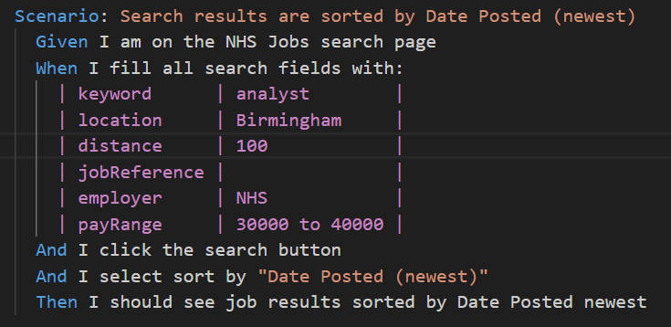
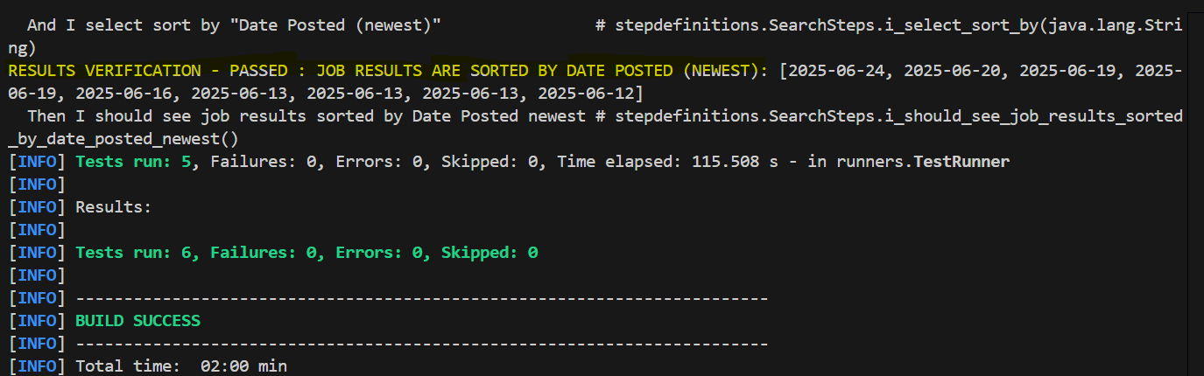
Automation Workflow
1. Launch browser
via WebDriverManager
2. Navigate to NHS
Jobs search page
3. Perform Search,
Apply Filters, Sort
4. Verify Results
Assertions

Slide 7
Performance Testing – Tools & Setup
Use Apache JMeter to simulate concurrent users.
Target URL: Search endpoint with keyword, location filters.
Simulate 100s of jobseekers searching simultaneously.
Measure response time, throughput, errors/sec.

Slide 8
Performance Test Scenarios
1. Load Test: Search with various keywords under load.
2. Stress Test: Exceed normal user load and monitor failure point.
3. Spike Test: Sudden increase in search traffic.
4. Endurance Test: Continuous search execution for 1-2 hours.
📌 Search Scenarios to Simulate:
1. 100 users perform keyword + location search concurrently.
2. 50 users apply working pattern filters and sort by 'Date Posted (newest)'.
3. 200 users paginate through 3+ result pages.
4. Mix of users hitting Best Match, Closing Date, and Date Posted options.

Slide 9
Data Migration Testing – NHS Trust to NHS Jobs
Understand source and destination schema mappings.
Validate record counts (vacancies, applications).
Check data integrity, truncation, encoding errors.
Run reconciliation reports: Pre vs Post migration.
Conduct migration dry-runs with rollback mechanisms.

Slide 10
Q4. Data Migration Testing for NHS Trust Vacancies & Applications
1. Pre-Migration Testing
Data Mapping Validation : Field mapping
Data Quality Checks : Identify and cleanse duplicate records, incomplete profiles, or inconsistent date formats
Tool & Script Review : Verify ETL scripts and migration logic match NHS Jobs data structure
2. Migration Execution (Test Environment)
Sample Migration : Migrate subset of data for trial
Field-Level Validation : Fields mapping in both source and target
Volume Testing : bulk migration for performance and system timeouts
3. Post-Migration Testing
Record Reconciliation (Count) Ensure total job listings match pre-migration counts
Functional Testing : UI to confirm visibility and filter accuracy
Data Integrity Checks : Ensure links are preserved
User Acceptance Testing (UAT) : Validate real-life scenarios
Security Compliance : NHS data protection/GDPR policies.
4. Additional Safeguards
Rollback Plan (Backup if migration fails)
Audit Logs: Validate audit trails logged.
Automation: Use tools/scripts to compare data.

Slide 11
Summary
Functional tests validate sorting and filtering logic.
Accessibility, compatibility, and performance considerations included.
Robust BDD implementation with maintainable codebase.
Data migration testing ensures trust-level onboarding success.

Slide 12
THANK YOU

